Slide 1



Dr. Khan Amir Maroof
Lecturer,
Dept. of Community Medicine
UCMS & GTB Hospital, Delhi

Slide 2

Introduction
2. Burden of rabies: Global, Asia, India
3. Rabies Control in India: Current strategies
4. Rabies vaccine: Requirement and Costing estimates
5. Postexposure prophylaxis: WHO recommendations
6. Rabies control: success stories from other countries
7. Rabies control in India: The future

Slide 3

Rabies is a preventable viral disease of mammals most often transmitted through the bite of a rabid animal.
Rabies is primarily a disease of terrestrial and airborne mammals
The dog has been, and still is, the main reservoir of rabies in India.¹
1. Ghosh TK. Rabies. Proceedings of the IX National Conference of Pediatric Infectious Diseases; 2006; Chennai, India.

Slide 4

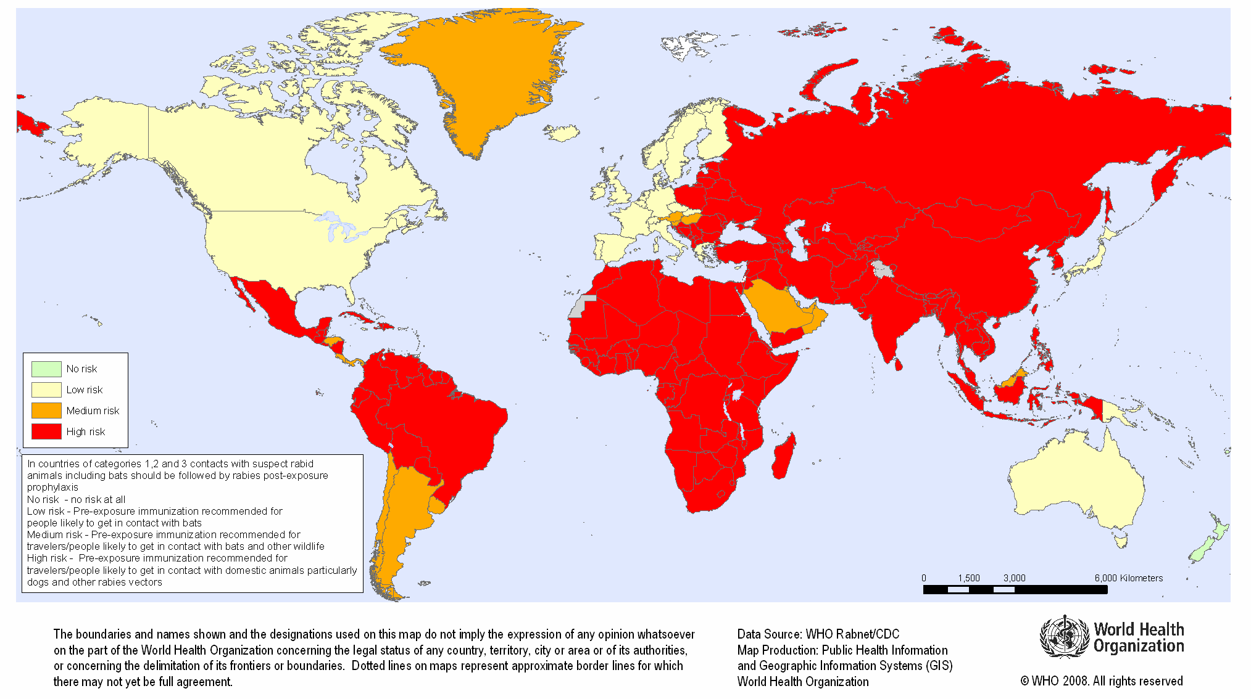

Slide 5

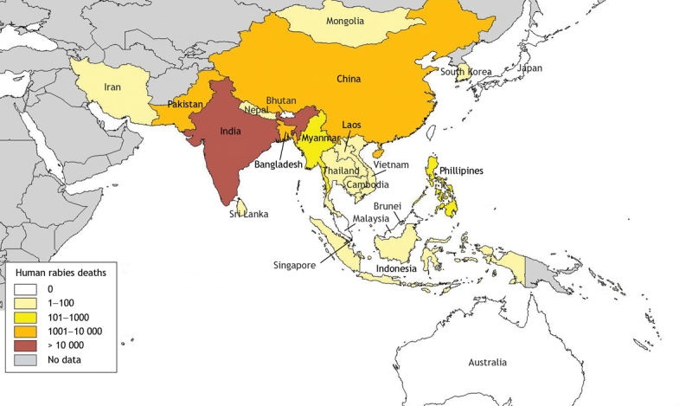
Source: http://www.ncbi.nlm.nih.gov/pmc/articles/PMC2244675/figure/f2-16/

Slide 6

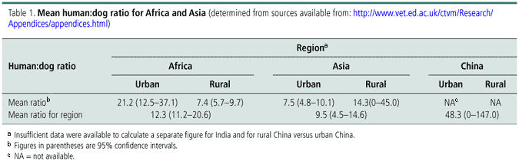
Source: Knobel Darryn L., Cleaveland Sarah, Coleman Paul G., Fèvre Eric M., Meltzer Martin I., Miranda M. Elizabeth G. et al . Re-evaluating the burden of rabies in Africa and Asia. Bull World Health Organ [serial on the Internet]. 2005 May [cited 2010 May 14] ; 83(5): 360-368. Available from: http://www.scielosp.org/scielo.php?script=sci_arttext&pid=S0042-96862005000500012&lng=en. doi: 10.1590/S0042-96862005000500012.

Slide 7

In India, about 15 million people are bitten by animals, mostly dogs, every year and need post-exposure prophylaxis.
Since 1985, India has reported an estimated 25 000–30 000 human deaths from rabies annually (the lower estimate is based on projected statistics from isolation hospitals in 1985).
Notes:
Because rabies is not a notifiable disease in India and there is no organized surveillance system of human or animal cases, the actual number of deaths may be much higher.

Slide 8

The incidence of animal bites is 17.4 per 1000 population.
A person is bitten every 2 seconds, and someone dies from rabies every 30 minutes.
The annual number of person-days lost because of animal bites is 38 million, and the cost of post-bite treatment is about $25 million.
India has approximately 25 million dogs, with an estimated dog:man ratio of 1:36.
Source: Sudarshan MK. Assessing burden of rabies in India. WHO sponsored national multi-centric rabies survey (May 2004). Assoc Prev Control Rabies India J 2004;6:44-5

Slide 9

There is at present no comprehensive national rabies control program in India.
Existing rabies control activities are being carried out by Municipal Corporations/committees, cantonments etc. in their respective areas.
The eleventh five year plan envisaged a pilot project ‘Elimination of dog rabies’ in the pilot project areas viz. Delhi, Pune, Manipur and Hyderabad.

Slide 10

Free of cost vaccination of dog population
Enforcement of licensing and obligatory registration of dogs
NGO’s will be involved in vaccination and sterilization of dogs and for creating awareness in the general community
The veterinary/para-veterinary staff will be trained in standard humane methods of catching stray dogs for vaccination/ sterilization of dogs
Laboratory services
M & E of MIS, disease surveillance, its quality and utilization
Source: Report, Working group on communicable and non communicable diseases, Eleventh Five Year Plan, September 2006, http://planningcommission.nic.in/aboutus/committee/wrkgrp11/wg11_comble.pdf
Notes:
: To break the chain of transmission, at least 70% of dog population would need to be vaccinated. The success of the animal birth control program hinges on the sterilization of 70% of the strays in a given geographic area within 6 months, before the next reproductive cycle begins, otherwise the entire effort is negated. This target is difficult to achieve, given the large number of strays and the limited resources. Hence the success of the animal birth control program in controlling the stray dog population is a subject of dispute and doubt.
: This will regulate the movement of the dog population thus reducing chances of human exposure.
: Diagnostic and referral laboratories will be identified and strengthened.
: NICD, Delhi, a national apex committee would periodically monitor and evaluate. On day to day basis, monitoring of the program in individual cities will be done by the civic authorities.

Slide 11

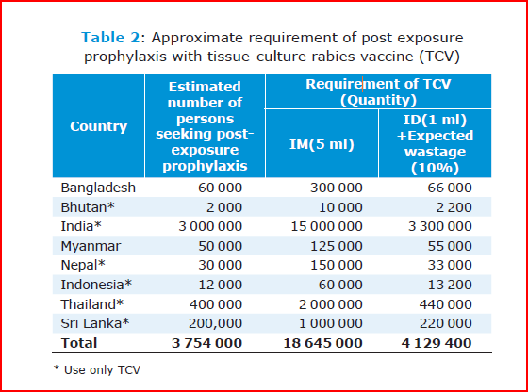
Source: Rabies in the South East Asia Region, World Health Organization, SEARO, New Delhi, India

Slide 12

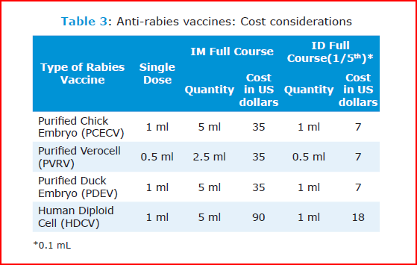
Source: Rabies in the South East Asia Region, World Health Organization, SEARO, New Delhi, India

Slide 13


Intra Muscular Schedule
  Dose : HDCV, PCEC & PDEV - 1 ml
    PVRV - 0.5ml & 1ml (PII Coonoor)
  Site : Deltoid or anterolateral thigh Route : Intra Muscular
  Schedule :
    Day 0 - 1st dose
    Day 7 - 2nd dose
    Day 21 or 28 - 3rd dose

Slide 14


Intradermal Schedule
  Dose : 0.1 ml (for all vaccines)
  Site : Deltoid Route : Intradermal
  Schedule :
    Day 0 - 1st dose
    Day 7 - 2nd dose
    Day 21 or 28 - 3rd dose

Slide 15

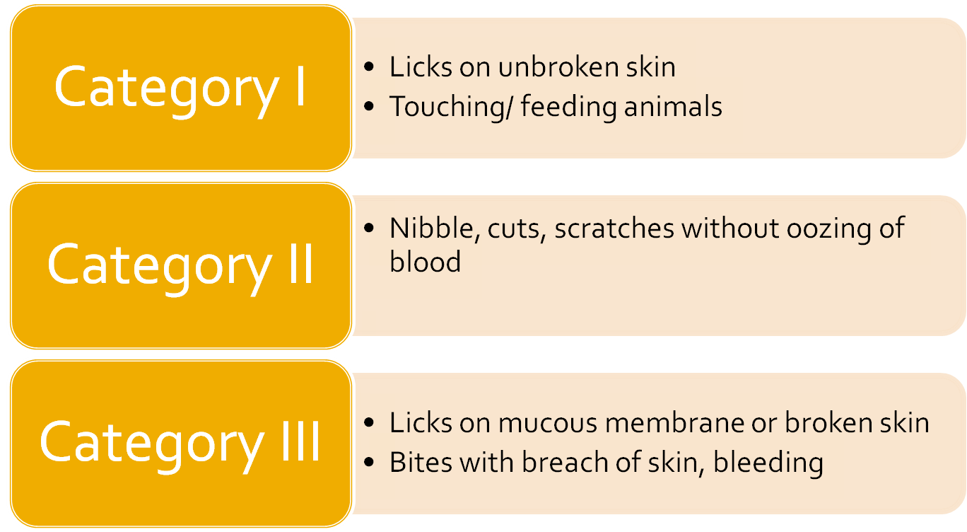

Slide 16

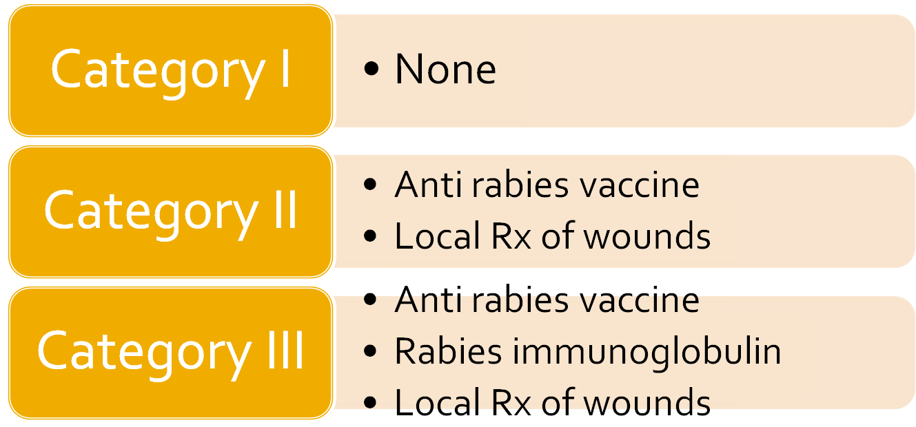
Exposure to rabbits, rodents and hares seldom require PEP for rabies
Exposure to bats does not warrant PEP for rabies in India

Slide 17
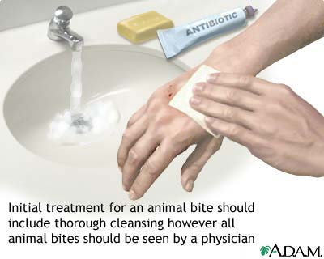

By mere washing of wounds and application of antiseptics
½ the Risk of Rabies
Suturing should be avoided
If severe bleeding, infiltrate RIG and minimum stay sutures
If suturing for cosmetic purposes, done 2 wks after starting vaccination

Slide 18

In the SEA Region, Sri Lanka and Thailand have registered a sharp decline in the number of human rabies deaths through mass dog vaccination campaigns, improved accessibility to human post-exposure prophylaxis and an effective vaccine delivery system.
Source: Vitasek J. A review of rabies elimination in Europe. Vet. Med. – Czech, 49, 2004 (5): 171–185

Slide 19

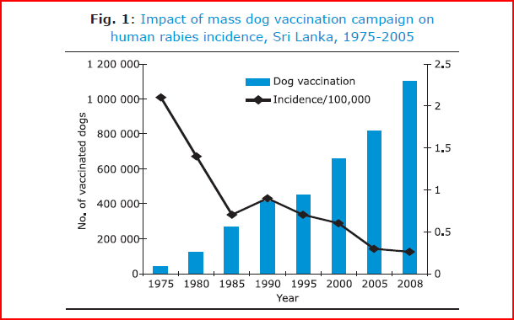
Source: Rabies in the South East Asia Region, World Health Organization, SEARO, New Delhi, India

Slide 20

The rabies situation has changed drastically in all European countries where oral vaccination campaigns of red foxes against rabies have been implemented.
In Latin America, approximately 45 million dogs a year have been vaccinated, resulting in significant declines in canine and human rabies.
Mass canine vaccination campaigns have been the most effective measure for controlling canine rabies.
Source: WHO Technical report series 931, WHO Expert consultation on Rabies, First Report, 2005
Notes:
All types of oral vaccines used have shown to be highly efficacious, enabling rabies elimination over large areas. Several countries are already declared rabies-free according to the internationally conditions set and other countries are in the final stage of this process
Since the 1980s, national mass canine vaccination campaigns have been conducted generally on an annual basis in Latin America with high coverage (around 80%) achieved in a short period of time (no more than one week).

Slide 21

Developing a comprehensive national rabies control program.
Since India shares borders with six countries that are all rabies endemic, it is essential that India’s rabies control efforts are coordinated regionally.
Promote prompt and proper care of dog bite wounds.
Vaccinating domestic dogs against rabies: this control strategy has been shown to be the most cost-effective in the medium–long term *
*Source: Meslin F-X, Fishbein DB, Matter HC. Rationale and prospects for rabies elimination in developing countries. In: Rupprecht CE, Dietzschold B, Koprowski H, editors. Lyssaviruses. Berlin: Springer Verlag; 1994. p. 1-26.

Slide 22

Promotion of vaccination of stray dogs to improve immunization coverage.
Advocacy for high level political commitment
The possibility of adding pre-exposure vaccination to the routine childhood immunization schedule should be considered
Human rabies must be made a mandatory reportable disease.
Notes:
At least 70% of the dog population will have to be vaccinated to achieve herd immunity. The costs are typically recouped within 5–10 years, mainly through decreased expenditure on human post-exposure treatment.

Slide 23
Intradermal route for PEP: Advocacy and training of staff
Operational research for rabies control should be conducted
Intersectoral co-ordination
Notes:
between the health department, veterinary health department, agriculture department and local administrative bodies, legal authorities etc. is essential to achieve the goal of rabies elimination.

Slide 24

