Slide 1


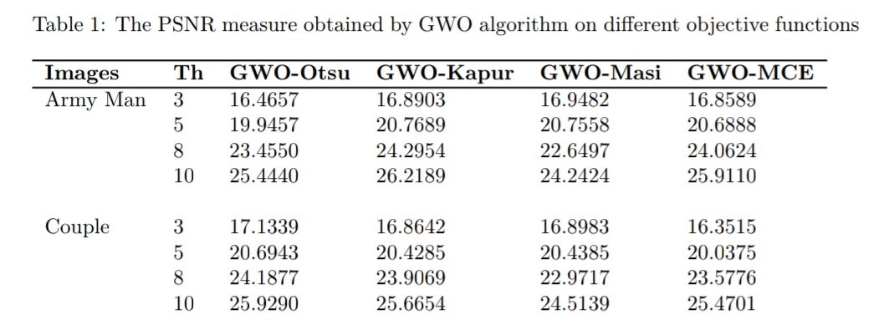
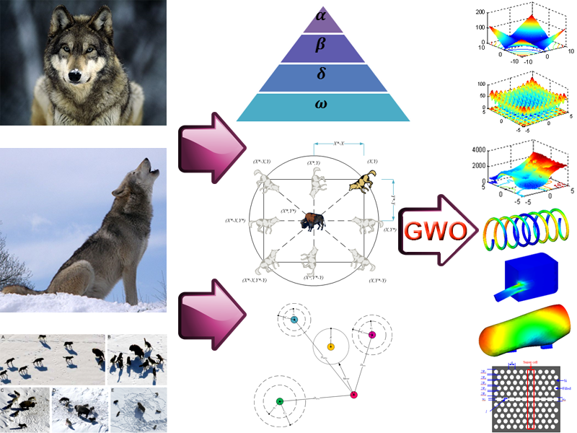
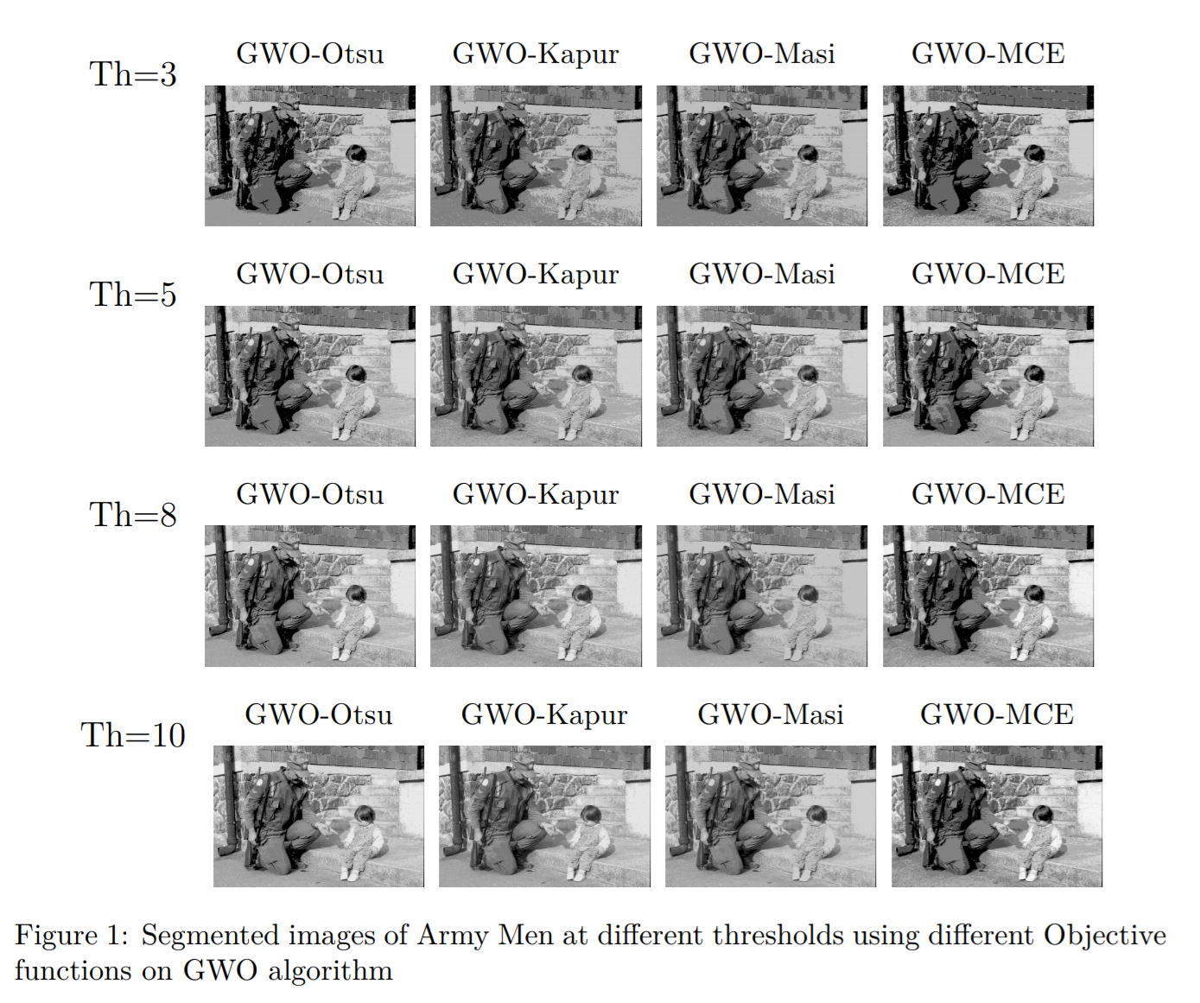
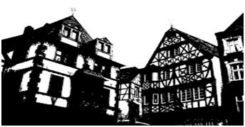
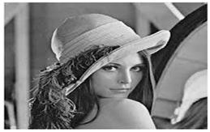
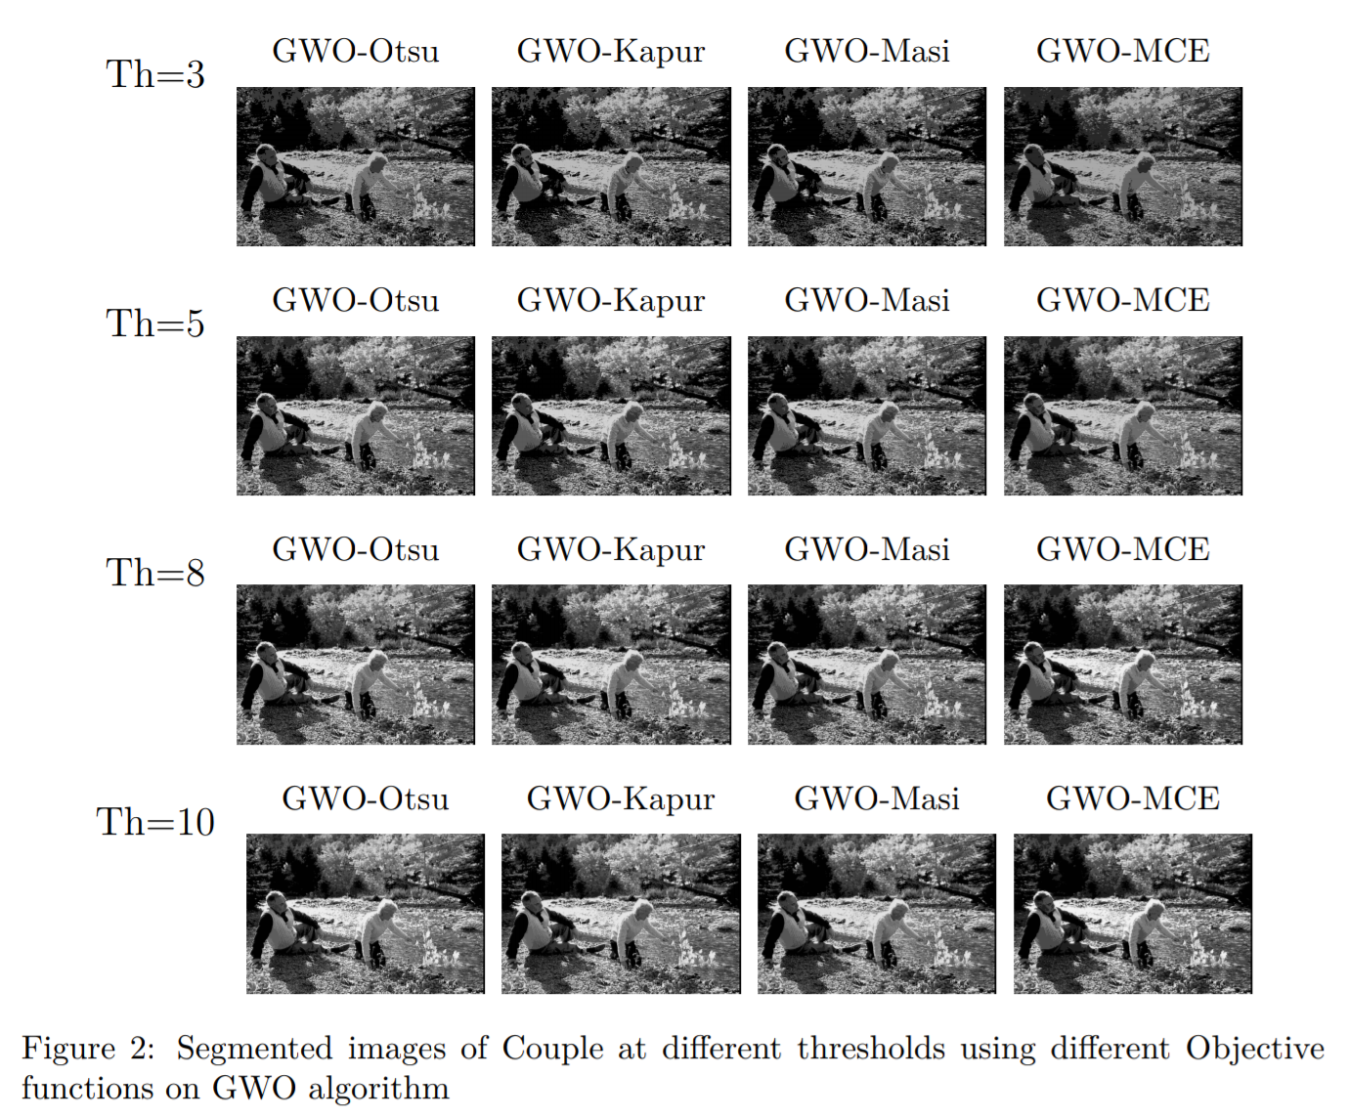
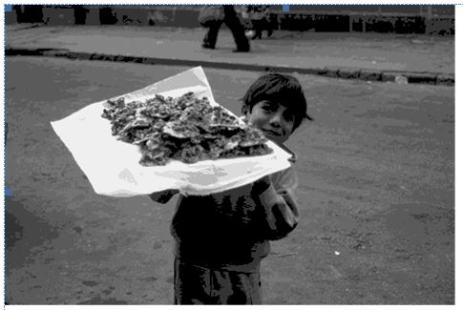
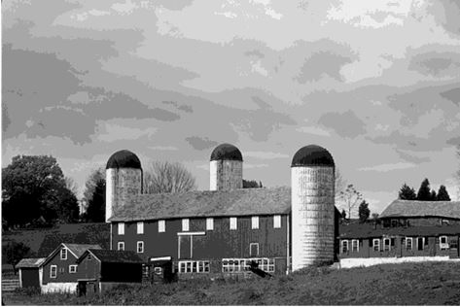
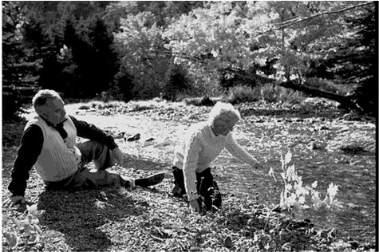
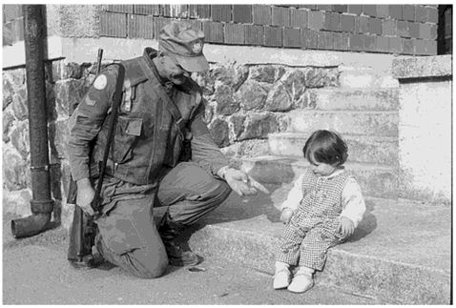
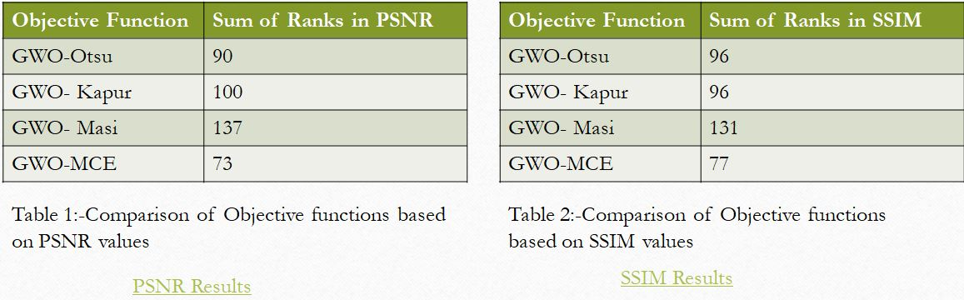

In our research of Investigation of Effective Objective Function For Multilevel Thresholding of an Image ,we find that
On the basis of PSNR values , Otsu class variance method objective function outperforms on GWO algorithm than other objective functions.
And on the basis of SSIM values , Minimum Cross Entropy outperforms on GWO algorithm than any other objective function.
INVESTIGATION OF EFFECTIVEOBJECTIVE FUNCTION FOR MULTILEVEL THRESHOLDING OF IMAGES
VIJAY KUMAR BOHAT
ANANDHAPADMANABHAN R
JAYARAJ N J
KARTIKEYA GUPTA
SUHAAS KORAMPALLY
Abstract
Performance of Various Objective functions
Thresholding is well known and easy technique for image segmentation. The Metaheuristic algorithm proposed in this paper is Grey Wolf Optimizer(GWO) . The objective functions used in this paper are Otsu's method, Kapur's entropy, Masi entropy, Minimum cross entropy. The performance of segmented image is measured using Peak Signal-to-Noise Ratio(PSNR) and Structural Similarity Index (SSIM) .
Introduction
Image Segmentation is the most important and essential preprocessing step. Image segmentation is the process of partitions an image into suitable number of homogeneous regions or trace the object boundaries. The goal of segmentation is to change the representation of an image into something that is more meaningful and easier to analyze based on gray level, color, texture, shape, size or position of an image. For the performance of higher level preprocessing system, it depends on the accuracy of segmentation technique used. Thresholding is considered as a most popular image segmentation technique. It is because of its simplicity, small amount of calculation and effective and stable performance. So, depending on the number of thresholds used to segment an image , thresholding techniques is divided into two types: Bi-level and Multilevel thresholding.
In Bi-level thresholding technique, one single global threshold is used to partition an image into two classes: the object and background. On the other side in Multilevel thresholding technique, more than one threshold is used to partition an image into different segments which corresponds for one background and several objects.
Dataset: The dataset we are using is Berkeley Segmentation Dataset and Benchmarks 300(BSD300)
Bi-level threshold image Multilevel threshold Image
1)Army Man
2)Couple
Methodology
Grey Wolf Optimizer(GWO) : It imitates the behavior and hunting mechanism of grey wolves in nature. The process of optimization happens in three steps as searching for prey, encircling prey, and attacking prey.
Objective function used in this study are as follows:
Otsu’s Method : Otsu’s method is also known as the between-class
variance technique as this segmentation technique maximizes the inter-class
variance and minimizes the within-class variance between the pixels in each
class..
2) Minimum Cross Entropy: Minimum cross entropy is proposed by Kullback
in 1978 under the name divergence. The minimum cross entropy thresholding
algorithm is originally developed for bi-level thresholding, it is later extended to
multilevel thresholding.
3) Masi Entropy: Masi entropy is a generalized entropy introduced by Masi.
This entropic measure is first applied to bi-level thresholding, it is then later extended
for multilevel thresholding. The optimum set of thresholds for the image
segmentation is found by maximizing the Masi entropy function. Multilevel
thresholding is technique which uses two or more threshold values to perform
image segmentation
.4) Kapur’s entropy : Kapur's method selects the optimum thresholds by
maximizing the entropy of the segmented classes.It uses Shannon's entropy
concept of entropy. Shannon's function says that the information content of an
event is inversely proportional to its probability of occurrence .Kapur's define
the entropy of an image assuming that an image is entirely represented by its
grey level histogram .
Conclusions
In our research of Investigation of Effective Objective Function For Multilevel Thresholding of an Image ,we find that
On the basis of PSNR values , Minimum cross-entropy objective function outperforms on GWO algorithm than other objective functions.
And based on SSIM values , Minimum Cross Entropy outperforms on GWO algorithm than any other objective function.
Experimental Results and Discussion
References
The objective functions are compared b based on PSNR values and SSIM
V values and find that Minimum cross .entropy has t ent entropy has the least sum of ranks.
1.Optimization Algorithm-- http://www.alimirjalili/GWO.html
2. https://www2.eecs.berkeley.edu/Research/Projects/CS/vision/bsds
3. http://engr.case.edu/merat_francis/eecs490f07/lectures/lecture22.pdf
4.https://drive.google.com/file/d/1oukIRPF5jdx9qO1CSi_DHvWvoSzcr0Of/view?usp=sharing
Team No. - 46

