Slide 1


INVESTIGATION OF EFFECTIVE OBJECTIVE FUNCTION FOR MULTILEVEL THRESHOLDING OF IMAGES
ANANDHAPADMANABHAN R DR. VIJAY KUMAR BOHAT
JAYARAJ NJ
KARTIKEYA GUPTA
SUHAAS KORAMPALLY

Slide 2
Introduction
Image segmentation is the process of partitioning an image into suitable number of homogeneous regions and change the representation of an image into something that is more meaningful and easier to analyze.
Thresholding is considered as a most popular image segmentation technique because of its simplicity, small amount of calculation and effective and stable performance.
Automatic segmentation techniques generally maximize or minimize an objective function in order to segment an image.
There are many objective functions in literature. But, which objective function is effective for multi-level thresholding of images?

Slide 3
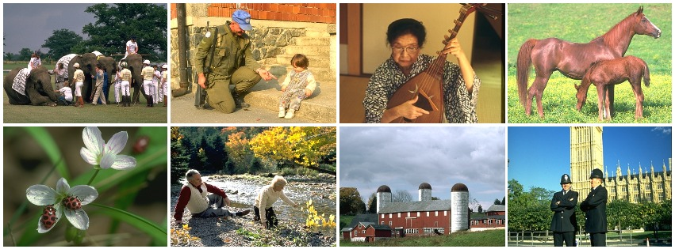
A large dataset of natural images that have been manually segmented. The human annotations serve as ground truth for learning grouping cues as well as a benchmark for comparing different segmentation and boundary detection algorithms.
Berkeley Segmentation Data Set and Benchmarks 300 (BSD300)

Slide 4
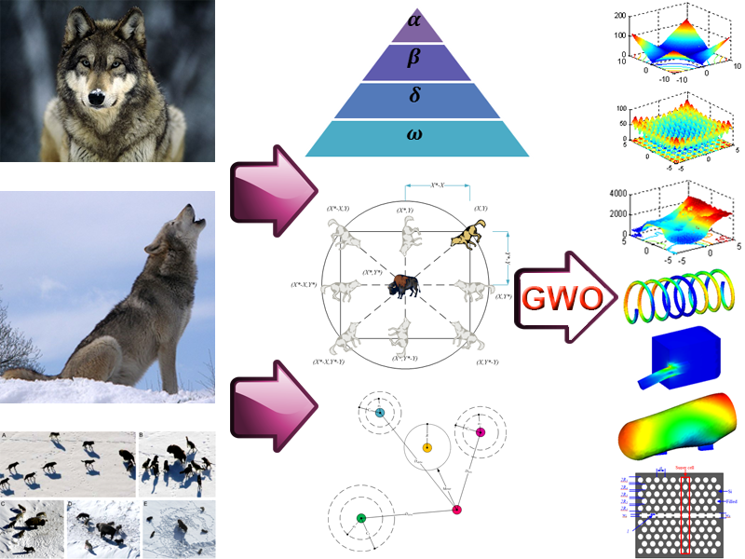
Methodology
The Grey Wolf Optimizer(GWO) algorithm imitates the behavior and hunting mechanism of grey wolves in nature. There are three types of grey wolfs employed for simulating the leadership hierarchy viz. Alpha(α), Beta(β) and Delta(δ). Rest of the wolfs are called Omega(ω). The process of optimization happens in three steps as searching for prey, encircling prey, and attacking prey.
This Optimizer is used to maximize or minimize an objective function automatically in order to segment an image.

Slide 5
Objective Functions used in the research:
Otsu’s Method:
Otsu’s method is also known as the between-class variance technique as this segmentation technique maximizes the inter-class variance and minimizes the within-class variance between the pixels in each class.
Minimum Cross Entropy:
Minimum cross entropy is proposed by Kullback in 1978 under the name divergence. The minimum cross entropy thresholding algorithm is originally developed for bi-level thresholding, it is later extended to multilevel thresholding.
Masi Entropy:
Masi entropy is a generalized entropy introduced by Masi. This entropic measure is first applied to bi-level thresholding, it is then later extended for multilevel thresholding. The optimum set of thresholds for the image segmentation is found by maximizing the Masi entropy function.
Kapur’s Method:
Kapur's method selects the optimum thresholds by maximizing the entropy of the segmented classes. It uses Shannon's entropy concept of entropy

Slide 6
Results Achieved
Objective Function | Sum of Ranks
Objective Function | Sum of Ranks in PSNR
Objective Function | Sum of Ranks in PSNR
GWO-Otsu | 90
GWO-Kapur | 100
GWO-Masi | 137
GWO-MCE | 73
Objective Function | Sum of Ranks in SSIM
GWO-Otsu | 96
GWO-Kapur | 96
GWO-Masi | 131
GWO-MCE | 77
Table 1:-Comparison of Objective functions based on PSNR values
Table 2:-Comparison of Objective functions based on SSIM values
PSNR Results
SSIM Results

Slide 7
Conclusion
Based on PSNR values MCE is the winner with sum of ranks 73. and Otsu is the second best with sum of ranks 90.
Based on SSIM index MCE out performs all other objective functions with sum of ranks 77. While , there is tie between Otsu and Kapur with sum of ranks 96.
Limitations:
Experiments can be performed on large data set.
Future scope:
In future, experiments will be performed on large datasets with even more Objective Functions and Optimization Algorithms. This will reveal tons of information to the research community on image segmentation.

Slide 8
References
https://www2.eecs.berkeley.edu/Research/Projects/CS/vision/bsds
https://www.sciencedirect.com/science/article/abs/pii/S0957417417302749?via%3Dihub
http://engr.case.edu/merat_francis/eecs490f07/lectures/lecture22.pdf
http://www.alimirjalili.com/GWO.html
https://drive.google.com/file/d/1oukIRPF5jdx9qO1CSi_DHvWvoSzcr0Of/view?usp=sharing

Slide 9
Thank You

