Slide 1
GetItBack Expense tracking with friends
Kartikeya Dubey

Slide 2
Features
Uses Facebook api to pull list of friends
Let’s you add a bill
View bills and returns Shows a picture of the user and the amount they owe or how much you owe them
Uses AChartEngine to plot a pie chart of how much you need to return or collect
Let’s you mark if your friends have paid off a bill
Let’s you send reminder through a wall post

Slide 3
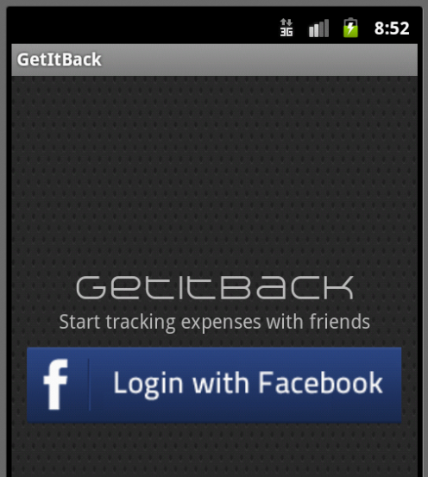
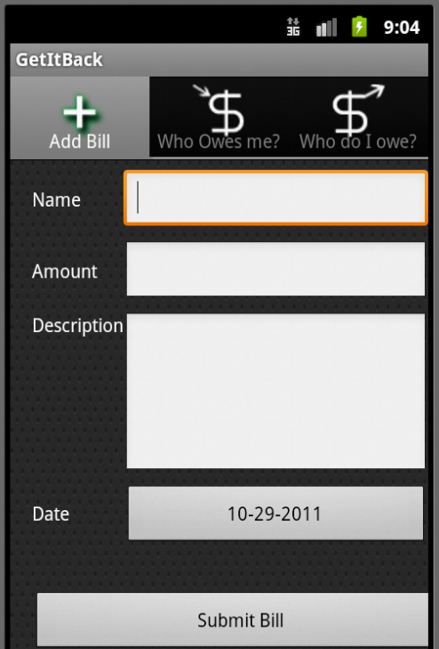
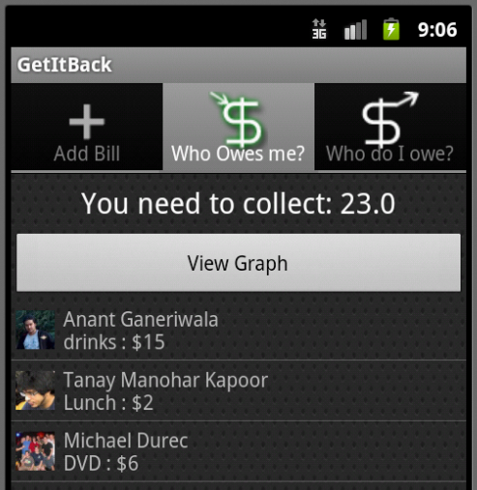
Frontend

Slide 4
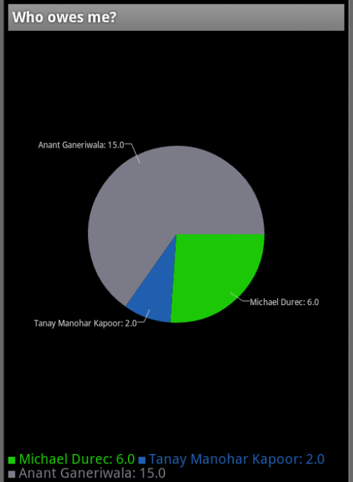
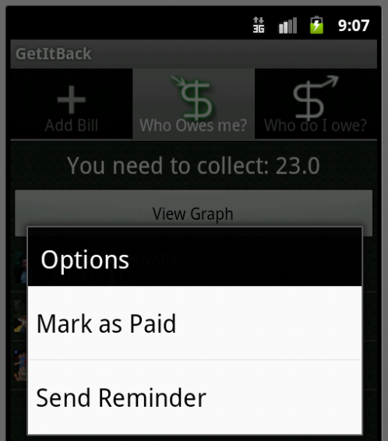
Frontend

Slide 5
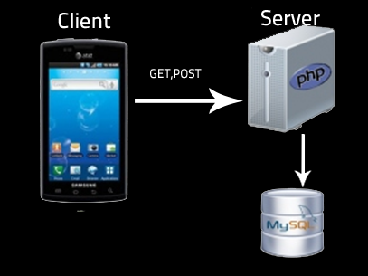
Backend

