Slide 1
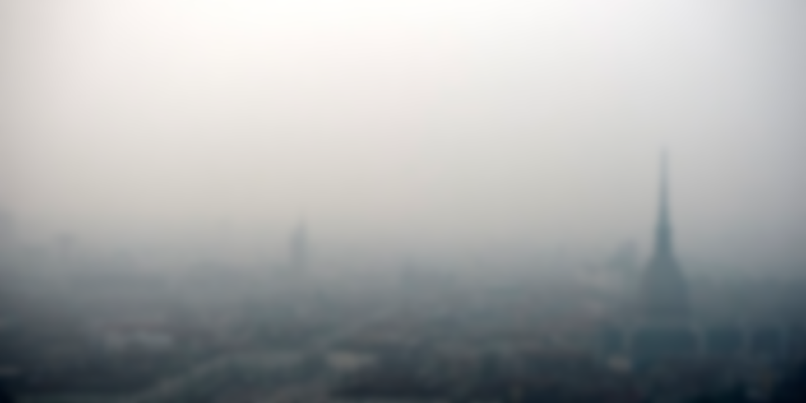

RootAccess Overnight Sustainability Hackathon 2026
Rasayanam
Diwali should light up homes, not fill lungs.
“AI-powered air pollution prediction and health advisory system”
Team Higure_evilman
Kartikeya Gupta | Hardhavan Singh | Krish Saini
Thapar Institute of Engineering and Technology, Patiala
Notes:
Diwali is the festival of light. But for millions in North India, the morning after Diwali is the darkest air of the year. We're Team Rasayanam, and this is Rasayanam: an air companion that tells you what the air will do before it does it, and what that means for your body.

Slide 2

One night a year, a city holds its breath
488
Imagine Aarav. He is 8, has asthma, and lives near a busy Delhi crossing.
On Diwali night his parents must guess: shut the windows now or later? School tomorrow? A walk at noon? Every AQI app tells them only once the smoke is already in his lungs.
µg/m³ of PM2.5: Delhi's average air after Diwali 2025
8×
India's safe limit of 60 µg/m³
≈ 22
cigarettes a day, just by breathing
Sources: CPCB data, Climate Trends analysis (Oct 2025); cigarette equivalence from Berkeley Earth (22 µg/m³ for a day ≈ 1 cigarette).
Notes:
Last Diwali, Delhi's PM2.5 averaged 488 after the festival: eight times India's safe limit, the same as smoking 22 cigarettes a day. Behind that number are children like Aarav. Aarav is illustrative; his story isn't. His parents have to guess, because every AQI app reports the air only after it has turned.

Slide 3




The forecast that arrives before the smoke
Rasayanam predicts PM2.5 and AQI for each monitoring station up to 7 days ahead, before and turns every prediction into advice a family can act on. Live, and updated every 10 minutes.
Aarav's Diwali, with Rasaynam
Day before, 6 pm
The 48-hour forecast shows his area turning severe from 9 pm on Diwali night.
Diwali, 8 pm
Windows shut, inhaler ready, breathing exercises from the Health Corner.
Next morning
The forecast shows a cleaner window at 2 pm. That's when he goes out.
Live AQI dashboard
AQI gauge, station selector and every pollutant, refreshed live.
7 days forecast
Hour-by-hour predictions plus Diwali climatology from past years.
Health Corner
Breathing exercises, care guidance, and when to see a chest or ENT doctor.
Learn
AQI and respiratory health, explained in plain words.
Notes:
Rasayanam predicts PM2.5 and AQI up to 48 hours ahead and turns it into advice. Here's Aarav's Diwali with it: the evening before, his parents see severe air coming at 9 pm. On Diwali night the windows are already shut and the inhaler ready. The next morning, Rasayanam shows a cleaner window at 2 pm. That's the product: a live dashboard, a 48-hour forecast, a Health Corner and plain-language learning.

Slide 4







Technical approach
1 Data
2 Machine learning
3 Backend
4 Frontend
Historical CSV, 2020–2025
46,848 hourly rows, 8 stations
Weather: temperature, humidity, wind, pressure, rain
Pollutants: PM2.5, PM10, NO₂, SO₂, CO
Cleaning, station-wise sorting
Lags, rolling means, seasonality, Diwali proximity
Target: CPCB AQI and PM2.5
HistGradientBoosting, 3 h and 24 h models
FastAPI + Uvicorn
48-hour recursive forecast: 16 steps per station
CPCB sub-index AQI and health advisory
REST /api and WebSocket /ws, every 10 min
HTML, CSS, JavaScript, Chart.js
Live dashboard, PM reports
Forecast and Diwali trends
Health Corner and Learn
Honest test
Trained on 2020–2024, tested on 2025, a year the model never saw.
Live by design
WebSocket pushes fresh data every 10 minutes and reconnects on its own.
Reproducible
Model, metrics and feature spec saved as files and loaded at start-up.
Notes:
Four layers. Data: six years of hourly readings from eight stations, with weather and five pollutants. Machine learning: we engineer lags, rolling averages, seasonality and Diwali proximity, then train gradient-boosted models for 3 and 24 hours ahead, tested honestly on 2025. Backend: FastAPI runs a 48-hour recursive forecast and pushes live updates over WebSockets every 10 minutes. Frontend: a dashboard anyone can read.

Slide 5





Impacts and benefits
Families
Plan around the smoke: when to shut windows, when it's safe to step out.
Asthma and heart patients
Advance warning to keep medicines ready and avoid the worst hours.
Hospitals
See severe nights coming and prepare for breathing emergencies.
City authorities
Act before limits are crossed, not after the headlines.
Goals we serve
From “the air is bad” to “the air will be bad at 9 pm, so here is what to do.”
SDG 3
Good health and well-being
SDG 11
Sustainable cities and communities
That shift, from reacting to preparing, is what protects a child's lungs.
SDG 13
Climate action
Notes:
Families plan around the smoke. Patients get warning in time to prepare. Hospitals see severe nights coming. Authorities can act before limits are crossed. It's the shift from 'the air is bad' to 'the air will be bad at 9 pm, here's what to do', and it serves SDGs 3, 11 and 13.

Slide 6

Diwali 2026 is on 8 November.
Let this one be about the lights.
Rasayanam forecasts the air before it turns, and tells every family what to do.
Thank you
Team Higure_evilman | github.com/kartikeyag-13/Rasaynam
Notes:
Diwali 2026 is on the 8th of November, one week from today. Let this one be about the lights. Rasayanam: know the air before it turns. Thank you.

