Slide 1
PHASE 1: STANDALONE MODE
SonarQube for IDE
Developer feedback loop
Real-time code quality and security feedback inside VS Code.
1. Write code
2. Find issue
Goal
Catch maintainability, reliability and security issues before code reaches pull request or CI.
3. Fix before PR
1

Slide 2
WHY THIS MATTERS
Not just another linter
SonarQube looks for risk, not only style.
Basic linting
SonarQube for IDE
Format, syntax, style
Quality, reliability, security
Naming and formatting
Runtime bugs and logic risks
Simple language mistakes
Security vulnerabilities and secrets
Complexity and maintainability debt
Mostly line-level checks
Clear remediation guidance
Key question
Could this code fail, expose risk, or become expensive to maintain?
2

Slide 3
PHASE 1 ROLLOUT
Standalone mode first
Low-friction adoption without connecting developers to the SonarQube server.
No server account
Immediate feedback
No token, project binding or user provisioning required
Issues appear as developers open, edit and save files
Lower rollout risk
Earlier fixes
Simple VSIX deployment, local configuration only
Fewer avoidable issues reaching PR review or CI
Recommended action: approve phase 1 as a standalone IDE rollout, then measure adoption and issue trends.
3

Slide 4
REQUIREMENTS
Runtime constraint in our environment
The extension has a bundled runtime, but endpoint security blocks it.
Base requirements
Required local fix
VS Code 1.99.3 or newer
Install approved JDK 21 and point the extension to it using User Settings JSON.
SonarQube for IDE VSIX
Node.js for JS / TS / CSS
{
"sonarlint.ls.javaHome":
"C:\\Program Files\\Java\\jdk-21"
}
Language tooling as needed
Decision needed: approve JDK 21 packaging + VS Code User Settings JSON as part of the extension deployment.
4

Slide 5
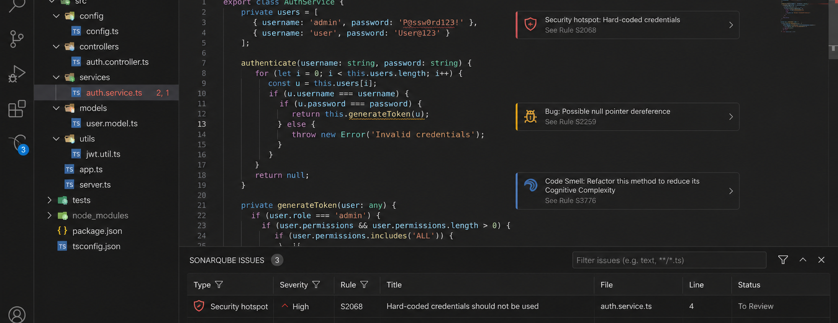
Developer experience
Issues appear exactly where developers work
Mock VS Code view: issue highlight, severity, rule ID and remediation context in the SonarQube panel.
What the developer gets: risk + rule + fix path, before PR.
5

Slide 6
ADOPTION PATH
Standalone now. Connected mode later.
Start with the value we can deploy cleanly today.
Standalone mode
PHASE 1
Connected mode
LATER
No server connection
Server project binding
No user/token setup
User token per developer
Local IDE rules
Server rule/profile sync
Fast deployment
Better team consistency
Best fit for current Community Build constraint
Needs access model and administration plan
CTO ask: approve standalone rollout first; revisit connected mode after user provisioning and server-governance constraints are solved.
6

