Slide 1
Sports Analytics Project
Power BI Dashboard & Exploratory Data Analysis

Slide 2
Project Overview
This project analyzes historical Olympic Games data to identify meaningful trends and patterns.
The analysis covers Olympic editions, seasons, host cities, sports, events, athlete participation and medals.
Power BI is used to transform relational data into an interactive and easy-to-understand analytical dashboard.
The dashboard helps compare Olympic performance across years, sports and regions/NOCs.
The project follows a MECE structure so each analytical area has a clear purpose.

Slide 3
Business Objective
Measure the scale and growth of Olympic Games over time.
Understand the distribution and evolution of sports and events.
Analyze athlete participation, gender and age patterns.
Evaluate medal distribution across Olympic Games and sports.
Compare regional/NOC participation and medal performance.
Present the findings through interactive KPIs, and charts.
Sports Analytics Project | Power BI • 3

Slide 4
Dataset & Data Model
Games — Olympic year, Games name and season.
City / Games_City — Olympic host locations.
Person / Games_Competitor — athlete information and participation.
Sport / Event — sports and individual Olympic events.
Competitor_Event / Medal — event participation and medal outcomes.
NOC_Region / Person_Region — region/NOC mapping.

Slide 5
KPI Dashboard
Olympic Games
Total Editions
Sports
Total Sports
Events
Total Events
Regions
Total Regions
Medals
Total Medals
KPI cards provide an executive-level summary before users explore detailed visuals.

Slide 6
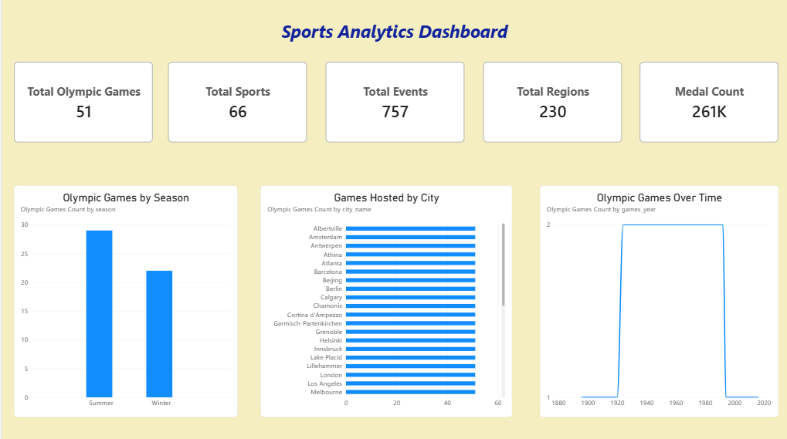

Slide 7
Dashboard — Olympic Overview
Olympic Games by Season — compares Summer and Winter editions.
Games Over Time — provides a historical timeline.
Games Hosted by City — identifies cities that hosted the most Olympic Games.

Slide 8
Key DAX Measures
Olympic Games Count = DISTINCTCOUNT(games[id])
Event Count = DISTINCTCOUNT(event[id])
Participant Count = DISTINCTCOUNT(games_competitor[person_id])
Average Age = AVERAGE(games_competitor[age])
Medal Count = CALCULATE(COUNTROWS(competitor_event), medal[medal_name] <> "No medal")
Gold Medal Count = CALCULATE(COUNTROWS(competitor_event), medal[medal_name] = "Gold")
Sports Analytics Project | Power BI • 10

Slide 9
Analytical Insights
The number of Olympic editions differs substantially between Summer and Winter Games.
The Olympic sports program has evolved over time, with changes in sports and events.
Athlete participation has expanded and can be compared across Olympic editions and seasons.
Medal distribution is concentrated in sports with many competitive events.
Regional/NOC performance varies significantly in both participation and medal achievement.
Interactive filtering allows these patterns to be examined for specific years, seasons or regions.

Slide 10
Tools & Skills Demonstrated
Technical and analytical skills used in the project
Power BI — dashboard creation, visual analytics and interactive reporting.
DAX — KPI measures, distinct counts, filtered calculations and analytical logic.
SQL / PostgreSQL — working with relational Olympic data.
Data Modeling — connecting Games, athletes, sports, events, medals and regions.
Data Visualization — selecting appropriate charts for trends, rankings and distributions.
Analytical Thinking — MECE structuring, comparison, trend analysis and KPI development.

Slide 11
Project Conclusion
The Sports Analytics dashboard provides a consolidated view of Olympic history and performance.
It combines Games, Sports & Participation, Medal Analysis and Regional Performance into one analytical solution.
The interactive design enables users to explore trends rather than relying only on static numbers.
The project demonstrates practical application of Power BI, DAX, SQL, data modeling and visualization.
Overall, the dashboard provides a structured approach to understanding Olympic sports and performance.

Slide 12
Thank You

