Slide 1
Data Structure and Algorithm

Slide 2

Name – Kartikey Shaurya
Reg no – 11902836

Slide 3
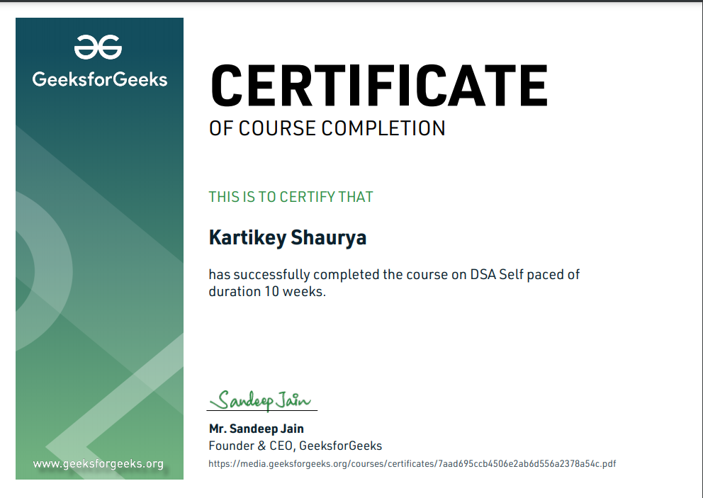

Slide 4
All contents
Introduction
Technology learnt
Project
Questioning ???
1.0 What it’s all about
2.0 My approach
3.0 Code Running

Slide 5
1.
Introduction

Slide 6
What are Data Structures ?

Slide 7
Why Data Structure are Needed
Processing speed
Data Search
Multiple requests
Efficient Memory use

Slide 8
2.
Topics learnt

Slide 9
Some Concepts that I have learnt
Basic Mathematics
Bit Magic
Recursion
Arrays
Searching
Sorting
Matrix
Hashing
Strings
Linked List
Stacks
Queues
Deques

Slide 10
Data Structures Examples

Slide 11

Strings

Slide 12
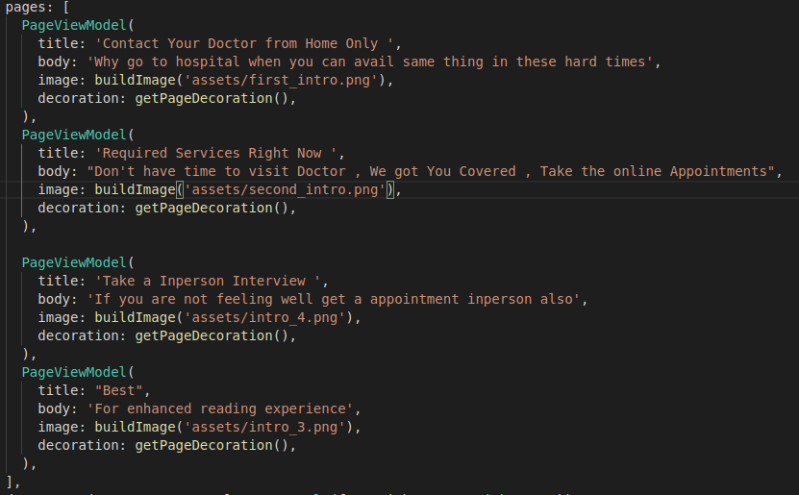

Example of Dictionary

Slide 13
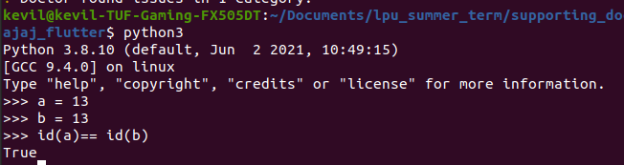
Stacks Example

Slide 14
Queues Example

Slide 15
3.
Project

Slide 16
Structure of my project
Product
Animation
Core

Slide 17
Pseudo code for my design
Define a function of bubble sort
Visualize it with the help of matplotlib and Seaborn
Generate the random value
Create a figure and subsequent plots
Set the maximum limit for the X axis
Update the Value as sorting proceeds
Finally create and show the Animation

Slide 18
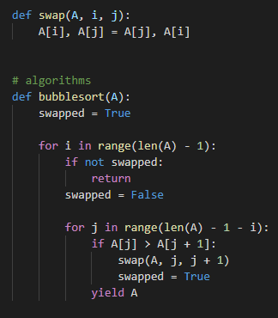
Bubble Sort
Bubble sort is the basic sorting algorithm, that works by repeatedly swapping the adjacent element if they are in the wrong order

Slide 19
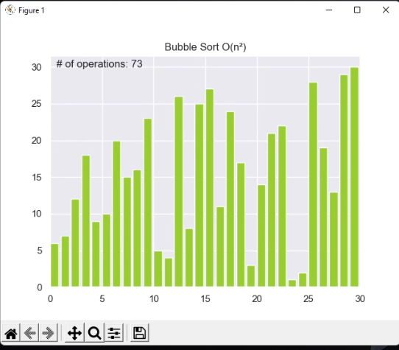
Animations
Matplotlib and seaborn are the most common animation that are used throughout the industry.
We have used bar chart for out animation purpose.

Slide 20
Products

Slide 21
Future application
We can apply sorting algorithm many places to increase customer experience

Slide 22
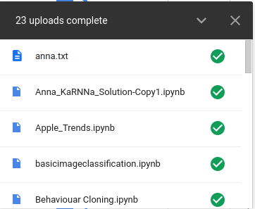
Google Drive
Based upon the network type we can apply different algorithm and improve uploading experience

Slide 23
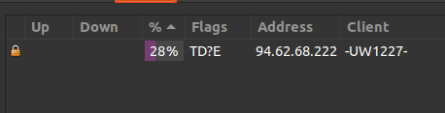
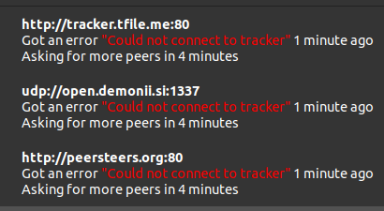
Ubuntu Application
Same application on different os

Slide 24
Thanks!
👦

