Slide 1


Department of Electronics and Communication Engineering
National Institute of Technology Goa
GPS - GUIDED AUTONOMOUS DELIVERY VEHICLE
EC 253 - Sensor Technology Project
Kartikey - 24ECE1020
Karun - 24ECE1021
Kathan - 24ECE1022
Palak - 24ECE1031
Mayuresh - 24ECE1053
1

Slide 2
Project Overview
System Introduction
Design Requirements & Technical Goals
Hardware Architecture & Specifications
Design and Implementation
1. System Overview
2. Key Functional Blocks
Operational Workflow & Mission Phases
Results and Conclusion
1. Results
2. Applications
3. Conclusion
Sources
2

Slide 3
SYSTEM INTRODUCTION
3

Slide 4
Executive Summary & Project Intent
Campus logistics, specifically the transit of documents, parcels, and inter department packages, traditionally rely on manual human trips between buildings. This project addresses the inefficiency of manual last mile delivery by automating the process through an autonomous robotic platform. By integrating modern spatial sensors and embedded web technologies, the DeliveryBot NITG provides a contactless, on demand delivery solution that operates entirely independently of remote control.
4

Slide 5
DESIGN REQUIREMENTS & TECHNICAL GOALS
5

Slide 6
Objectives
1. To design a physical 2WD differential drive prototype capable of autonomous navigation between predefined campus waypoints (e.g., Terekhol Hostel, Admin Block, Gyan Mandir).
2. To implement a non-blocking C++ state machine architecture that eliminates processing delays and ensures real-time sensor responsiveness.
3. To develop a mobile-first web User Interface (UI) hosted via an ESP32 Access Point for intuitive destination selection and dispatching
4. To integrate a robust sensor suite combining GPS tracking and magnetic heading correction to overcome the limitations of straight-line GPS navigation on curved campus pathways.
5. To deploy a sequential ultrasonic array that performs dynamic obstacle detection while actively preventing sensor crosstalk.
6

Slide 7
HARDWARE ARCHITECTURE & SPECIFICATIONS
7

Slide 8
Components Used
Microcontroller (ESP32 WROOM-32): The central dual core processing unit running the Arduino framework. It manages the HTTP server (AP Mode), state machine logic, and hardware abstraction
Global Positioning System (NEO-6M): Interfaces via UART to provide 1Hz geographical coordinate fixes for macro navigation.
Magnetometer / Compass (HMC5883L/QMC5883L): Interfaces via I2C to provide continuous 8-point cardinal direction output for real-time heading correction.
Ultrasonic Sensor Array (3x HC-SR04): Positioned at the Left, Center, and Right of the chassis for spatial awareness and obstacle detection.
Motor Driver (L298N): Governs the 2WD differential chassis via PWM signals. It utilises an onboard 5V regulator to power the ESP32 logic, eliminating the need for a separate buck converter.
Drive Chassis: A 2WD differential-wheeled platform allowing independent left and right motor speed control for precise manoeuvring.
8

Slide 9
DESIGN AND IMPLEMENTATION
9

Slide 10
System Overview
The architecture of the DeliveryBot is segmented into three distinct software and hardware layers: the Mobile Web Interface, the Navigation and Control Core, and the Hardware Abstraction Layer. Power distribution is streamlined; the main battery routes directly into the L298N motor driver, which leverages its internal 5V regulator to safely supply the ESP32 logic board and connected sensors. The entire software stack operates under strict non blocking principles, meaning no delay() functions are permitted, ensuring the robot can simultaneously serve the web UI, read GPS bytes, and poll ultrasonic echoes without freezing.
10

Slide 11
Key Functional Blocks
1. Central Processing Unit (ESP32)
Role: Acts as both the web server and the navigation brain. The ESP32 creates a local WiFi network (SSID: DeliveryBot_NITG) hosted at 192.168.4.1. The UI is stored in PROGMEM with Base64 encoded assets, allowing users to select a destination securely and trigger the dispatch sequence.
2. Spatial Navigation Subsystem (GPS + Compass)
Role: Standard GPS logic dictates moving in a straight line between two points, which fails on curved campus roads. This subsystem utilises a Waypoint Queue. Pre-surveyed coordinates form a breadcrumb trail. The NEO-6M verifies arrival at an intermediate node, while the magnetometer constantly corrects the chassis orientation to point toward the next specific coordinate in the queue.
11

Slide 12
3. Obstacle Detection Subsystem (Ultrasonic Array)
Role: Three HC-SR04 sensors provide a forward-facing spatial sweep. To prevent ultrasonic signals from bouncing and triggering false positives in adjacent sensors (crosstalk), the firmware enforces sequential firing. The state machine reads these values continuously; if an obstacle breaches the distance threshold, the robot transitions to a halt state.
4. Drive and Locomotion Subsystem
Role: The L298N accepts variable Pulse Width Modulation (PWM) signals generated by the ESP32's LEDC peripheral. By manipulating the duty cycle independently for the left and right motors, the state machine can execute pivot turns, smooth arcs, and straight-line acceleration phases.
12

Slide 13
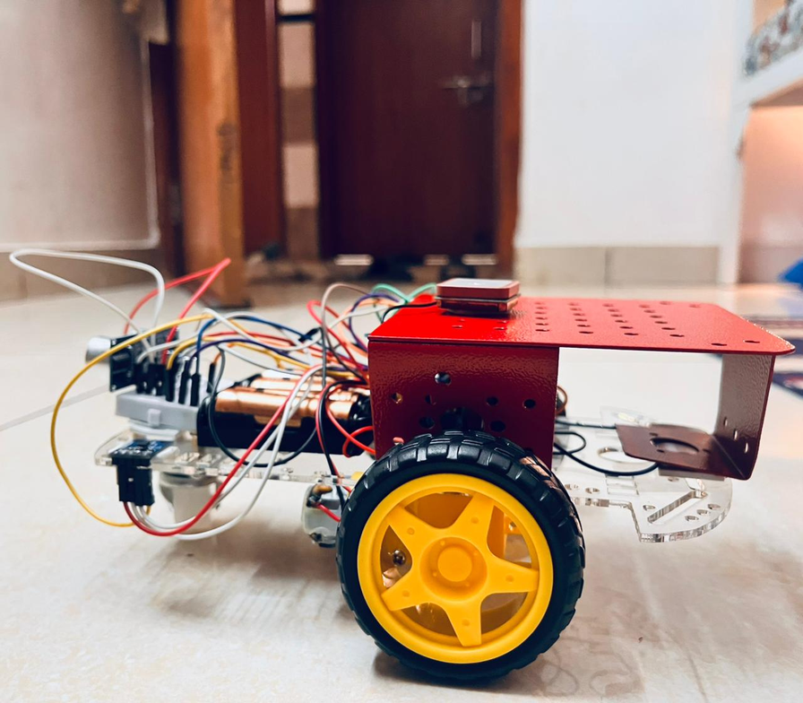
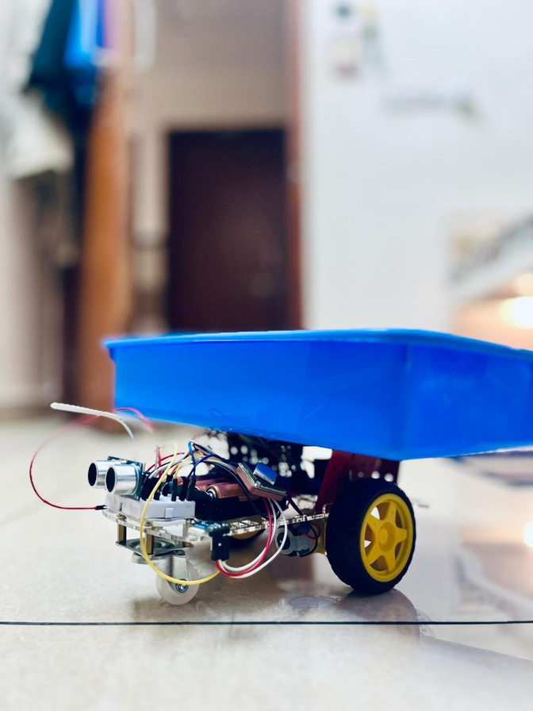
DeliveryBot NITG: Final Assembly
13

Slide 14
OPERATIONAL WORKFLOW & MISSION PHASES
14

Slide 15
Operations
The operation of the autonomous delivery robot follows a strict sequential phase structure governed by its internal state machine:
Phase 1: Initialization and UI Serving Upon boot, the ESP32 initializes all hardware peripherals and performs a silent diagnostic check (verifying I2C lines and UART streams). It broadcasts its AP WiFi network. A user connects via a smartphone, accesses the captive portal, and selects a predefined surveyed location (such as the Seminar Hall or Main Gate) from the HTML interface.
Phase 2: Waypoint Queuing and Dispatch Once a destination is submitted, the handleDispatch() function is triggered. The system loads an array of intermediate GPS coordinates specific to that route. This queue ensures the robot follows the physical geometry of the campus roads rather than attempting to drive through buildings in a straight line.
15

Slide 16
Phase 3: Autonomous Transit The robot engages the drive motors. During transit, the non blocking loop continuously drains bytes from the NEO-6M GPS module to calculate distance to the current active waypoint. Simultaneously, it reads the magnetometer to calculate the required steering angle, adjusting the left and right motor PWM values dynamically to maintain the correct heading.
Phase 4: Real-Time Obstacle Avoidance. While moving, the ultrasonic array cycles continuously. If an obstacle is detected in the robot's path, the state machine instantly overrides the drive commands and halts the motors. In the current iteration, the robot waits for the obstacle to clear and retries the path. (Dynamic spatial re-routing around the obstacle is marked as a deferred upgrade for future versions) .
Phase 5: Arrival and Standby Once the GPS module verifies that the robot has reached the final coordinate in the queue within an acceptable margin of error, the system halts the motors, updates the web UI to reflect a successful delivery, and enters a standby state awaiting the next dispatch command.
16

Slide 17
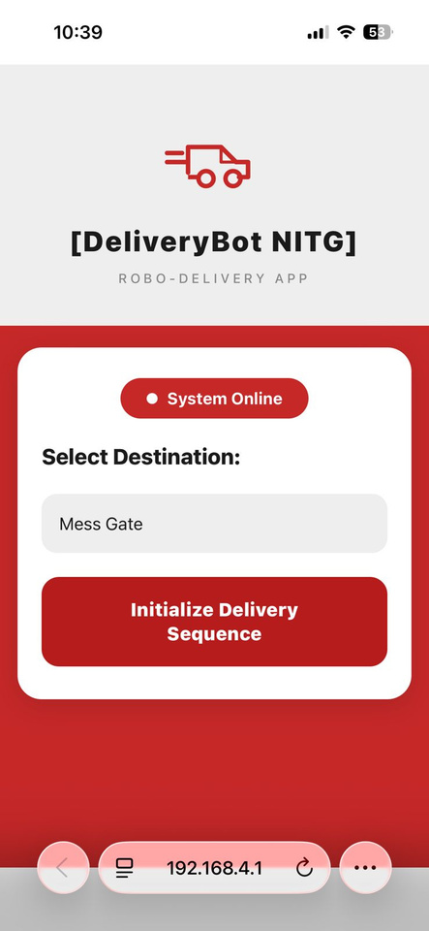
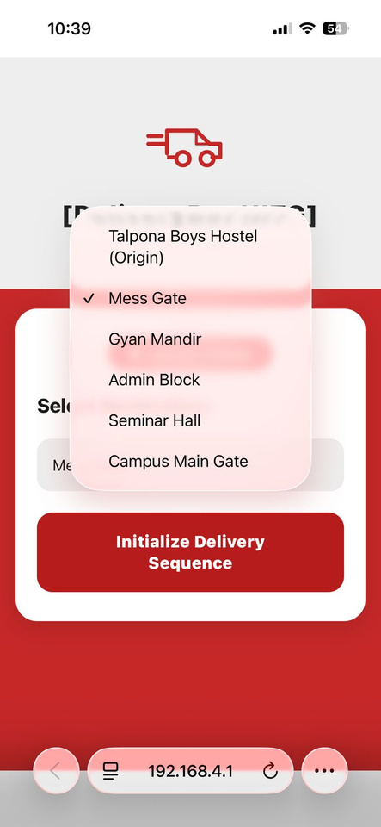

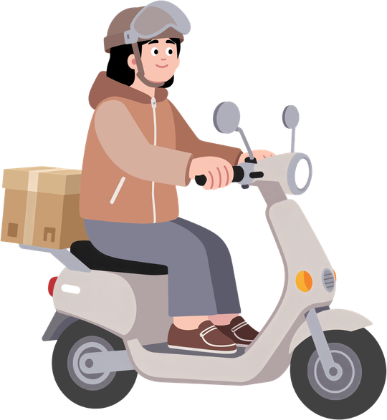

End-to-End Delivery Sequence: From Selection to Arrival
Destination selection
Mission Dispatch
Completion & Standby
17

Slide 18
VISIONARY & INNOVATIVE
18

Slide 19
Future Improvements
1. Sensor Fusion & Odometry: Transition from open-loop GPS to precise dead-reckoning. By combining motor encoders, RTK GPS, and a 9-DOF IMU through an Extended Kalman Filter (EKF), the robot will maintain accurate positioning even if GPS signals drop under heavy tree cover.
2. Dynamic Obstacle Avoidance: Replace the basic "stop-and-wait" ultrasonic logic with a 2D LiDAR. Using a dedicated computer running ROS (Robot Operating System), the robot can use local path planners (like DWA or TEB) to dynamically route around pedestrians and obstacles on the fly.
3.Distributed Compute Architecture: Split the processing workload. An onboard Linux computer (Raspberry Pi/Jetson) will handle the heavy lifting (ROS, global path planning, LTE communication), while the ESP32 acts strictly as a hard-real-time motor controller and safety watchdog.
19

Slide 20
1. Cloud Connectivity & Fleet Management: Upgrade from a local WiFi Access Point to a 4G/LTE modem connected to an IoT cloud backbone (e.g., AWS or Google Cloud). This enables centralized telemetry streaming and remote dispatcher control from anywhere in the world.
2. Hardware Safety & Security: Add physical safety features, including a hardware-interrupt Emergency Stop (E-Stop) button. Additionally, the delivery bay must be enclosed and fitted with an electronic lock that opens only via a recipient's OTP or QR code.
20

Slide 21
RESULTS AND CONCLUSION
21

Slide 22
Results
Firmware Stability: Version 4.0 of the firmware was successfully deployed, resolving critical logic bugs, including the elimination of hidden 90ms blocking delays in the ultrasonic read loop and fixing LEDC API incompatibilities between ESP32 Core versions.
Hardware Validation: Individual validation sketches successfully demonstrated the isolated functionality of the 5-phase motor PWM ramping, sequential ultrasonic firing, raw I2C compass auto-detection, and non-blocking GPS byte drainage.
Navigational Accuracy: The implementation of the waypoint queue system successfully corrected previous navigational failures, allowing the chassis to handle V-shaped roads, complex curves, and real-world GPS drift without requiring manual steering intervention.
22

Slide 23
Applications
Campus Logistics: Automated, contactless transport of library books, administrative documents, or lab materials between university departments.
Medical Facilities: Safe transportation of non critical medical supplies or sterile equipment across hospital wings without tying up human staff.
Corporate Tech Parks: Last-mile parcel delivery within closed, geofenced corporate environments.
23

Slide 24
Conclusion
This project successfully demonstrates the integration of multiple distinct sensor technologies into a cohesive, autonomous robotic platform. By strictly adhering to non blocking software architecture and leveraging an ESP32 as both an embedded web server and a localized navigation brain, the system bridges the gap between hardware abstraction and practical logistics. The DeliveryBot prototype satisfies the core objectives of spatial awareness, waypoint navigation, and user accessible dispatching, proving the viability of autonomous robotic transit within complex, structured environments.
24

Slide 25
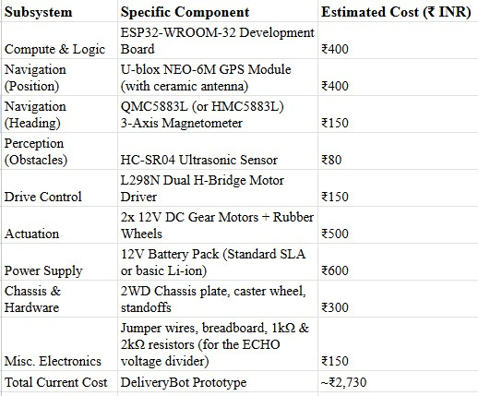
Estimated Cost
25

Slide 26
THANK YOU!
26

