Slide 1
Parallel programming using Message Passing interface (mpi)

Slide 2
Parallel Programming Models
Explicit Parallelism
The programmer specifies directly the activities of the multiple concurrent “threads of control” that form a parallel computation.
Provide the programmer with more control over program behavior and hence can be used to achieve higher performance.
Implicit Parallelism
The programmer provides high-level specification of program behavior.
It is then the responsibility of the compiler or library to implement this parallelism efficiently and correctly.

Slide 3
Parallel Programming Models
Shared Memory
The programmer’s task is to specify the activities of a set of processes that communicate by reading and writing shared memory.
Advantage: the programmer need not be concerned with data-distribution issues.
Disadvantage: performance implementations may be difficult on computers that lack hardware support for shared memory, and race conditions tend to arise more easily
Distributed Memory
Processes have only local memory and must use some other mechanism (e.g., message passing or remote procedure call) to exchange information.
Advantage: programmers have explicit control over data distribution and communication.

Slide 4
Shared vs Distributed Memory
Shared memory
Distributed memory
P
P
P
P
Bus
Memory
M
M
M
M
P
P
P
P
Network

Slide 5
Parallel Programming Models
Parallel Programming Tools:
Parallel Virtual Machine (PVM)
Distributed memory, explicit parallelism
Message-Passing Interface (MPI)
Distributed memory, explicit parallelism
PThreads
Shared memory, explicit parallelism
OpenMP
Shared memory, explicit parallelism
High-Performance Fortran (HPF)
Implicit parallelism
Parallelizing Compilers
Implicit parallelism

Slide 6
What is Mpi?
Mpi is a proposed standard message passing interface.
It is a library specification and not a language, its library is available in C and fortron77 languages.
Its programs are compiled normally and linked with MPI library.
MPI provide source code portability of message passing prog. In C and Fortron77 across various Architecture.
MPI works on Distributed Architecture of memory and is a part of explicit Parallel programing.

Slide 7
The 6 Basic C MPI Calls
MPI is used to create parallel programs based on message passing
Usually the same program is run on multiple processors
The 6 basic calls inC MPI are:
MPI_Init( &argc, &argv)
MPI_Comm_rank( MPI_COMM_WORLD, &myid )
MPI_Comm_Size( MPI_COMM_WORLD, &numprocs)
MPI_Send(&buffer, count,MPI_INT,destination, tag, MPI_COMM_WORLD)
MPI_Recv(&buffer, count, MPI_INT,source,tag, MPI_COMM_WORLD, &status)
call MPI_Finalize()

Slide 8
Data types
Data types
When sending data via message, We need to send data type also.
Predefined types correspond to "normal" types
MPI_REAL , MPI_FLOAT - Fortran real and C float respectively
MPI_DOUBLE_PRECISION , MPI_DOUBLE - Fortan double precision and C double repectively
MPI_INTEGER and MPI_INT - Fortran and C integer respectively
User can also create user-defined types

Slide 9
Communication Routines
Point to Point Communication:
Involves message passing between two, and only two, different MPI tasks. One task performs a send operation and the other task performs a matching receive operation.
Ex: MPI_Send(), MPI_Recv()
Collective Communication:
Collective communication must involve all processes in the scope of a communicator.
Ex: MPI_Bcast(), MPI_Scatter(), MPI_Gather().

Slide 10
MPI “Hello, World”
A parallel hello world program
Initialize MPI
Have each node print out its node number
Quit MPI

Slide 11
C/MPI version of “Hello, World”
#include <stdio.h> #include <math.h> #include <mpi.h>
void main(int argc,char **argv) { int myid, numprocs;
MPI_Init (&argc, &argv) ; MPI_Comm_size(MPI_COMM_WORLD, &numprocs) ; MPI_Comm_rank(MPI_COMM_WORLD, &myid) ;
printf(“Hello from %d\n”, myid) ;
MPI_Finalize():
getch(); }

Slide 12
Fortran/MPI version of “Hello, World”
program hello include ‘mpif.h’ integer myid, ierr, numprocs call MPI_Init( ierr) call MPI_Comm_rank( MPI_COMM_WORLD, myid, ierr) call MPI_Comm_Size(MPI_COMM_WORLD, numprocs,ierr) write (*,*) “Hello from “, myid write (*,*) “Numprocs is”, numprocs call MPI_Finalize(ierr) stop end

Slide 13
Python version
from mpi4py import MPI
comm = MPI.COMM_WORLD
rank = comm.Get_rank()
if rank == 0:
data = {'a': 7, 'b': 3.14}
comm.send(data, dest=1, tag=11)
elif rank == 1:
data = comm.recv(source=0, tag=11)
To execute use command:
$ mpiexec -n 4 python script.py

Slide 14
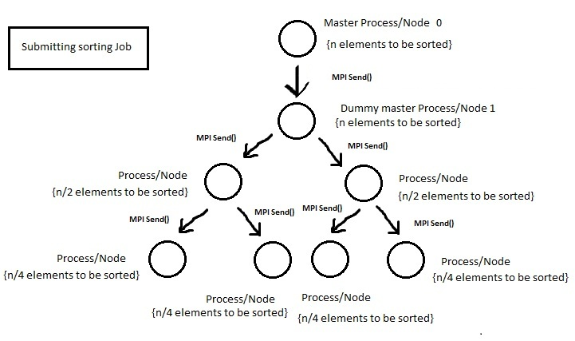
Merge sort using mpi

Slide 15
Why mpi ?
Easy to write and understand parallel programs.
Runs on either shared or distributed memory architectures.
MPI programs are portable and scalable.
Only message passing library which is a standard (Industry standard).
Language bindings available for Java ,C ,C++ ,Python ,R ,Matlab and Fortran.
Works on a wide variety of parallel computing architectures.

Slide 16
Thank you

