Slide 1

Integrated Real-Time Resource Scheduling
Kartik Gopalan and Tzi-cker Chiueh
State University of New York
Stony Brook
{kartik,chiueh}@cs.sunysb.edu
Experimental Computer Systems Lab

Slide 2
Motivation for IRS
Integrated Real-time Resource Scheduling
Real-time applications use multiple system resources such as CPU, disk, network and memory.
Time bound on completion of multiple tasks.
Read
Frame
Transcode
T
T
Transmit
Task Precedence Graph
Experimental Computer Systems Lab

Slide 3
Challenges
Integrated Real-time Resource Scheduling
Coordinate allocation and scheduling of multiple resources.
Maximize efficiency of system resource usage.
Key : Per-task delay assignment.
Disk
T₁
CPU
T
T
T₂
Network
T₃
Task Precedence Graph
Experimental Computer Systems Lab

Slide 4
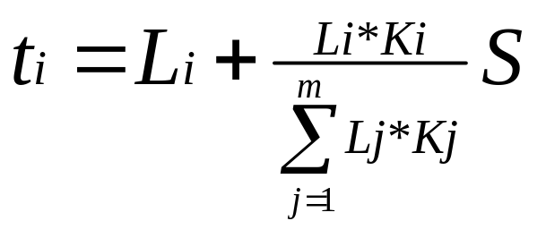
Contributions
Integrated Real-time Resource Scheduling
Optimal delay allocation for Linear TPG
Iterative relaxation based heuristic for Non-linear TPG.
Experimental Computer Systems Lab

Slide 5
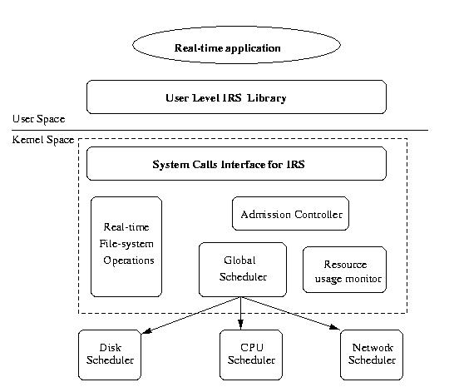
Proof of Concept Implementation
Integrated Real-time Resource Scheduling
Experimental Computer Systems Lab

Slide 6
Work-In-Progress
Integrated Real-time Resource Scheduling
Gage : Per-request response time guarantees in Web server cluster.
Direct solution for non-linear TPG.
Experimental Computer Systems Lab

