Slide 1

Real-Time Support in General Purpose Operating Systems
Kartik Gopalan
kartik@cs.sunysb.edu

Slide 2
Outline of Talk
Real-Time Support in General Purpose Operating Systems
Real-Time Support in General Purpose Operating Systems
Introduction
Design Issues in Real-Time OS
Representative Works
Integrated Resource Allocation and Scheduling
Future Research Areas
Experimental Computer Systems Lab

Slide 3
Real-Time Support in General Purpose Operating Systems
Real-Time Support in General Purpose Operating Systems
Introduction
Design Issues in Real-Time OS
Representative Works
Integrated Resource Allocation and Scheduling
Future Research Areas
Experimental Computer Systems Lab

Slide 4
General Purpose Operating System
Real-Time Support in General Purpose Operating Systems
Real-Time Support in General Purpose Operating Systems
  Multitasking
  Multiuser
  Handles multiple resources - CPU, disk, network, memory
  Applications
    Have unpredictable starting, blocking and terminating behaviour
    Have widely varying resource requirement
Experimental Computer Systems Lab

Slide 5
Real-Time Operating System
Real-Time Support in General Purpose Operating Systems
Real-Time Support in General Purpose Operating Systems
Timeliness :
Correctness depends on timing as well as logical result of computation.
Predictability :
Bounded worst case execution times of tasks.
Experimental Computer Systems Lab

Slide 6
Misconception
Real-Time Support in General Purpose Operating Systems
Real-Time Support in General Purpose Operating Systems
Real-time computing is very fast computing
rather
It is timely and predictable computing.
Experimental Computer Systems Lab

Slide 7
Classes of Real-Time Applications
Real-Time Support in General Purpose Operating Systems
Real-Time Support in General Purpose Operating Systems
  Hard
    Strict deadlines
    Missing deadline reduces overall system value
  Firm
    Strict deadlines
    Missing deadlines causes no gain/loss in value
  Soft
    Lenient deadlines
    Results produce partial value even after deadline.
Experimental Computer Systems Lab

Slide 8
Why Real-Time GPOS?
Real-Time Support in General Purpose Operating Systems
Real-Time Support in General Purpose Operating Systems
  To support coexistence of real-time and non real-time applications
  To provide generic OS services to real-time applications needing multiple system resources
E.g. Multimedia applications, online trading, ASPs.
Experimental Computer Systems Lab

Slide 9
Real-Time Support in General Purpose Operating Systems
Real-Time Support in General Purpose Operating Systems
Introduction
Design Issues in Real-Time OS
Representative Works
Integrated Resource Allocation and Scheduling
Future Research Areas
Experimental Computer Systems Lab

Slide 10
Design Issues in Real-Time OS
Real-Time Support in General Purpose Operating Systems
Real-Time Support in General Purpose Operating Systems
  Quality of Service (QoS) specification
  Admission control
  Resource scheduling
  Real-time threads
Experimental Computer Systems Lab

Slide 11
QoS Specification
Real-Time Support in General Purpose Operating Systems
Real-Time Support in General Purpose Operating Systems
Communicating desired QoS levels to OS
E.g Periodicity, delay bounds, jitter, data rate, price.
Declarative Specification
Specify what you need rather than how to get it.
E.g.
Specifying periodicity Vs. specifying scheduling policy
Experimental Computer Systems Lab

Slide 12
Admission Control
Real-Time Support in General Purpose Operating Systems
Real-Time Support in General Purpose Operating Systems
  Decision procedure to admit new real-time applications with certain level of QoS
  Requires mapping requested QoS level to actual resource requirement
Two types
  Deterministic admission control
  Statistical admission control
Experimental Computer Systems Lab

Slide 13
Resource Scheduling
Real-Time Support in General Purpose Operating Systems
Real-Time Support in General Purpose Operating Systems
  Mechanism to multiplex shared resources among competing applications
  One scheduler per resource in system
  Global scheduler - coordinate individual resource schedulers
  Two classes of scheduling
    Priority based
    Proportional sharing based
Experimental Computer Systems Lab

Slide 14
Resource Scheduling (contd…)
Real-Time Support in General Purpose Operating Systems
Real-Time Support in General Purpose Operating Systems
Priority Based Scheduling
  Assign explicit/implicit priority to applications
  Give control of resource to highest priority task
  Needs rate control to avoid starvation problem
  Two classes
    Static priority based - RMS, Expedited Forwarding
    Dynamic priority based - EDF, multi-level feedback
Experimental Computer Systems Lab

Slide 15
Resource Scheduling (contd…)
Real-Time Support in General Purpose Operating Systems
Real-Time Support in General Purpose Operating Systems
Proportional Sharing Based Scheduling
  Give share of service cycle in proportion to fraction of resource reserved
  Provides delay-bound on waiting times of tasks in ready queue(s).
  No starvation of tasks
Experimental Computer Systems Lab

Slide 16
Resource Scheduling (contd…)
Real-Time Support in General Purpose Operating Systems
Real-Time Support in General Purpose Operating Systems
Proportional Sharing Examples
  Weighted Round Robin
    One ready queue
  Hierarchical Proportional Share
    Hierarchy of proportional sharing schedulers
  Weighted Fair Queuing
    Multiple queues
    Minimum service rate guarantee
Experimental Computer Systems Lab

Slide 17
Real-Time Threads
Real-Time Support in General Purpose Operating Systems
Real-Time Support in General Purpose Operating Systems
  Threads encapsulate timing attributes - deadline, start time, periodicity.
  Bounded blocking on synchronization primitives such as mutex, condition variable etc.
  Handle priority inversion
Experimental Computer Systems Lab

Slide 18
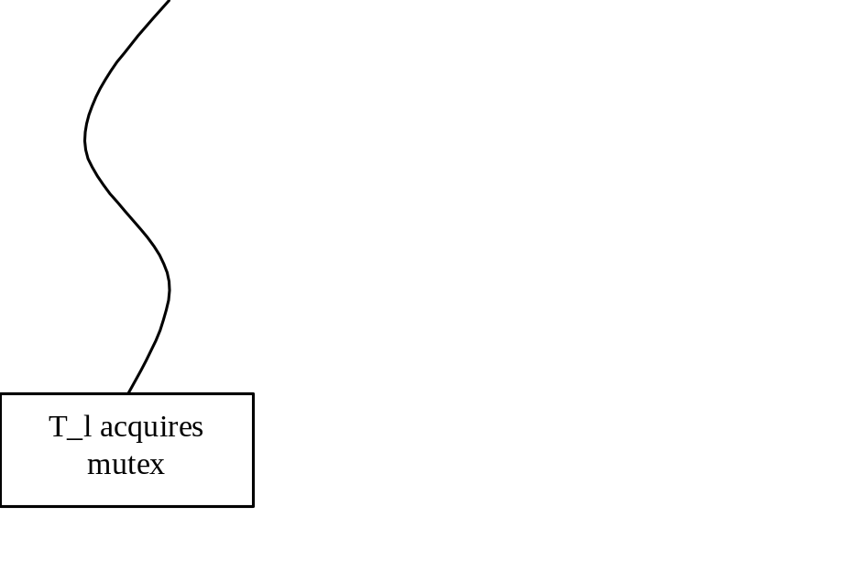
Priority Inversion
Real-Time Support in General Purpose Operating Systems
Real-Time Support in General Purpose Operating Systems
  Unbounded blocking of high priority task due to low priority task
Experimental Computer Systems Lab

Slide 19
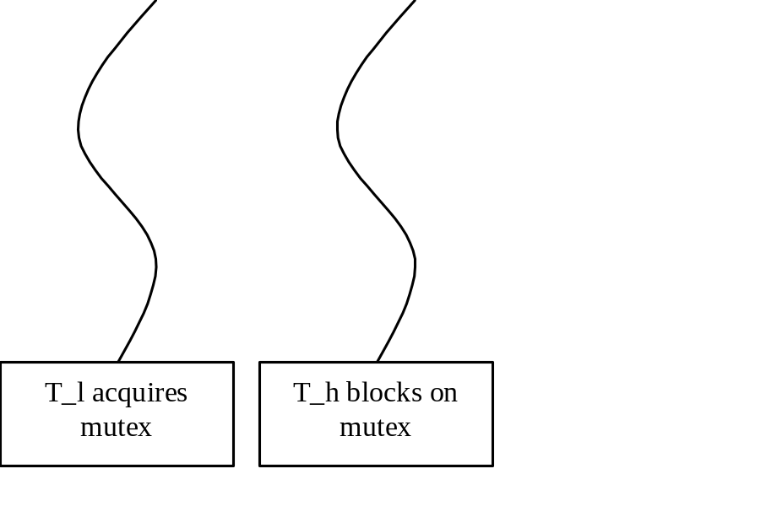
Priority Inversion
Real-Time Support in General Purpose Operating Systems
Real-Time Support in General Purpose Operating Systems
  Unbounded blocking of high priority task due to low priority task
Experimental Computer Systems Lab

Slide 20
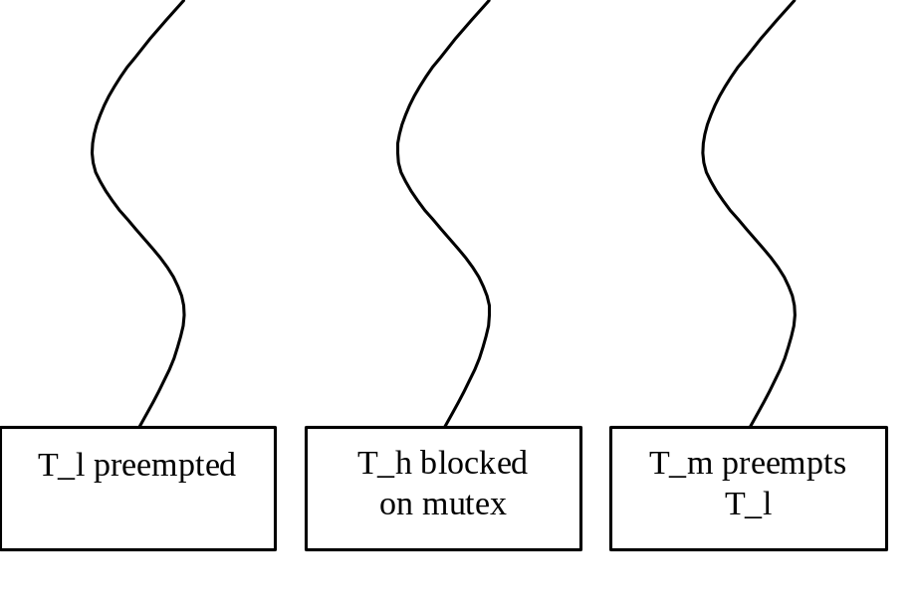
Priority Inversion
Real-Time Support in General Purpose Operating Systems
Real-Time Support in General Purpose Operating Systems
  Unbounded blocking of high priority task due to low priority task
Experimental Computer Systems Lab

Slide 21
Priority Inheritance
Real-Time Support in General Purpose Operating Systems
Real-Time Support in General Purpose Operating Systems
  T_l inherits the priority of T_h
Experimental Computer Systems Lab

Slide 22
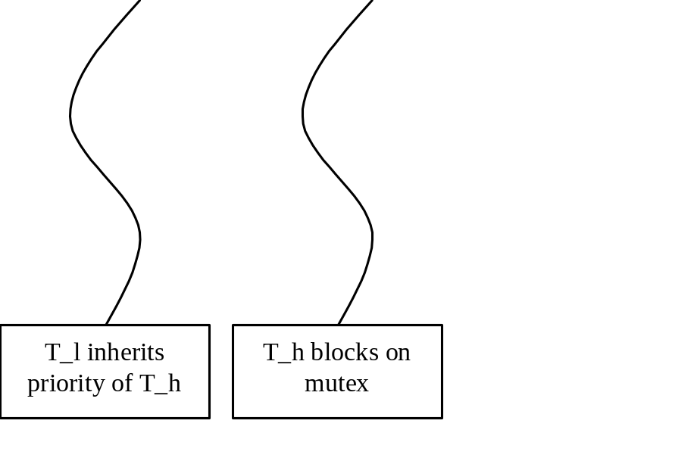
Priority Inheritance
Real-Time Support in General Purpose Operating Systems
Real-Time Support in General Purpose Operating Systems
  T_l inherits the priority of T_h
Experimental Computer Systems Lab

Slide 23
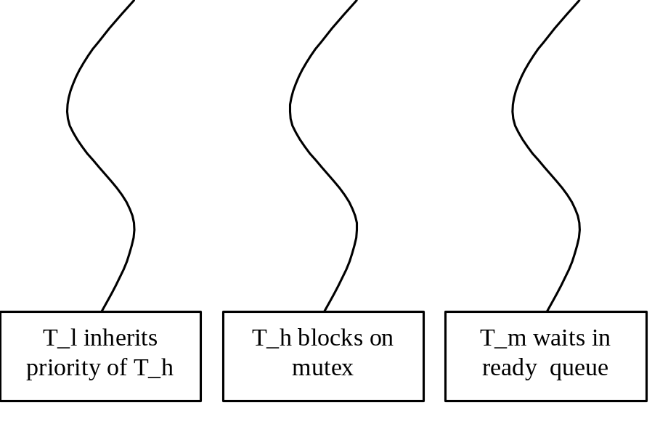
Priority Inheritance
Real-Time Support in General Purpose Operating Systems
Real-Time Support in General Purpose Operating Systems
  T_l inherits the priority of T_h
Experimental Computer Systems Lab

Slide 24
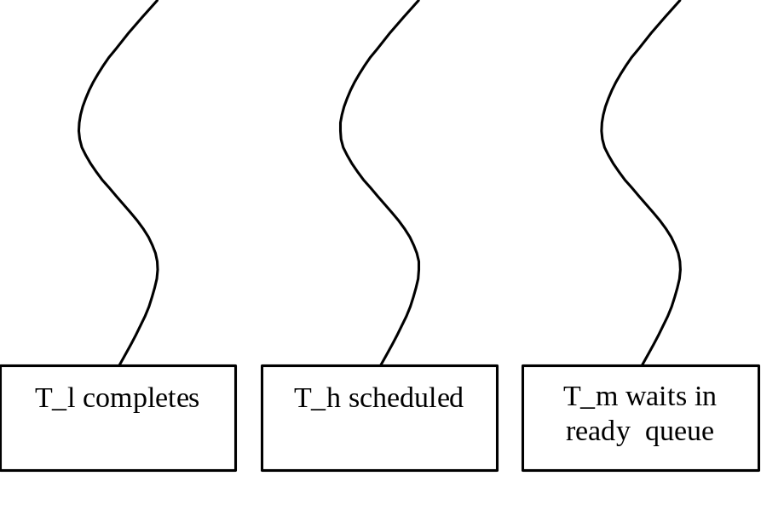
Priority Inheritance
Real-Time Support in General Purpose Operating Systems
Real-Time Support in General Purpose Operating Systems
  T_l inherits the priority of T_h
Experimental Computer Systems Lab

Slide 25
Predictable memory management
Real-Time Support in General Purpose Operating Systems
Real-Time Support in General Purpose Operating Systems
Unpredictability due to virtual memory
  Time to service page faults can be unbounded
    Solution : Preload and wire all pages at startup
  Lost CPU cycles due to miss on TLB lookup
    Solution : Preload TLB with page table entries at context switch time
Experimental Computer Systems Lab

Slide 26
Real-Time Support in General Purpose Operating Systems
Real-Time Support in General Purpose Operating Systems
Introduction
Design Issues in Real-Time OS
Representative Works
Integrated Resource Allocation and Scheduling
Future Research Areas
Experimental Computer Systems Lab

Slide 27
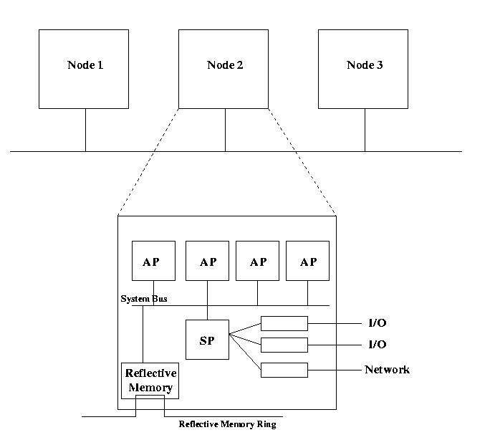
Spring System
(University of Massachusetts)
Real-Time Support in General Purpose Operating Systems
Real-Time Support in General Purpose Operating Systems
Experimental Computer Systems Lab

Slide 28
Spring System
(University of Massachusetts)
Real-Time Support in General Purpose Operating Systems
Real-Time Support in General Purpose Operating Systems
  Multiprocessor and distributed real-time system
  Aims for absolute predictability in dynamic hard real-time environments
  Dynamic planning based scheduler
  Uses “Worst Case Execution Time” (WCET)
  Languages : Spring-C and System Description Language (SDL)
Experimental Computer Systems Lab

Slide 29
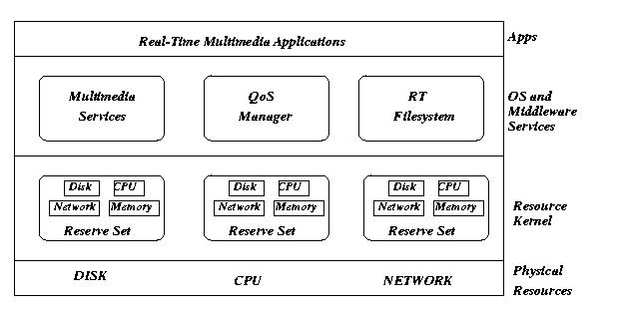
Real-Time Mach
(CMU)
Real-Time Support in General Purpose Operating Systems
Real-Time Support in General Purpose Operating Systems
Experimental Computer Systems Lab

Slide 30
Real-Time Mach
(CMU)
Real-Time Support in General Purpose Operating Systems
Real-Time Support in General Purpose Operating Systems
  Microkernel based
  Priority driven preemptive scheduling
    Fixed priority, EDF, Round Robin
  Temporal Protection via lazy evaluation
    Lazy network protocol processing
    Lazy inter-process communication
    Lazy address space copying
  Reserve Set
    Each set has certain fraction of different resources
    Multiple applications can belong to same set.
Experimental Computer Systems Lab

Slide 31
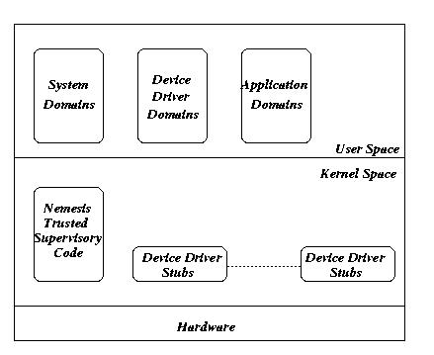
Nemesis
(University of Cambridge)
Real-Time Support in General Purpose Operating Systems
Real-Time Support in General Purpose Operating Systems
Experimental Computer Systems Lab

Slide 32
Nemesis
(University of Cambridge)
Real-Time Support in General Purpose Operating Systems
Real-Time Support in General Purpose Operating Systems
  Microkernel based
  Vertically structured OS
    Most OS functions execute as shared libraries
    Easy accounting of resource usage to applications
  Split level CPU scheduling
    Scheduling among domains by kernel (EDF)
    Scheduling among threads by domain itself
  Single address space OS
    Enables IPC without copying bulk data
Experimental Computer Systems Lab

Slide 33
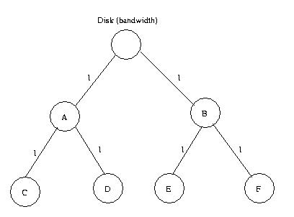
Eclipse/BSD
(Bell Labs)
Real-Time Support in General Purpose Operating Systems
Real-Time Support in General Purpose Operating Systems
  Derived from FreeBSD
  Hierarchy of reservations
    Scheduler nodes – implement scheduling policy
    Queue nodes – queue resource requests
  Hierarchical proportional share schedulers for CPU, disk and network link.
  API for QoS specification through /reserv file system
Experimental Computer Systems Lab

Slide 34
SMART
(SUN Microsystems)
Real-Time Support in General Purpose Operating Systems
Real-Time Support in General Purpose Operating Systems
  Scheduler for multimedia and real-time applications
  Two task attributes
    Urgency
    Importance
  Scheduling Policy
    Schedule most important task, if it is NRT
    Else schedule RT task with earliest deadline s.t. deadlines of higher importance are not missed.
Experimental Computer Systems Lab

Slide 35
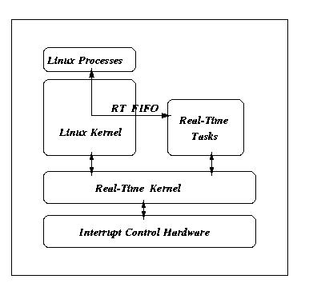
RT-Linux
(New Mexico Institute of Technology)
Real-Time Support in General Purpose Operating Systems
Real-Time Support in General Purpose Operating Systems
Experimental Computer Systems Lab

Slide 36
RT-Linux
(New Mexico Institute of Technology)
Real-Time Support in General Purpose Operating Systems
Real-Time Support in General Purpose Operating Systems
  Hard real-time OS
  Linux run as lowest priority NRT thread of a hard real-time kernel
  Key idea : Software emulation of interrupt control hardware
  Scheduling : Priority driven, EDF, RMS
  RT tasks communicate with standard Linux processes via FIFOs and shared memory
Experimental Computer Systems Lab

Slide 37
KURT Linux
(University of Kansas)
Real-Time Support in General Purpose Operating Systems
Real-Time Support in General Purpose Operating Systems
  Firm real-time variant of Linux
  Programs the timer chip in one-shot mode to obtain fine resolution timer functionality
  Explicit planning based scheduler
  Real-time functionality implemented as loadable kernel modules
Experimental Computer Systems Lab

Slide 38
Windows NT extensions
Real-Time Support in General Purpose Operating Systems
Real-Time Support in General Purpose Operating Systems
  Popularity has pushed NT towards use in RT environments
  INtime (from Radisys)
    NT run as lowest priority thread of real-time kernel
    HAL modified to prevent NT from masking interrupts
  Rtx (from VenturCom)
    A real-time kernel runs inside NT as a device driver
    Priority based scheduling – NT threads given lowest priority
Experimental Computer Systems Lab

Slide 39
Others from Windows family
Real-Time Support in General Purpose Operating Systems
Real-Time Support in General Purpose Operating Systems
  Rialto (from Microsoft Research)
    Firm real-time applications
    Scheduling graph determines which tasks are feasible every cycle.
    Scheduling among feasible tasks in EDF order
  Windows CE
    Embedded OS with small footprint
    Priority based scheduling
    Interrupt servicing performed by prioritized threads
Experimental Computer Systems Lab

Slide 40
Real-Time Support in General Purpose Operating Systems
Real-Time Support in General Purpose Operating Systems
Introduction
Design Issues in Real-Time OS
Representative Works
Integrated Resource Allocation and Scheduling
Future Research Areas
Experimental Computer Systems Lab

Slide 41
Integrated Resource Allocation and Scheduling
Real-Time Support in General Purpose Operating Systems
Real-Time Support in General Purpose Operating Systems
  Most soft real-time applications, such as multimedia tasks, utilize multiple system resources
  End-to-end QoS guarantees requires coordinated management of multiple system resources
  Most real-time OSes support at best independent resource management
Experimental Computer Systems Lab

Slide 42
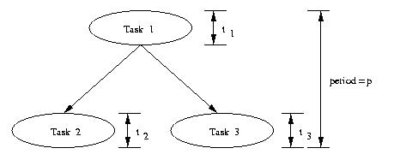
IRS
Real-Time Support in General Purpose Operating Systems
Real-Time Support in General Purpose Operating Systems
Unified framework of resource allocation and real-time scheduling
Real-time task modeled as periodic execution of Task Precedence Graph
Experimental Computer Systems Lab

Slide 43
Resource Allocation in IRS
Real-Time Support in General Purpose Operating Systems
Real-Time Support in General Purpose Operating Systems
Goal : Compute delay budget allocation for each task in TPG s.t.
TPG completes within a period.
Load on different resources is balanced to the extent possible
Algorithm
Compute minimal delay budget for each task in TPG
Apportion the slack in delay budget to each task in proportion to load on each resource.
Experimental Computer Systems Lab

Slide 44
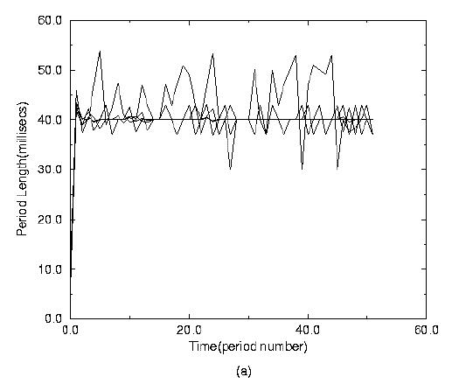
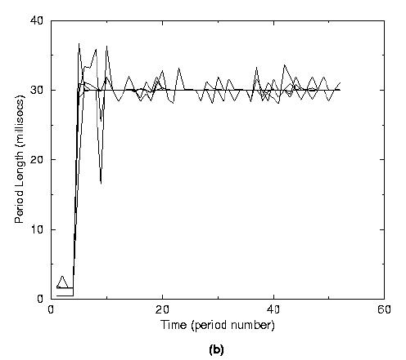
Comparison of Jitter
Real-Time Support in General Purpose Operating Systems
Real-Time Support in General Purpose Operating Systems
(a) without IRS (b) with IRS

Slide 45
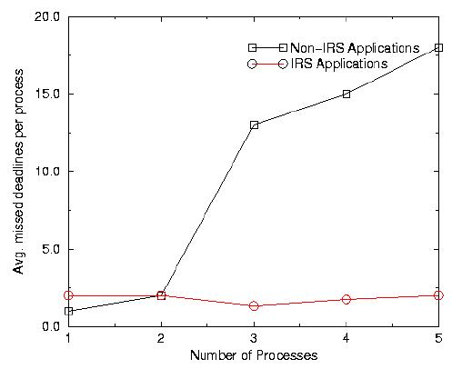
Deadline Misses
Real-Time Support in General Purpose Operating Systems
Real-Time Support in General Purpose Operating Systems
Number of deadline misses for non-IRS vs. IRS applications

Slide 46
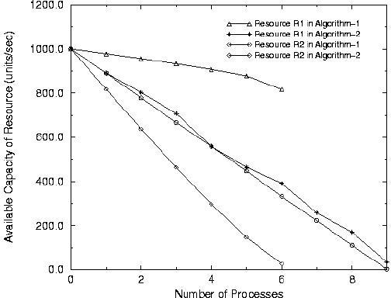
Resource Allocation
Real-Time Support in General Purpose Operating Systems
Real-Time Support in General Purpose Operating Systems
Traditional allocation (Algo1) Vs IRS allocation (Algo2)

Slide 47
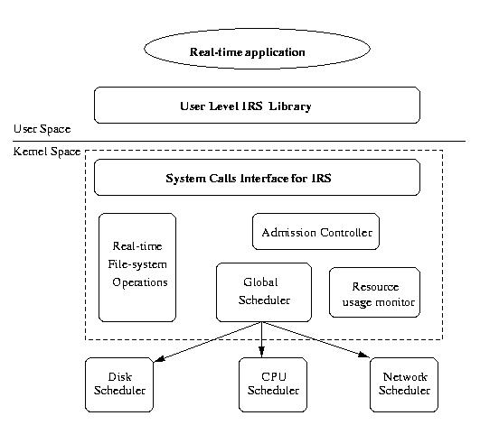
Architecture of IRS
Real-Time Support in General Purpose Operating Systems
Real-Time Support in General Purpose Operating Systems
Experimental Computer Systems Lab

Slide 48
Other Theoretical Frameworks
Real-Time Support in General Purpose Operating Systems
Real-Time Support in General Purpose Operating Systems
  Continuous Media Resource Model (Berkeley)
    End-to-end performance guarantees to applications using continuous media
    Meta-scheduler coordinates reservation between CPU, network and file system components
  QoS Resource Allocation Model (CMU)
    Allocating multiple finite resources to applications along multiple QoS dimensions
    Goal : Maximize overall system utility
Experimental Computer Systems Lab

Slide 49
Real-Time Support in General Purpose Operating Systems
Real-Time Support in General Purpose Operating Systems
Introduction
Design Issues in Real-Time OS
Representative Works
Integrated Resource Allocation and Scheduling
Future Research Areas
Experimental Computer Systems Lab

Slide 50
Future Research Areas
Real-Time Support in General Purpose Operating Systems
Real-Time Support in General Purpose Operating Systems
  Simple and general API for real-time applications
  Time bound fault recovery of real-time systems
  Verification of timeliness property of real-time systems
  Detailed accounting of kernel activities performed on behalf of user applications
  QoS in transaction processing systems.
Experimental Computer Systems Lab

Slide 51
Real-Time Support in General Purpose Operating Systems
Real-Time Support in General Purpose Operating Systems
Experimental Computer Systems Lab

