Slide 1
Defeating Dynamic Data Kernel Rootkit Attacks via VMM-based Guest-Transparent Monitoring

Slide 2
Kernel Rootkits
Target the OS kernels
Hard to protect against and detect, because they target the core root of trust.
Common techniques for hiding
  Hijack control flow
    Injection and execution of malicious code at kernel level
  Manipulate kernel states

Slide 3
Dynamic data attack
Modify dynamically allocated kernel data structures
Without using injected code
For example: /dev/kmem
Techniques to prevent kernel code injection are ineffective
  No kernel code may be modified!

Slide 4
Attack examples
Shutting down SELinux
  Change selinux_ops structure
Resource status manipulation
  Change data structures reporting network usage status to ifconfig
Process Hiding
  Remove process information from internal kernel tables.

Slide 5
Contribution
System to prevent dynamic data attacks on kernel
Actively intercept and prevent malicious modifications to critical kernel data
Challenge:
  Kernel data is dynamic in both location and content
  How do you tell if modifications are valid or not?

Slide 6
Approach
Monitor the execution of OS at the instruction-level from the VMM.
Provide VMM with
  a higher-level view of the kernel’s memory
  Policies to manage kernel memory
At runtime,
  Monitor key data structures
  Enforce policies upon every write

Slide 7
Assumption
Monitoring begins AFTER the OS has booted up and reached a stable state
Otherwise too many changes to critical kernel data structures

Slide 8
What to monitor and protect?
Location of data
  static and dynamic
Content of data
  Invariant vs variant
Number of instances
  fixed and changing
Most rootkits target static location, invariant content, and a fixed number of instances

Slide 9
Challenge: Semantic Gap
VMM only has access to raw OS memory
But to protect the OS, VMM needs to understand its internal structure
This is the semantic gap.
Means VMM needs extra help to bridge this gap
Two primitives to bridge this gap:
  Memoryguard
  Watchpoint

Slide 10
Memoryguard
Guard a data structure at a given range of memory address
Any write to the guarded region is intercepted and validated by the VMM
Similar to page-table protections, except that
Memoryguard can apply more complex policies

Slide 11
Watchpoint
Used to track pointer state changes that affect regions protected by memoryguard
If the pointer moves, detect and update the corresponding memoryguard

Slide 12
Challenge in protecting dynamic data
Which writes are valid and which aren’t?
Access invariant property:
  For each data structure, explicitly enumerate all kernel functions that are allowed to/prohibited from modifying the data.
Assumption: Allowed set of functions is fixed during the lifetime of the system

Slide 13
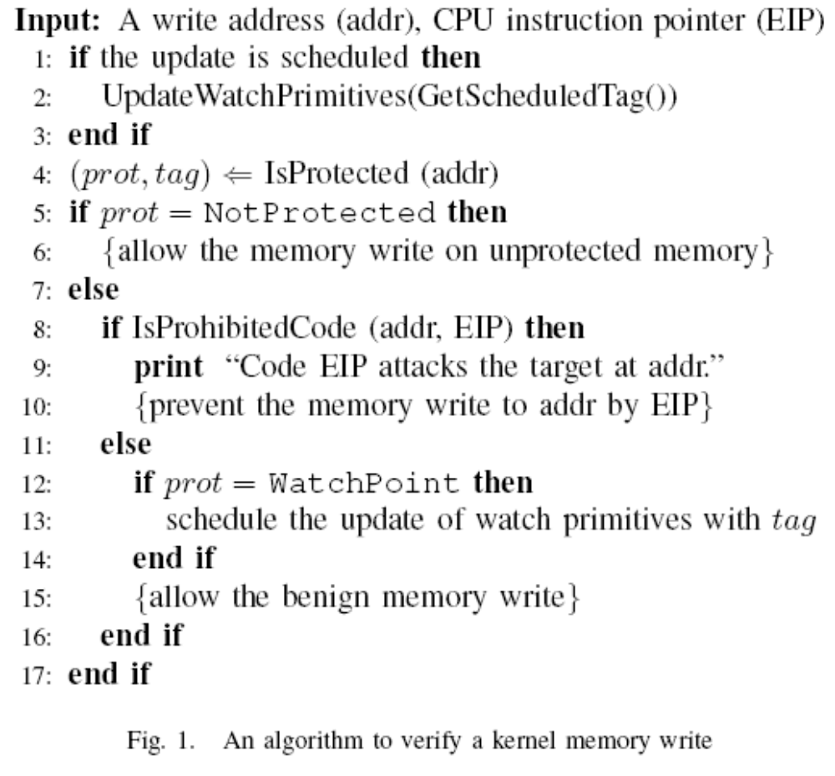

Slide 14
Implementation
QEMU/KVM platform
Dynamic compiler to translate guest instructions to host instructions
Cache of recently recompiled and used blocks
Interception code implemented in cache

Slide 15
Preventing /dev/kmem attacks
Invokes __generic_copy_from_user
Policy: Disallow modifications from __generic_copy_from_user
SELinux attack:
  protect security_ops pointer, which is declared statically
NIC data manipulation
  Protect net_device_stats structure
Process hiding attack:
  Protect init_task_union which is the head of task struct list
  Protect each task_struct with a memory guard

Slide 16
Optimizing Performance
Allow user code to execute natively.
  KQEMU acceleration module
Only kernel code is intercepted and monitored
  Every instruction in kernel code?

Slide 17
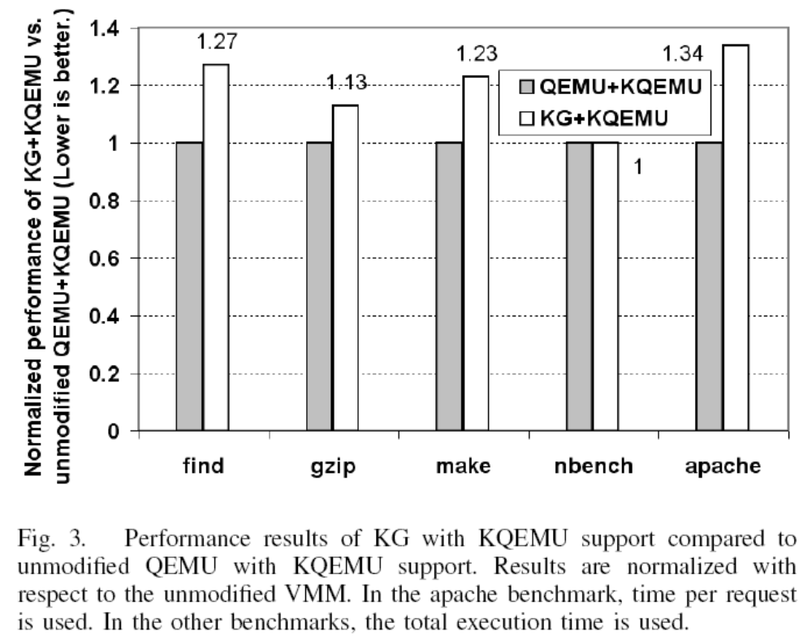
Runtime Overhead

Slide 18
Key trick and limitations
Main idea is the Access Invariant Concept
  Set of functions allowed to modify a data structure is limited and does not change
  Allow modifications from known good functions.
Limitation:
  Cannot detect malicious modifications by known good functions.
  Mechanism needs to be very conservative.
    Impact of false positives (denying valid write operations) can be incorrect kernel execution.
    Better to suspend the VM and inform sysadmin with diagnostic information.

