Slide 1
I/O Virtualization using Intel VT-d

Slide 2
I/O Virtualization
Simple definition
  Enabling VMs to perform I/O operations
Key requirements
  Protected access to I/O resources
  Ability to share I/O resources

Slide 3
Differing requirements
Server consolidation in Data Centers
  Scalability
  Performance
  Reliability
  Availability
Client platforms
  Cost and trust
  Virtual-appliance Model: management, security, content protection
    Applications: Intrusion monitoring (enterprise), DRM (home computers)

Slide 4
Three VMM architectures
OS Hosted VMMs
  KVM
  Reuse Host drivers and other code
  Only as secure as host OS
Standalone Hypervisors
  VMWare ESX Server
  Smaller code path from Guest OS to I/O device
  Limited portability
Hybrid VMMs
  Xen
  Small Hypervisor with its own CPU scheduler
  Service OS (Domain 0) to handle I/O
  Hopefully service OS is more secure than general purpose host-OS
  Too many privilege transitions between guest OS, VMM, and Service OS

Slide 5
Virtualizing I/O
Emulation
Para-virtualized Devices
Direct Assignment

Slide 6
IOVM Architecture
Dedicated VM that manages and interacts with a specific I/O device on behalf of rest of the system.
I/O device directly assigned to IOVM
IOVM can then perform either emulation of para-virtualization of the device for other “normal” VMs.
Improves isolation of the system from driver crashes.
  Simply restart the IOVM if driver misbehaves

Slide 7
VT-d support for direct assignment

Slide 8
Key problem
Isolation
How to prevent one VM from issuing DMA request to the memory of another VM?
How to prevent an I/O device from issuing DMA to an unrelated VM?
How to prevent interrupts from an I/O device from interfering with operations of an unrelated VM?

Slide 9
Solution 1: DMA remapping
System software (VMM) can create multiple protection domains.
Protection Domain is an isolated environment to which a subset of the host physical memory is allocated.
  For example, memory allocated to a VM or to an IOVM
Address specified in DMA request from an I/O device is treated as a DMA virtual address (DVA)
  For example, DVA could be the guest physical address (GPA), also called pseudo-physical address.
DVA is then translated to Host Physical Address (HPA) by the DMA remapping hardware.

Slide 10
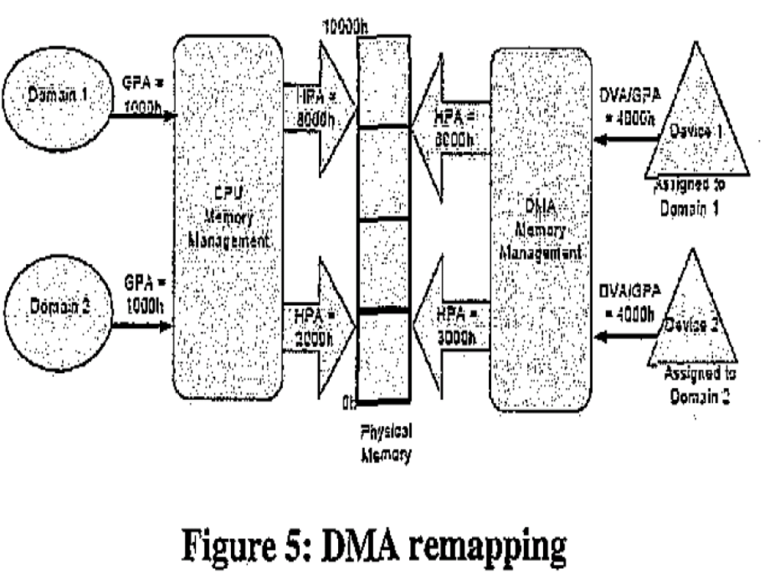

Slide 11
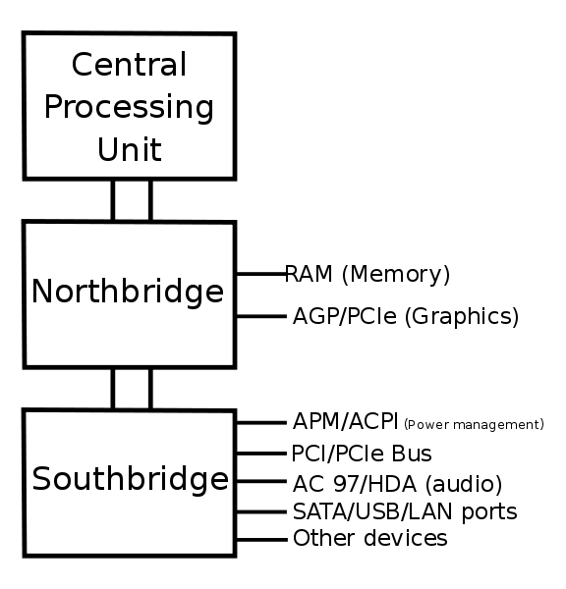
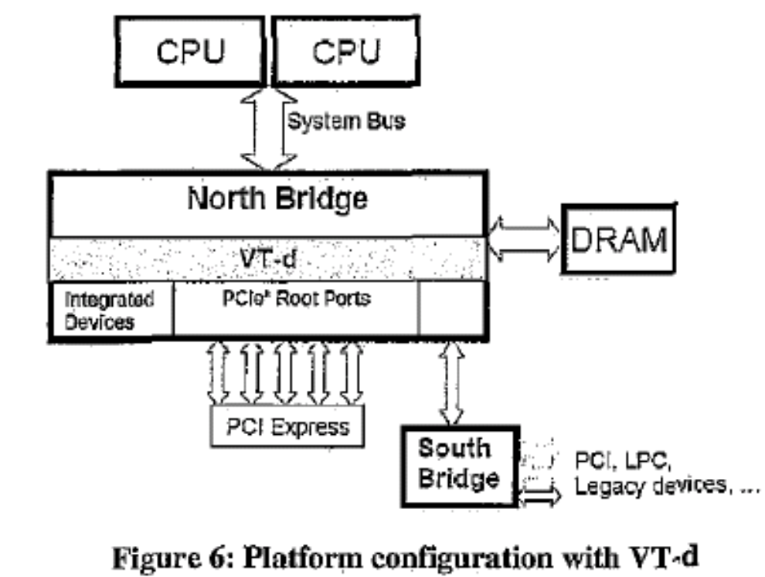

Slide 12
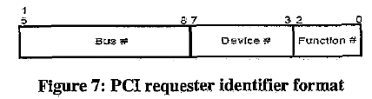
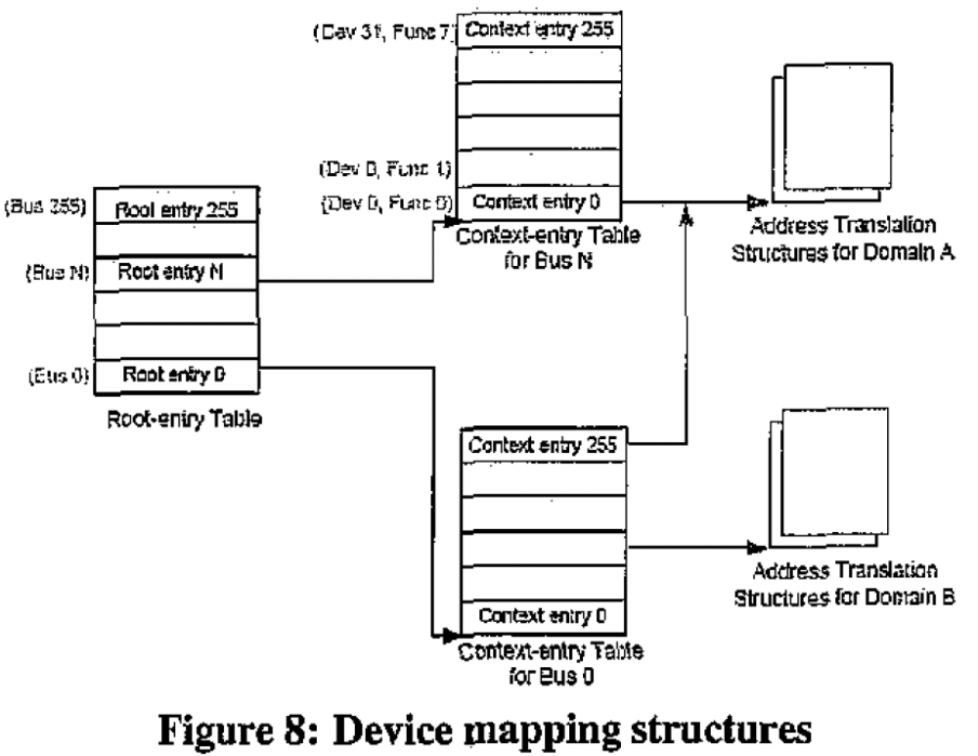
Mapping devices to protection domains

Slide 13
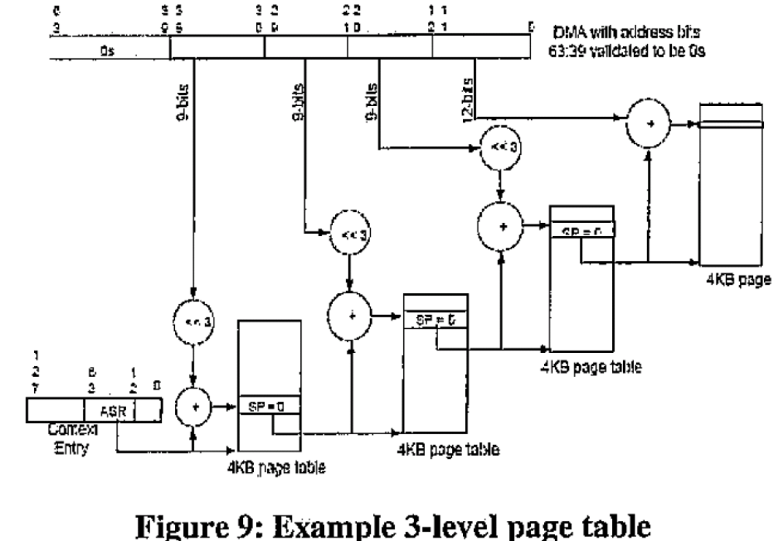
Translating from DVA to HPA

Slide 14
Observations
Page tables always in main memory
But where are the root-entry table and context-entry tables located?
  In the Northbridge?
  Or in main memory?
VMM programs the DMA (and interrupt) remapping structures to perform DVA/GPA to HPA mappings.

Slide 15
Traditional interrupt architecture
Legacy interrupts : routed through I/O interrupt controllers
MSI: Message Signaled interrupts:
  Issued as DMA write transactions to pre-defined architectural addresses
  Interrupt attributes, including destination processor, are encoded in the address and data of the DMA write request.
This means target processor is specified by the device.

Slide 16
Interrupt remapping in VT-d
Redefine the interrupt message format
Still a DMA write request, as with MSI.
But the write request is only a message identifier, not the actual interrupt attributes.
The DMA write requests that correspond to interrupts are remapped through interrupt-remapping table.
Each entry in the interrupt remapping table contains interrupt attributes, including the destination processor ID.
This table can be programmed from the system software (VMM).
So, if the guest VCPU responsible for target protection domain moves from one physical CPU (PCPU) to another, then the VMM can reprogram the interrupt remapping table to reflect the new destination processor.
This eliminates the likelihood that incorrect PCPU might be interrupted.

Slide 17
Hardware caching and invalidation
Cache frequently used remapping structures and entries
  Context cache
    indicates context entry table is in main memory
  Page directory entry cache
  IOTLB
  Interrupt entry cache
Software responsible for cache consistency by invalidating stale entries
  Synchronous versus queued (batched) invalidation
Device-IOTLB
  Problem: IOTLB performance may be worse than CPU TLBs because of multiple concurrent DMA operations
  Solution: Allow devices to individually cache their own translations in a Device-IOTLB.
  Device queries the DMA remapping hardware and caches important mapping.
  DMA request could specify either DVA or HPA.
  Issues: Security – which devices can be trusted to not use malicious HPAs?

Slide 18
Future VT-d support
Allow devices to be shared securely among multiple protection domains
Requires fundamental changes in how devices represent themselves to rest of the system
Implies multiple virtual functional units exposed by device, each of which can be discovered, configured, and managed.

