Slide 1
Transparent Network Services via a Virtual Traffic Layer for Virtual Machines

Slide 2
Motivation
HPC community more interested in using VMs
Particularly because of
  VM migration capabilities
    Much more cleaner than process migration
  Transparent addition of new services without changing the VM or the applications.
Monitoring and controlling
  Execution of VMs
  Network communication of VMs

Slide 3
Problem being addressed
How to provide new class of network services to applications in the VMs?
  Without modifying either the VM or the Apps.
Goals:
  Monitor traffic
  Control routing
  Interpose and modify data and signaling

Slide 4
Contribution
VTL: Virtual traffic later toolset
  Packet capture
  Packet inspection
  Connection state maintenance and modification
  And combination of the above
Basically a fancy NAT for VMs

Slide 5
Service Examples
Tor-VTL
Subnet Tunneling
Local Acks
Split TCP
Protocol transformations
Stateful firewall
TCP Keep-alives
Traffic wormholing for IDS

Slide 6
VTL Toolset
Library of packet monitoring and manipulation functions
User-level code that relies on libpcap or winpcap
Assumption: All traffic goes through a virtual network interface (“host-only” NIC) via domain 0 or equialent.

Slide 7
Relationship to VNET
VNET
  Allows nodes on disjoint IP subnets to pretend as if they are on the same subnet.
  Relies on a set of proxying hosts that perform MAC address transformations in packets while keeping IP addresses the same.
VTL can work either standalone or with VNET
  VTL-VNET communication via a local channel.

Slide 8
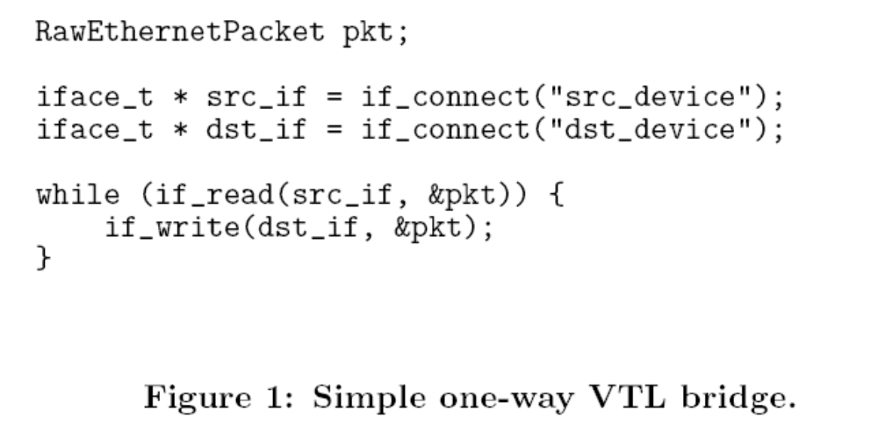
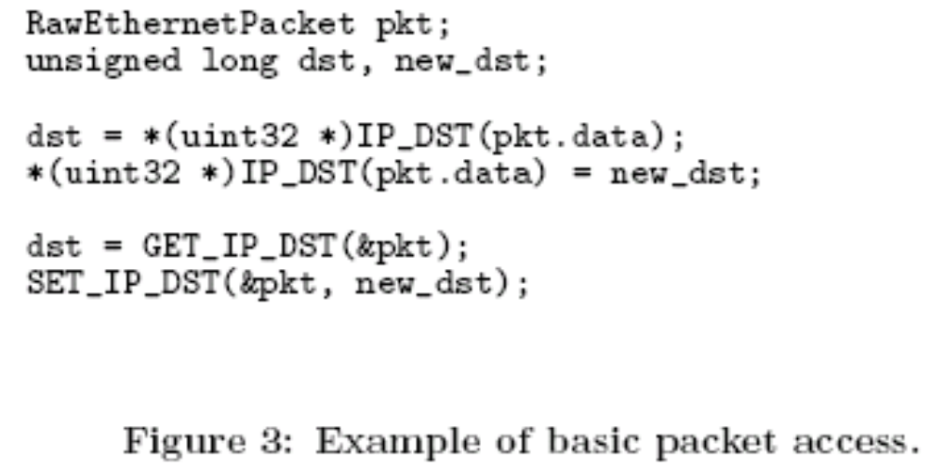
VTL Example

Slide 9
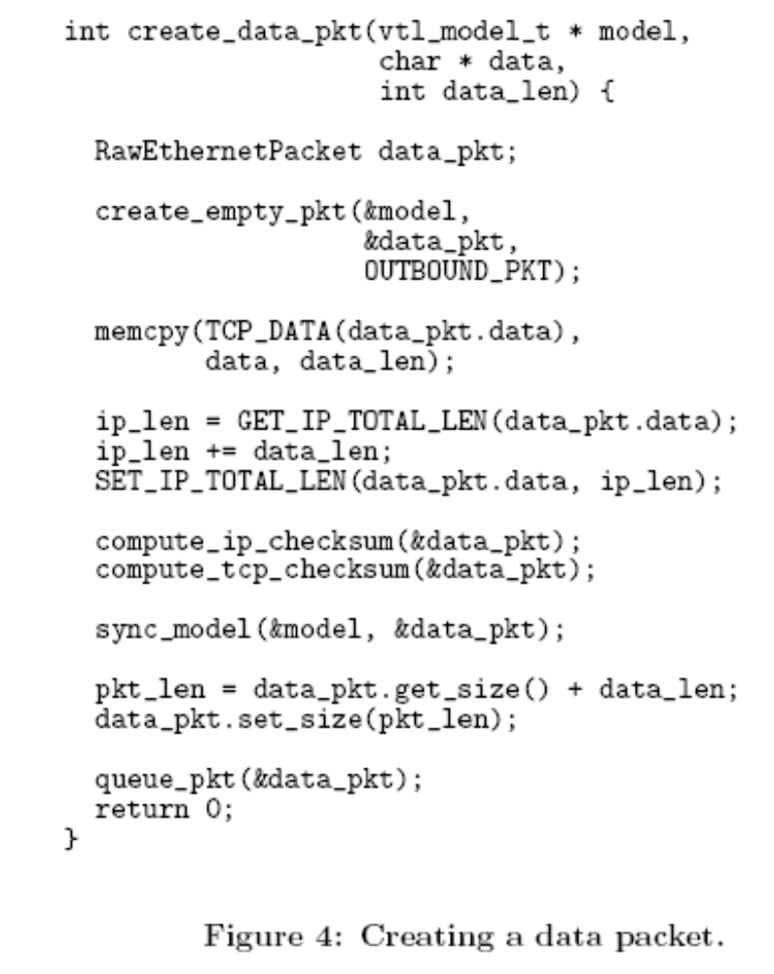

Slide 10
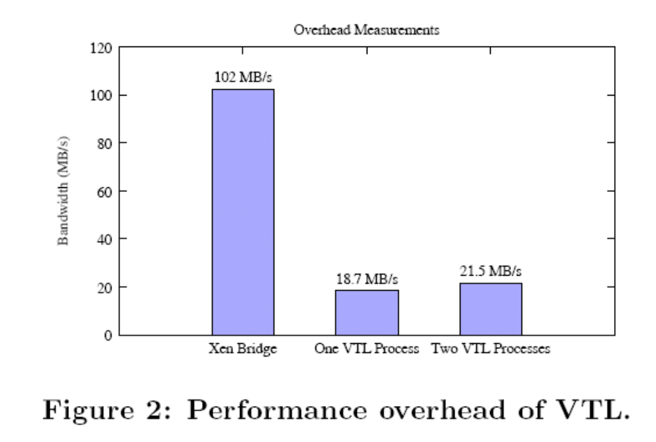
User space overhead

Slide 11
State Model
Basically connection state information for individual network connections in VM
For TCP
  Sequence and ACK numbers
  Timestamps
  Receive window size?
  IP state (?) etc
Initialization
  Manually
  Supplying an example packet

Slide 12
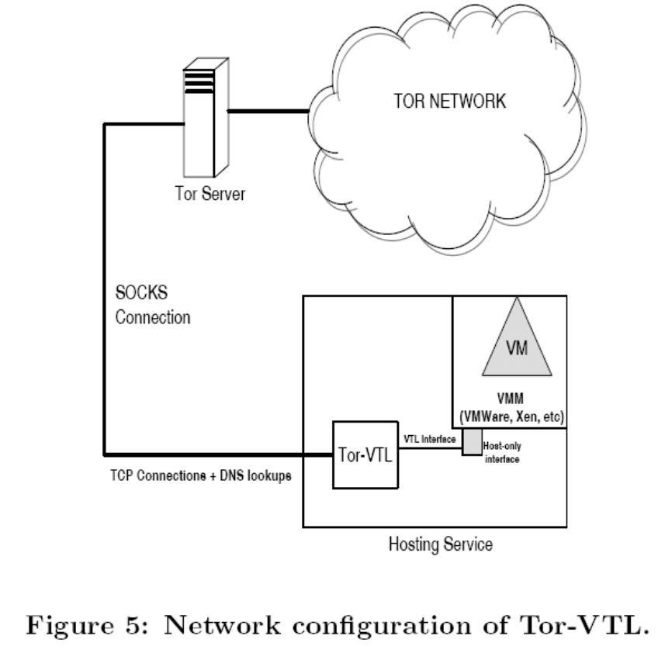
Anonymous TOR Service
Use of SOCKS standard for proxies
Four states:
  Open, Established, close, Error
DNS Lookups
  SOCKS4a
ARP interception

Slide 13
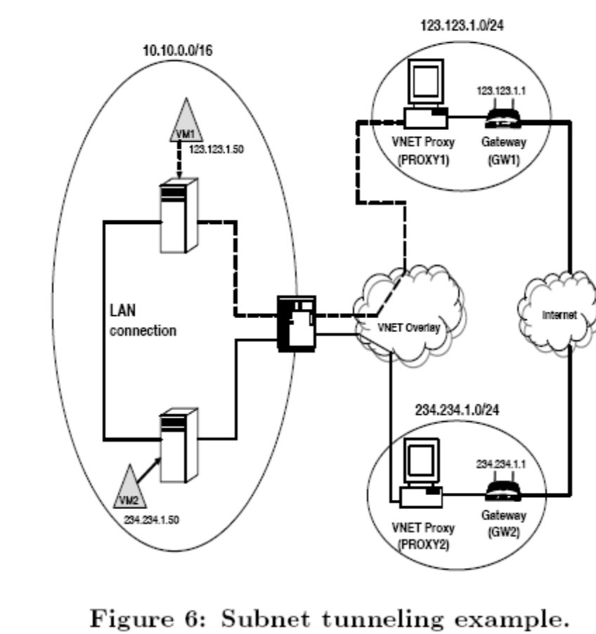
Subnet Tunneling
Optimize communication between two VM on the same LAN but different VNET sIP subnets
Basically MAC address remapping

Slide 14
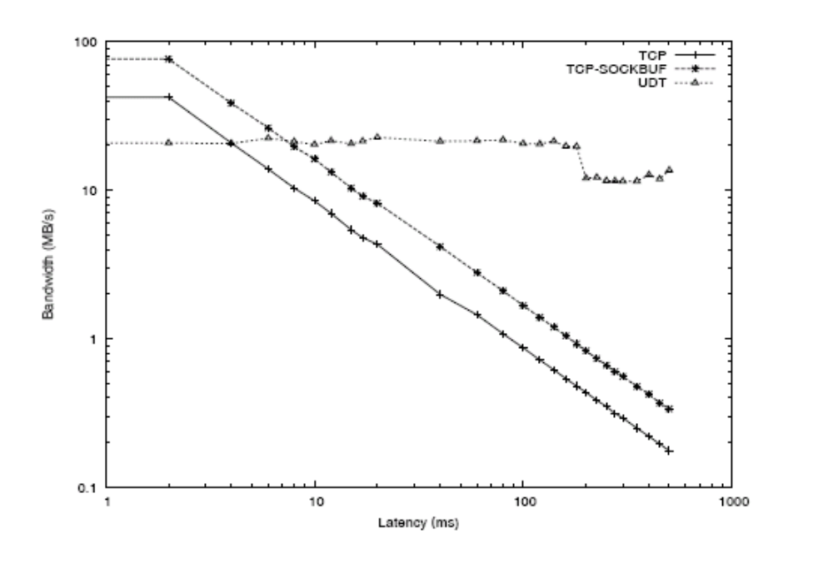
Enhancing Network Performance
For high bandwidth-delay product networks
Local ACKs
Split TCP
Protocol transformations

Slide 15
Connection persistence during VM migration
Over wide-area, we have longer VM migration time during which VM does not run.
Routing changes: Handled by VNET
Timeouts: handled by VTL
TCP keep-alive packets
Advertising a receive window size of zero to peer
Respond to periodic probes from peer

Slide 16
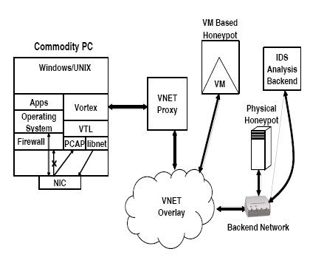
Coorperative wormhole scheduling and Vortex

