Slide 1
SnowFlock: Rapid Virtual Machine Cloning for Cloud Computing
University of Toronto and Carnegie Mellon University
http://sysweb.cs.toronto.edu/snowflock

Slide 2
Motivation
Cloud computing systems use virtual machines (VMs)
Often lots of VMs must be created and deployed very quickly
  Flash crowds, parallel scientific apps
In many applications, it is helpful if these new VMs “clone” the existing state of an existing VM, instead of booting from scratch
VMs’ computational demands may vary
  Single VCPU needed at some times
  Hundreds at other times

Slide 3
Problem – lack of agility
Creating (or migrating) a VM is a slow and expensive operation
  Lots of memory state
  Lots of network traffic (migration)
E.g. Amazon’s EC2 takes several minutes to create an EC2 instance
So why not keep idle VMs around?
  Likely to be consolidated and “swapped out” by the hypervisor
  Expensive to restart at a moment’s notice.

Slide 4
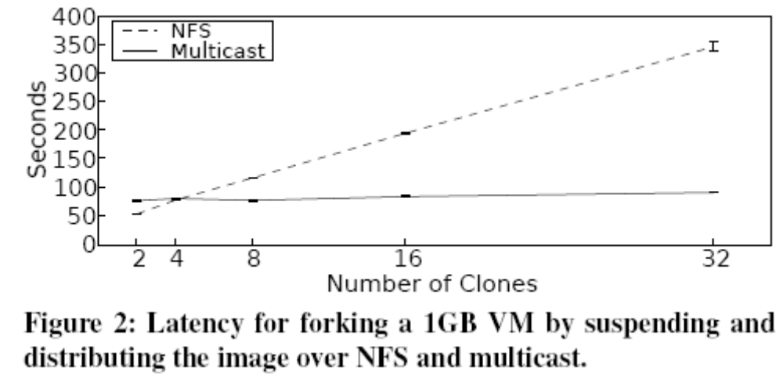
Performance of Suspend-resume and multicast
Need to further reduce the total network
state pushed over the network

Slide 5
Contributions – Fast and parallel VM forking
Create one or more copies of an existing VM
Create the copies on other hosts in the network
Semantics:
  ID = VM_fork(N);
  If ID.IsChild()
  child VM execution
  Else
  parent VM execution

Slide 6
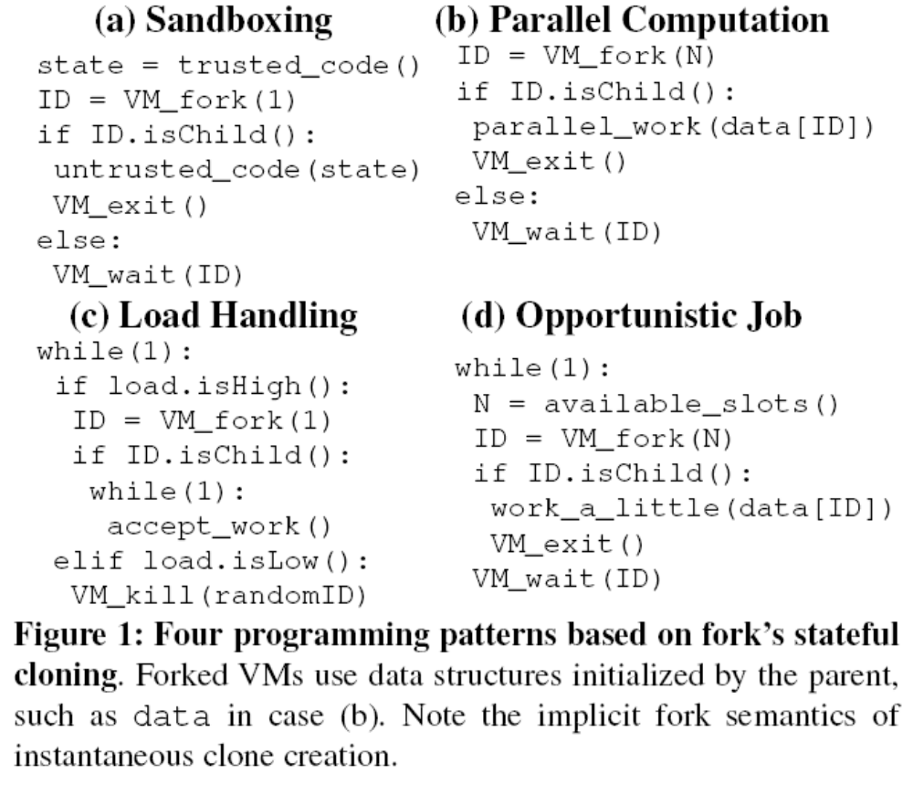
Examples

Slide 7
Key features
Child VMs are ephemeral
  Memory and disk image are discarded once they exit
Explicit (network) communication required to transfer state between child and parent VMs
Replicates all processes and threads of parent VM
Applications must be cognizant of VM-fork() semantics
  Modifying apps
Dedicated isolated virtual networks connecting child VMs and parent VM

Slide 8
Insights
Child only needs minimal execution state to start off
Children initially access only a fraction of original memory image
Common for children to allocate memory after forking
Children often execute similar code and access common data structures

Slide 9
Major Components
VM Descriptors
  Minimal VM state encapsulation
Memory-on-demand
  Lazily fetch portions of VM state over network
Avoidance heuristics
  Avoid sending unnecessary memory pages
Multicast
  One transmission to multiple senders

Slide 10
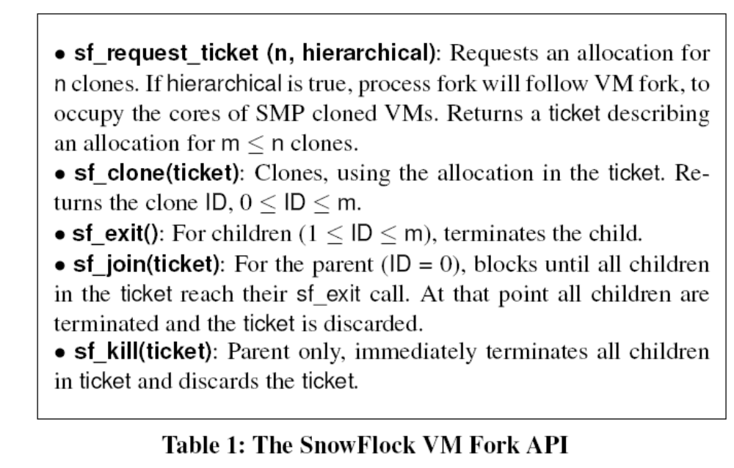
API
….Plus integration with MPI libraries

Slide 11
VM Descriptors
A thread in guest suspends VM execution
Makes a hypercall
Domain 0 populates the VM descriptor
  Metadata describing VM and its virtual devices
  Few shared memory pages with hypervisor
  VCPU Registers
  GDT
  Page tables (biggest component)
VM descriptor is multicast to target VMs

Slide 12
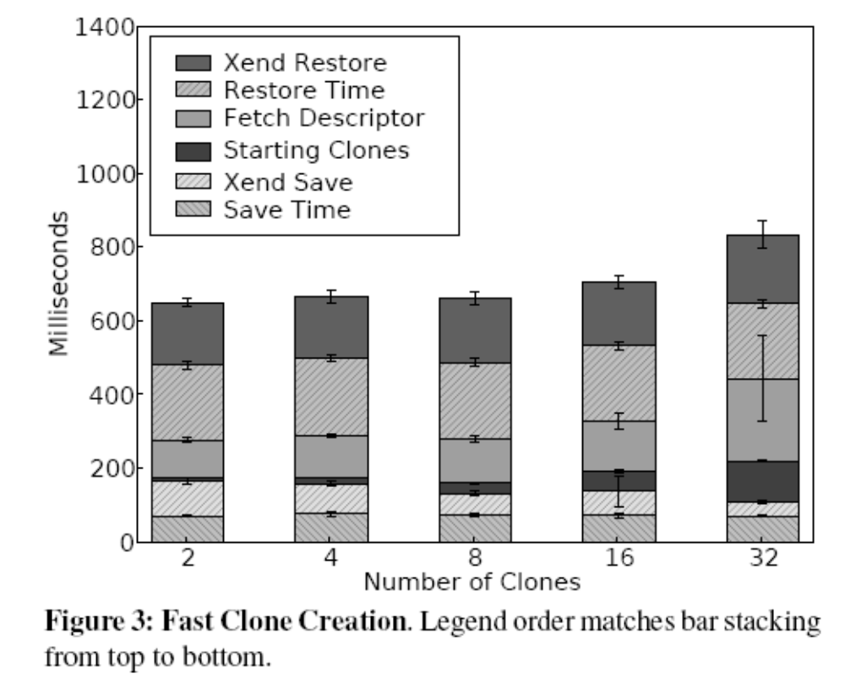
Descriptor creation overhead

Slide 13
Memory-on-demand -- memtap
The key part of the work
Lazily fetch clone’s memory from parent
Target VM
  access a missing page
  Page Fault in the hypervisor (via shadow page table)
  Memtap fetches and maps the missing page
At parent VM
  Copy-on-write to preserve original pages of clone

Slide 14
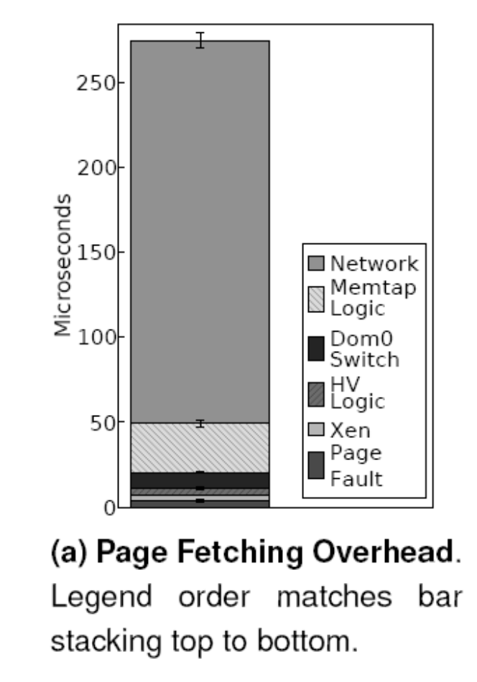
275us overhead for page fetching comparable to TCP/IP

Slide 15
Avoidance Heuristics
Intercept memory allocation requests
  Don’t fetch memory from parent
Intercept device writes to guest memory
  Again don’t fetch from parent

Slide 16
Multicast
Once one child requests a page
  Multicast the page to all children
Use IP multicast support in routers and switches
Multicast must use
  Reliability
  Flow control to avoid overwhelming receivers

Slide 17
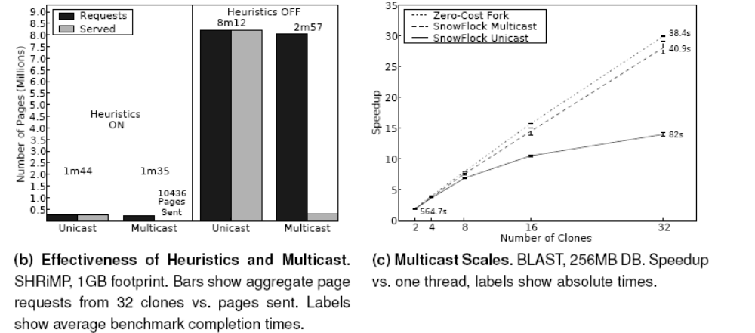
Avoidance heuristics and multicast performance

Slide 18
Other features
Virtual disk
  COW disks using blktap
  Avoid redundant transmissions
Network isolation
  Mac address rewriting
  Not clear

Slide 19
Performance
32 Dell 4GB quad core machines
Xen + Linux
1GB VMs
Gigabit network

Slide 20
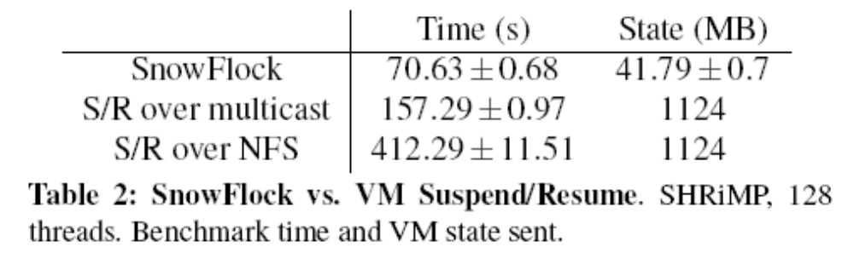
Execution time and memory txfered

Slide 21
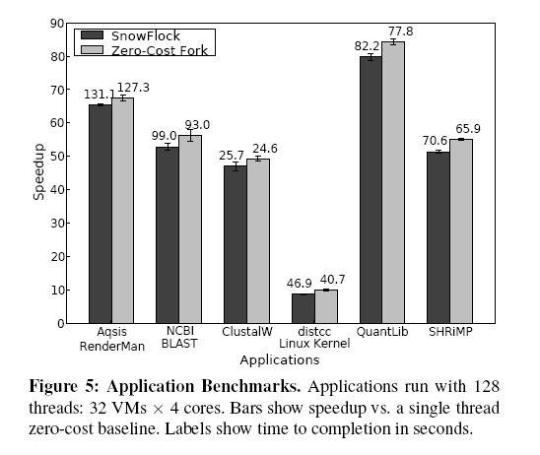
Speedups

Slide 22
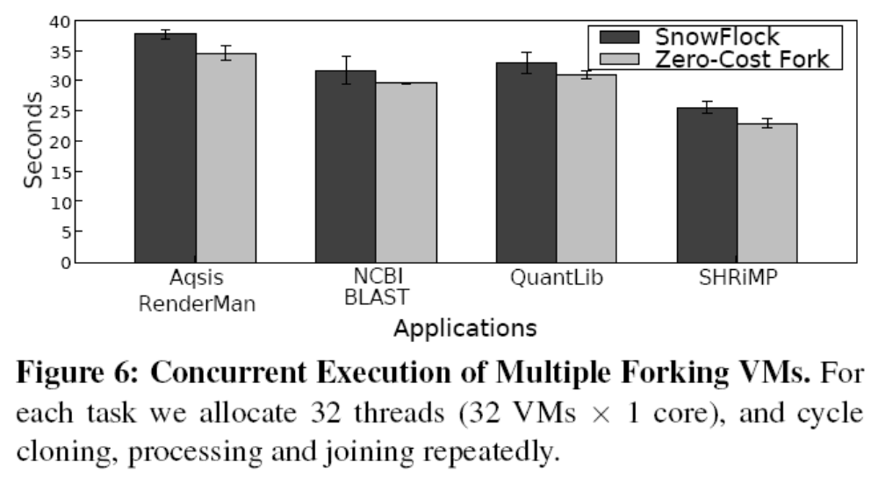
Concurrent multiple forks

Slide 23
Conclusions
A lot of different interesting tricks for a useful application
Objective is performance rather than reliability
  Memory-on-demand has same problem as our post-copy approach

