Slide 1
Miscellaneous Character Device and Process List

Slide 2
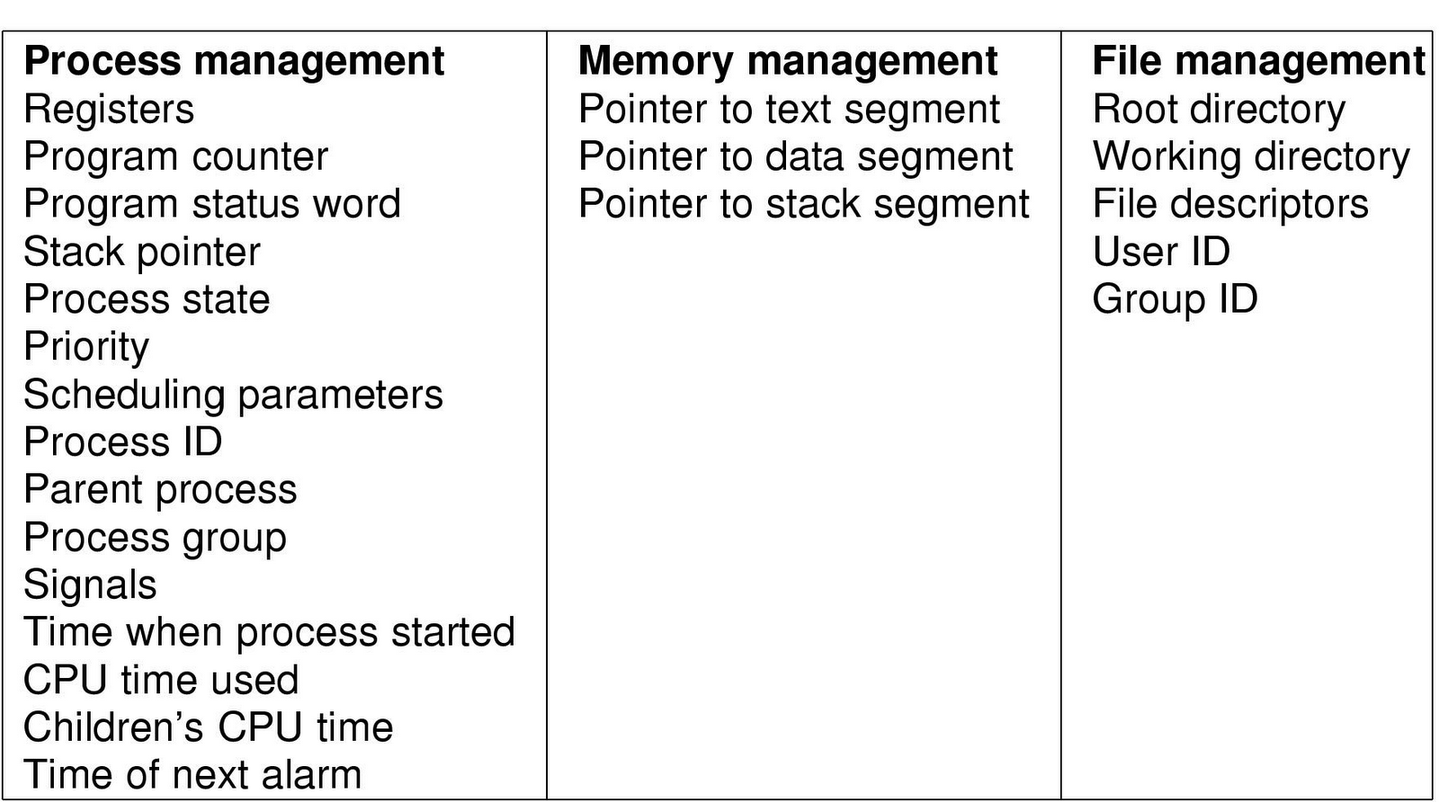
Typical Kernel-level data structure for each process
See task_struct in Linux at http://lxr.linux.no
Notes:
Process control blocks
task_struct

Slide 3
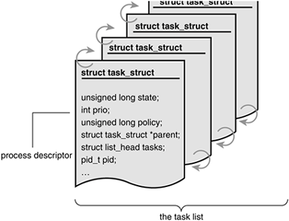
Task List
Notes:
The kernel stores the list of processes in a circular doubly linked list called the task list. Each element in the task list is a process descriptor of the type ”struct task_struct” which is defined in <linux/sched.h>. The task structure contains all the information about a specific process.

Slide 4
Exercise
Implement a miscellaneous character device that retrieve the following process information from the kernel and pass the information to the userspace process.
Command name.
Process ID.
Parent process ID.

Slide 5
Hints
Miscellaneous character device
linux/sched.h
struct task_struct
for_each_task
copy_to_user

