Slide 1
Paging and Page Replacement Algorithms
Section 3.4 Tanenbaum’s book
Kartik Gopalan

Slide 2
OS Involvement with Page Table Management
Four times when OS deals with page-tables
Process creation
create page table
Upon context switch
Load MMU context for a new process (e.g. load CR3 register with base address of page table)
TLB may be flushed
Page fault time
determine the virtual address causing fault (read CR2 register for faulting address)
swap target page out, bring needed page in
Process termination time
release page table and other pages

Slide 3
Page Fault
Translation for mapped pages are handled by MMU
Accessing unmapped or protected pages causes page fault
Page Fault is a hardware exception
It occurs when a process accesses a virtual page
that is currently not resident in physical memory OR
for which it doesn’t have the correct access permissions OR
which hasn’t yet been allocated by the operating system
Virtual Pages
unmapped
unmapped
mapped
unmapped
mapped
unmapped
mapped
mapped
Physical Page

Slide 4
Page-fault handling
Process accesses unmapped/protected virtual address
MMU hardware raises trap
Because it cannot find a valid page-table entry
Process is paused
Program counter and Registers saved
OS runs page-fault handler (PFH)
PFH examines the virtual address which caused the fault
Is this a write to an unallocated page?
PFH allocates a new physical page
Is this an already allocated page?
PFH reads the page from the swap device (page-in)
PFH updates the page-table entry.
Is this a disallowed access? E.g. writing to a read-only page?
PFH terminates the process
Process resumes from where it left off (unless terminated by PFH).
Program counter and Registers restored
OS may periodically page-out victim page to disk to create space

Slide 5
Locking Pages in Memory
Virtual memory and I/O occasionally interact
Problem
Process P1 issues call for read from device into buffer
While waiting for I/O, another processes P2 starts up
P2 has a page fault
Buffer for the P1 may be chosen as victim to be paged out, resulting in a DMA error.
Need to specify some pages as “locked” or “pinned” in memory
These pages are exempted from being victim pages

Slide 6
Page Replacement
Resident pages must be occasionally evicted from memory to make room for new pages
Pages that have not been modified can be simply discarded i.e. overwritten with new content
Modified pages must be saved before reuse
unmodified pages are simply overwritten
Ideally, we’d like to evict pages that are least needed.
Goal of page replacement algorithm
minimize the number of page faults
E.g. if we evict an often used page, we may need to bring back in soon resulting in more page faults.

Slide 7
Page Replacement Algorithms
Least Recently Used (LRU)
Not Frequently Used (NFU)
Aging
Working Set
WSClock
Optimal Page Replacement
Not Recently Used (NRU)
FIFO
Second Chance
Clock

Slide 8
Optimal Page Replacement Algorithm (OPR)
Replace the page that’s NOT needed for the longest time in the future
Page access timeline
1 | 2 | 3 | 4 | 1 | 5 | 2 | 4
Assume we have 3 frames in physical memory
Eviction
Decisions
t0 | t1 | t2 | t3 | t4 | t5 | t6 | t7
1 | 1 | 1 | 1 | 1 | 5 | 5 | 5
 | 2 | 2 | 2 | 2 | 2 | 2 | 2
 |  | 3 | 4 | 4 | 4 | 4 | 4
Frame 0
Frame 1
Frame 2

Slide 9
Optimal Page Replacement Algorithm (OPR)
Why is it optimal?
Here, “Optimal” means that no other algorithm can give fewer page faults than OPR.
OPR is optimal but unrealizable
Because we cannot predict all future memory accesses
But OPR can serve as a useful baseline to measure the effectiveness of other algorithms
How do we know its optimal?
Try proof by contradiction
What if you can find another algorithm which does not pick the page needed farthest point in the future and can still yield fewer page faults than OPT?
Other algorithms try to approximate OPR
Estimate the pages not needed for a long time by recording the sequence of pages used in the past.

Slide 10
Least Recently Used (LRU)
Assume pages used recently will be used again soon
throw out page that has not been used for longest time in the past
Ideally: Must keep a linked list of pages
most recently used at front, least at rear
update this list every memory reference !! Not practical.
Aging: Alternatively keep counter in each page table entry
Counter tracks the number of references to a page
Choose page with lowest value counter
Periodically zero the counter
Note: This only approximates LRU
Implementation details in Tanenbaum Section 3.4.7

Slide 11
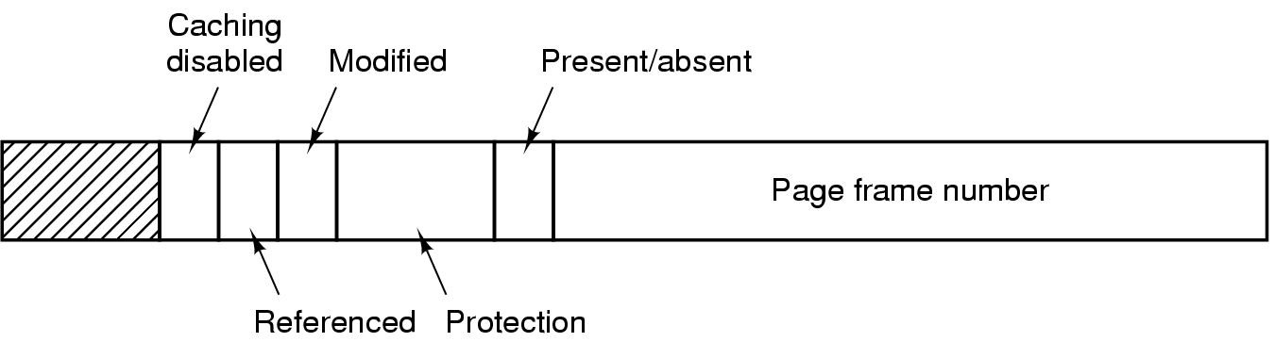
(Recall) Page Table Entry (PTE)
Referenced bit: Whether the page was accessed since last time the bit was reset.
Modified bit: Also called “Dirty” bit. Whether the page was written to, since the last time the bit was reset.
Present/Absent bit: Whether the PTE contains a valid page frame #. Used for marking swapped/unallocated pages.

Slide 12
Not Recently Used Page Replacement Algorithm
NRU periodically scans all PTEs
After each scan, pages are classified as
not referenced, not modified (0,0)
not referenced, modified (0,1)
referenced, not modified (1,0)
referenced, modified (1,1)
When selecting a victim page
remove page from the lowest numbered non-empty class
Also reset all referenced bits
Implies that pages are moved from 3➔1 and from 4➔2
Before the next NRU scan, some pages may be referenced or modified again
Implies some pages may move back from 1–>3, 1–>4, 2–>4, 3–>4
Advantage: Simple to implement
Disadvantage: Doesn’t distinguish among pages within the same class

Slide 13
FIFO Page Replacement Algorithm
Maintain a linked list of all pages
in order they came into memory
Page at beginning of list replaced
Disadvantage
page in memory for the longest time may be often used

Slide 14
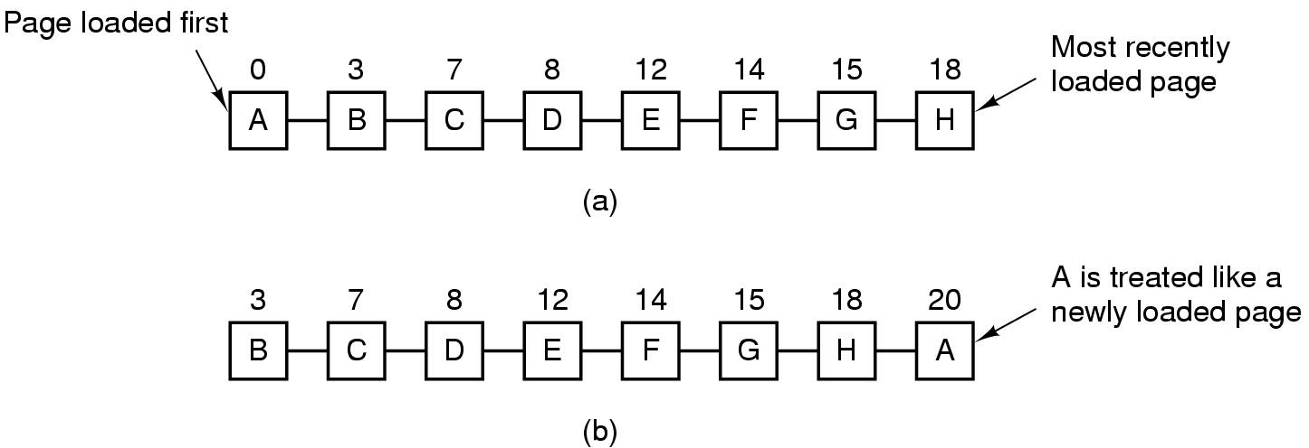
Second Chance Page Replacement Algorithm
FIFO List
New FIFO list: if fault occurs at time 20, A has R bit set
Pages are sorted in FIFO order
Basic idea: Select the oldest page that has not been recently used.
How it works: When selecting a victim page:
Look at the oldest page in the list.
If R bit of the page is set, then set R=0 and move the page to the front of the FIFO list; go back to step 1
Select the oldest page with R=0 as the victim page.
If no page with R=0 (unlikely), then select the oldest page (FIFO)

Slide 15
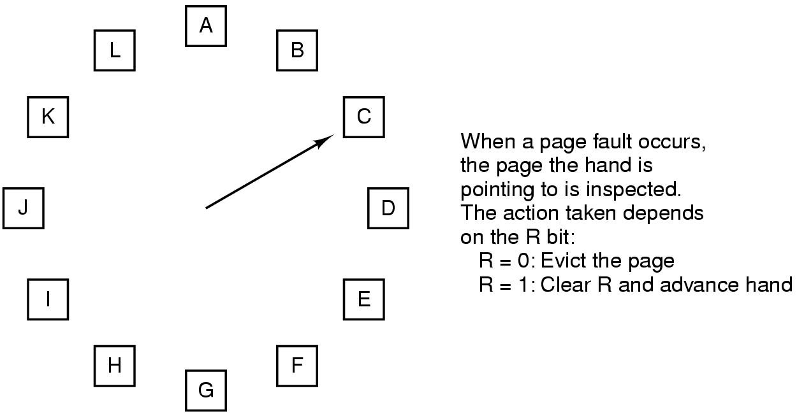
The Clock Page Replacement Algorithm
; Put new page in its position
Logically the same as Second Chance, except that it doesn’t keep moving pages around the linked list. Hence it is more memory-efficient.

Slide 16
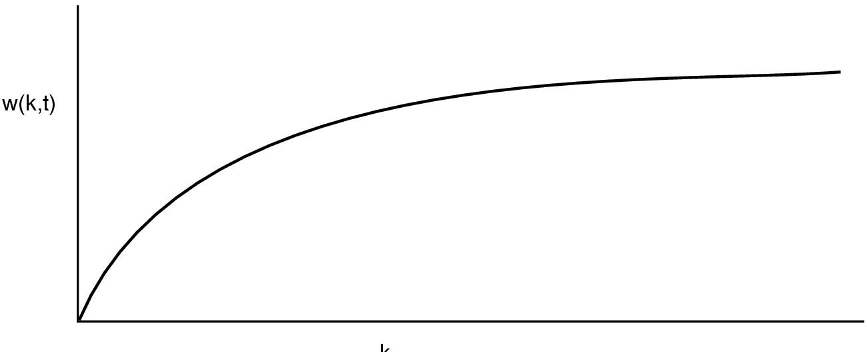
The Working Set Page Replacement Algorithm (1)
K
Working Set: The set of all pages that a process is currently using.
In theory, if the entire working set is in memory, then there’ll be no page faults.
In practice, predicting the exact working set is impossible.
Assume, the working set is the set of pages used by the K most recent memory references
For typical processes w(K,t) — the size of the working set at time t — becomes constant over time

Slide 17
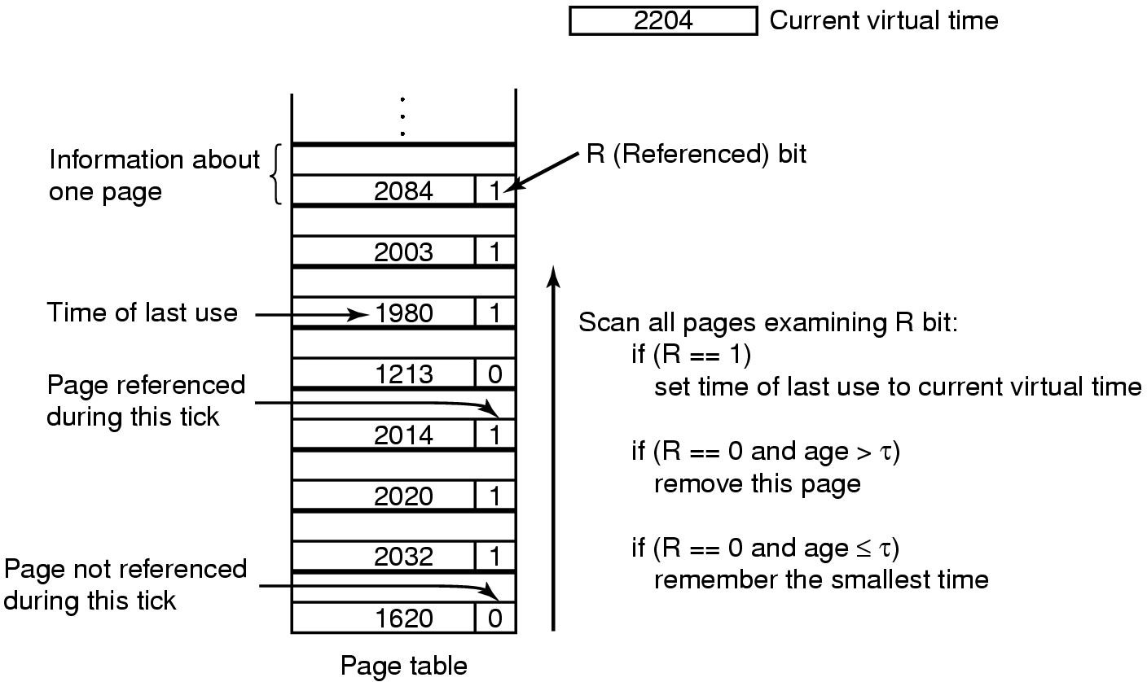
The Working Set Page Replacement Algorithm (2)
Keep track of the working set of a process
When its time to evict a page, choose one which is not in the working set of the process.
If no page with (R==0) and (age > 𝛕)
evict the page with R==0 and smallest time

Slide 18
Internal versus External Fragmentation
Internal Fragmentation
Occurs when part of memory allocated to a process remains unused.
E.g. a process may be allocated a 4KB page, but it uses only 1-byte in the page.
External fragmentation
Occurs when none of the available free memory fragments is big enough to satisfy a new memory allocation request.
E.g. a process may request 16KB contiguous physical memory allocation, but all available free memory is of size less than 16KB.
Can a virtual memory paging system have
Internal fragmentation? Yes
External fragmentation? No. Why?
Allocated
Free
8KB
8KB
4KB
4KB

Slide 19
Periodic Eviction Policy
Need for a background process, paging daemon
periodically checks memory pressure and evicts pages from memory
When to evict?
Based on Low and High “watermarks”.
Two thresholds of memory usage
When memory usage is above “High” watermark, say 90%, indicating high memory pressure
Start evicting pages till memory usage falls below “Low” watermark, say 80%
Why two thresholds?
To enable hysteresis
So that the system state doesn’t fluctuate rapidly around a single threshold.

Slide 20
Thrashing
Despite good designs, system may still thrash when
some processes need more memory
but no processes need less
Thrashing
When the working set of all processes does not fit in the main memory.
Hence, paging daemon has to constantly page-out pages to disk and bring them back in almost immediately.
Solution : Reduce the degree of multi-programming ➔ number of processes competing for memory
swap some less important processes to disk
And free up all the pages they hold

Slide 21
Shared Memory between multiple processes
Virtual Address space 1
Virtual Address space 2
PTE1
PTE2
Physical memory
PTE = Page Table Entry
PTEs for virtual pages in different processes map to common physical
page frames in DRAM.

Slide 22
Copy-on-write
Right after fork()
Child process has identical memory content as parent.
But copying is inefficient, especially if the child calls exec
Copy-on-write
Delays copying memory till either child or parent actually write to a page.
Pages are shared as “read-only” (RO) between the parent and child
Writes cause hardware to trap to OS
OS intercepts write faults, copies page, and marks them read/write (RW)
P
R
M
Read-only
page frame number
protection bits

Slide 23
Memory-mapped Files
Normally, files are accessed with system calls
Open, read, write, close
Memory mapping (using mmap) allows a program to access a file with load/store operations
Virtual Address space
Foo.txt

