Slide 1
Memory Management
From Chapter 3, Modern Operating Systems, Andrew S. Tanenbaum
Kartik Gopalan

Slide 2
Memory Management
Ideally programmers want memory that is
large
fast
non volatile
Memory hierarchy
small amount of fast, expensive memory – cache
some medium-speed, medium price main memory
Lots of slow, cheap disk storage
Memory manager handles the memory hierarchy

Slide 3
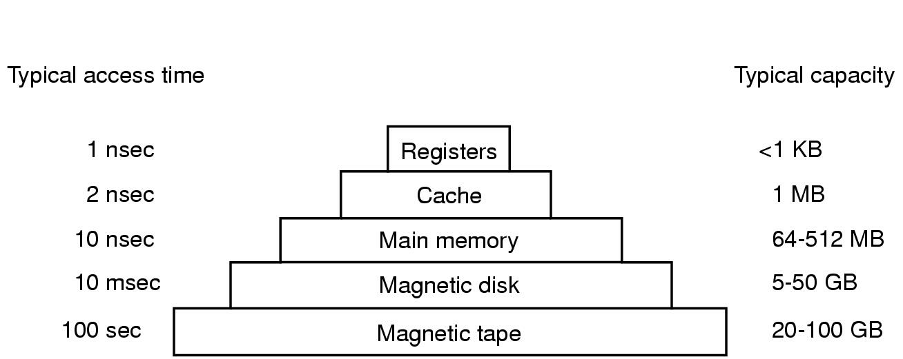
Typical Memory Hierarchy
SMALLER
FASTER
SLOWER
BIGGER

Slide 4
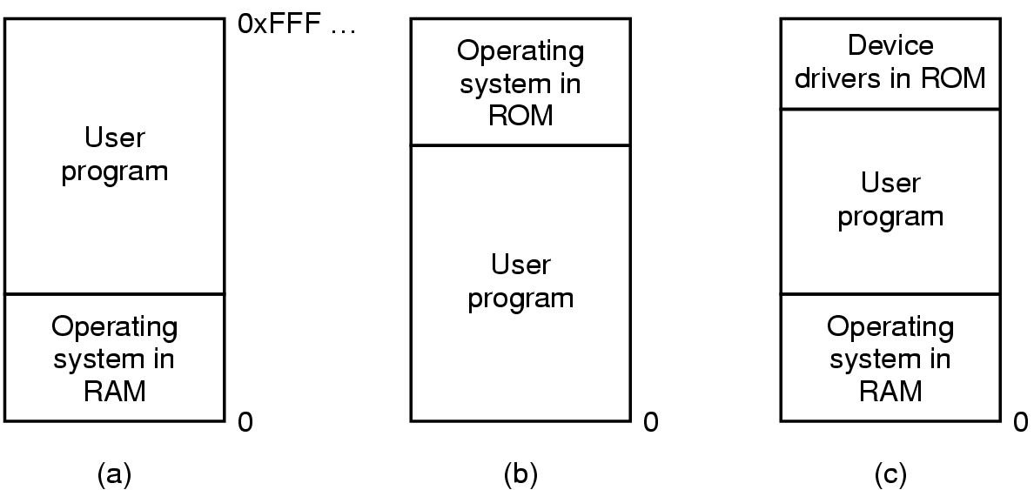
Basic Memory Management "Mono-programming" without Swapping or Paging
Three simple ways of organizing memory
- an operating system with one user process

Slide 5
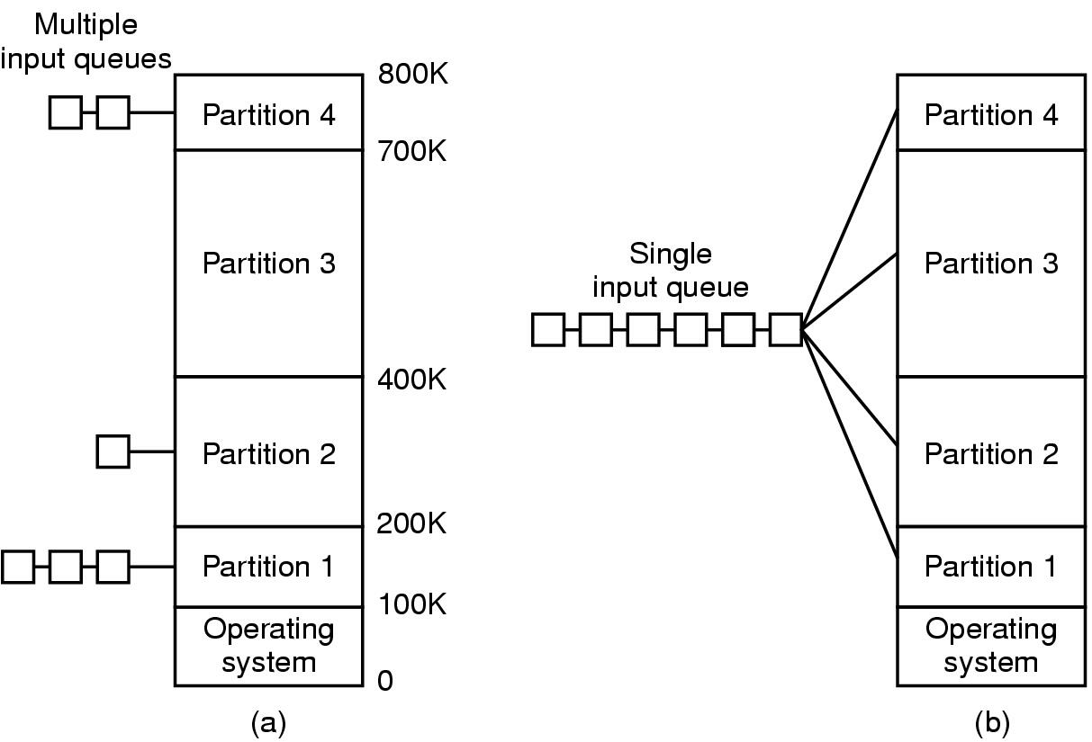
Multiprogramming with Fixed Partitions
Fixed memory partitions
(a) separate input queues of processes for each partition
(b) single input queue

Slide 6
Relocation and Protection
Problem: A programmer doesn’t know where a program will be loaded in memory
address locations of variables and code routines cannot be absolute
must keep a program out of other processes’ partitions
Solution: Use base and limit values
Relocation
Address locations in a program are relative.
They are added to a base value to map to physical addresses.
Protection
Access to address locations larger than limit value results in an error
LIMIT
Relative Addresses in
original program binary
0
Physical
MAX
BASE +
LIMIT
Relocated Addresses
in Executing Binary
BASE
0

Slide 7
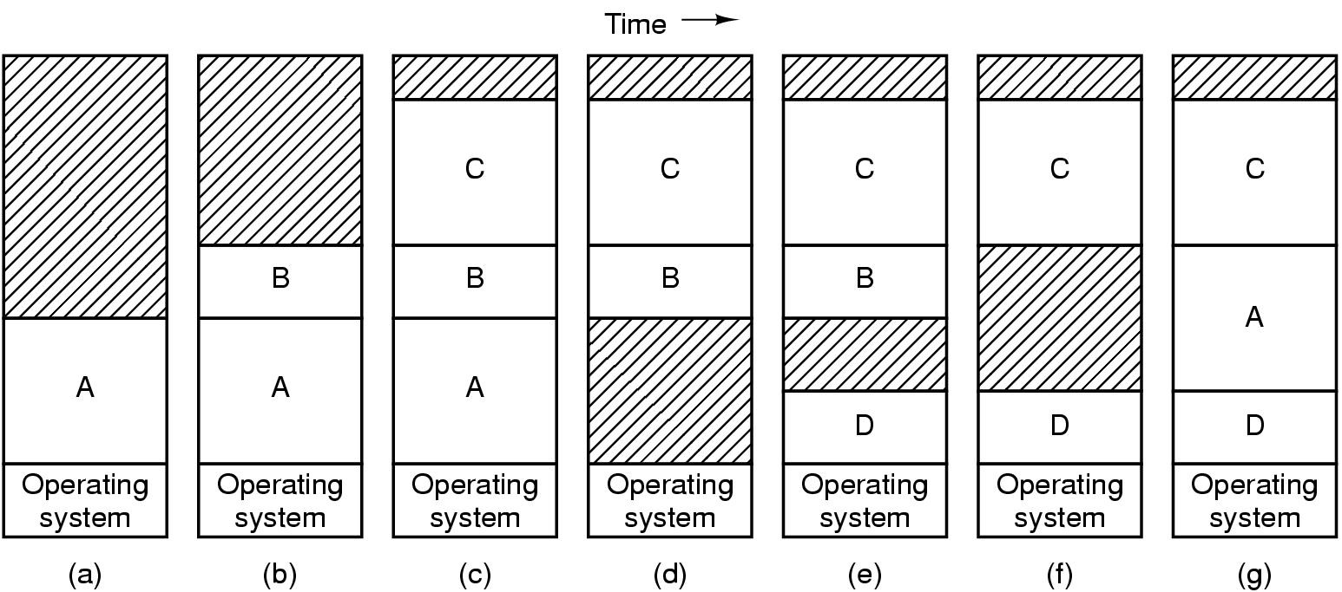
What if physical memory is not enough to hold all processes?
— Swapping
Physical memory may not be enough to accommodate the needs of all processes
Memory allocation changes as
processes come into memory
leave memory and are swapped out to disk
Re-enter memory by getting swapped-in from disk
Shaded regions are unused memory

Slide 8
Virtual Memory
Swapping the memory of an entire process is useful when the sum of memory needed by all processes is greater than the total RAM available in the system.
But sometimes, a single process might require more memory than the total RAM in the system.
In such cases swapping an entire process is not enough.
Rather, we need to break up the memory space of a process into smaller equal-sized pieces, called PAGES.
OS then decides which pages stay in memory and which get moved to disk.
Virtual memory: means that each process gets an illusion that it has more memory than the physical RAM in the system.
Virtual Address Space
of a single Process
}
Page
Entire
Physical RAM

Slide 9
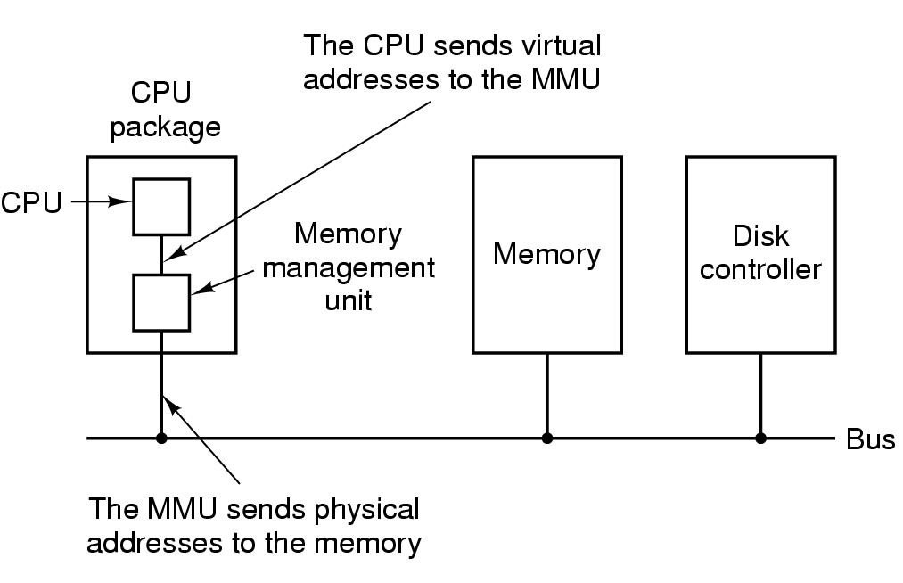
Memory Management Unit (MMU)
MMU is a hardware module that accompanies the CPU
It translates the Virtual Address used by executing instructions to Physical Addresses in the main memory.

Slide 10
Size of address space (in bytes) as a function of address size (in bits)
Number of bits in address | Maximum address space size (bytes)
0 | 2⁰ = 1 byte
1 | 2¹ = 2 bytes
2 | 2² = 4 bytes
10 | 2¹⁰ = 1024 = 1KiB
12 | 2¹² = 4KiB
16 | 2¹⁶ = 64 KiB
32 | 2³² = 4GiB (Gibibytes)
64 | 2⁶⁴ = 16 EiB (Exbibytes)

Slide 11
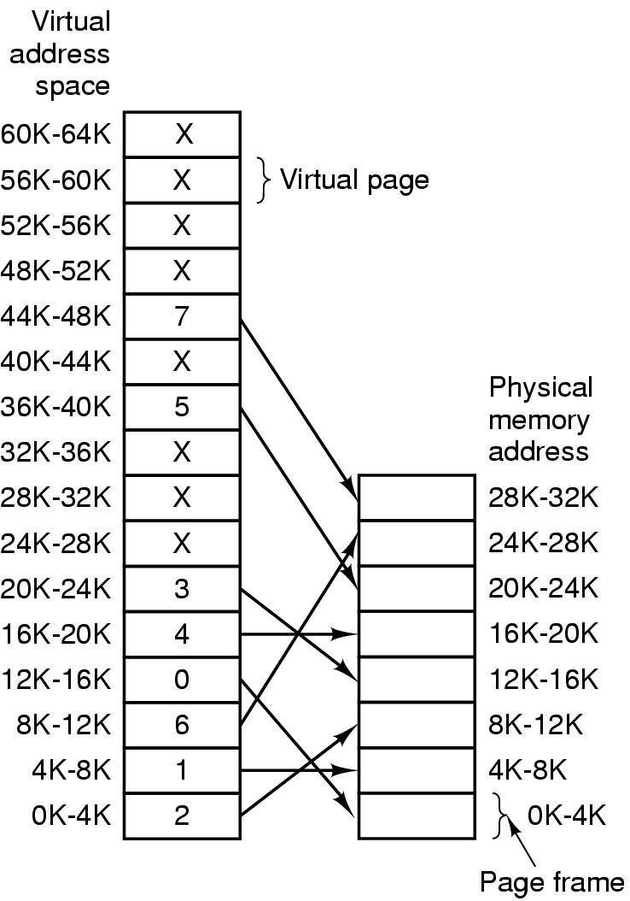
Page Table
An array that stores the mapping from virtual page numbers to physical numbers
The OS maintains
One page table per userspace process.
And usually another page table for kernel memory.

Slide 12
Translating Virtual address (VA) to physical address (PA)
Virtual Address Space
Physical RAM
Byte Address =
Page Number x Page Size +
Byte Offset in the page
VA = VPN x Page Size + Byte Offset
PA = PPN x Page Size + Byte Offset
6
Byte Offset
5
4
3
Virtual
Page
Numbers
(VPN)
2
Physical
Page (frame)
Numbers
(PPN)
2
Byte Offset
1
1
0
0

Slide 13
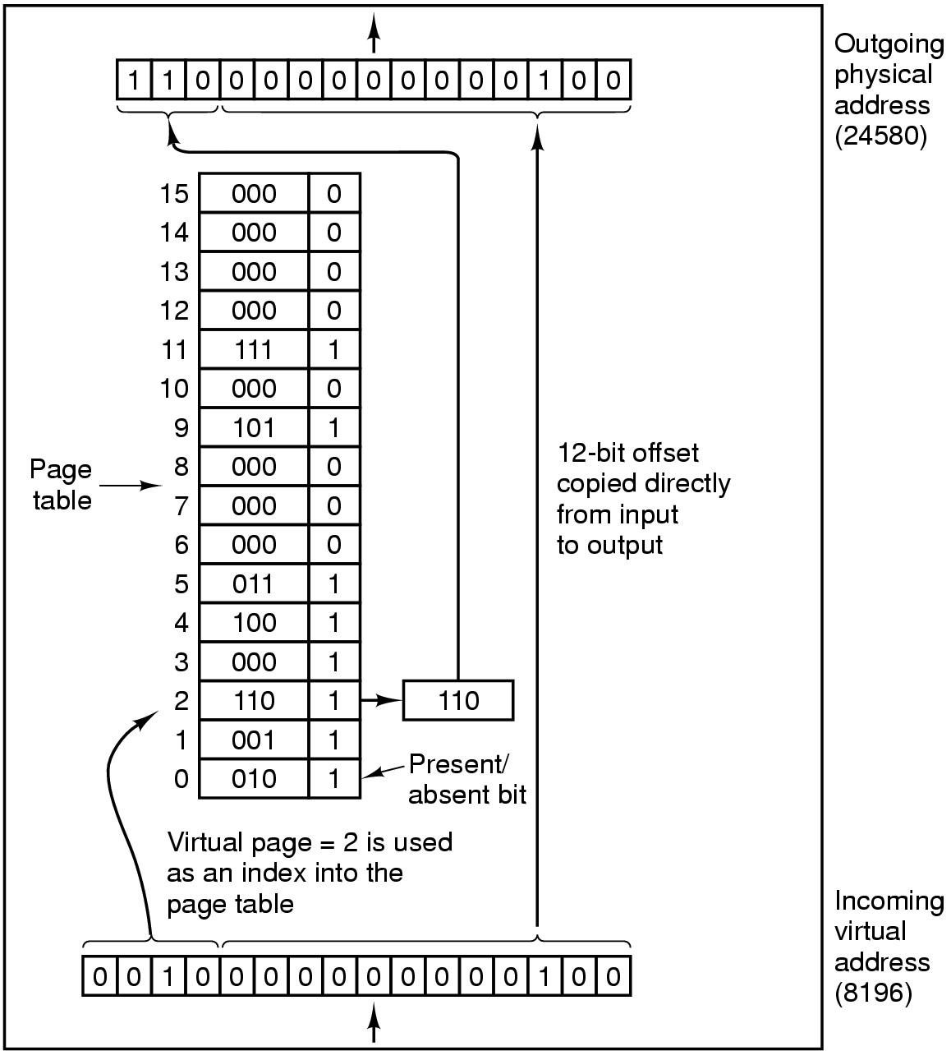
Virtual Address Translation
For Small Address Space
Internal operation of MMU with 16 4 KB pages

Slide 14
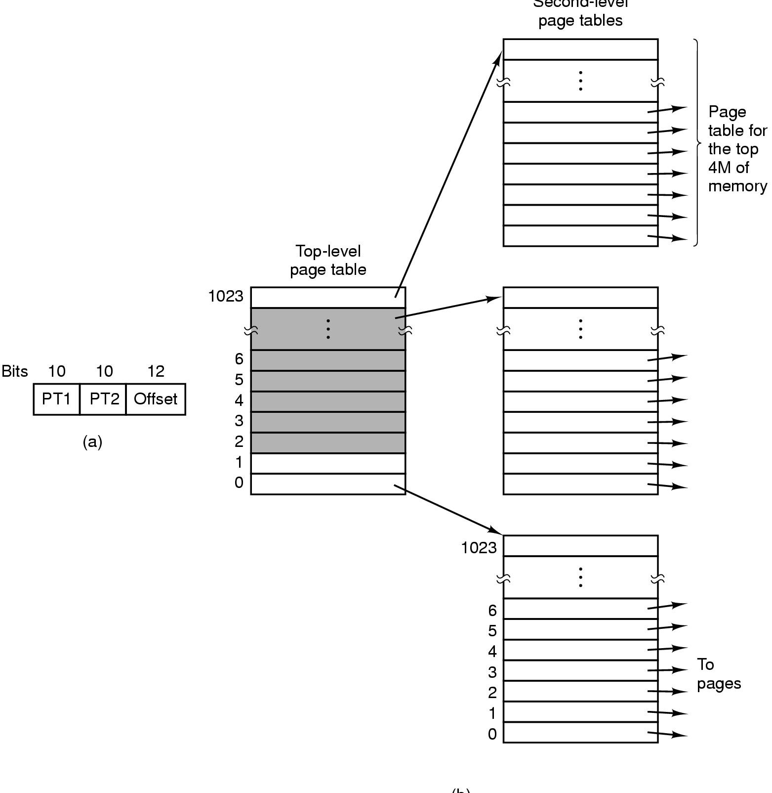
Virtual Address Translation
For Large Address Space
Second-level page tables
32 bit address with 2 page table fields
Two-level page tables
PT too Big for MMU
Keep it in main memory
But how does MMU know where to find PT?
Registers (CR2 on Intel)
Top-level
page table

Slide 15
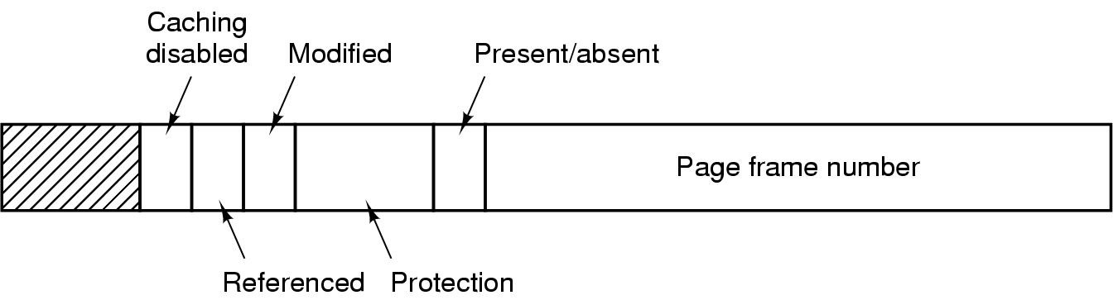
Typical Page Table Entry (PTE)
Page Frame number = physical page number for the virtual page represented by the PTE
Referenced bit: Whether the page was accessed since last time the bit was reset.
Modified bit: Also called “Dirty” bit. Whether the page was written to, since the last time the bit was reset.
Protection bits: Whether the page is readable? writeable? executable? contains higher privilege code/data?
Present/Absent bit: Whether the PTE contains a valid page frame #. Used for marking swapped/unallocated pages.

Slide 16
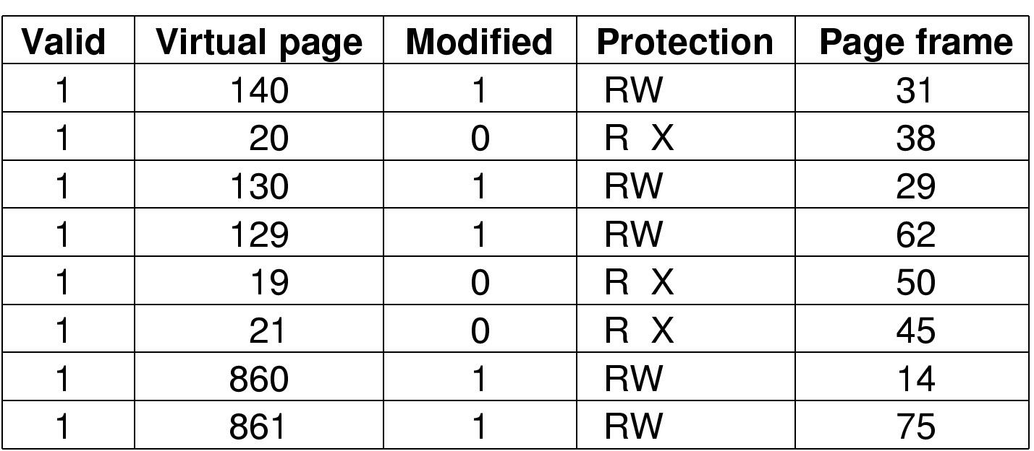
TLBs – Translation Lookaside Buffers
TLB is a small cache that speeds up the translation of virtual addresses to physical addresses.
TLB is part of the MMU hardware (comes with CPU)
It is not a Data Cache or Instruction Cache. Those are separate.
TLB simply caches translations from virtual page number to physical page number so that the MMU don’t have to access page-table in memory too often.
On x86 architecture, TLB has to be “flushed” upon every context switch because there is no field in TLB to identify the process context.

Slide 17
Cold Start Penalty
Cost of repopulating the TLB (and other caches) upon a context switch.
Immediately after a context switch, all (or many) of TLB entries are invalidated.
On some x86 processors, TLB has to be “flushed” upon every context switch because there is no field in TLB to identify the process context.
Every memory access by the newly scheduled process may results in a TLB miss.
MMU must then walk the page-table in main memory to repopulate the missing TLB entry, which takes longer than a cache hit.

Slide 18
Tagged TLB
A“tag” in each TLB entry identifies the process/thread context to which the TLB entry belongs
Thus TLB entries for more than one execution context can be stored simultaneously in the TLB.
TLB lookup hardware matches the tag in addition to the virtual page number.
With tags, context switch no longer requires a complete TLB flush.
Reduces cold-start penalty.

Slide 19
Two types of memory translation architectures
Architected Page Tables
Page table interface defined by ISA and understood by memory translation hardware
E.g. x86 architecture
MMU handles TLB miss (in hardware)
OS handles page faults (in software)
ISA specifies page table format
Architected TLBs
TLB interface defined by ISA and understood by MMU
E.g. alpha architecture
TLB miss handled by OS (in software)
ISA does not specify page table format

Slide 20
Impact of Page Size on Page tables
Small page size
Advantages
less internal fragmentation
page-in/page-out less expensive
Disadvantages
process that needs more pages has larger page table

Slide 21
TLB Coverage
Max amount of memory mapped by TLB
Max mount of memory that can be accessed without TLB misses
TLB Coverage = N x P bytes
N = Number of entries in TLB
P = Page size in bytes
N is fixed by hardware constraints
So, to increase TLB Coverage, we must increase P.
Consider these extreme examples
Suppose P = 1 byte
TLB Coverage = N bytes only
Suppose P = 2^64 bytes (on a 64-bit ISA)
TLB Coverage = N x2^64bytes
TLB can perform translations for N processes without any TLB misses!
Of course, both examples above are impractical and meant to illustrate the tradeoffs.
But what if P is something reasonable, but greater than than the standard 4KB?
This brings us next to superpages.
Notes:
Application with working sets larger than 1MB will pay the cost of TLB misses

Slide 22
Superpages
Memory pages of larger sizes than standard pages
supported by most modern CPUs
Superpage size = power of 2 x the base page size
Only one TLB entry per superpage
But multiple (identical) page-table entries, one per base page
Constraints:
contiguous (physically and virtually)
aligned (physically and virtually)
uniform protection attributes
one reference bit, one dirty bit

Slide 23
A superpage TLB
Alpha: 8,64,512KB; 4MB
Itanium:
4,8,16,64,256KB;
1,4,16,64,256MB
virtual memory
base page entry (size=1)
virtual
address
superpage entry (size=4)
physical
address
TLB
physical memory

Slide 24
Quiz
Consider a machine that has a 32-bit virtual address space and 8KByte page size.
What is the total size (in bytes) of the virtual address space for each process?
How many bits in a 32-bit address are needed to determine the page number of the address?
How many bits in a 32-bit address represent the byte offset into a page?
How many page-table entries are present in the page table?

Slide 25
Quiz Answers
Consider a machine that has a 32-bit virtual address space and 4KByte page size.
Total size (in bytes) of the virtual address space for each process = 2^32 = 4 * 1024 * 1024 *1024 bytes = 4 GB
Number of pages in virtual address space = 4GB/8KB = 512*1024 = 2^9*2^10 = 2^19
So the number of bits in a 32-bit address are needed to determine the page number of the address = log2(4GB/8KB) = log2(2^19) = 19 bits
How many bits in a 32-bit address represent the byte offset into a page?
log2(8KB) = log2(2^13) = 13
Also, 32 – 19 = 13 bits
How many page-table entries are present in the page table?
Number of PTEs = Number of pages in virtual address = 4GB/8KB = 2^19 pages

Slide 26
References
Chapter 3: Modern Operating Systems, Andrew S. Tanenbaum
X86 architecture
http://en.wikipedia.org/wiki/X86
Memory segment
http://en.wikipedia.org/wiki/Memory_segment
Memory model
http://en.wikipedia.org/wiki/Memory_model
IA-32 Intel Architecture Software Developer’s Manual, Volume 1: Basic Architecture

