Slide 1
Example: Producer-Consumer Problem
Common Buffer
Empty
Full
Producers
Consumers
Producers and consumers run in concurrent processes.
Producers produce data and consumers consume data.
Producer informs consumers when data is available
Consumer informs producers when a buffer is empty.
Two types of synchronization needed
Locking the buffer to prevent concurrent modification
Informing the other side that data/buffer is available

Slide 2
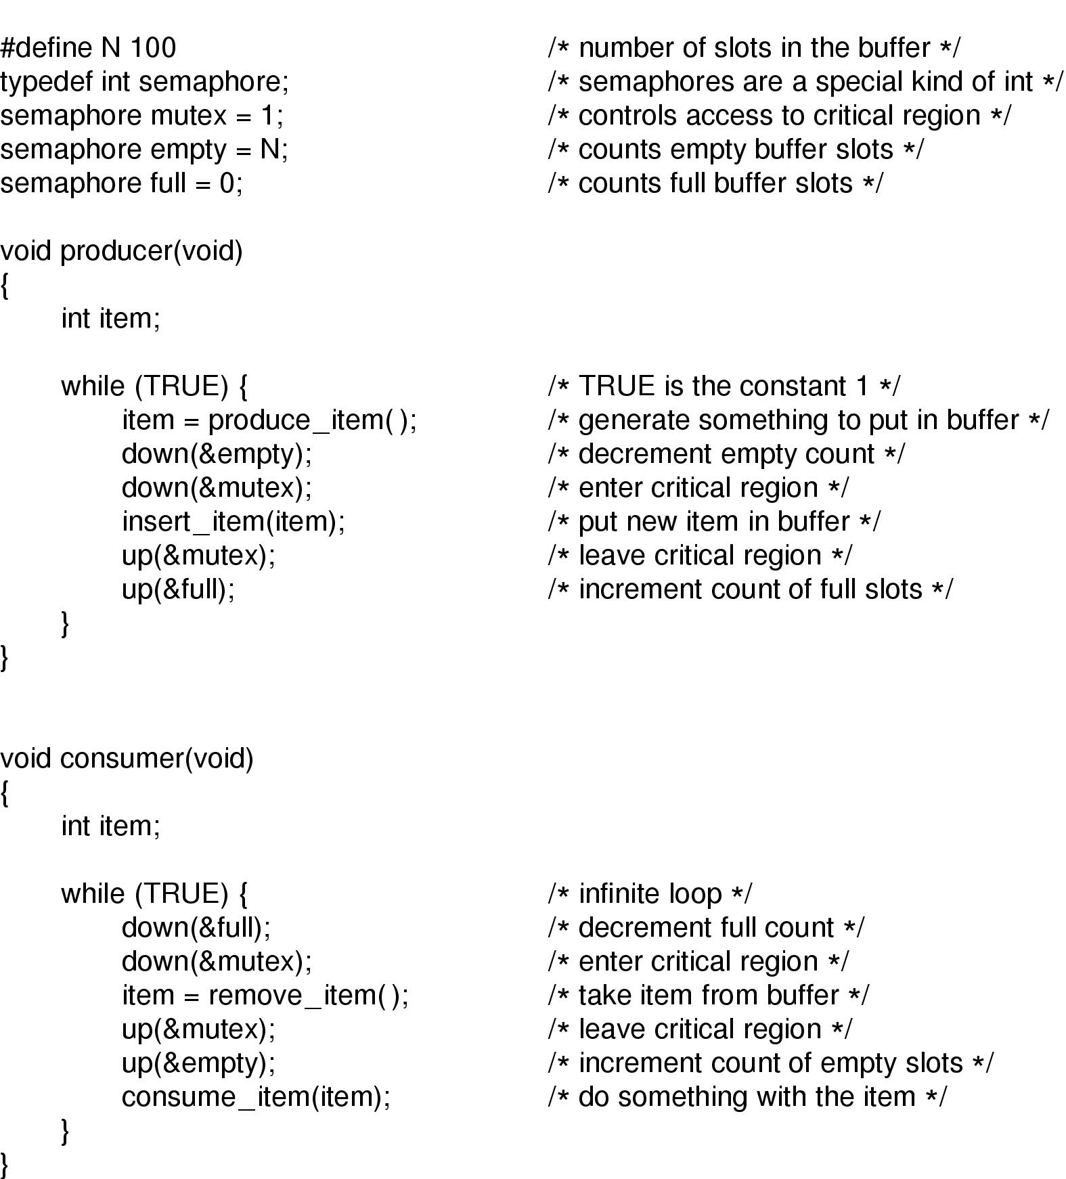
Using Semaphores for the P-C problem
Note: Two types of semaphores used here.
A binary semaphore to lock the queue (mutex)
Regular sems to block on event (empty and full).
Up: Increments the value of semaphore, wakes up sleepers to compete on sem
Down: Decrements semaphore, but blocks the caller if sem value is 0

Slide 3
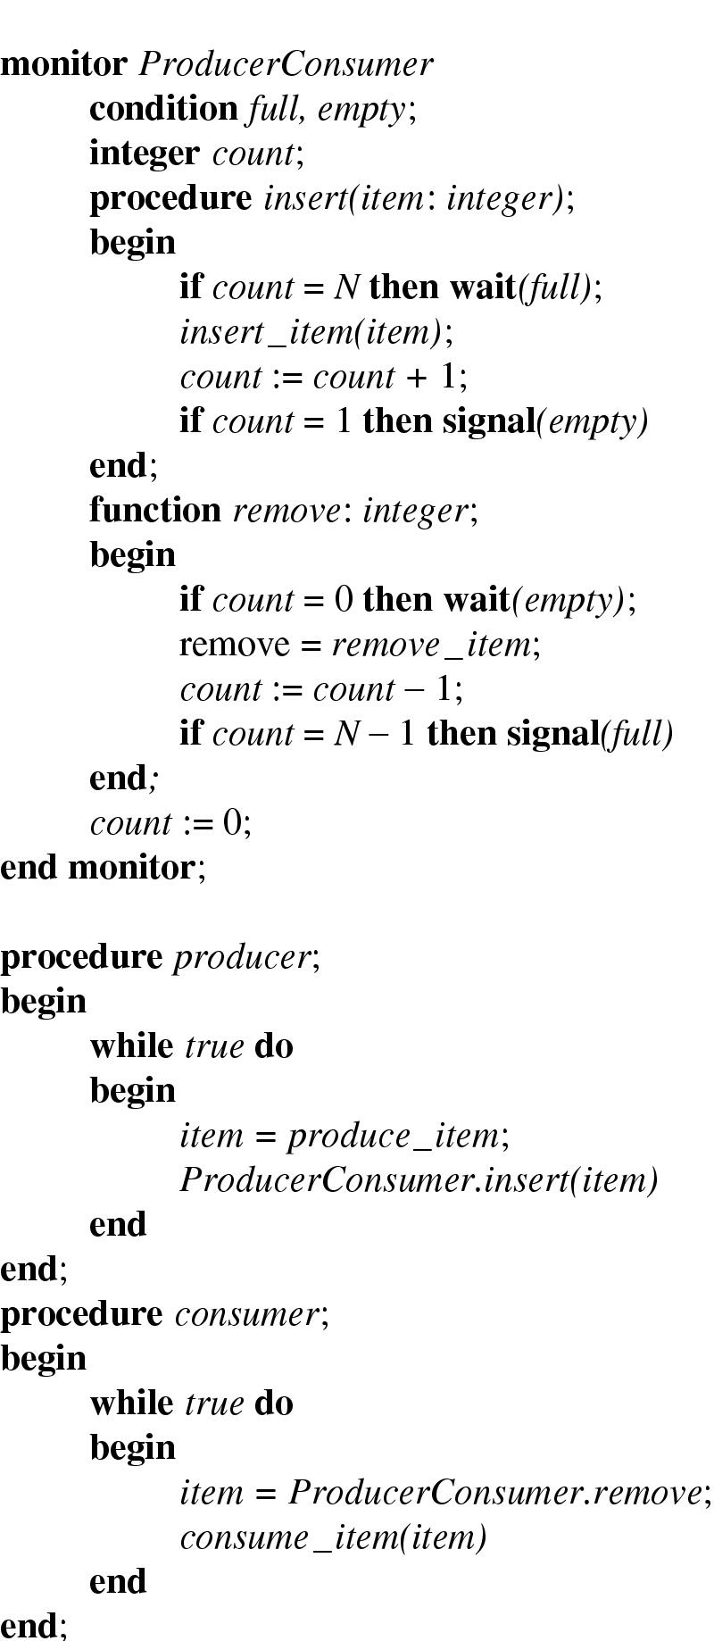
P-C problem with monitors and condition variables

Slide 4
Kernel APIs
For using semaphores
sema_init()
or DEFINE_SEMAPHORE, which initializes semaphore to 1
down_interruptible() (preferred over down())
up()
For alternative implementations using mutexes and waitqs:
mutex_init() or DEFINE_MUTEX,
mutex_lock(),
mutex_unlock(),
init_wait_queue_head(),
wait_event_interruptible() (preferred over wait_event)
wake_up_interruptible() (or wake_up).

