Slide 1
File Systems
Kartik Gopalan
Chapter 4
From Tanenbaum’s Modern Operating System

Slide 2
What is a File System?
File system is the OS component that organizes data on the raw storage device.
Data, by itself, is just a meaningless sequence of bits and bytes.
Metadata is the information that describes the data.
Also called attributes.
Without meta-data, data itself will be incomprehensible.
A File System defines
Format of the data objects.
The format/meaning of meta-data associated with each data object. E.g. File name, permissions, and size of a file.
Location of the individual data blocks of for each data object.
A framework to manage free space on the raw storage.

Slide 3
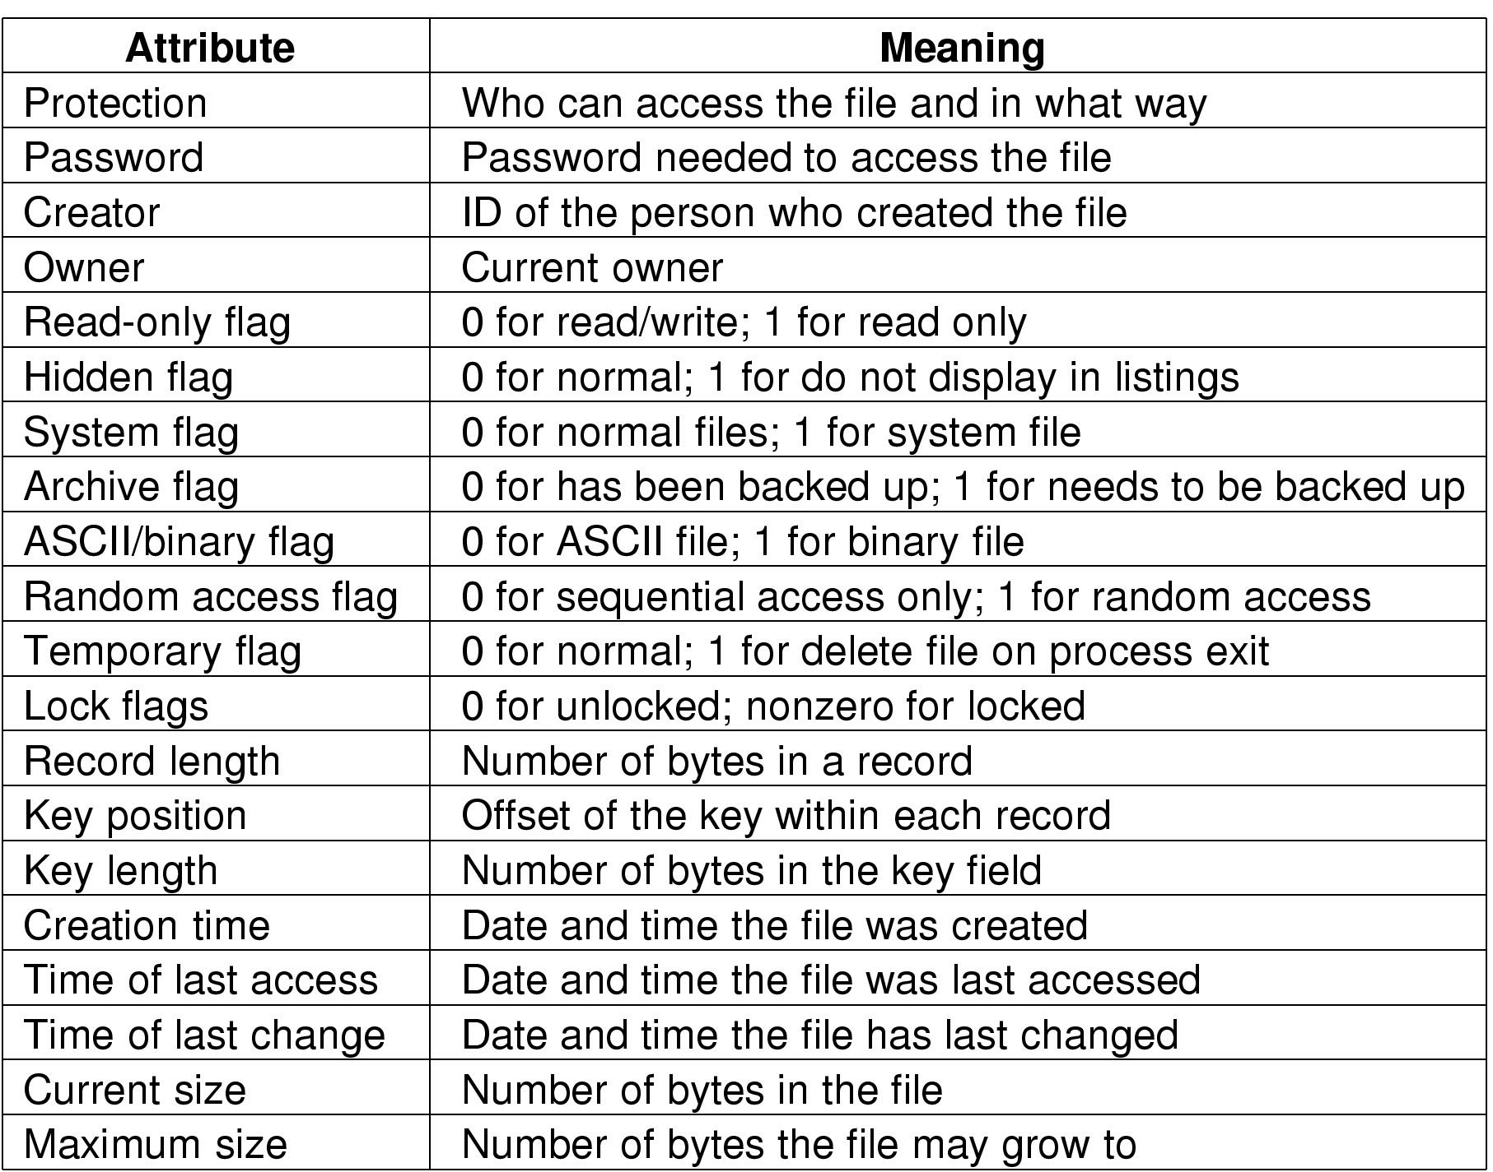
Metadata — Examples

Slide 4
File Types
Regular files
Contains actual data
Directories
Files that help locate other files
Character Special Files
Typically for byte-oriented I/O operations
Block special files
For block-oriented I/O operations

Slide 5
Basic File System Operations
Create a file
Open an existing file
Write to a file
Read from a file
Seek to somewhere in a file
Close an open file
Delete a file

Slide 6
Virtual File System (VFS)
VFS provides
A common system call interface to user applications to access different file systems implemented in the OS.
A common interface to file systems to “plug into” the operating system and provide services to user applications.
User Applications
System Calls
Virtual File System
File System 1
File System 2
File System N
……
File System Cache
Device Drivers
Storage 1
Storage 2
……
Storage 3

Slide 7
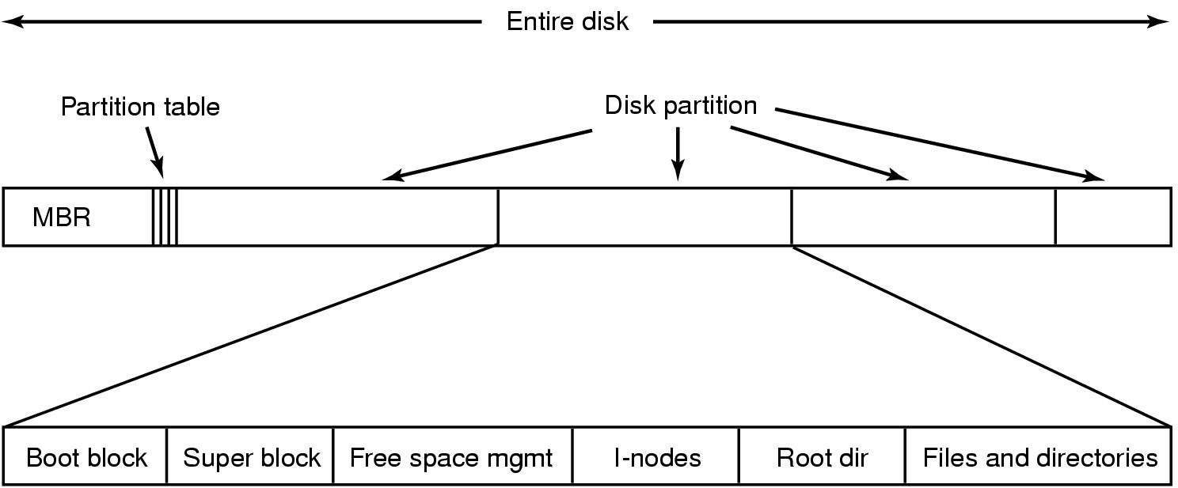
Partitions and File-system Layout
File System 1
File System 2
File System 3
…

Slide 8
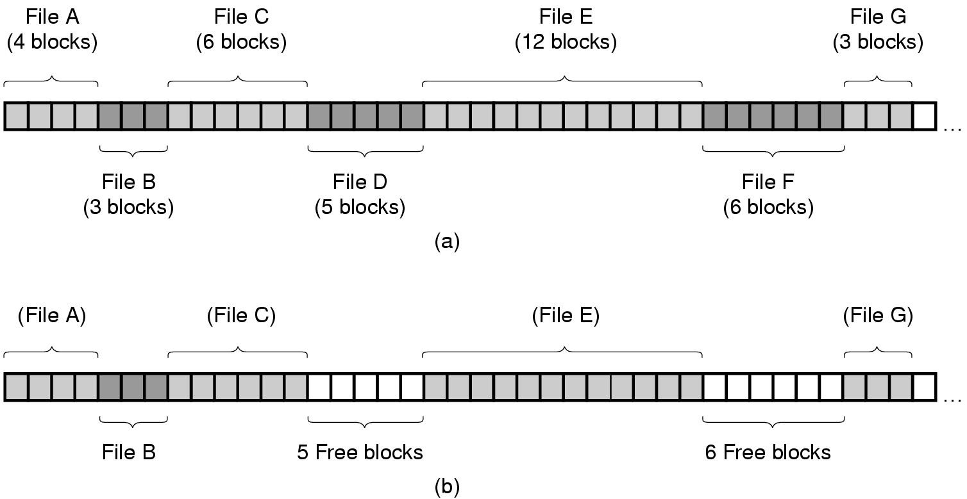
Organizing Files on Disk: Contiguous Allocation
(a) Contiguous allocation of disk space for 7 files
(b) State of the disk after files D and E have been removed

Slide 9
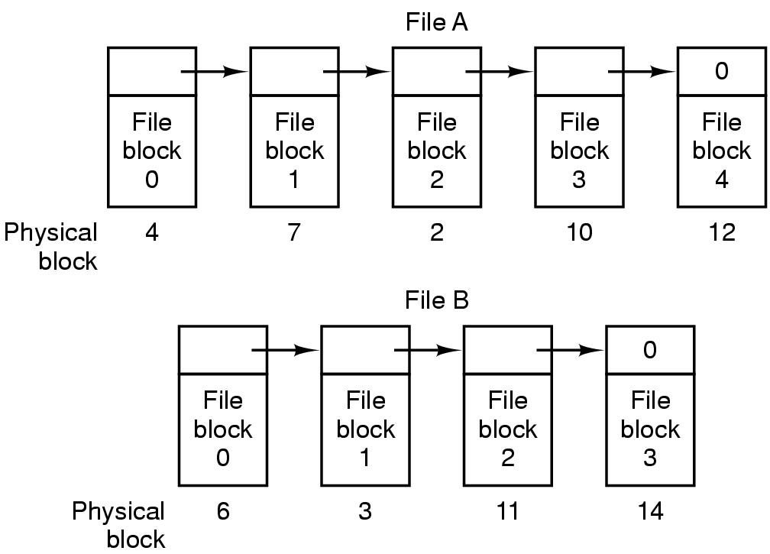
Organizing Files on Disk: Singly Linked List of Blocks
Advantage: Logically contiguous blocks can be discontiguous on disk
Disadvantage: Random seeks are expensive. Requires traversal from the start.

Slide 10
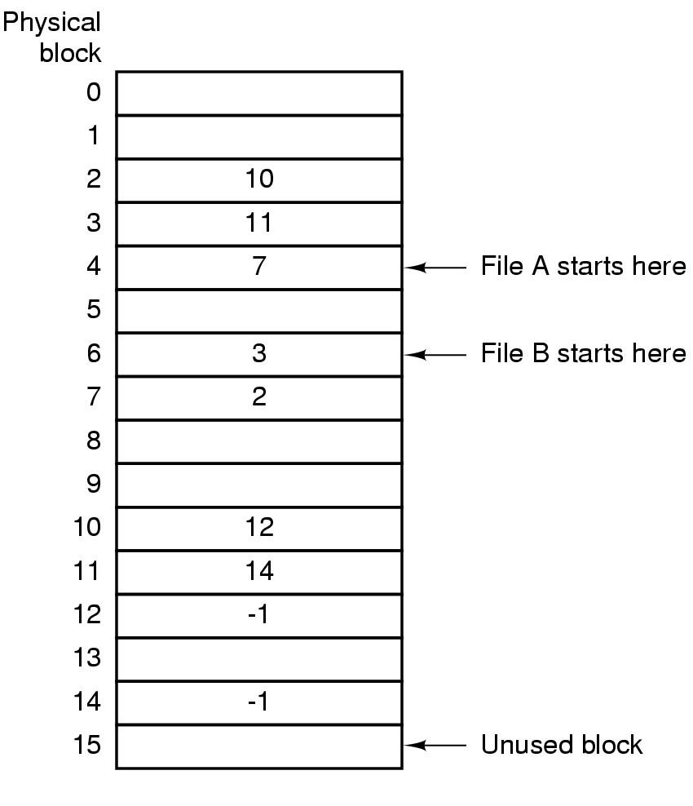
Organizing Files on Disk: File Allocation Table
Linked list allocation using a file allocation table in RAM
Doesn’t need a separate “next” pointer within each block
But random seeks are still expensive

Slide 11
i-nodes (index nodes)
Each file is described by an i-node
i-node stores the metadata for the file
Metadata = file info + location of data blocks
i-nodes are stored on the disk
An i-node is to a file what a page-table is to a virtual address space
Page table maps
virtual page number in a virtual address space ——> physical page frame number in DRAM
i-node maps
logical block number in a file ——> physical block location on disk

Slide 12
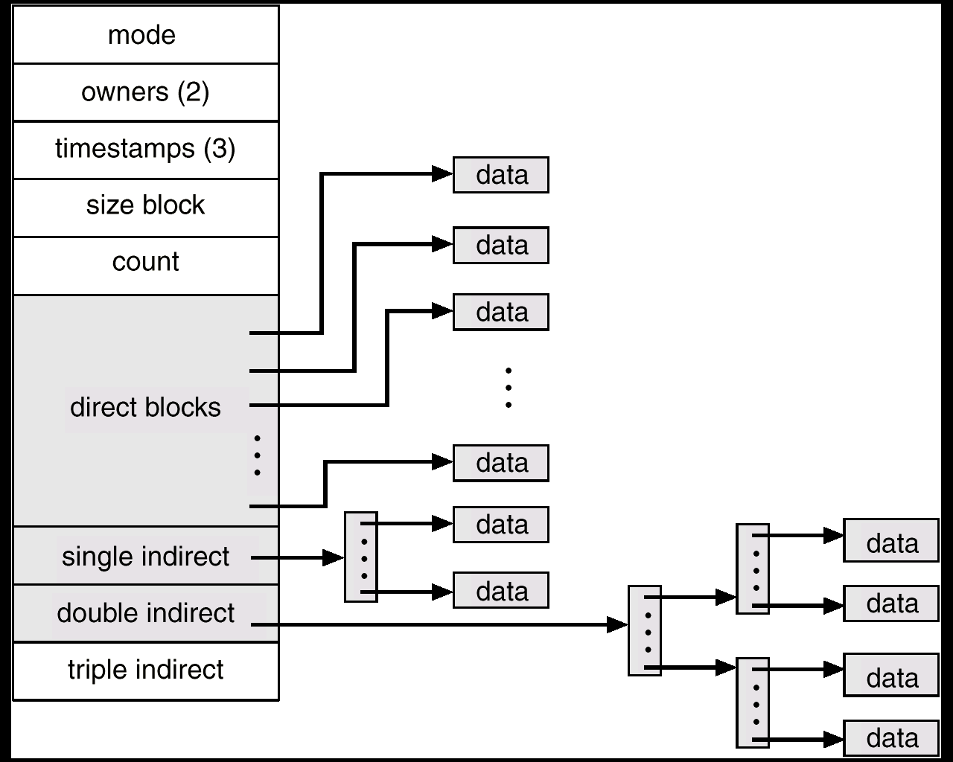
Unix i-node (index node)
Small files can be accessed quickly
If each block is 4KB
First 48KB of file reachable from 12 direct blocks
Next 4MB available from single-indirect blocks
Next 4GB available from double-indirect blocks
Next 4TB available through the triple-indirect blocks
Any block can be found with at most 3 disk accesses

Slide 13
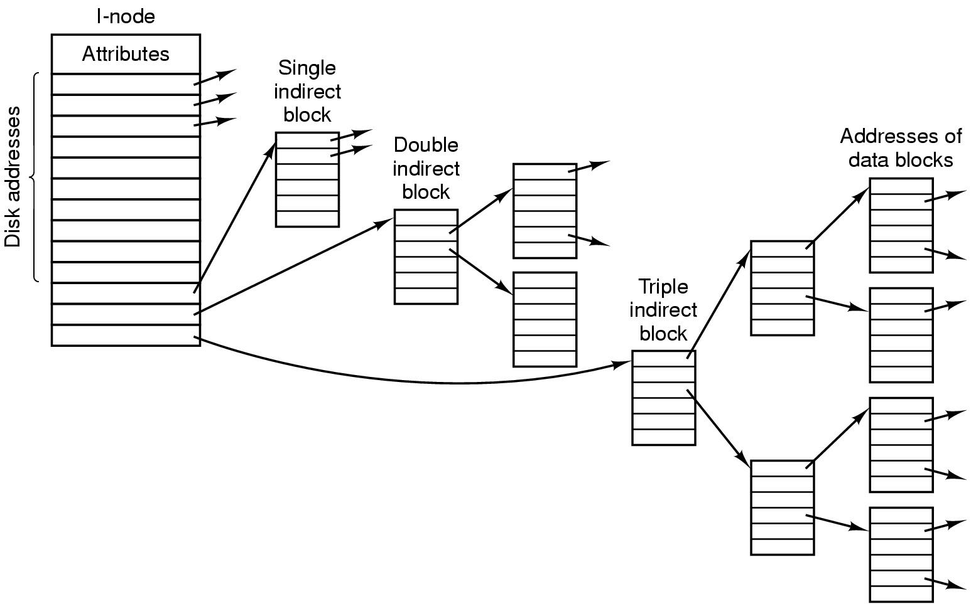
Another view of a UNIX i-node
Ref: Tanenbaum’s OS book
The whole data structure above is ONE i-node for ONE file
i-node grows dynamically as the file grows
Just like page-tables, i-node tracks a giant array broken up into many pieces

Slide 14
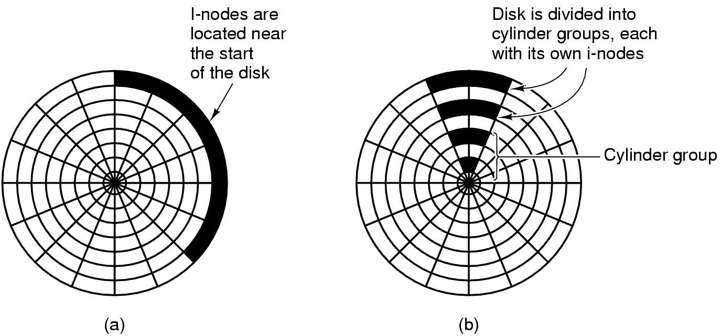
Performance impact of i-node placement
I-nodes placed at the start of the disk
Longer average seek times
Each track on disk has its own blocks and i-nodes
Shorter average seek times

Slide 15
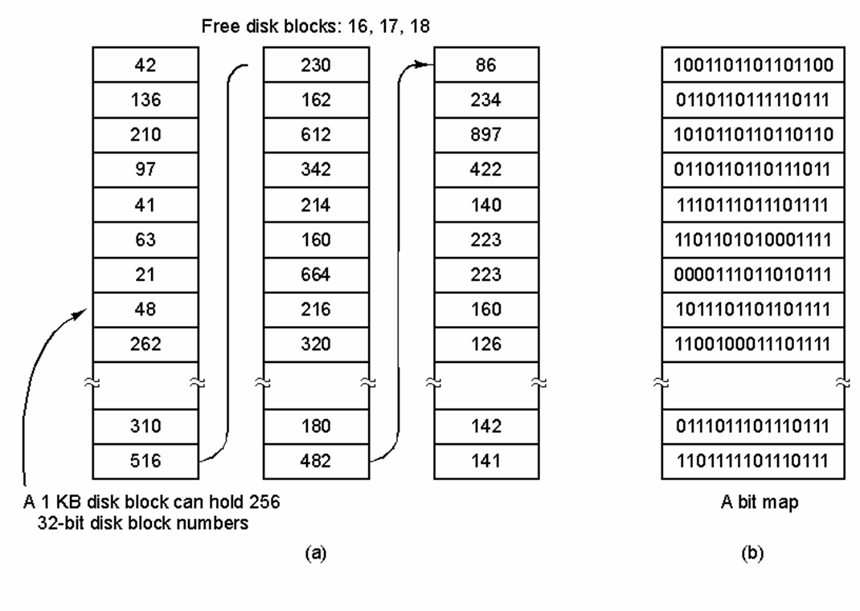
Managing Free Space on Disk
Linked list

Slide 16
File System Cache
Small area in main memory that stores frequently accessed data blocks in the file system.
Before accessing the disk, look in the FS cache.
If data block is in FS cache, no need to go to disk.
Periodically, purge the cache of infrequently used data blocks.
Claim: If the cache works well, then most I/O accesses to the physical disk will be writes. Why?

Slide 17
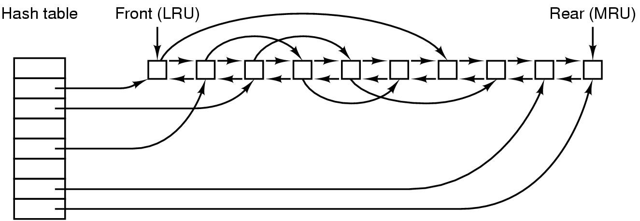
Data Structure for File-System Cache
Cache Lookup:
Pages in cache are looked up via a hash table for fast access.
Cache Eviction:
Another doubly-linked list maintained to identify least-recently used (LRU) victim pages that are periodically purged.
Is the victim page dirty? Then write to disk. Else discard.

Slide 18
Virtual memory page cache and FS cache
Often they are managed in a unified manner
Meaning: one common page-cache is used for managing pages for both virtual memory and file system.
For example, Linux maintains one common set of data structures to keep track of active and inactive (LRU) pages.

Slide 19
Log-Structured File Systems
With CPUs faster, memory larger
disk caches are also getting larger
increasing number of read requests come from file system cache
Thus, most disk accesses will be writes
LFS treats the entire disk as a log
all writes are initially buffered in memory
periodically commit the writes to the end of the disk log
When file is opened, locate i-node, then find blocks

Slide 20
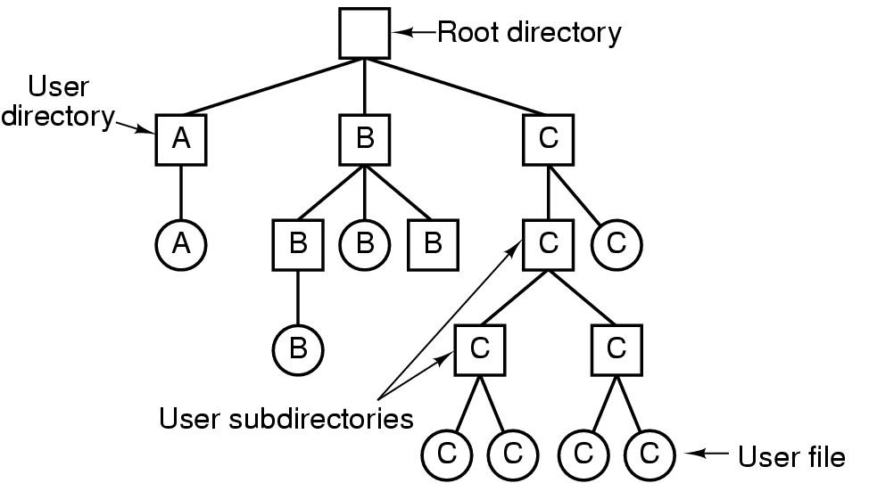
Hierarchical Directory Systems

Slide 21
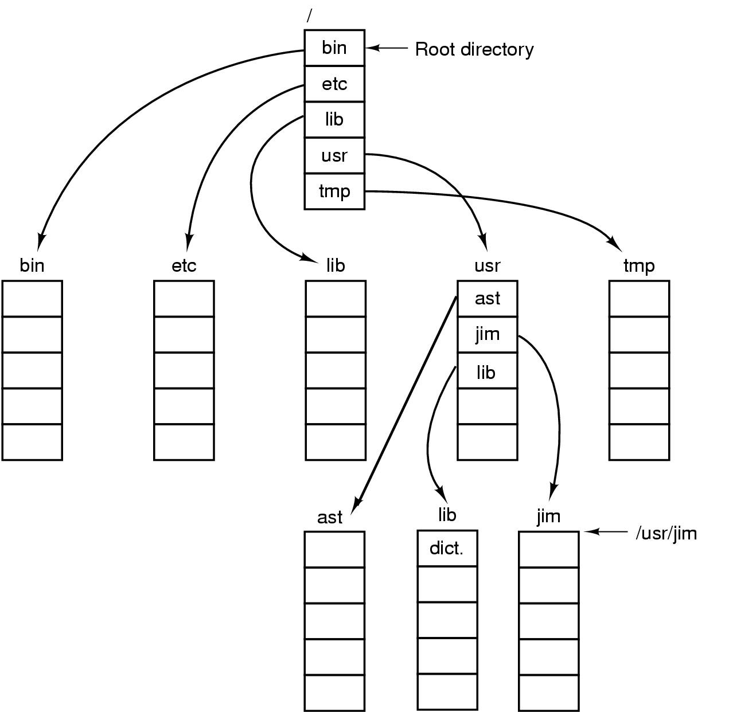
Path Names

Slide 22
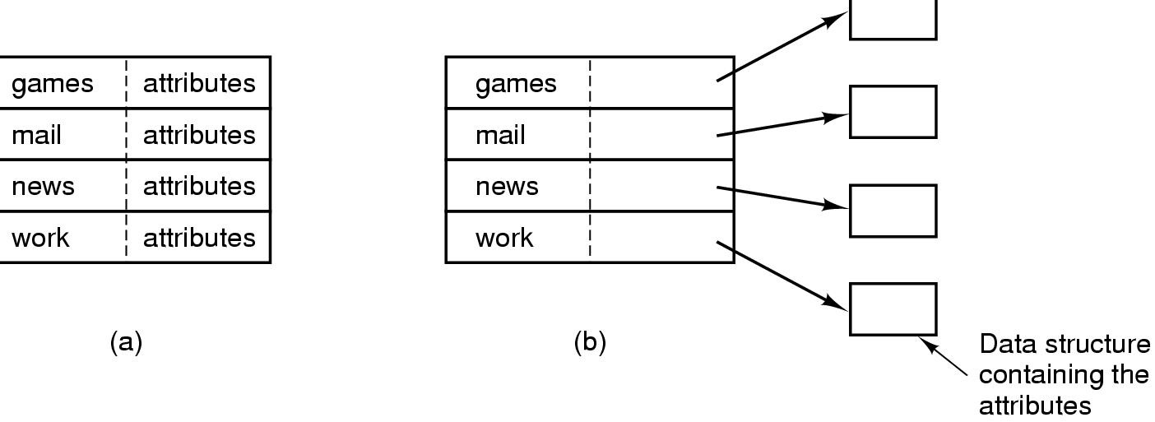
Implementing Directories
I-nodes
(a) A simple directory with fixed size entries. Disk addresses and attributes are stored in directory entry
(b) Directory in which each entry just refers to an i-node

Slide 23
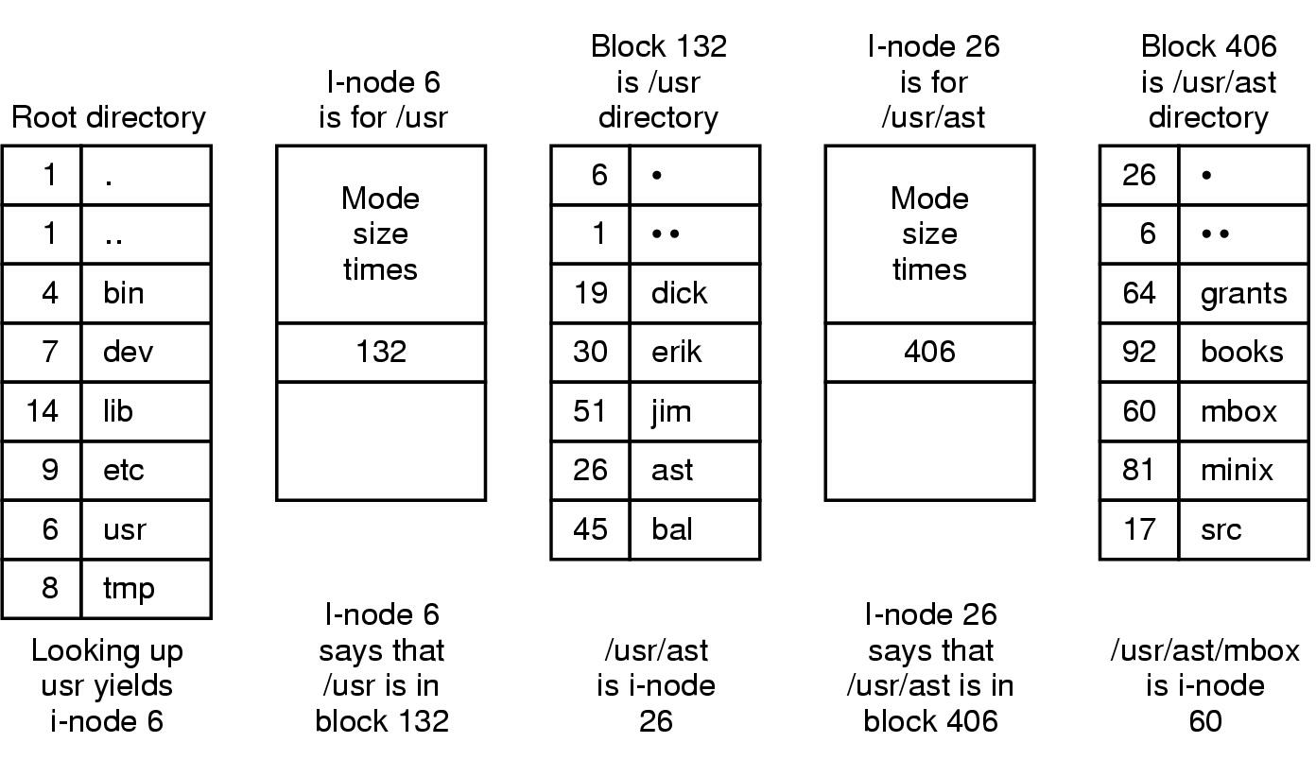
Path lookup in a typical Unix File System
The steps in looking up /usr/ast/mbox
Next, lookup i-node 60 to locate the data blocks of the file /usr/ast/mbox

Slide 24
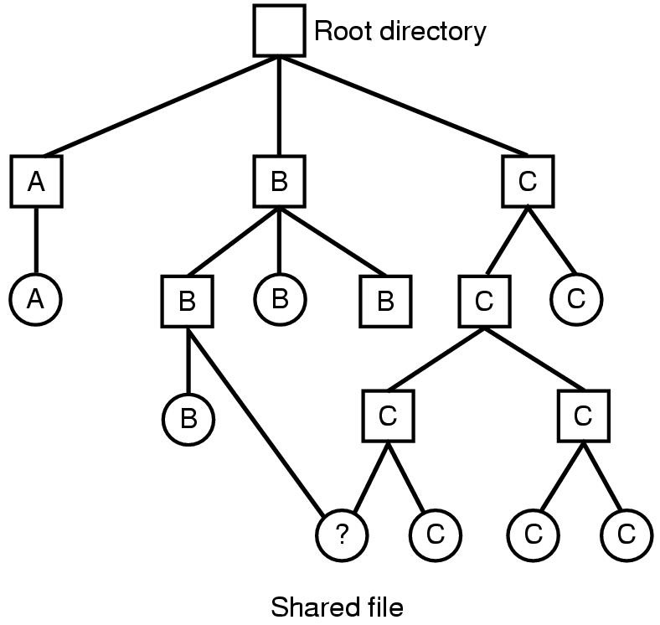
Shared Files — Hard Links
A file shared between two directories

Slide 25
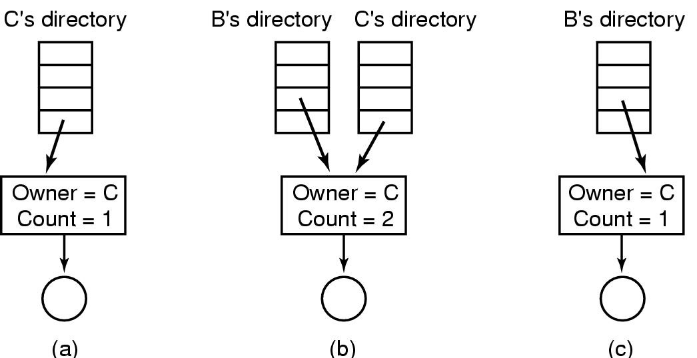
Shared Files – Hard Links
Situation prior to linking
After the hard link is created
After the original owner removes the file
File still exists, but with count decremented

Slide 26
Quiz on Inodes
All blocks in a disk are of size 4KB (4096 bytes). A disk block can store either data or metadata (but not both).
Each block address, i.e. a block’s location on the disk, is 8-bytes in size
Assume that all file attributes other than data block addresses, take up negligible space in the top-level block of inode block.
Last three entries of the top-level block of inode contain single, double, and triple indirect block addresses.
Rest of the space in the top-level inode (between end of attributes and single-indirect block address) is used to store direct block addresses.
Question 1: What is the largest size of a file that can be accessed through
direct block entries?
direct + single indirect block entries?
direct + single + double indirect block entries?
direct + single + double + triple indirect block entries?
Question 2: What is the size of an inode (in bytes) for a 32GB file?

