Slide 1
Airbnb Listings Analysis
Clustering · Prediction · Insights
A comprehensive ML-driven exploration of 500 Airbnb listings
covering EDA, K-Means Clustering, and Booking Success Prediction
500
4
100%
Listings
Clusters
RF Accuracy

Slide 2
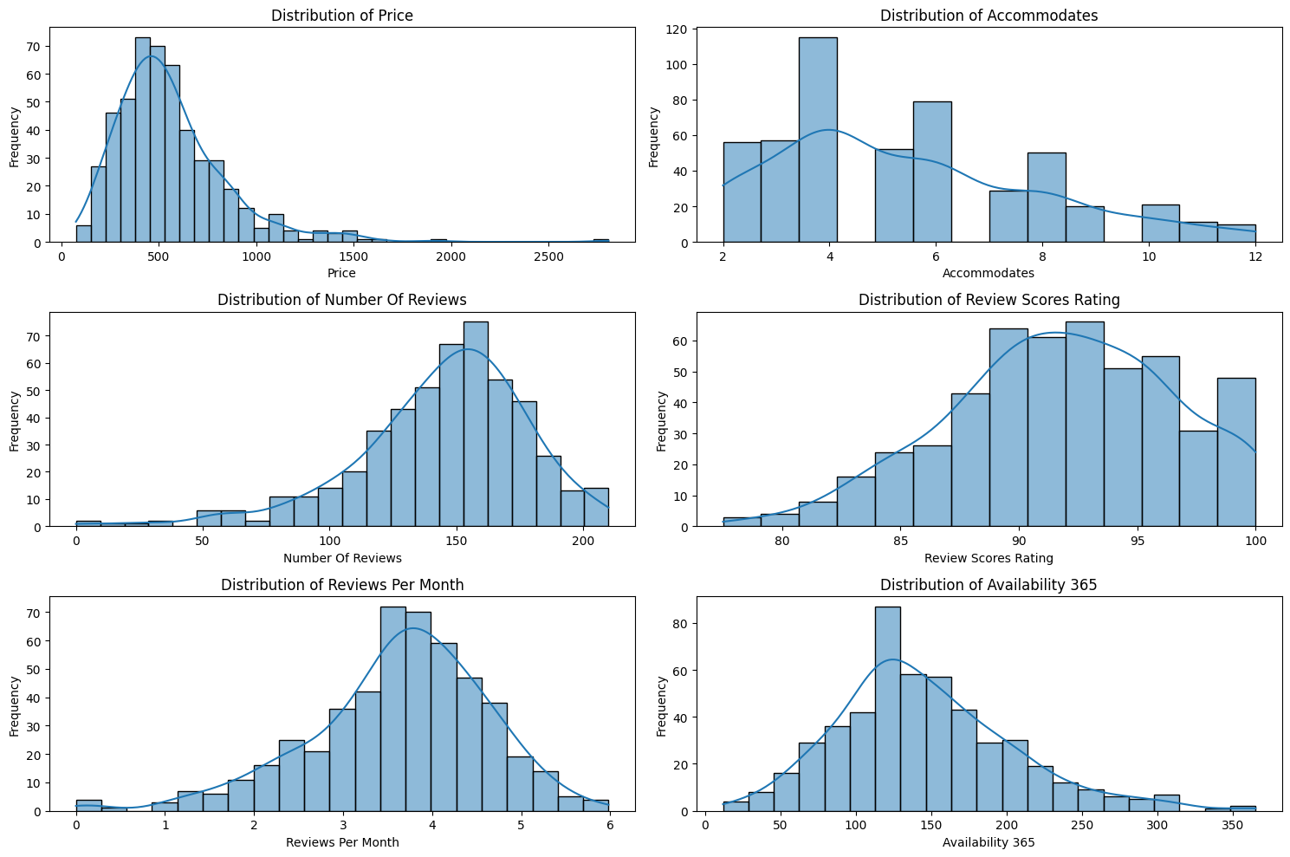
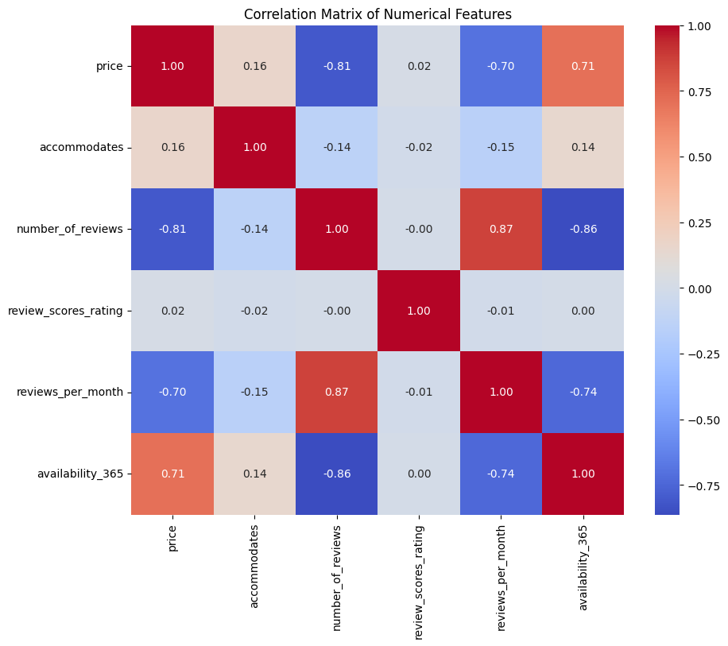
Exploratory Data Analysis
Feature Distributions
Correlation Heatmap

Slide 3
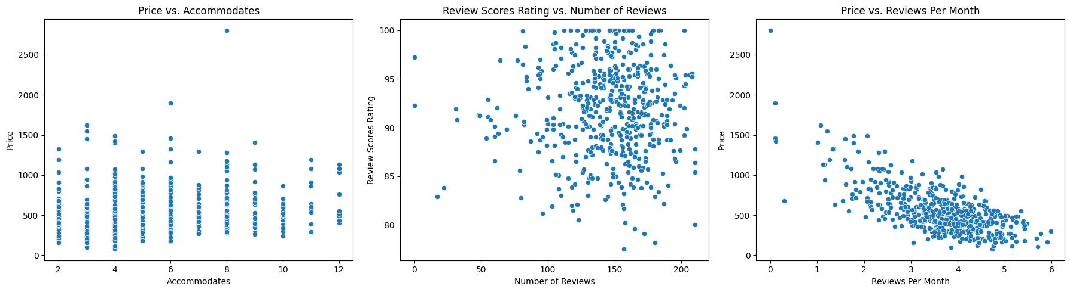
EDA: Relationships & Price Patterns
Scatter Plots: Price vs. Key Features
Key EDA Insights
Price is right-skewed — most listings cluster between $200–$800, with a few luxury outliers above $2,000
number_of_reviews & reviews_per_month strongly correlated (r = 0.87) — active listings drive engagement
availability_365 negatively correlates with reviews (r = -0.86) — less available = more frequently booked

Slide 4
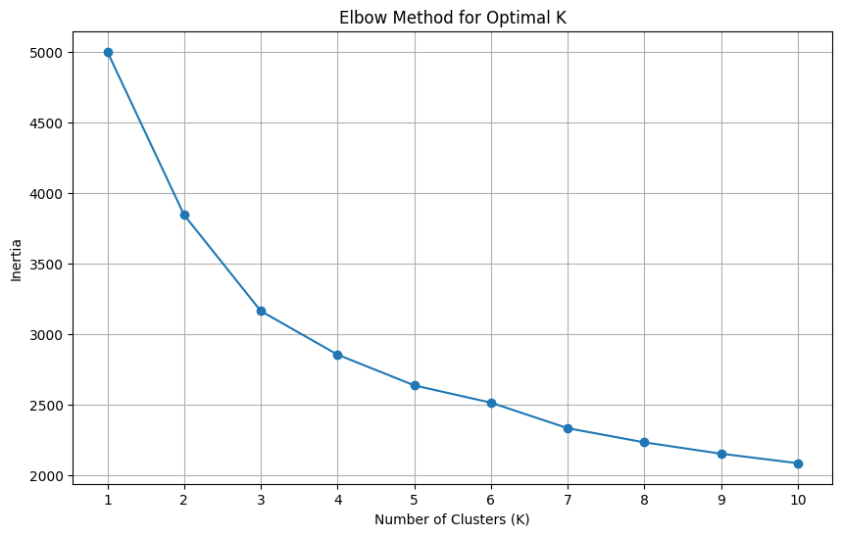
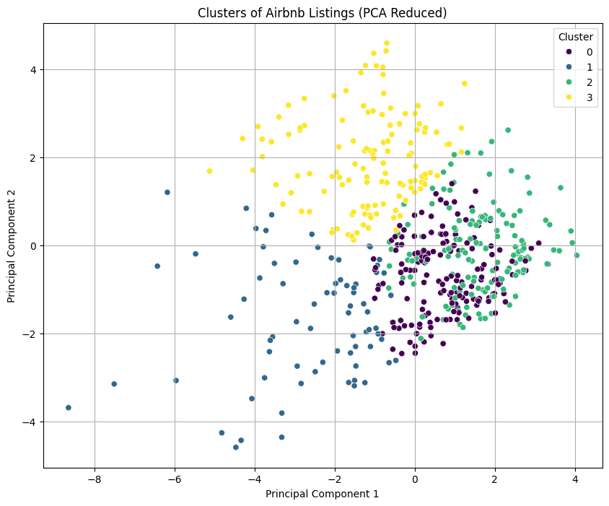
K-Means Clustering
Elbow Method → Optimal K = 4
PCA-reduced Cluster Visualisation (4 clusters)
C0 — Moderate
C1 — Premium
C2 — Budget
C3 — Large Cap
Avg price, small capacity, steady reviews
High price, low reviews, high availability
Low price, private rooms, very popular
Big spaces, avg price, group travel

Slide 5
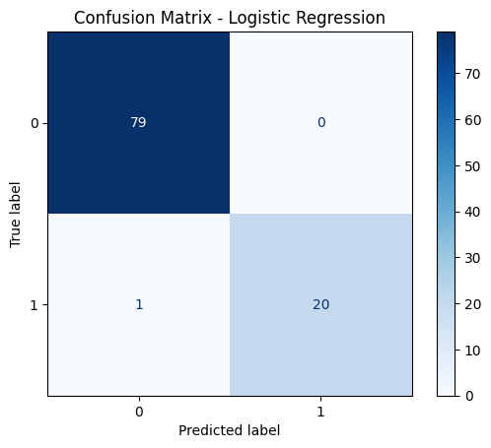
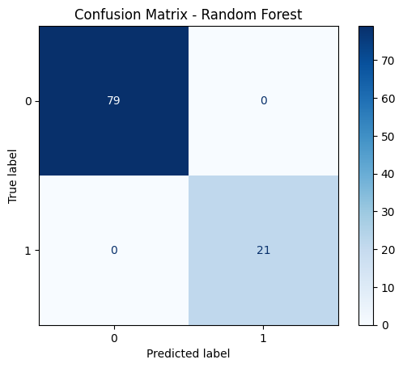
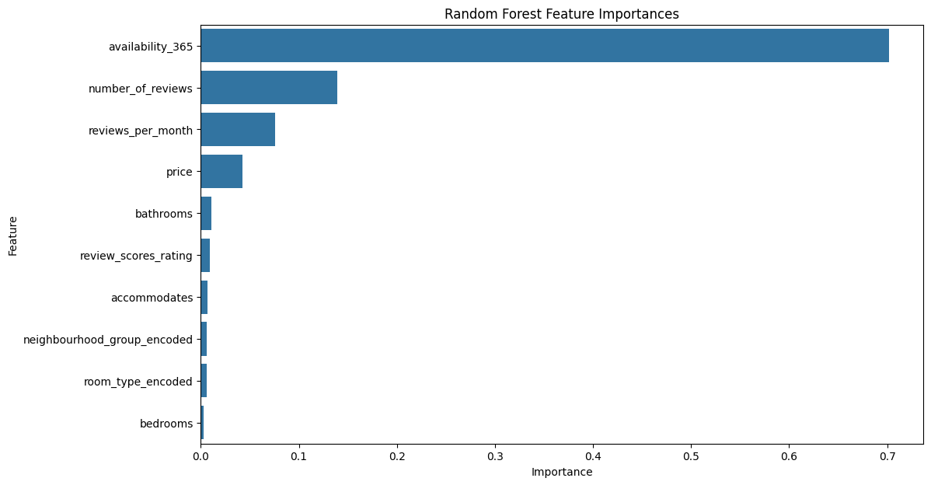
Model Performance & Feature Importance
Logistic Regression
Random Forest (Perfect Score)
RF Feature Importances
Model Comparison
Key Takeaway
Metric | Log. Reg. | Rand. Forest
Accuracy | 99.0% | 100.0% ✓
Precision | 100.0% | 100.0% ✓
Recall | 95.2% | 100.0% ✓
F1-Score | 97.6% | 100.0% ✓
availability_365 drives 70.2% of booking prediction
Random Forest achieves perfect classification
Hosts should actively manage calendar availability
Airbnb Listings Analysis · K-Means + Random Forest · 500 Listings Dataset

