Slide 1
Faculty of computer science
Probability and Statistics
Moscow 2023
A nomogram based on a patient-reported outcomes measure: predicting the risk of readmission for patients with chronic heart failure
Qiang Han , Jia Ren, Jing Tian, Hong Yang, Qing Zhang , Ruoya Wang, Jinghua Zhao, Linai Han , Chenhao Li, Jingjing Yan, Ke Wang, Chu Zheng, Qinghua Han and Yanbo Zhang
Presented by: Kartik Joshi

Slide 2
Problem
Faculty of computer science
CHF risk of readmission
Probability and Statistics
/11
Re-admission is the main adverse outcome for patients with heart failure (HF). Because it could be associated with a high mortality, lead to a decreased quality of life , and cause a significant financial burden perspective.
Thus, it is important to assess the prognosis of HF, as patients at higher risk of poor outcomes could receive more intensive therapy and close monitoring

Slide 3

Methodology
Faculty of computer science
CHF risk of readmission
Probability and Statistics
/11
The patient-reported outcomes measure (PROM) evaluates a patient’s quality of life by the way of scales to promote communication, inspect and identify Health-related quality of life(HRQOL) issues, enhance patient-centered treatment, and increase patient satisfaction.
Nomograms have been regarded as dependable instruments by creating simple intuitive diagrams of the predictive models that quantify the risk of clinical adverse events.

Slide 4
About our data
Faculty of computer science
CHF risk of readmission
Probability and Statistics
/11
This prognostic nomogram data of 454 patients with CHF(chronic heart failure) , to predict the possibility of re-admission, from May 2017 to January 2020, patients in the department of cardiology of the top three hospitals in the Shanxi Province of China.
The questionnaire survey of inpatients who met the inclusion criteria and screened the filled scale. Follow-up calls were made via phone at 1, 3, 6, 12, 18,and 24 months after discharge to record whether a patient was readmitted, as well as the readmission time. Following criteria were taken in hand:
(1) aged ≥18 years, (2) diagnosed with HF, according to the guideline for the diagnosis and treatment of HF in China (2018) (3) fall under the New York Heart Association (NYHA) functional class II-IV, and (4) received HF treatment while in the hospital.

Slide 5
Molding the data for the model
Faculty of computer science
CHF risk of readmission
Probability and Statistics
/11
The CHF-PROM is divided into four domains which are further divided into12 subdomains, including a total of 57 items. The reliability of 12 subdomains were
considered acceptable defined by the specific values of Cronbach’s alpha coefficient The CHF-PROM uses a 5-point Likert scale to rate the responses and the scores for each item range from 0 (never) to 4 (always).
To ensure consistency between the PROM and answers to the 56 items: positively scoring items were recorded as the raw score, and negatively scoring items were recorded as 4 minus the raw score. This ensured that the score for each item still ranged from 0 to 4 and further, the correspondence of a higher score to a more positive PROM.

Slide 6
Statistical analysis
Faculty of computer science
CHF risk of readmission
Probability and Statistics
/11
Categorical variables in demographic characteristics were described by frequency, and the Log-Rank test was performed for comparison between groups.
The median follow-up time was calculated by the Reverse Kaplan Meier method. The variables of P-value < 0.05 and subdomains of PRO (patient-reported outcomes) were initially included in the Cox regression analysis to identify the factors that increase the risk of CHF readmission.
The final model streamlined with the maximum concordance index (C-index) and minimal Akaike information criterion (AIC).

Slide 7
Log-rank test
Faculty of computer science
CHF risk of readmission
Probability and Statistics
/11
It is a hypothesis test to compare the survival distributions of two samples. It is a nonparametric test(not restricted by assumptions concerning the nature of the population from which a sample is drawn) and appropriate to use when the data are right skewed and censored (technically, the censoring must be non-informative).
It is widely used in clinical trials to establish the efficacy of a new treatment in comparison with a control treatment when the measurement is the time to event (such as the time from initial treatment to a heart attack).
Reverse Kaplan Meier method.
This method is calculated in the same way as the Kaplan-Meier (used for estimating the survival function based on the time to the occurrence of the event) estimate of the survival function, but with the meaning of the status indicator reversed so that our event of interest becomes the censor.

Slide 8
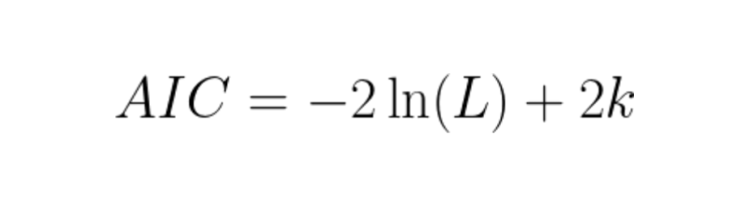
Akaike Information Criterion
Faculty of computer science
CHF risk of readmission
Probability and Statistics
/11
Where:
AIC equation, where L = likelihood
k = # of parameters.
The Akaike information criterion (AIC) is a mathematical method for evaluating how well a model fits the data it was generated from. In statistics, AIC is used to compare different possible models and determine which one is the best fit for the data.

Slide 9
Results
Faculty of computer science
CHF risk of readmission
Probability and Statistics
/11
The final prediction model obtained by the step-forward selection, which
included gender, income, health care, appetite, sleep,
anxiety, depression, paranoia, support, and independence(Table 3).
Each variable was a points axis and the total score with seven predictors was reached by adding each point. Total points projection on the probability axis, could be directly calculate the probability of without readmission (Probability of readmission = 1 - Probability of without readmission).
The nomogram displayed moderate discrimination with a C-index of 0.737 (95% CI 0.673–0.800) and splendid calibration.

Slide 10
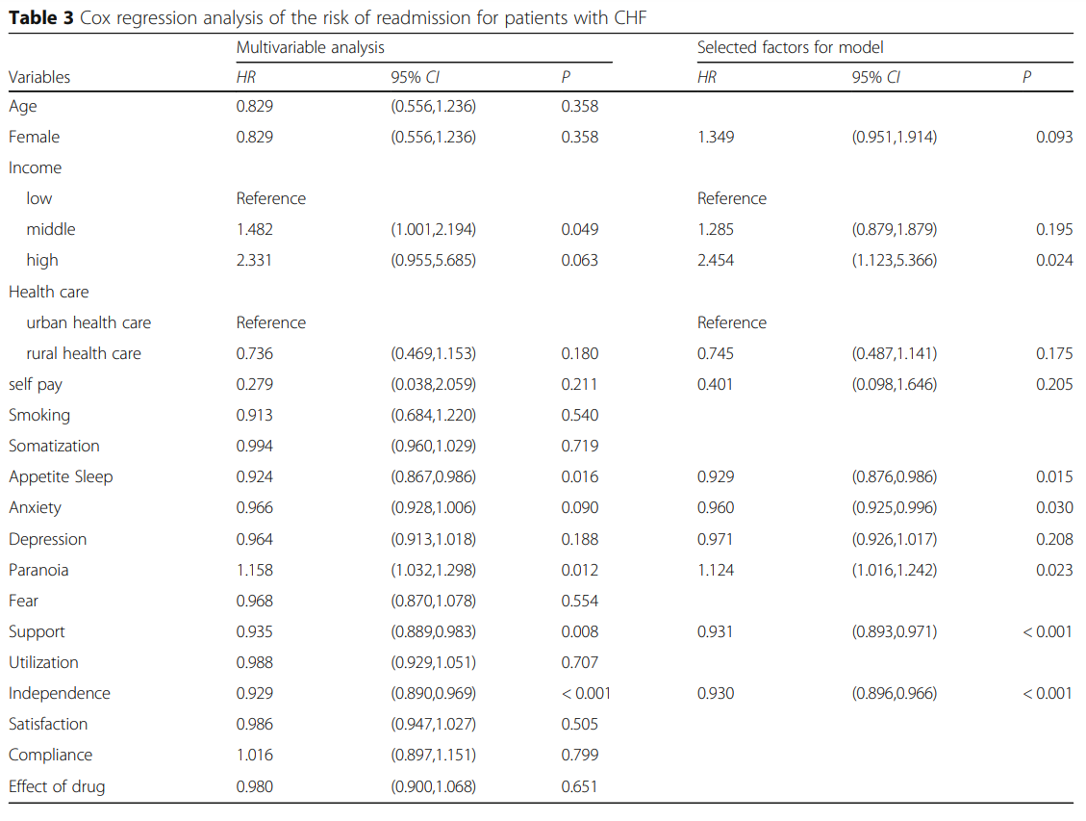
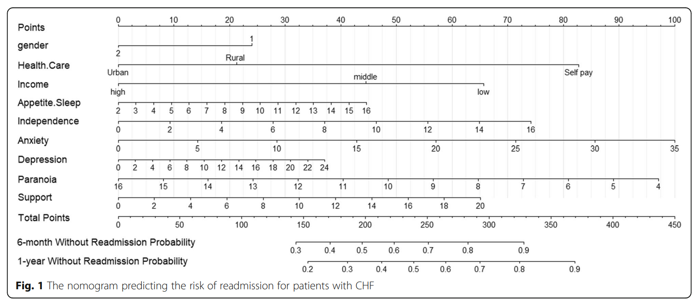
Results
Faculty of computer science
CHF risk of readmission
Probability and Statistics
/11

Slide 11
Conclusion
Faculty of computer science
CHF risk of readmission
Probability and Statistics
/11
In this paper, authors formulate that using PRO (patient-reported outcomes) as a measurement tool, this study has constructed and internally validated a neoteric nomogram to predict the probability of readmission for CHF patients .
The nomogram is moderate accurate, easy to use, and displays splendid calibration; so, it can assist clinicians in assessing the risk of readmission for CHF patients, and further, make personalized treatment recommendations for them.

