Slide 1
EMPLOYEE PAYROLL SYSTEM
Group Members
Anubhav Singh (205500)
Aruneet Gan Chaudhuri (205422)
Kartik Jain (205460)

Slide 2
Introduction
Welcome to the Employee Payroll System presentation. This system is designed to manage employee payment information and compute their salary efficiently. This project ensures accurate and efficient payroll processing.

Slide 3
Project Objectives
Automating employee payroll system
Handles payroll for different types of employment
Ensuring precise salary calculations
Ensuring Transparency
Provide Comprehensive Employee Information
Establishing a scalable foundation for future developments

Slide 4
Project Architecture
The project consists of three main components
Main Class
Computation package
Employee class
EmployeeManager class
SalaryCalculator class
Slip Package
It4u package
PaySlipGenerator class

Slide 5
Employee Class
The Employee class represents an employee with the following attributes:
- int id
- String name
- String department
- String roleType
- double grossSalary
- double fixedSalary
- double hra
- double lta
- double pf
- double tax
- double hourlyRate
- double workingHours
It also includes getters and setters for each attribute.
Employee
ID
Name
Department
Role Type

Slide 6
EmployeeManager Class
The EmployeeManager class manages a list of employees and provides functionalities
Employee manager
Adding Employee
Find Employee by ID
Sorting Employee by Salary
Printing Employee Details

Slide 7
SalaryCalculator Class
This is one of the most important step which generates the data for the payslip.
The SalaryCalculator class computes salaries for employees based on their role type:
- For FTE: Basic pay, HRA, LTA, PF, tax
- For Contractual: Hourly rate, working hours, tax deductions
It contains the method calculateSalary(Employee employee) to perform these calculations.

Slide 8
PaySlipGenerator Class
Functionality: Automates the creation of payslips for employees, providing a clear breakdown of salary components and deductions.
Importance: Enhances transparency, accuracy, and efficiency in payroll processing.

Slide 9
PaySlipGenerator Class
Features
1. Employee Information Display
Displays essential employee details such as:
ID
Name
Department
2. Role-Based Salary Components
Full-Time Employees (FTE):
Detailed breakdown including Basic Pay, HRA, and LTA.
Contractual Employees:
Displays total gross salary.
3. Deductions and Net Salary Calculation
Deductions:
Provident Fund (PF)
Tax
Net Salary Calculation:
Calculates and displays the net salary credited to the employee after deductions.

Slide 10
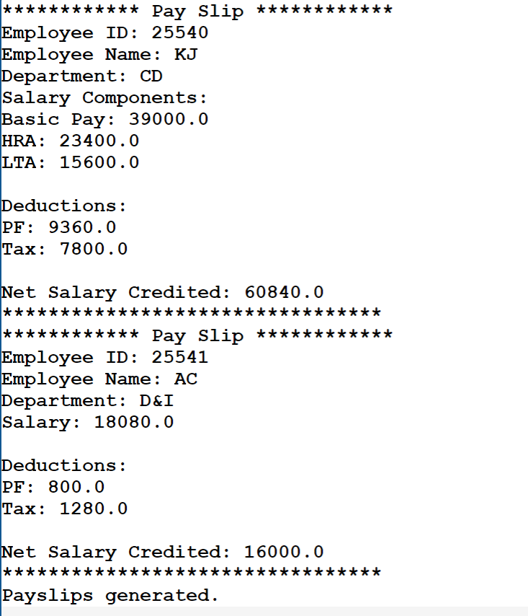
PaySlipGenerator Class

Slide 11
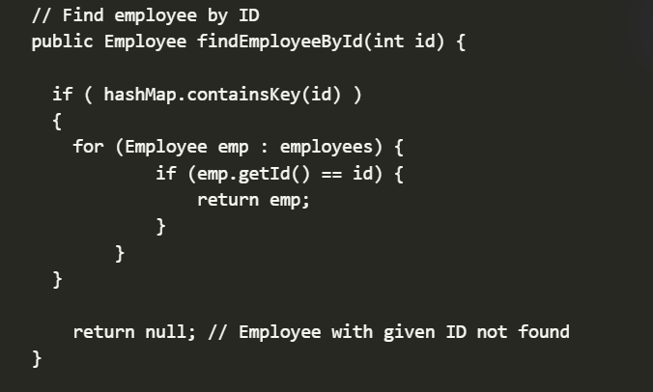
Sample Code Snippets
Below are some key code snippets demonstrating the implementation
Searching Employee by their Emp Id

Slide 12
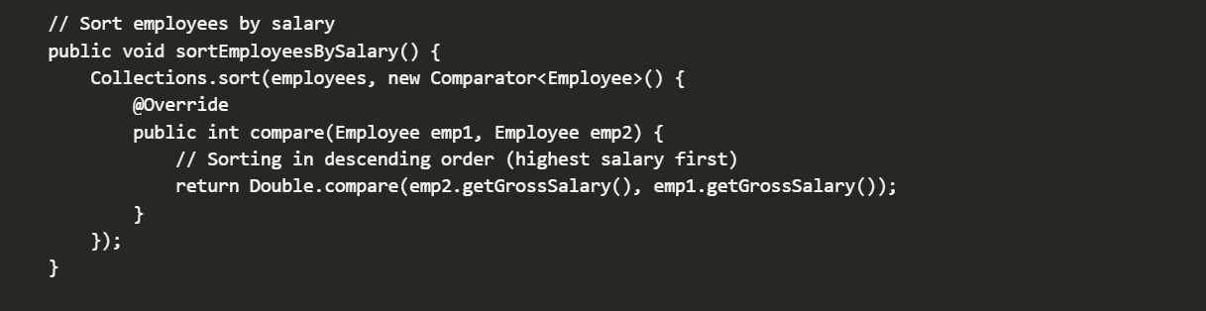
Sample Code Snippets
Below are some key code snippets demonstrating the implementation
Sorting Employee according to their salaries

Slide 13
Future Scope
The project can be enhanced further with the following features
Future Scope
Cloud Integration
Time attendance and Tracking
Generating pay slips as PDF
Integration with HR System

Slide 14
Conclusion
In conclusion, the Payroll System project efficiently manages employee information and computes salaries accurately. It demonstrates the effective use of Java 8 features and provides a solid foundation for future enhancements. With further development, it can be scaled to meet the needs of larger organizations and provide more advanced functionalities.

Slide 15
THANK YOU

