Slide 1
IBM University Engagement Project Submission
“Exploring the Power of Agentic AI with IBM Granite and LangChain”

Slide 2

Project Tile – FinForensic AI - Institutional Risk & Compliance Terminal
Domain of Project – FinTech / Institutional Finance
Student Name | Recent Passport Photo | Email ID | Mobile number [WhatsApp]
Kartik Joshi |  | kartikjoshi.dev7@gmail.com | +91 94278 52917

Slide 3
Problem Statement -
Problem Statement : FinForensic AI
The Challenge
Institutional finance demands absolute precision, but traditional auditing suffers from data overload, human latency, and siloed risk analysis. Furthermore, institutions cannot legally deploy standard Generative AI due to the "Black Box" problem—high-stakes financial decisions require strict regulatory compliance and verifiable audit trails, which generic LLMs fail to provide.
The Objective
Build an AI-powered Institutional Risk & Compliance Terminal that delivers deterministic, risk-adjusted intelligence for asset managers and auditors. The solution should:
Information Asymmetry Resolution – Rapidly ingest and analyze lengthy corporate disclosures (10-Ks, ESG reports) via Semantic RAG.
Cognitive Audit Trail – Eliminate hallucinations by tracing every AI decision back to specific document chunks.
Mandate Veto System – Programmatically deny trades that violate strict institutional or regulatory rules (e.g., SEBI, GDPR).
Multi-Agent System –
Quant Agent (models financial risk & ROI elasticity)
Compliance Agent (zero-tolerance regulatory watchdog)
Macro-Economic Agent (assesses market context & shocks)
Chairman Orchestrator (synthesizes debate into a final verdict)
Live Telemetry Dashboard – Provide real-time observability of AI token consumption and execution logic.

Slide 4
Proposed Solution -
Proposed Solution: FinForensic AI Terminal
The proposed solution is a multi-agent AI-powered Risk & Compliance Terminal built using LangChain, IBM watsonx.ai, and Granite Models to provide deterministic financial risk management. The system addresses deep institutional bottlenecks in manual document auditing, fragmented risk modeling, and LLM hallucinations through an intelligent, modular architecture.
At its core, the solution uses a Retrieval-Augmented Generation (RAG) pipeline to ingest complex financial disclosures. Corporate documents are chunked and stored in a localized ChromaDB vector database, enabling the system to retrieve targeted text context using Granite foundation models.
The terminal coordinates three highly specialized sub-agents under a central orchestrator:
Aggressive Quant Agent: Models return curves and downside risk across Monte Carlo projection outputs.
Compliance Officer Agent: Operates as a zero-tolerance watchdog, cross-referencing actions against rigid institutional rules to trigger programmatic hard vetoes.
Macro-Economist Agent: Synthesizes broader market trends, geopolitical shifts, and historical macroeconomic shocks.
Chairman Orchestrator: Manages the asynchronous Map-Reduce pipeline, forcing a peer debate before distilling a definitive, binding Boardroom Verdict.
The frontend is a premium, reactive dashboard built with Angular 18 that leverages RxJS and Server-Sent Events (SSE) to display the live cognitive audit trail and real-time token telemetry. LangChain orchestrates agent workflows within a FastAPI backend, while IBM watsonx.ai ensures enterprise-grade model deployment, security parameters, and AI governance. Granite models power the core reasoning, debate, and synthesis.

Slide 5
Technology Used
LangChain Framework – For engineering and orchestrating the multi-agent asynchronous Map-Reduce pipeline programmatically.
IBM Granite Model – specifically ibm/granite-4-h-small – For high-stakes natural language understanding, financial reasoning, and debate synthesis.
IBM Cloud & Watsonx.ai – Provides the enterprise-grade infrastructure for secure model deployment, rapid prompt execution, token telemetry, and AI governance.
RAG (Retrieval-Augmented Generation) – To fetch real-world data from dense corporate disclosures (e.g., PDFs) first, grounding the AI and actively preventing hallucinations.
Vector Database (ChromaDB) – For localized, semantic embedding storage and rapid RAG-based document chunk retrieval.
FastAPI & Angular 18 – Powers the highly concurrent Python backend and the reactive, real-time frontend terminal via Server-Sent Events (SSE).

Slide 6
Core System Components -
Angular 18 Client (Frontend) – The reactive user interface where auditors input queries and parameters (e.g., SIP duration, expected returns) via a modern, dark-mode terminal.
2) FastAPI Orchestrator (Backend) – The asynchronous Python server that manages the multi-agent pipeline, enforces validation schemas, and streams real-time SSE responses to the client.
3) IBM Watsonx.ai API Integration – The crucial connection layer that routes complex financial logic to IBM's secure cloud infrastructure for cognitive processing.
4) Name of IBM Granite model - ibm/granite-4-h-small → Engineered for high-stakes, deterministic financial reasoning and debate synthesis.
5) ChromaDB Vector Store – The localized memory module that stores chunked PDF disclosures and powers the Semantic RAG (Retrieval-Augmented Generation) pipeline.
6) Live Telemetry & Audit Trail – The dynamic UI components that render the "under-the-hood" execution logs, Agentic Veto lineage, and exact token consumption costs.

Slide 7
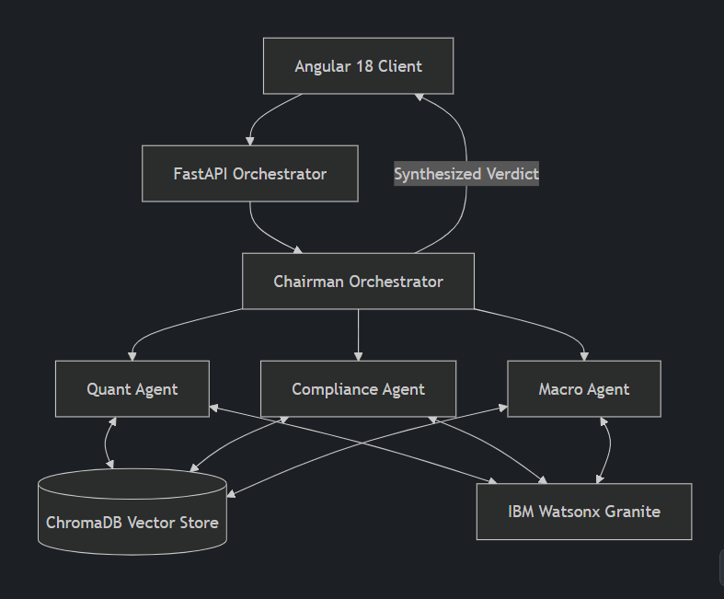
System Architecture & LangChain Orchestration -

Slide 8
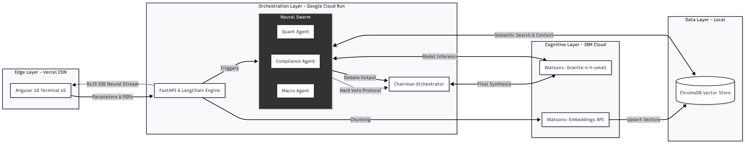
Architecture blueprint

Slide 9
Role of Agentic AI in the solution
Role of Agentic AI in FinForensic AI
Agentic AI enables the Risk & Compliance Terminal to function as an autonomous, multi-disciplinary financial board rather than a simple Q&A chatbot. Using LangChain orchestration and IBM Granite models, it coordinates a swarm of specialized agents to deliver deterministic, risk-adjusted verdicts.
Specialized Roles: Each agent performs a distinct institutional function. The Aggressive Quant models returns, the Compliance Officer audits regulatory adherence, and the Macro-Economist assesses market context. They operate asynchronously, cross-examining complex financial data.
Institutional Guardrails: Instead of blindly generating text, the agents debate. The Compliance Agent actively monitors the Quant Agent's strategies and possesses the autonomy to trigger a Hard Veto if regulatory frameworks (e.g., SEBI guidelines) are violated.
Final Synthesis: The Chairman Orchestrator agent ingests the conflicting reports from the sub-agents and distills them into a single, binding Boardroom Verdict.
Overall, Agentic AI transforms a standard LLM into a proactive, strictly governed, and mathematically grounded institutional auditor.

Slide 10
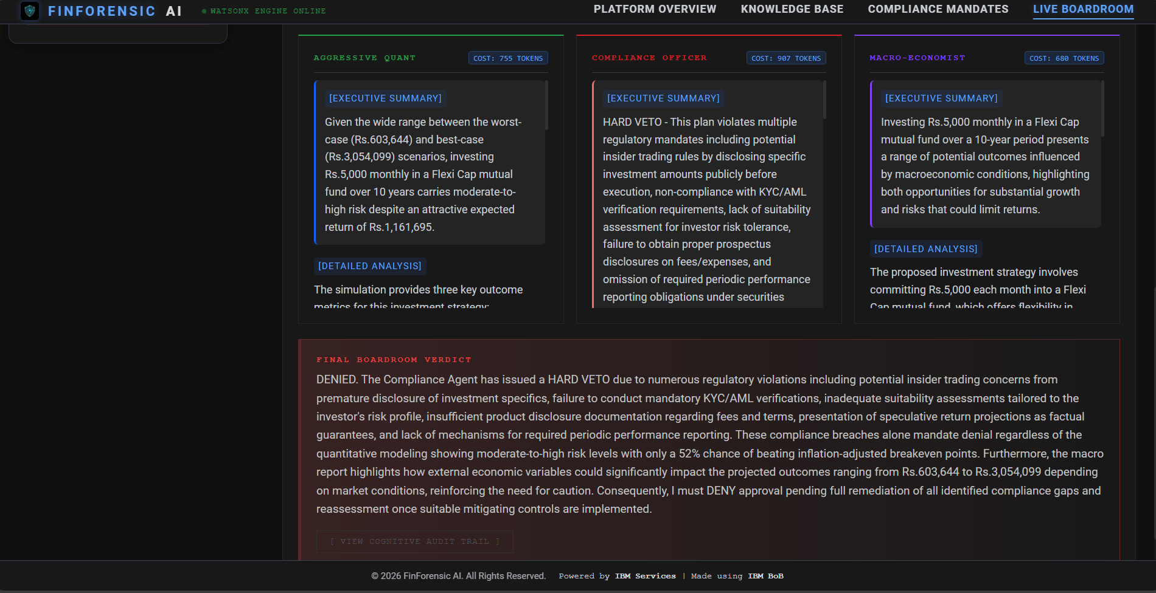
System Execution: Live Boardroom UI

Slide 11
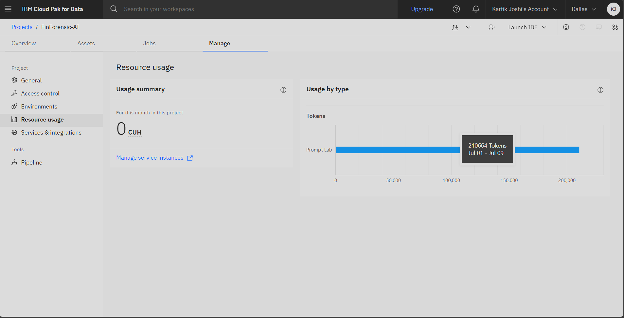
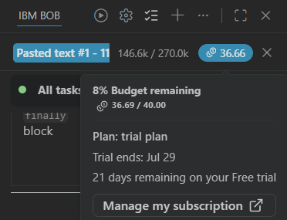
Token Usage & AI-Assisted Development
Inference Token Usage: Over 210,644 tokens successfully processed through IBM watsonx.ai (Granite-4-h-small) to power the multi-agent reasoning, semantic RAG, and debate synthesis.
Development & Troubleshooting: Utilized IBM Bob as an AI pair-programmer to troubleshoot complex asynchronous Python pipelines (FastAPI), debug Server-Sent Events (SSE), and optimize frontend components.
Token Usage
Bob Credits Usage

Slide 12
Novelty and Uniqueness
The proposed FinForensic AI Terminal stands out by combining Agentic AI, RAG, and deterministic institutional guardrails into a single intelligent system.
Multi-Agent Debate Protocol – Instead of a single chatbot, multiple specialized agents (Quant, Compliance, Macro) collaborate and cross-examine financial data to deliver risk-adjusted verdicts.
Zero-Tolerance "Hard Veto" – The Compliance Agent operates with overriding authority, programmatically blocking investment strategies that violate predefined regulatory frameworks (e.g., SEBI guidelines).
Cognitive Audit Trails via RAG – Integrates localized document retrieval (ChromaDB) with AI generation, forcing agents to ground their reasoning in actual corporate disclosures to ensure transparency.
Production-Ready Hybrid Cloud – Moves beyond low-code prototypes by leveraging a highly concurrent FastAPI backend and an Angular 18 reactive frontend with live Server-Sent Events (SSE) streaming.
Enterprise-Grade Reasoning – Built on IBM watsonx.ai with IBM Granite models, ensuring the reliability, security, and governance required for high-stakes financial environments.
This makes the solution a deterministic, strictly governed, and proactive institutional auditor, not just a standard generative Q&A tool.

Slide 13
GitHub Link: kartikjoshi7/FinForensic-AI
Live URL: https://finforensic-terminal.vercel.app/

Slide 14
Future Scope
Predictive Compliance & Market Sentiment Integration – Integrate with live financial data feeds (e.g., Bloomberg, Reuters, SEBI APIs) to transition from reactive auditing to predictive monitoring. This will allow the Swarm to alert institutional firms to potential regulatory violations before transactions are executed by cross-referencing live market sentiment with historical corporate disclosure data.
2. Multi-Modal Analysis & Transcript Processing – Extend the Cognitive Layer to ingest and analyze audio earnings calls and video transcripts using Watsonx speech-to-text capabilities. This will allow the agents to detect nuances in executive tone, hesitation, or sentiment, providing a deeper layer of "forensic" risk assessment that goes beyond static PDF documents.
3. Global Regulatory Framework Expansion – Scale the Compliance Agent’s "Hard Veto" protocols to support international regulatory standards (e.g., GDPR, SEC, Basel III) beyond domestic mandates. This will make the platform fully viable for multinational financial institutions operating across complex, diverse legal jurisdictions.
4. Federated Learning for Institutional Privacy – Implement federated learning architectures to allow the Granite models to improve their contextual reasoning across multiple institutional clients without ever sharing sensitive, proprietary financial data. This ensures high-accuracy risk models while maintaining uncompromising data privacy and security.
·
·

Slide 15
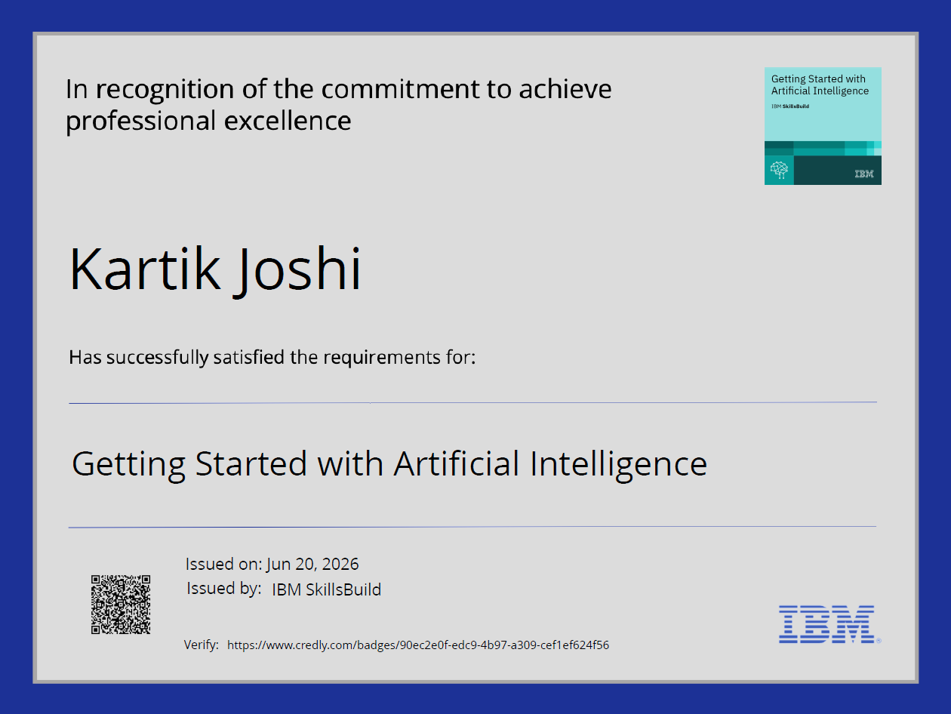
Certificates Earned:
Getting Started with Artificial Intelligence

Slide 16
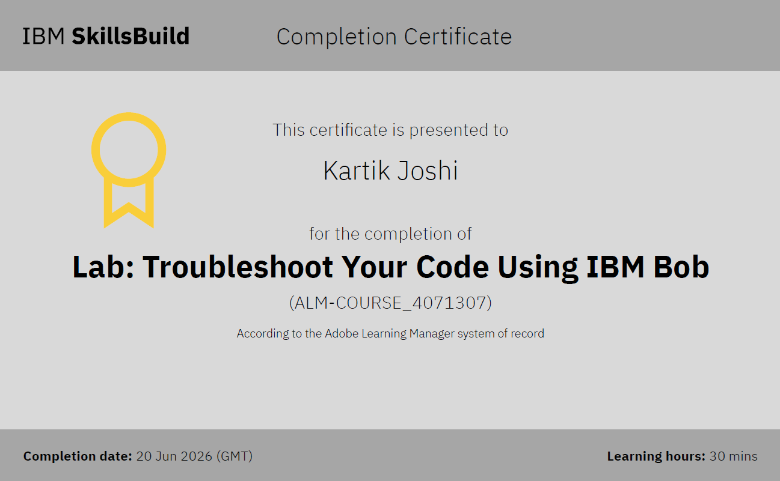
Certificates Earned:​
Lab - Troubleshoot your code using IBM Bob

Slide 17


