Slide 1

Website: www.hcltech.com

Slide 2

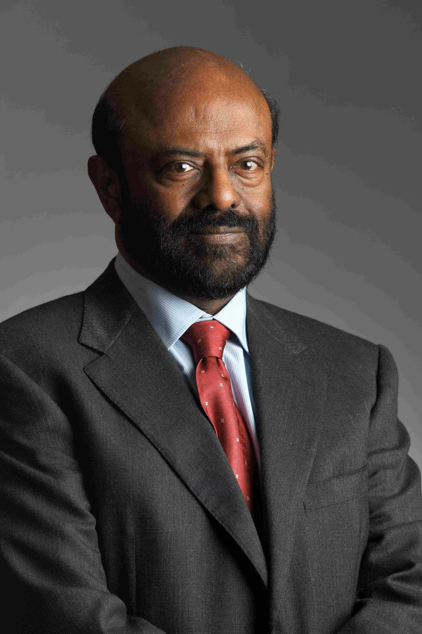
FOUNDER : SHIV NADAR YEAR : 1976 CEO & MANAGING DIRECTOR : C. VIJAYAKUMAR CHAIRPERSON: ROSHINI NADAR MALHOTRA HEADQUARTER : NOIDA , UTTAR PRADESH employees : 224,000+(as per 2024) PRESENCE : 66O COUNTRIES
ABOUT HCLTECH

Slide 3
HISTORY & EVOLUTION
1976: Founded as Hindustan Computers Limited
1991: HCL Technologies created to focus on software & IT services
2000s: Expanded globally across the US, Europe, and Asia
2019: Acquired IBM software products – major boost to product portfolio
Today: Among India’s top 3 IT companies, serving Fortune 500 clients

Slide 4

IT & Business Services (ITBS)
Engineering & R&D Services (ERS)
DOMAIN
OF
WORK
Digital & Analytics Services
Cloud Services
Cybersecurity & Risk Management
Enterprise Application Services

Slide 5

Cloud Technologies
TECHNOLOGIES
USED
DevOps & Automation,
AI & ML
Cybersecurity Technologies
IoT & Edge Computing

Slide 6
VISION
"We bring together the best of technology and our people to supercharge progress."
MISSION
"To be the partner and employer of choice, by delivering technology-led business transformation and empowering people to find their spark."
HCLTech’s Work Strategy – Mode 1-2-3
Mode 1: core it services(effciency , modernization)
Mode 2 : next-gen sevices (cloud , digital , AI , IoT)
Mode 3 : IP&Software products(HCLsoftwares)
Financials & Market Position
FY 2023-24 Revenue: Over $13 billion

