Slide 1
Keen Hackathon
CHALLENGE : TU DORTMUND
GROUP MEMBERS:
SAYALI BARVE KARTIK KADUR
PRUTHA MODAK KAVYASHREE RENUKACHARI
SOURABH RANADE

Slide 2
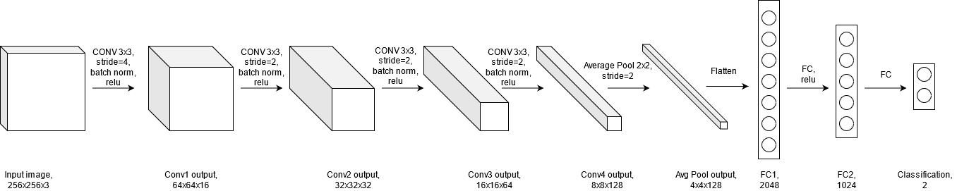
Model and Dataset Configuration
Our model is a minimalistic approach to solve the problem of Condition Detection via AI Image Recognition.
Our model uses just four Convolution layers along with one average pool layer and two fully connected layers.
The model accepts input image shapes which multiple of 64(128,256,512).
Dataset is normalized with mean and standard deviation which is calculated over training dataset.

Slide 3
Software/Hardware Stack:
Used the Pytorch framework to build the model architecture.
In order to improve the training performance we have made use of preloading multiple batches of dataset.
We have used the following hardware specifications:
GPU : NVIDIA GTX 1660Ti – 6GB VRAM
RAM: 16GB

Slide 4
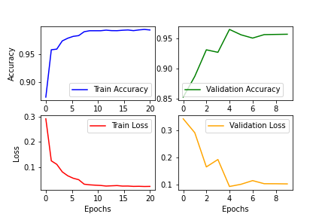
Hyperparameter and Results :
Hyperparameters:
Optimizer : Adam
Epochs : 20
Batch Size : 64
Initial Learning Rate : 0.0001
Loss Function : CrossEntropyLoss
Result: Validation accuracy - 95.7%.

