Slide 1

DEPARTMENT OF COMPUTER SCIENCE AND ENGINEERING (AI)
Principles of Computer Vision
AI-Virtual Mouse System
TEAM MEMBERS
Sl. No. | Name | Roll No.
1. | Kartik Mittal | 215890116
2. | Ananya Gupta | 215890030
3. | Anshuman Mukherjee | 215890086
4. | Sakcham Gupta | 215890050
COURSE INSTRUCTOR
Dr. Megha. P. Arakeri Professor Dept. of Computer Science and Engineering MIT Bengaluru [MAHE]

Slide 2

Outline
Introduction
Objectives
Packages
Methodology
Results and Accuracy
Conclusion
References

Slide 3
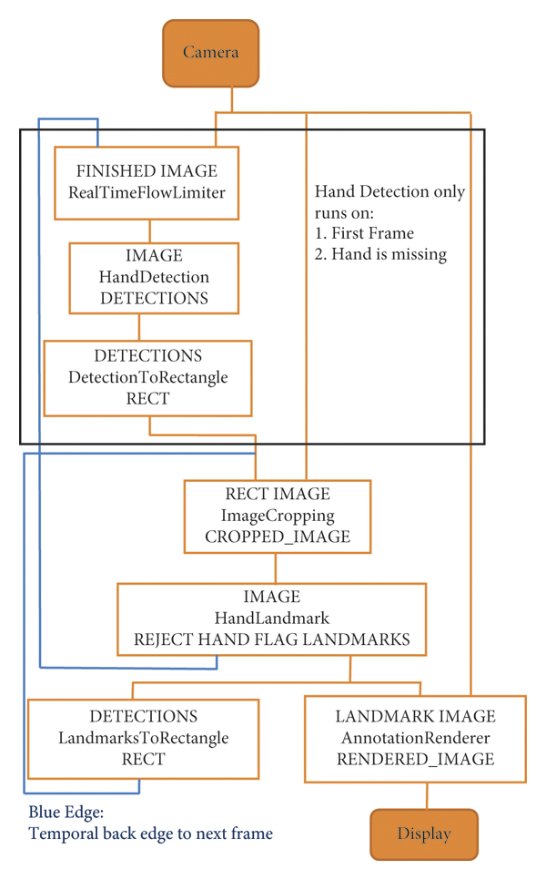
Introduction
This projects presents an AI virtual mouse that uses computer vision to perform computer mouse operations
The main purpose of the system is to perform computer mouse cursor functions and scrolling functions using a built-in camera on the computer, rather than using a traditional mouse device.
The model uses the MediaPipe package to track hands and arms, and also uses the
PyAutoGUI and OpenCV
Mediapipe hand recognition graph as show in the figure.

Slide 4
Objective
The main objective of the proposed AI virtual mouse system is to develop an alternative to the regular and traditional mouse system.
Other objectives can be:
Accessibility
Convenience
Flexibility
Hygiene and safety
Efficiency

Slide 5
Packages
The packages used in the project are as follows:
OpenCV: OpenCV, short for Open Source Computer Vision Library, is a widely used open-source computer vision and machine learning software library
MediaPipe: Mediapipe is an open-source framework developed by Google that facilitates the development of customizable machine learning pipelines for various media processing tasks
PyAutoGUI: PyAutoGUI is a Python library that enables programmatically controlling the mouse and keyboard.
Math: The math module is a standard module in Python to perform Mathematical calculations.
Enum: Enum is a class in python for creating enumerations, which are a set of symbolic names (members) bound to unique, constant values.

Slide 6
Packages
PyCaw: The PyCaw package, also known as Python Core Audio Windows, is a Python library that facilitates easy access to the Windows Core Audio API.
ComTypes: It enables seamless integration between Python and the Windows-based COM components, allowing for the manipulation and automation of various software applications and services.

Slide 7
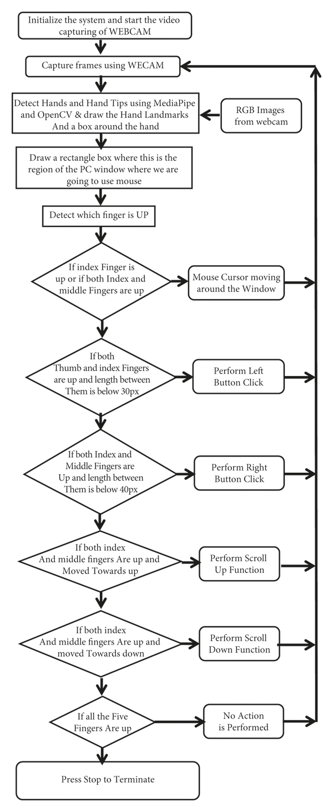
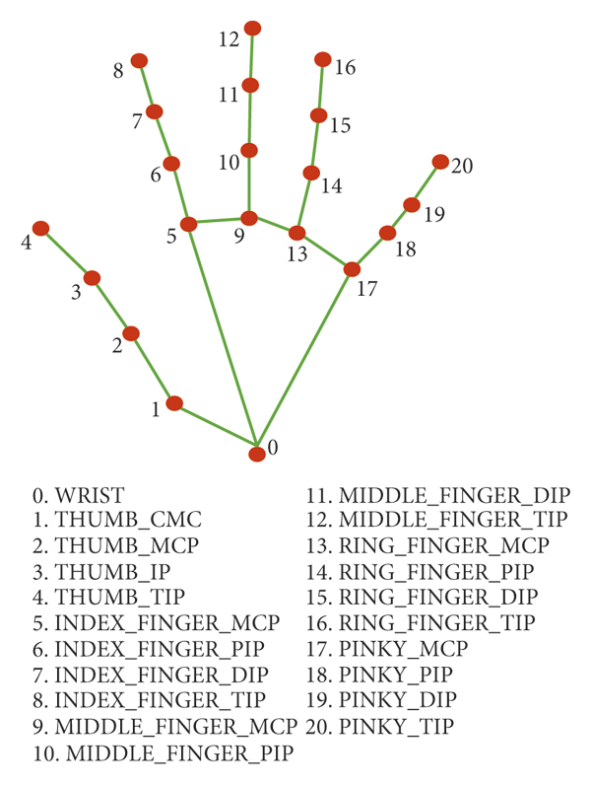
Methodology
The various functions and conditions used in the system are explained in the flowchart of the real-time AI virtual mouse system in Figure on right.
Single-shot detector model is used for detecting and recognizing a hand or palm in real time.
A model of hand landmark consists of locating 21 joint or knuckle co-ordinates in the hand region, as shown in Figure on left.

Slide 8
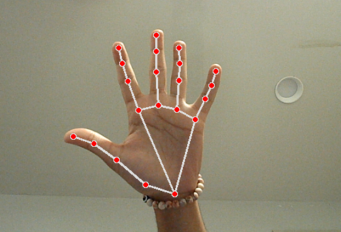
Methodology
The Camera Used in the AI Virtual Mouse System
Leveraging the capabilities of the Python computer vision library OpenCV, the system initiates video capture via a designated video capture object, as depicted in Figure
Capturing the Video and Processing
The video frames are processed from BGR to RGB color:
def findHands(self, img, draw = True):
imgRGB = cv2.cvtColor(img, cv2.COLOR_BGR2RGB)
self.results = self.hands.process(imgRGB)

Slide 9
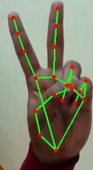
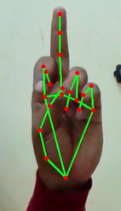
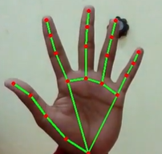
Methodology
Detecting Which Finger Is Up and Performing the Particular Mouse Function
In this stage, we are detecting which finger is up using the tip Id of the respective finger that we found using the MediaPipe.
No action:
Move Cursor:
Left Click:

Slide 10
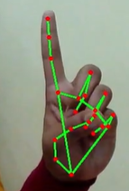
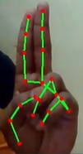
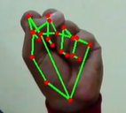
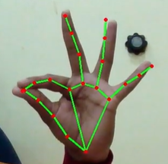
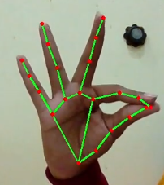
Methodology
Right Click:
Double Click:
Drag/Drop:
Volume Control:
Scrolling:

Slide 11
Results and Accuracy
Cross comparison of the testing of the AI virtual mouse system is difficult because only limited numbers of datasets are available.
An experimental test has been conducted to summarize the results shown in Table
Mouse function performed | Success | Failure | Accuracy (%)
Mouse movement | 100 | 0 | 100%
Left button click | 98 | 2 | 98%
Right button click | 99 | 1 | 99%
Scroll function | 93 | 7 | 93%
Volume control | 96 | 4 | 96%
No action performed | 100 | 0 | 100%
Result | 681 | 19 | 97.28%
The test was performed 25 times by 4 persons resulting in 600 gestures with manual labelling.
This test has been made in different light conditions and at different distances from the screen
10 times in normal light conditions, 5 times in faint light conditions, 5 times in close distance from the webcam, and 5 times in long distance from the webcam.

Slide 12
Results and Accuracy

Slide 13
Conclusion
Based on the model's outcomes, it can be concluded that the proposed AI virtual mouse system exhibits superior performance and accuracy
The AI virtual mouse holds promise for real-world applications and can contribute to reducing the spread of COVID-19.
However, the model does encounter certain limitations, such as a slight reduction in accuracy during Volume functions and scrolling window
To address these issues, our next focus will involve enhancing the finger-tip detection algorithm to yield more precise and reliable results.

Slide 14
References
S. Shriram, B. Nagaraj, J. Jaya, S. Shankar, P. Ajay, "Deep Learning-Based Real-Time AI Virtual Mouse System Using Computer Vision to Avoid COVID-19 Spread", Journal of Healthcare Engineering, vol. 2021, Article ID 8133076, 8 pages, 2021.
View at: Publisher Site
MediaPipe Framework in Python | Google for Developers
Mouse Control Functions — PyAutoGUI documentation

