Slide 1

DEPARTMENT OF COMPUTER SCIENCE AND ENGINEERING (AI)
OPEN-SOURCE TECHNOLOGIES LAB CSE_2164
TEXT-TO-SPEECH(TTS)
TEAM MEMBER
Sl. No. | Name | Roll No.
1. | Kartik Mittal | 215890116
COURSE INSTRUCTORS
Dr. Simi VR Assistant Professor (Senior scale) Dept. of Computer Science and Engineering MIT Bengaluru [MAHE]
Dr. Deepti Gupta Assistant Professor (Senior scale) Dept. of Computer Science and Engineering MIT Bengaluru [MAHE]

Slide 2

Outline
Introduction - Slide 3
Problem Statement - Slide 4
Objectives - Slide 5
Methodology - Slides 6-11
Implementation Details - Slides 12-17
(Technology, Content, Visuals,
Usability, Conventions)
Results - Slides 18
Conclusion - Slides 19
References - Slides 20

Slide 3
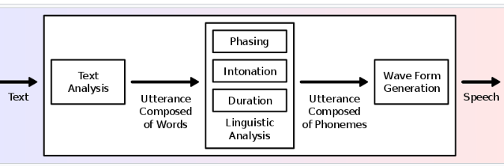
Introduction
A text-to-speech (TTS) system converts normal language text into speech; other systems render symbolic linguistic representations like phonetic transcriptions into speech. The reverse process is speech recognition.
Speech synthesis is the artificial production of human speech. A computer system used for this purpose is called a speech synthesizer, and can be implemented in software or hardware products.
Overview of a typical TTS system

Slide 4
Problem Statement
Speech synthesis, or the artificial production of the human voice, has come a long way over the last 70 years. Whether you currently use text-to-speech services to listen to books, study or proofread your written work, there’s no doubt that text-to-speech services have made life easier for people in a variety of professions or any disabled person. Hence, a basic Text-To-Speech web app would be made so that It can help many people, using HTML and CSS for frontend and Javascript for the working of web app using Web Speech API.

Slide 5
Objectives
To develop a web application using HTML/CSS/JS for implementing Text-To-Speech.

Slide 6
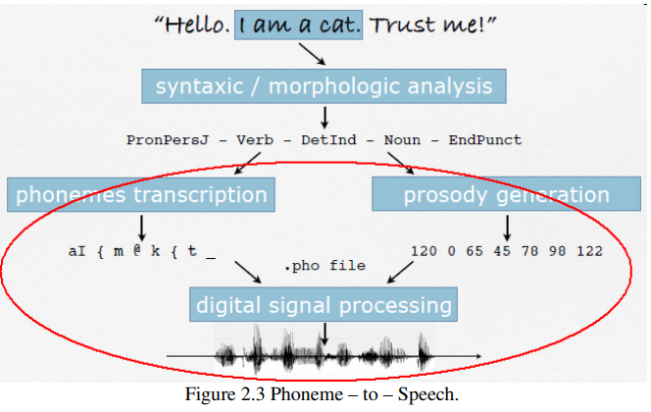
Methodology
Working of the API: Behind the scene.
A Text–to–Speech system (or “engine”) is composed of two main parts [2]: Texts–to–Phoneme (Natural Language Processing, NLP) and Phoneme–to– Speech (Digital Signal Processing, DSP).
Texts–to–Phoneme: Also called a Grapheme–to–Phoneme conversion, the process of assigning phonetic transcription to words. The text must be converted into a linguistic representation that includes the phonemes to be produced, their duration, 11 the location of phrase boundaries, and the pitch / frequency contours for each phrase.
Phoneme–to–Speech: The Phonetic transcription and prosody information obtained in the linguistic analysis stage are converted into an acoustic waveform.

Slide 7
Methodology
Files used:
index.html
style.css
script.js
In the JavaScript code,
First, I got the user text and call a function textToSpeech() with passing user text as an argument. Inside this function, using the speech synthesis property of the window object, I converted the entered text to speech. Speech Synthesis is a web speech API that controls the speech service.
After this, I got all available voices from the user device using the getVoices() method of Speech Synthesis and insert it into HTML select tag.

Slide 8
Methodology
There are 6 properties of web speech API which we can tweak from and I used 5 of them,
Text
The text property gets and sets the text that will be synthesized when the utterance is spoken. The text can be provided as plain text.
2. Volume
The volume property gets and sets the volume of the utterance. It is a float that represents the volume value, between 0 (lowest) and 1 (highest). The default value is 1 if this property is unset.

Slide 9
Methodology
Rate
The rate property gets and sets the rate of the utterance. It is a float representing the rate value which can range between 0.1 (lowest) and 10 (highest). The default value is 1 if this property is unset.
4. Pitch
The pitch property gets and sets the pitch of the utterance. It is a float representing the pitch value that can range between 0 (lowest) and 2 (highest). The default pitch is 1 if this property is unset.

Slide 10
Methodology
5. Voices
The voice property gets and sets the voice that will be used to speak the utterance. This should be set to one of the SpeechSynthesisVoice objects. If it is not set, the most suitable default voice available for the utterance’s language setting will be used.

Slide 11
Methodology
In HTML file,
An empty select menu. We will fill the empty select menu with the list of voices available using JavaScript.
Range sliders for volume, pitch, and rate.
A text area to type in.
Control button for speech.
In CSS file,
All the design elements are implemented to improve the look and feel of the whole webpage.

Slide 12
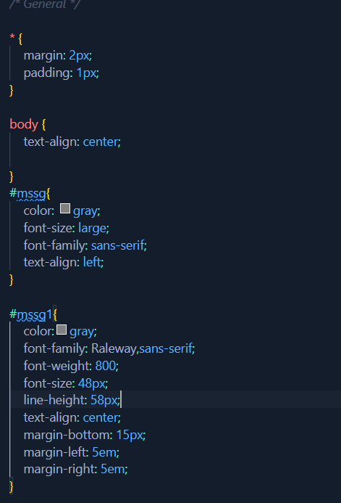
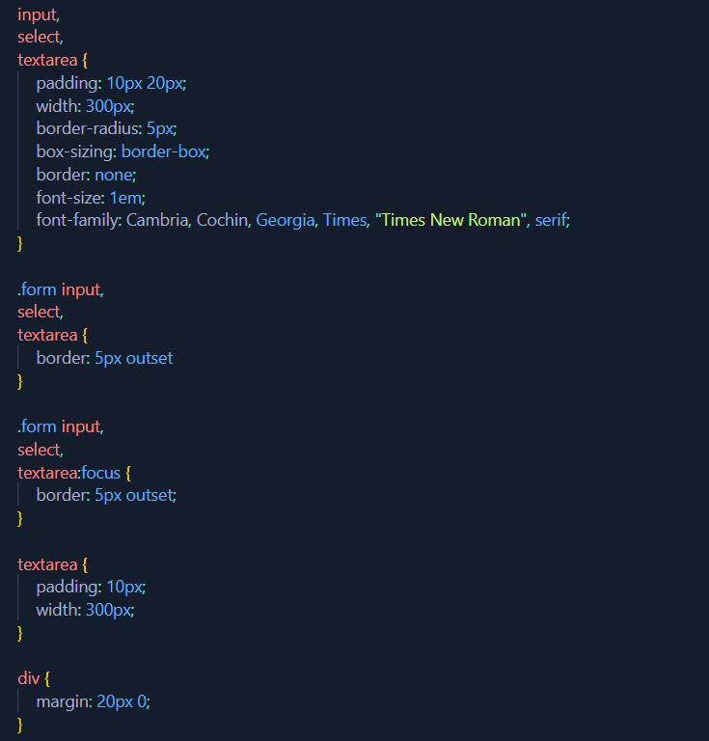
Implementation
CSS Code snips

Slide 13
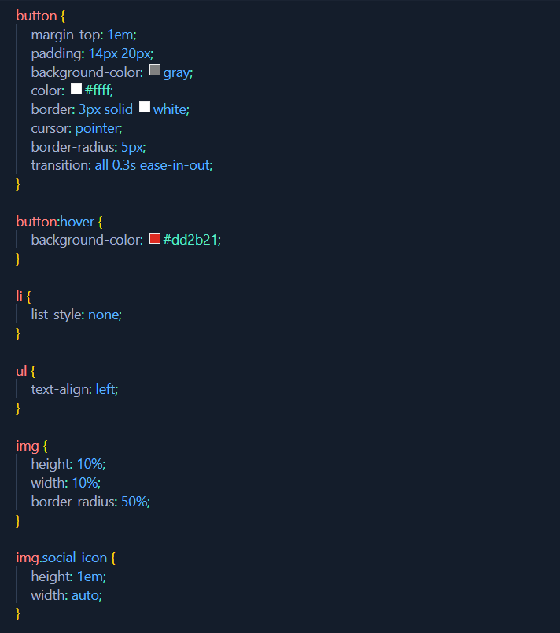
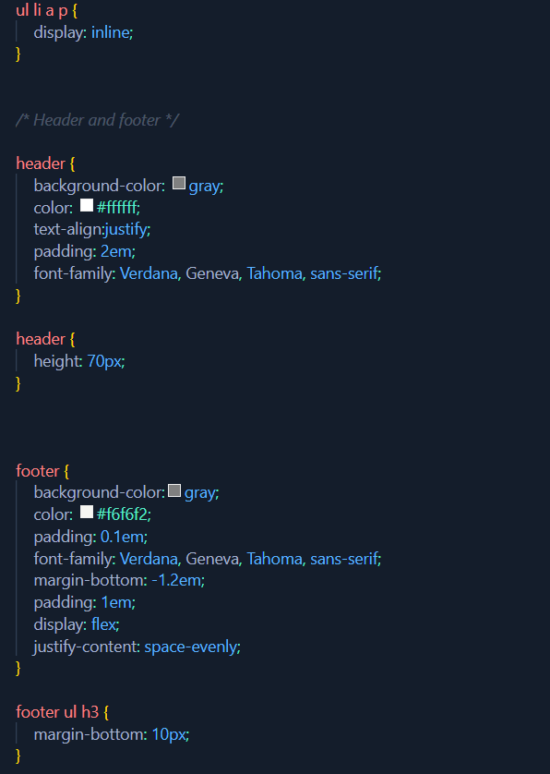
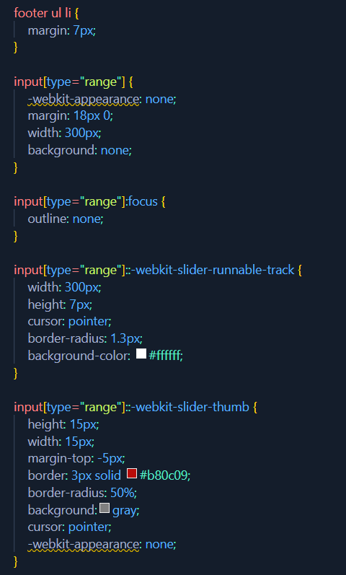
Implementation

Slide 14
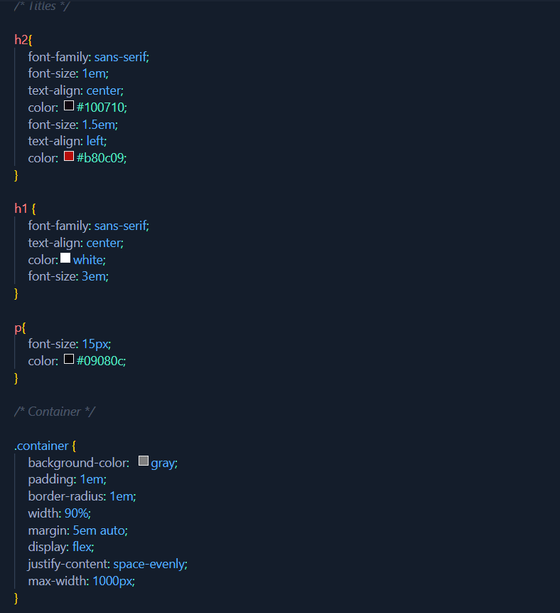
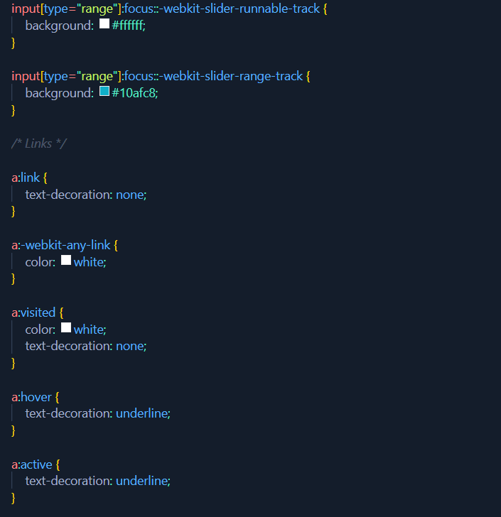
Implementation

Slide 15
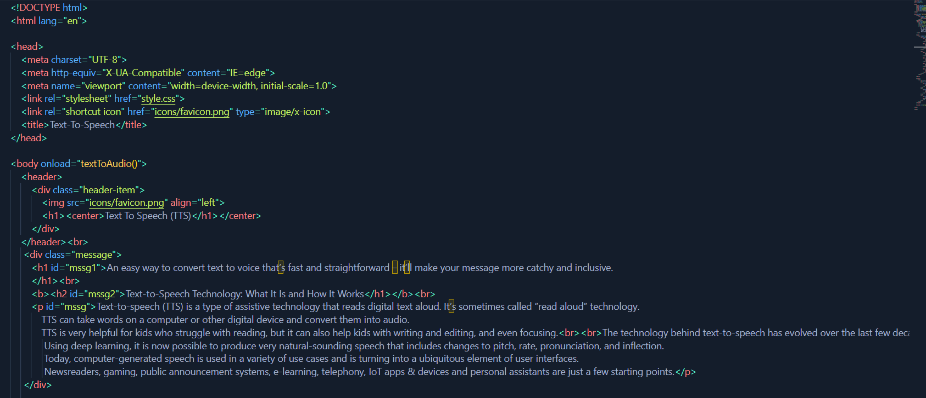
Implementation
HTML CODE SNIPS

Slide 16
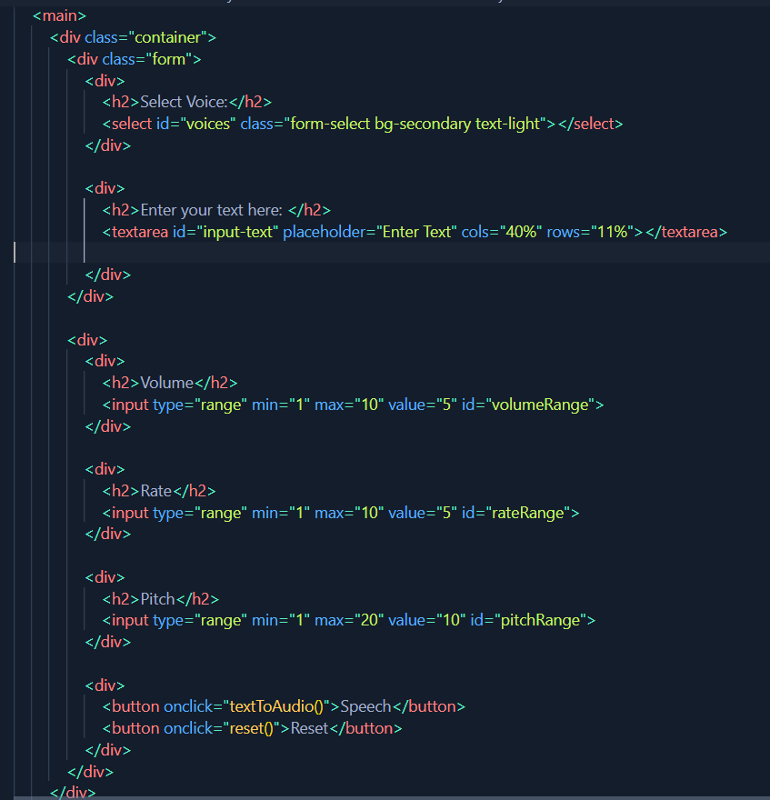
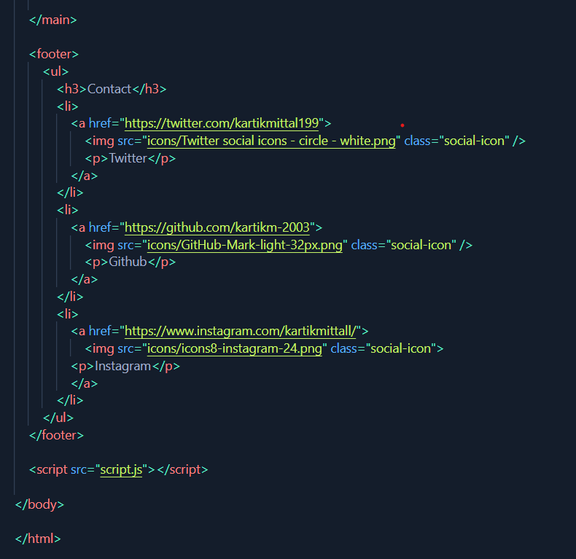
Implementation

Slide 17
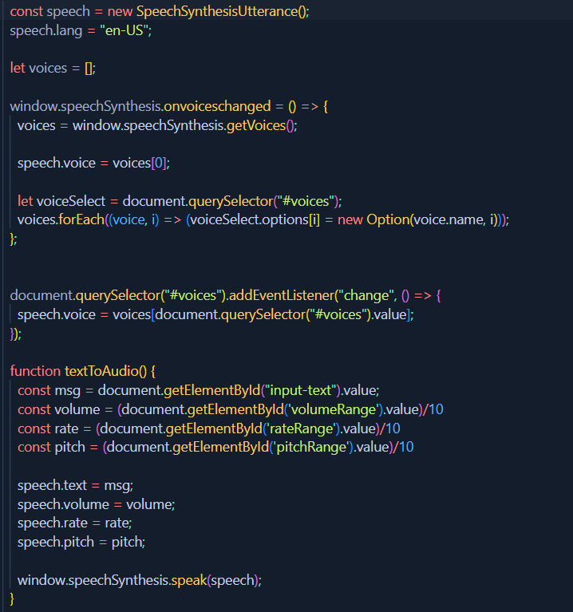
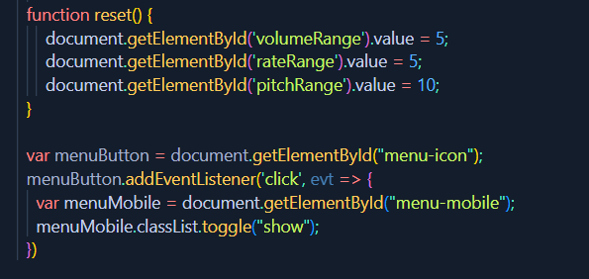
Implementation
JAVASCRIPT CODE SNIPS

Slide 18
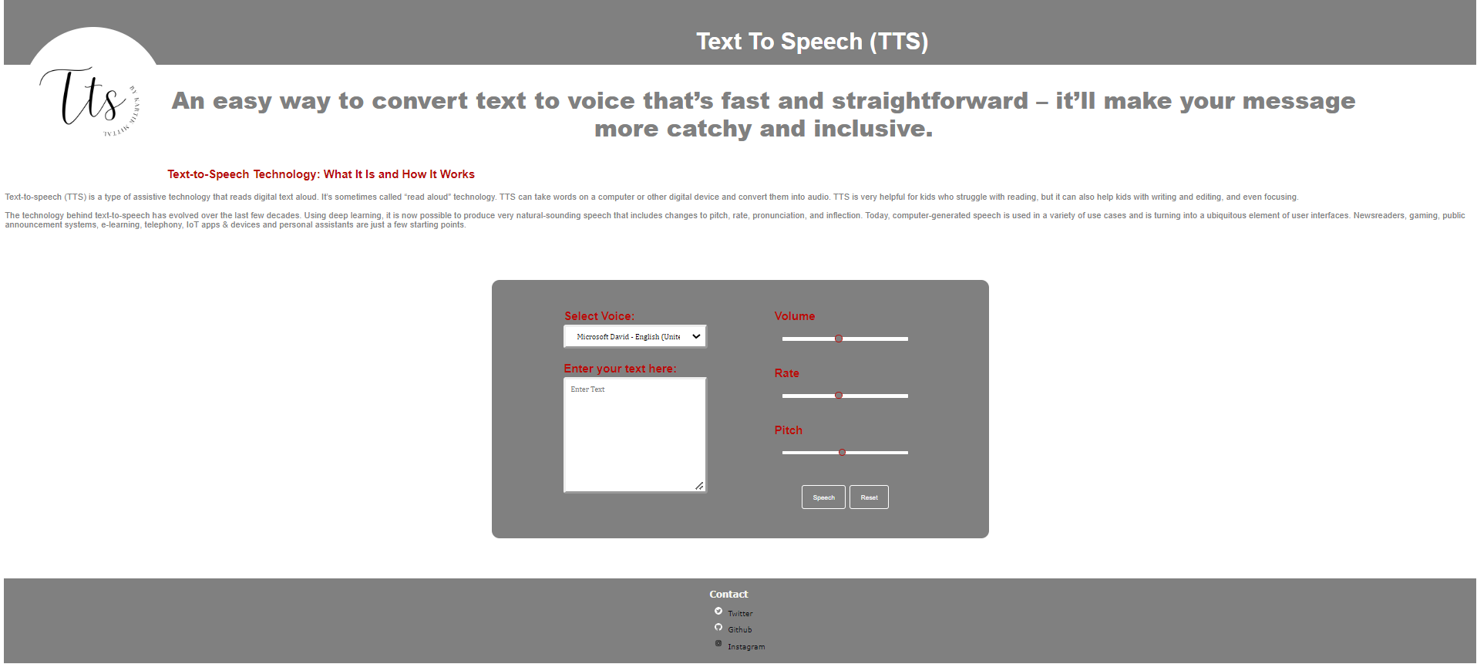
Results

Slide 19
Conclusion
Hence, We have successfully implemented Web app project of Text-To-Spech using HTML/CSS/JS by integrating Web speech API.

Slide 20
References
https://www.theseus.fi/bitstream/handle/10024/39427/Thesis_TextToSpeech_software_comparison_by_YingZheng.pdf;jsessionid=4E34D13EC1DD191B3FA314D123AEDCEA?sequence=1
A Short History Of Text-to-Speech | Speechify

