Slide 1
Yelp Restaurant Image Classification
Team Members
Kunal singh Deora
Manasi laddha
Pranay goyal

Slide 2
Problem Statement
Yelp users have to manually select restaurant label when they are uploading the image.
Selecting label is optional ; leaving some restaurants partially/uncategorized
No model available to automatically tag images with multiple labels
Human image tagging is not accurate

Slide 3
Our Proposal
Build a predictive model which classify user-submitted photos and automatically tag restaurants with multiple labels
0: good_for_lunch
1: good_for_dinner
2: takes_reservations
3: outdoor_seating
4: restaurant_is_expensive

Slide 4
Actors/Use Cases
Actor
Yelp business is our sole actor in the system
Use Cases
Yelp user can see the predicted tags for the business
Yelp user can search the businesses based on a tag

Slide 5
Architecture of Application
Data Processing & Cleaning
Feature Vector Generation
Building CNN Model of Each Business Label
(Concurrent Execution)
Training, Testing and Saving CNN Model
(Concurrent Execution)
Validation of CNN Model
Predicting Labels on Business Images
(Concurrent Execution)
Analyzing the Prediction
(>94% )
Generating Prediction CSV to Load in MySQL

Slide 6
Magnitude of Dataset
train_photos.tgz - photos of the training set (234,545 images)
test_photos.tgz - photos of the test set (500 images)
train_photo_to_biz_ids.csv - maps the photo id to business id (234,545 rows)
test_photo_to_biz_ids.csv - maps the photo id to business id ( 500 rows)
train.csv - main training dataset. Includes the business id's, and their corresponding labels. (1996 rows)
Reference link : https://www.kaggle.com/c/yelp-restaurant-photo-classification/data
Note – 12 % of Original Data (6.5GB)

Slide 7
Infrastructure
User Interface – Play Framework, Scala Controllers, Lightbend Activator, JavaScript, Bootstrap, CSS, HTML
Database – In memory database (MySQL) and Slick for database querying
Apache Spark – Scala Integration – Convolutional Neural Network Algorithm implemented in Scala using DeepLearning4J.
Data Cleaning & Preparation – Scala, MS Excel

Slide 8
Feature Vector Generation
Image Dataset
Image Preprocessing -> Squaring , RGB Vectoring, GrayScaling
Mapping Image Vectors with Image IDs
Biz-Image Dataset
Data Cleaning -> Removing Businesses with no Image Dataset or <20 Images
Mapping Business Ids with Image IDs
Biz-Label Dataset
Mapping Business Ids with Labels
Data Cleaning -> Removing Business with no Labels and Labels > 5
Transformed Data Set to Generate ND4J Dataset
List [ Int, String , Vector[Int], List[Int] ]

Slide 9
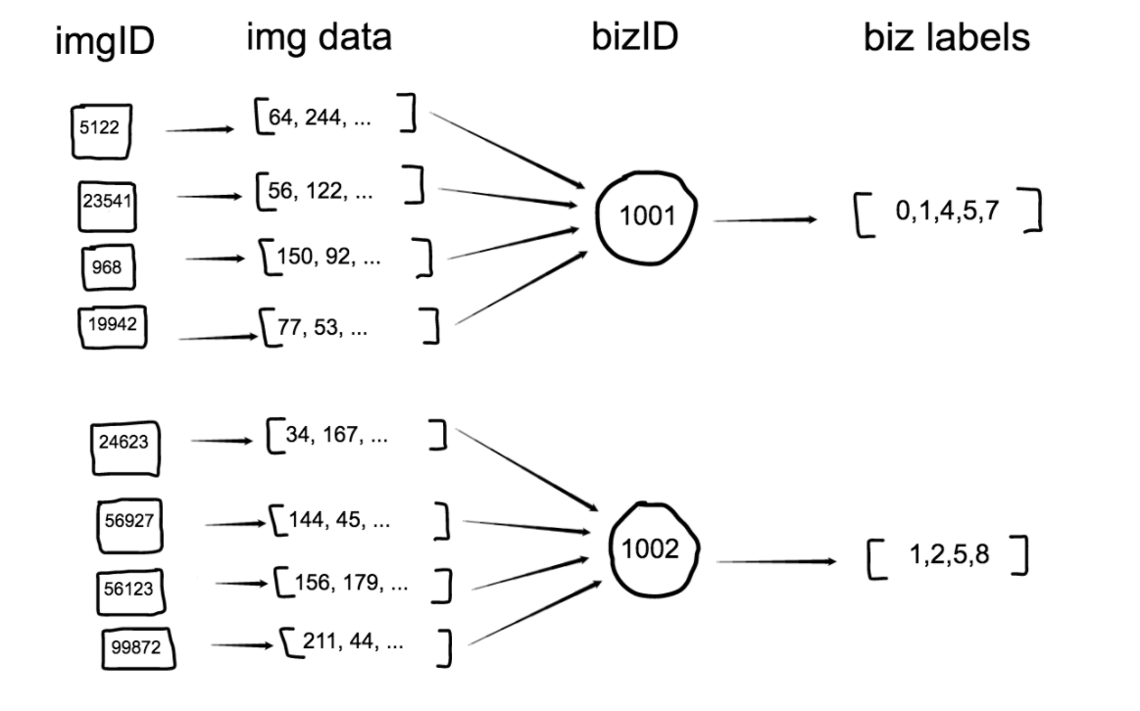
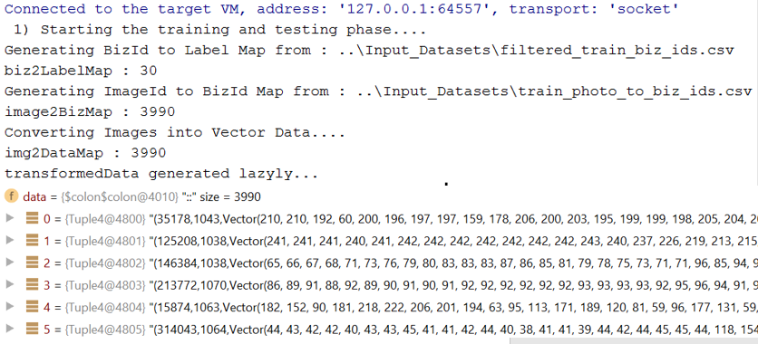
Feature Vector Generation Continued….

Slide 10
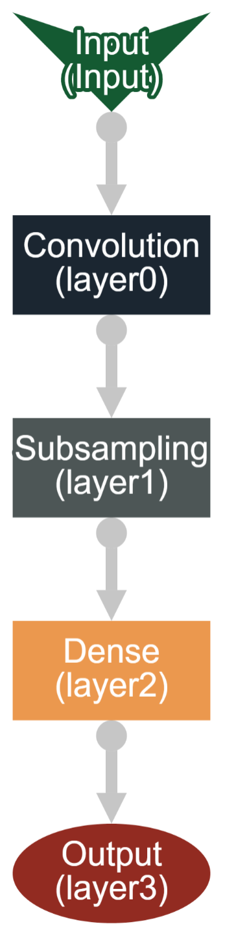
Image Classifier CNN Model
Normalization, Shuffle and Split ND4J Dataset : 70 % Training, 10% Validating and 20% Testing
Convert this to Dataset Listener to Work in Mini Batch Mode
Layers of Model –
1) Convolution Layer:
Input Feature Matrix – 16384 Features + 2 Labels
2) Subsampling layer: Shuffle the data for each epoch
3) Dense Layer:
Hidden Layer that classify features extracted by the convolutional layers
4) Output Layer : 2 Outputs - 0 or 1 for the Model Label
Configuration: Stride: (2,2) Learning rate (0.01) epochs(20)
Loading and saving the CNN as Model.json with Model configurations and Model.bin with Model parameters

Slide 11
Challenges in Implementing CNN
Parameter Selection for CNN Model Architecture to Improve Accuracy
Seed
Learning Rate
Stride
No of Layers*
No of Iterations *
No of Epochs *
Dataset Counts
Execution Time
Sequential Execution of Each Model took 30-40 minutes
Parallel Execution of 5 Models took 100 minutes
Memory Overflow with ND4J
Mini Batches to avoid overflow issues with 7000 images. Batch Size 128
Created Data Set Iterator instead of Dataset Object

Slide 12
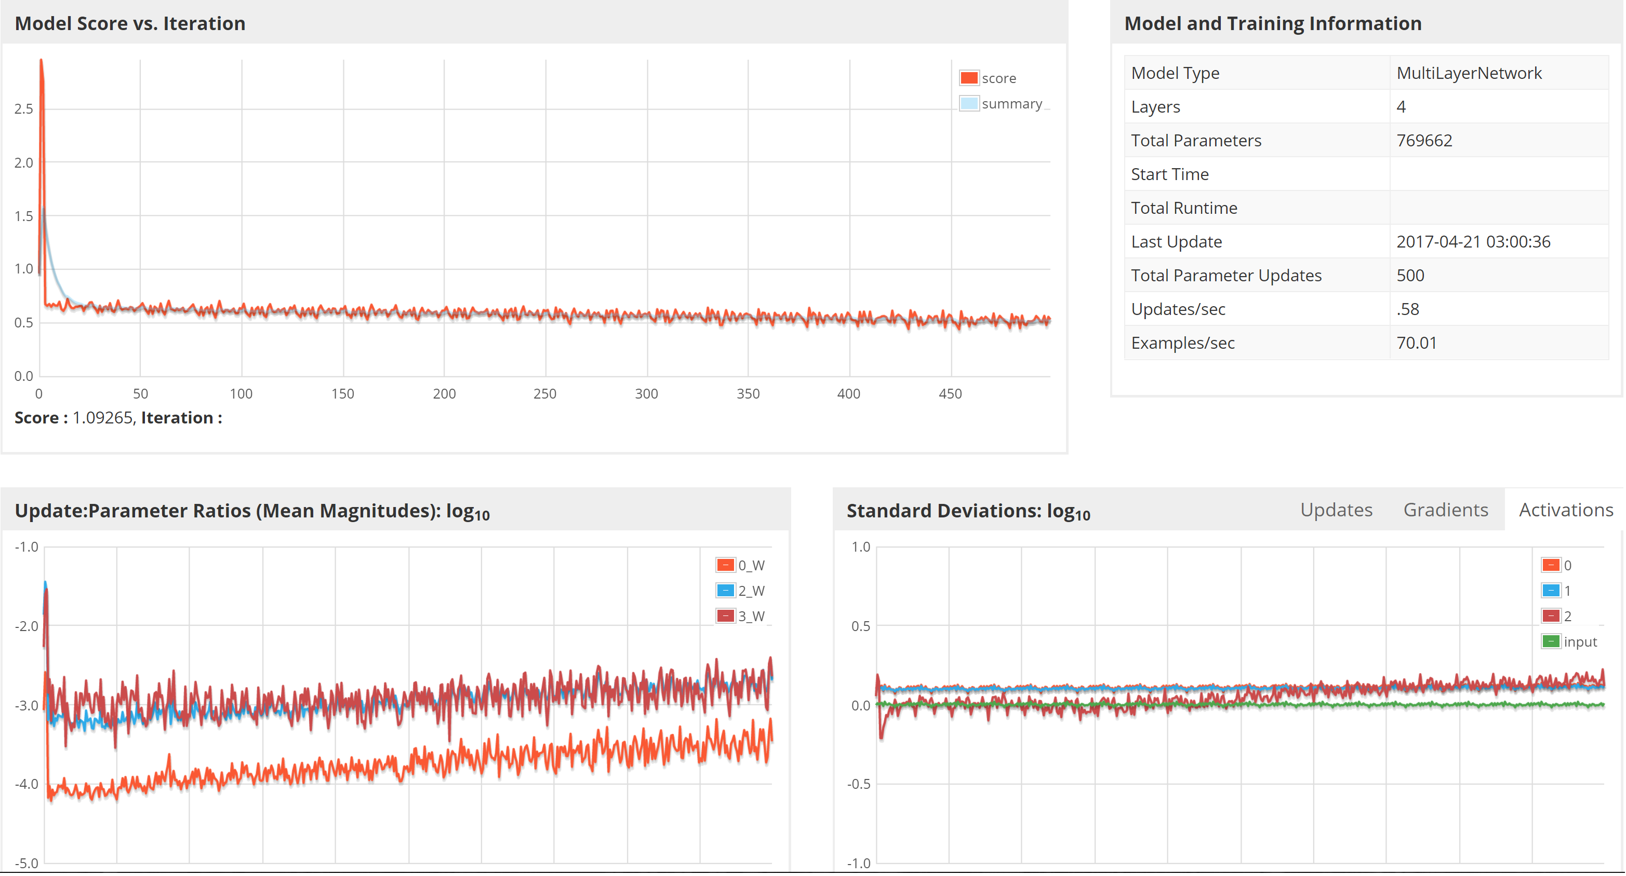
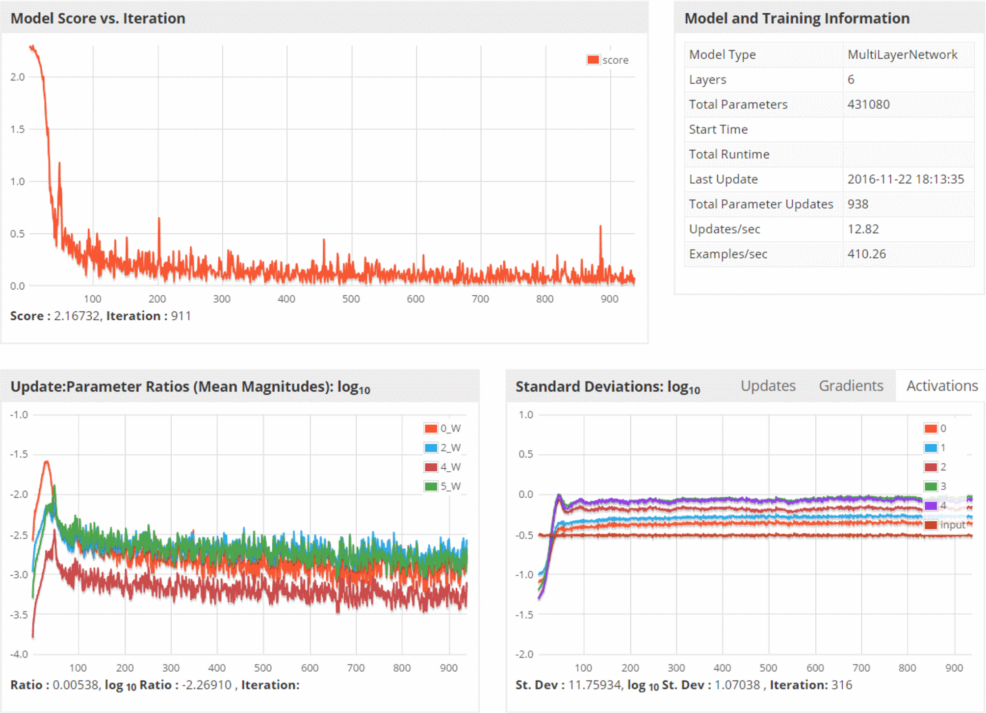
Analysis of Model
Obtained using DeepLearning visualization UI : localhost:9000/train
Our Model
Ideal model by DL4J
Notes:
Compare our model graph(Iteration vs score) with actual dl4j graphs

Slide 13
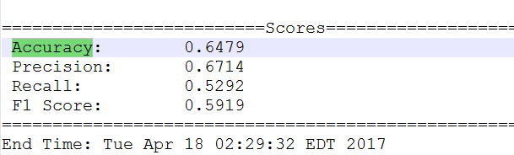
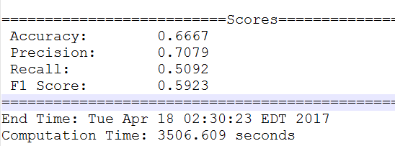
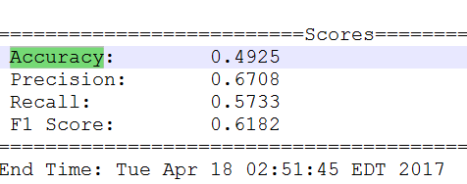
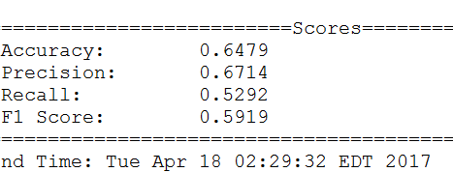
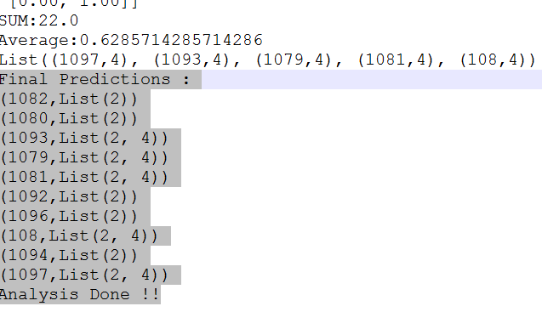
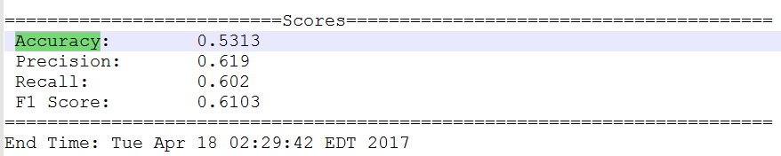
Evaluation of Models
Model – Label 1
Model – Label 2
Model – Label 3
Model – Label 4
Model – Label 5
Validating Model via Predicting for
Business not used in Training and Testing
Validation Accuracy = 62.8 %

Slide 14
Architecture of User Interface
Controller
Business Model
Play UI
Display All Predictions
Display Search Results
Responds to Yelp User Requests
Fetches results from MySQL using Slick
Id, Name, Label Prediction Y/N
Lightbend Activator
Stored in MySQL

Slide 15
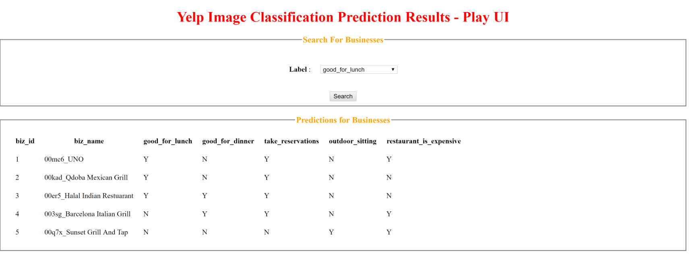
UI using Play Framework

Slide 16
Acceptance Criteria
Proposed Criteria | Actual Criteria
Number of yelp businesses(5) | 5
Number of label classification (5) | 5
Proposed accuracy of our model (63%) | 62.2%

Slide 17
Future Scope
Since we have saved the CNN model, we can use it to perform real time predictions for business when a new image is uploaded.
Generate Models for the remaining 5 Business Labels
Leverage the complete dataset to improve the model accuracy further

Slide 18
Thank you ☺

