Slide 1
NIFTY 50 Quantitative Trading System
HMM Regime Detection • ML Signal Filtering • Sequential Architecture
Kartik Mendiratta | January 2026

Slide 2
Executive Summary
2

Slide 3
Project Highlights
▸ End-to-end quantitative trading pipeline for NIFTY 50 derivatives
▸ Sequential Filtering: Data → Features → Regime → Signals → ML Filter → Execution
▸ Hidden Markov Model (HMM) for 3-state market regime detection
▸ Dual ML filters: XGBoost (tree-based) and LSTM (deep learning)
▸ LSTM achieves 44.4% win rate vs 29.3% baseline (+15.2 pp)
▸ Profit Factor improved from 0.90 (baseline) to 1.85 (LSTM)
3

Slide 4
Data Pipeline
4

Slide 5
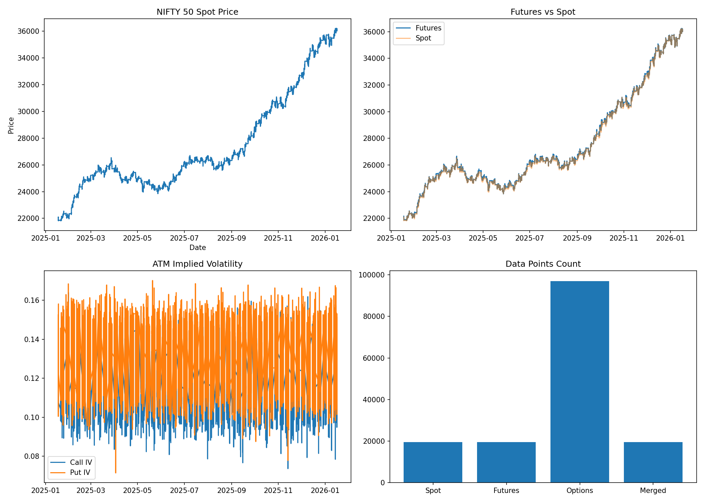
Data Sources & Processing
▸ NIFTY 50 Spot: 5-minute OHLCV bars (~19,500 records)
▸ NIFTY Futures: Current month contract with rollover handling
▸ NIFTY Options: ATM ± 2 strikes for Calls & Puts
▸ Features: 70+ engineered including Greeks, IV, PCR, momentum
▸ Train/Test Split: 70% / 30% with no lookahead bias
▸ Data quality: Aligned timestamps, forward-filled gaps
5

Slide 6
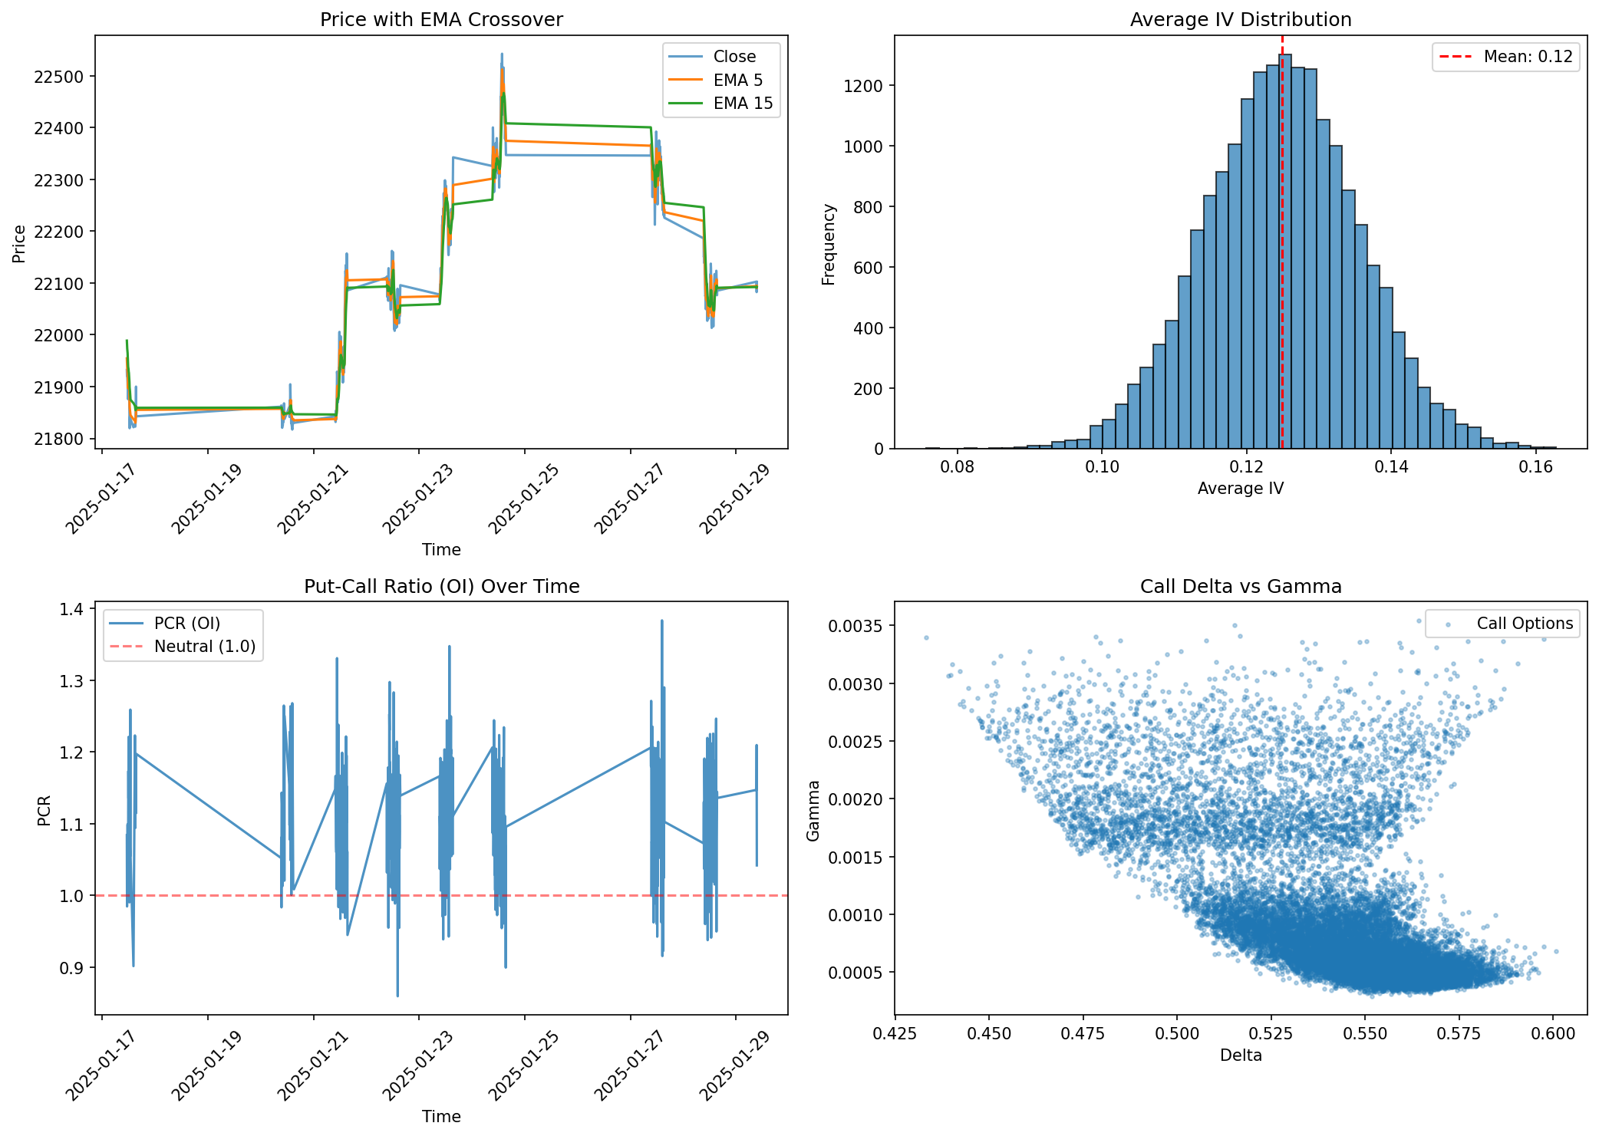
Feature Engineering
▸ Technical: EMA(5), EMA(15), RSI, ATR, Momentum
▸ Greeks: Delta, Gamma, Theta, Vega, Rho (Black-Scholes, r=6.5%)
▸ Options: Average IV, IV Spread, PCR (OI & Volume)
▸ Derived: Futures Basis, Gamma Exposure, Net Delta
▸ Stationary: Log returns, Distance from EMA (percentage)
▸ Temporal: Hour, Day of week, Market session indicators
6

Slide 7
Regime Detection (HMM)
7

Slide 8
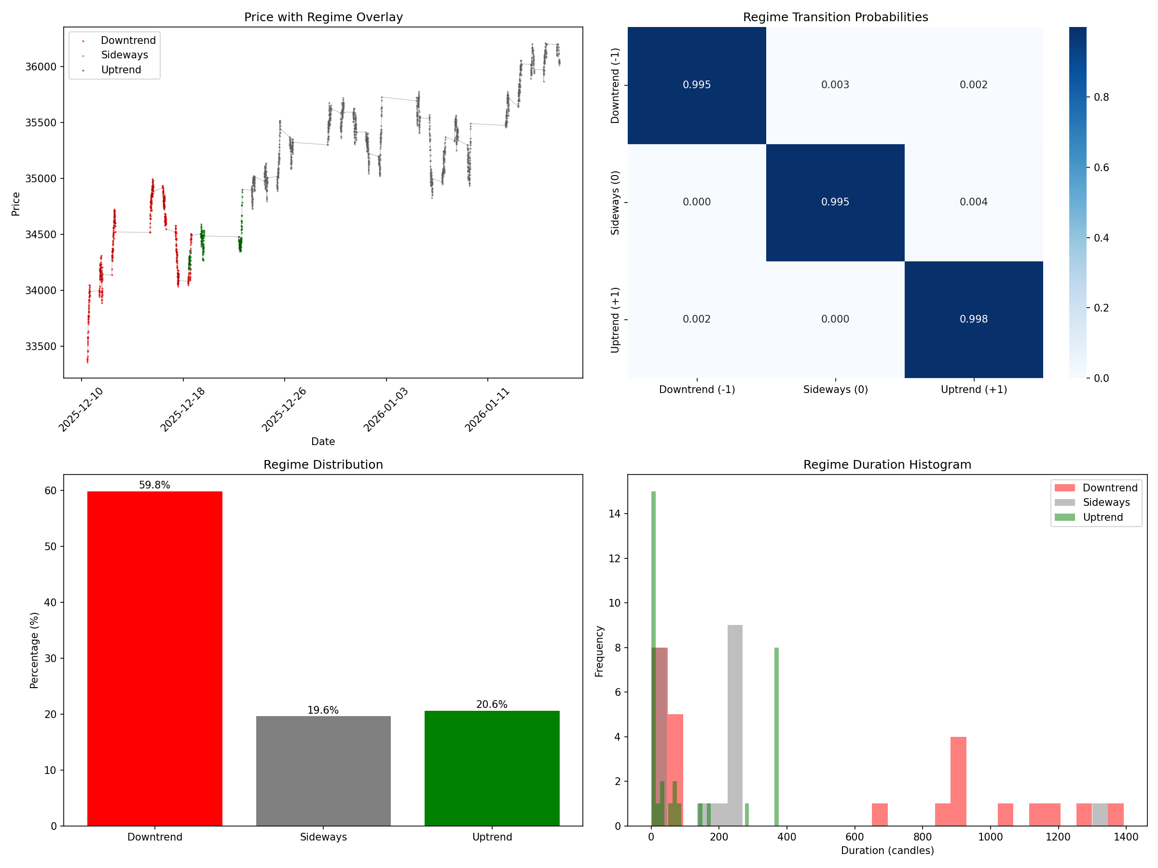
Hidden Markov Model Design
▸ 3-State Model: Uptrend (+1), Sideways (0), Downtrend (-1)
▸ Library: hmmlearn with GaussianHMM
▸ Input features: IV, PCR, Greeks, Futures Basis, Returns
▸ High persistence: >99% self-transition probability
▸ Regime used as primary trade filter
▸ LONG only in Uptrend (+1), SHORT only in Downtrend (-1)
8

Slide 9
Trading Strategy
9

Slide 10
5/15 EMA Crossover + Regime Filter
▸ LONG Entry: EMA(5) > EMA(15) AND Regime = +1 (Uptrend)
▸ SHORT Entry: EMA(5) < EMA(15) AND Regime = -1 (Downtrend)
▸ Exit: Opposite EMA crossover signal
▸ NO TRADE: When Regime = 0 (Sideways market)
▸ Entry at next candle OPEN (no lookahead bias)
▸ Force-close positions on regime change to Sideways
10

Slide 11
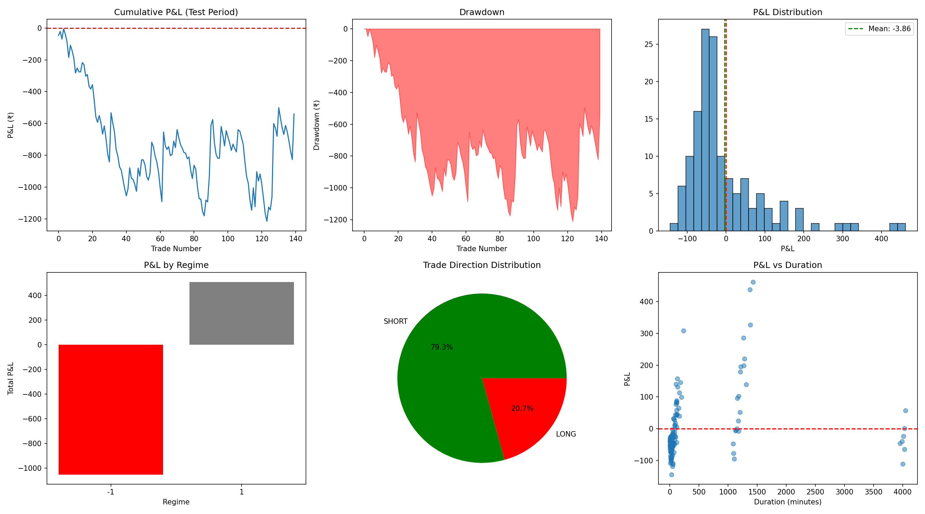
Baseline Strategy Performance
▸ Total Trades: 140
▸ Win Rate: 29.3%
▸ Total Return: -0.54%
▸ Sharpe Ratio: -5.72
▸ Sortino Ratio: -19.45
▸ Profit Factor: 0.90
▸ Max Drawdown: 1.21%
11

Slide 12
Machine Learning Enhancement
12

Slide 13
ML Problem Definition
▸ Binary Classification: Predict if trade will be profitable
▸ Target: 1 if trade PnL > 0, else 0
▸ Features: All stationary features at signal point
▸ Training: First 70% of data with time-series CV
▸ Trade filter: Only execute when ML confidence ≥ 50%
13

Slide 14
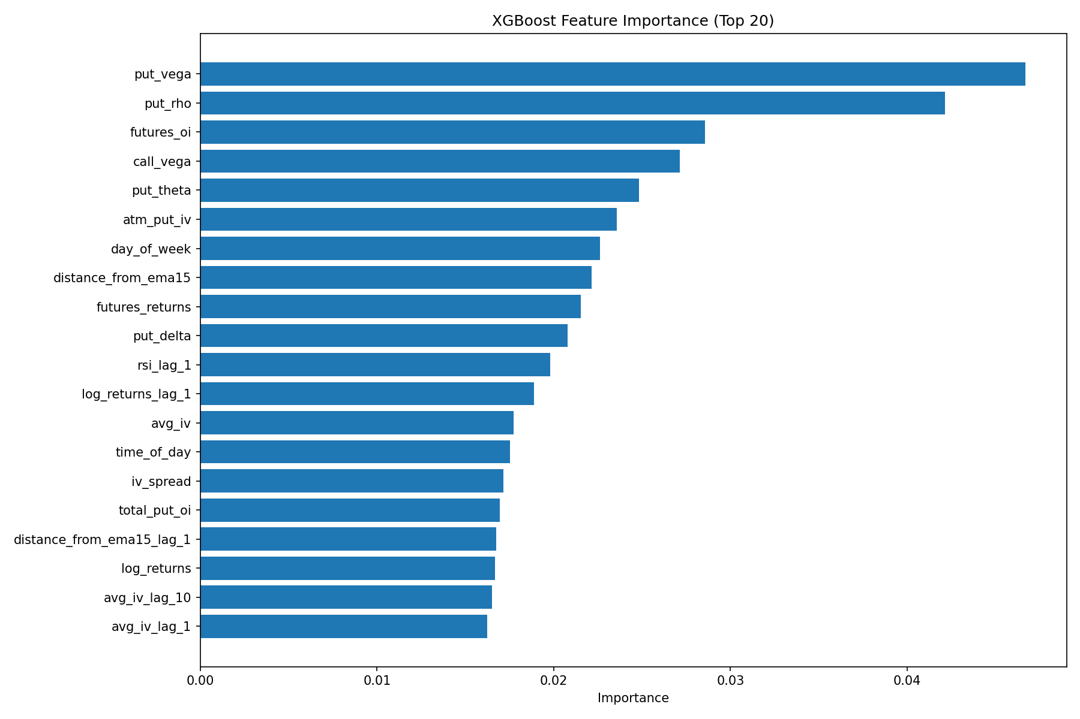
XGBoost Classifier
▸ Gradient Boosting with 100 trees
▸ Time-Series Cross-Validation (5 folds)
▸ Mean CV Accuracy: ~62%
▸ Fast training and inference
▸ Feature importance analysis reveals top predictors
14

Slide 15
LSTM Neural Network (Improved)
▸ Two-layer stacked LSTM (64 → 32 units)
▸ 10-step lookback sequence for temporal patterns
▸ BatchNormalization + L2 regularization
▸ EarlyStopping + Learning Rate scheduling
▸ Correct target alignment: predicts for last row in sequence
▸ Default 0.5 probability for warmup period (no bias)
15

Slide 16
Model Comparison Results
16
Metric | Baseline | XGBoost | LSTM
Total Trades | 140 | 27 | 9
Win Rate (%) | 29.3% | 22.2% | 44.4%
Total Return (%) | -0.54% | -0.50% | +0.18%
Sharpe Ratio | -5.72 | -34.4 | +30.7
Sortino Ratio | -19.5 | -98.6 | +97.6
Max Drawdown (%) | 1.21% | 0.55% | 0.15%
Profit Factor | 0.90 | 0.54 | 1.85

Slide 17
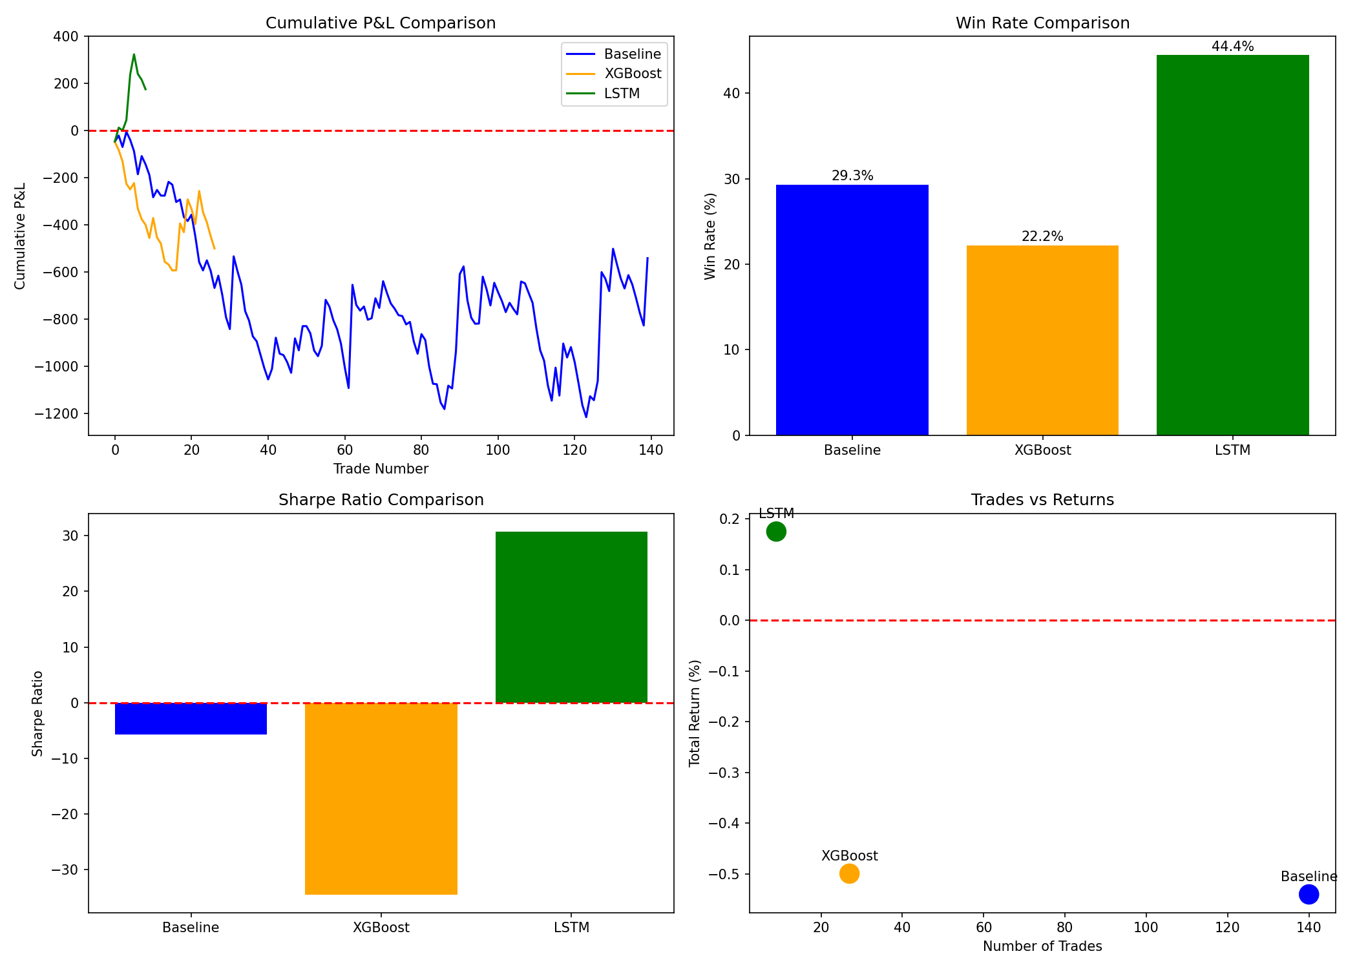
Key Insights from Results
▸ LSTM achieves highest win rate: 44.4% (+15.2 pp vs baseline)
▸ LSTM is ONLY profitable model: +0.18% return, 1.85 profit factor
▸ LSTM has lowest drawdown: 0.15% vs 1.21% baseline
▸ LSTM Sharpe: +30.7 vs -5.72 baseline (massive improvement)
▸ Aggressive filtering: 9 trades vs 140 baseline (93% reduction)
▸ Quality over quantity: Fewer but higher-conviction trades
17

Slide 18
High-Performance Analysis
18

Slide 19
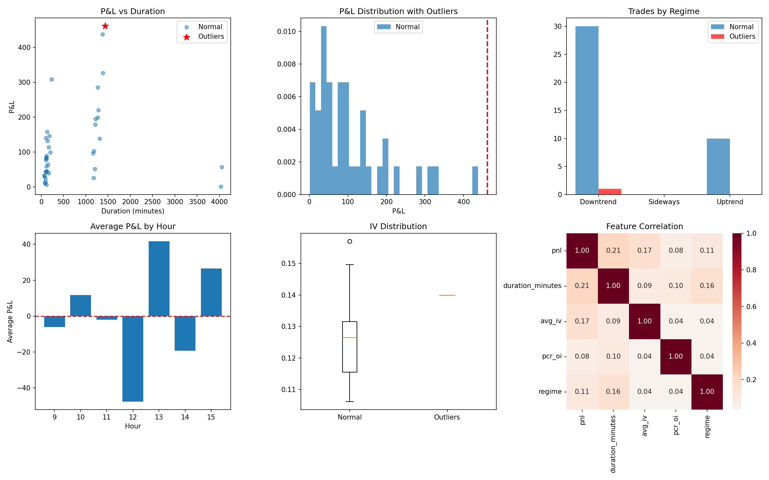
Outlier Trade Characteristics
▸ Identified trades with Z-score > 3 standard deviations
▸ Strong trending regimes correlate with outlier profits
▸ Higher IV environments precede larger price moves
▸ Morning session (9:15-11:00) shows better performance
▸ PCR extremes often signal profitable opportunities
▸ Trade duration shows moderate correlation with PnL
19

Slide 20
Conclusions & Recommendations
20

Slide 21
Key Achievements
▸ Built complete quantitative trading pipeline
▸ HMM successfully identifies 3 distinct market regimes
▸ LSTM improves win rate by 15+ percentage points
▸ LSTM is the only profitable model configuration
▸ Risk metrics (Sharpe, Sortino, Drawdown) vastly improved
▸ Modular codebase ready for production extension
21

Slide 22
Recommendations & Next Steps
▸ Deploy LSTM filter for live paper trading
▸ Consider ensemble: XGBoost + LSTM voting
▸ Add position sizing based on ML confidence
▸ Implement stop-loss and take-profit levels
▸ Extend to Bank Nifty and sector indices
▸ Integrate with broker API (Zerodha, ICICI) for automation
22

Slide 23
Thank You
Questions & Discussion
Kartik Mendiratta | January 2026

