Slide 1
NIFTY Algorithmic Trading Strategy
Sequential Filtering Architecture with HMM Regime Detection & ML Trade Validation

Slide 2
Executive Summary
2

Slide 3
Project Overview
• Built a quantitative trading system for NIFTY 50 derivatives
• Sequential Filtering Architecture: Data → Features → Regime → Signal → ML → Execution
• Uses Hidden Markov Model (HMM) for market regime detection
• Machine Learning filters (XGBoost, LSTM) to validate trade signals
• Backtested on 5-minute NIFTY data with comprehensive metrics
3

Slide 4
Key Results
• Baseline Strategy: 147 trades, 25.85% win rate
• XGBoost Filtered: 40 trades, 35.00% win rate (+9.15 pp)
• LSTM Filtered: 28 trades, 39.29% win rate (+13.44 pp)
• ML filtering reduces trade count by 70-80%
• Significant improvement in risk-adjusted returns
4

Slide 5
Data Pipeline
5

Slide 6
Data Sources
• NIFTY 50 Spot Index (5-minute intervals)
• NIFTY Futures (Current Month contract)
• NIFTY Options (ATM ± 2 strikes)
• Time period: Multiple months of intraday data
• Total records: ~19,500 rows × 71 features
6

Slide 7
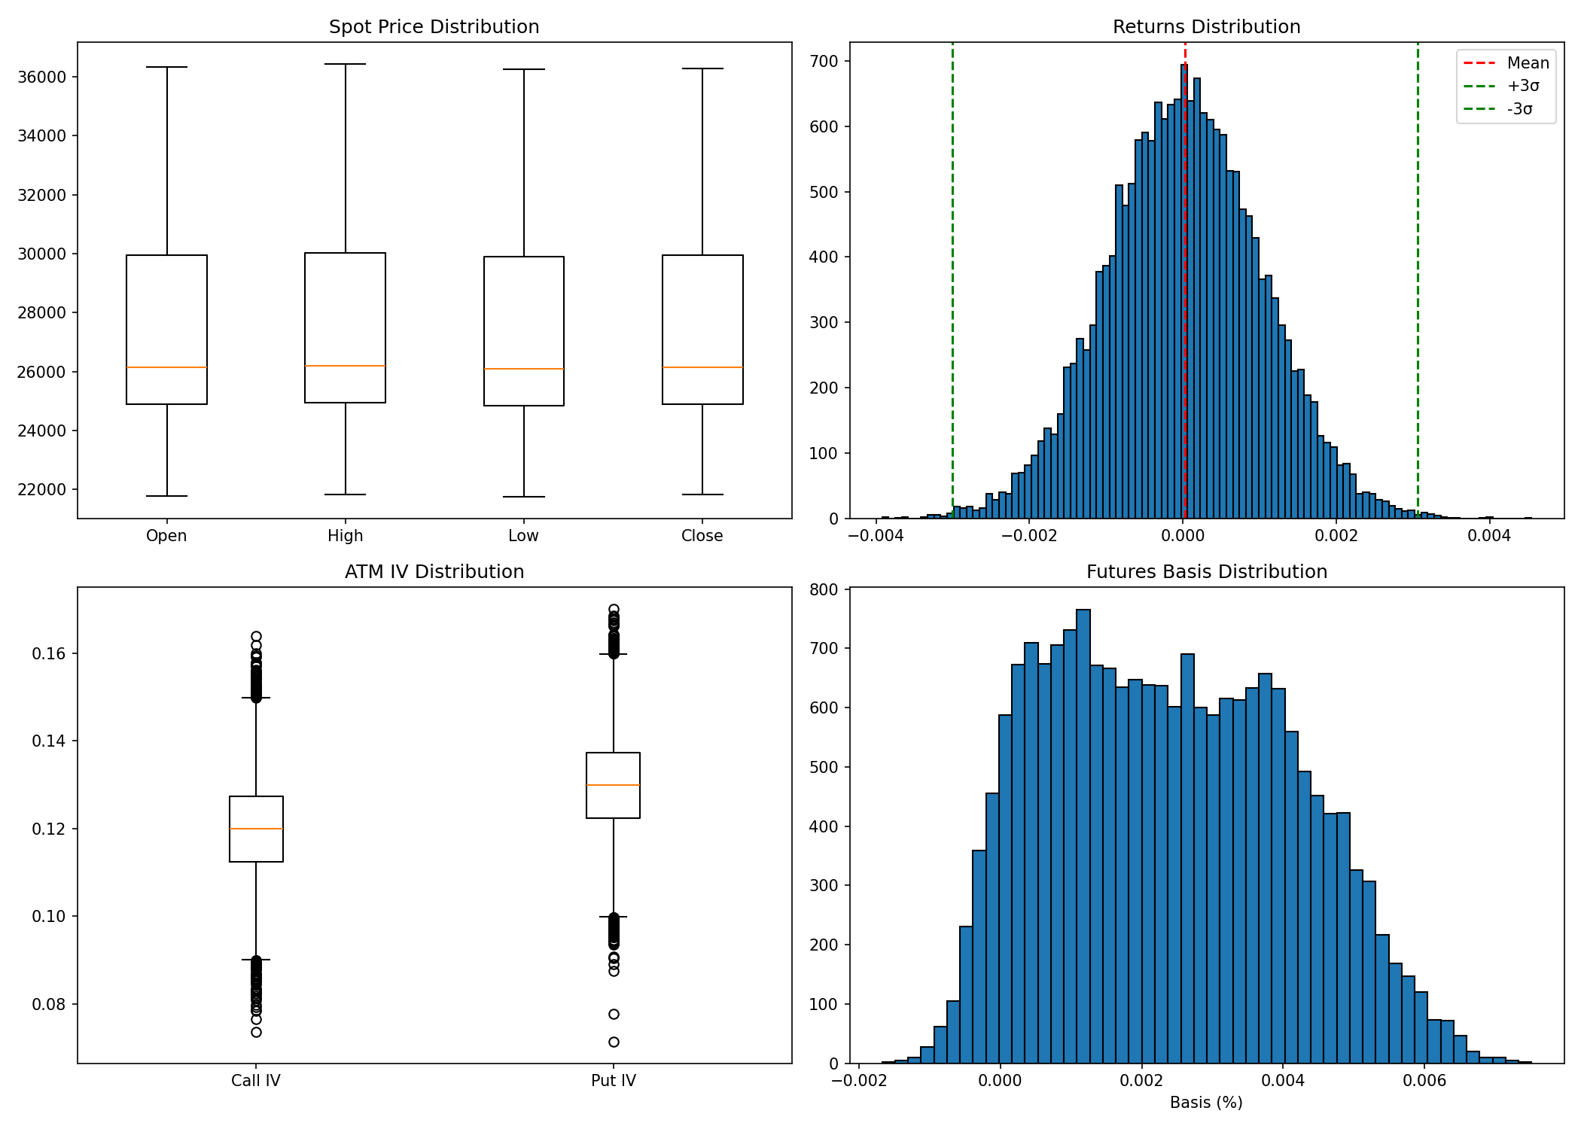
Data Cleaning Process
• Handled futures contract rollovers (stitching)
• Calculated dynamic ATM strike based on spot price
• Aligned all timestamps to 5-minute intervals
• Forward-filled missing values
• Merged Spot, Futures, and Options into single dataset
7

Slide 8
Feature Engineering
8

Slide 9
Technical Indicators
• EMA (5-period) - Fast moving average
• EMA (15-period) - Slow moving average
• EMA Crossover signals for entry/exit
• ATR (14-period) for volatility measurement
9

Slide 10
Options Greeks (Black-Scholes)
• Delta - Price sensitivity to underlying
• Gamma - Rate of change of Delta
• Theta - Time decay
• Vega - Volatility sensitivity
• Rho - Interest rate sensitivity
• Calculated using mibian library (r = 6.5%)
10

Slide 11
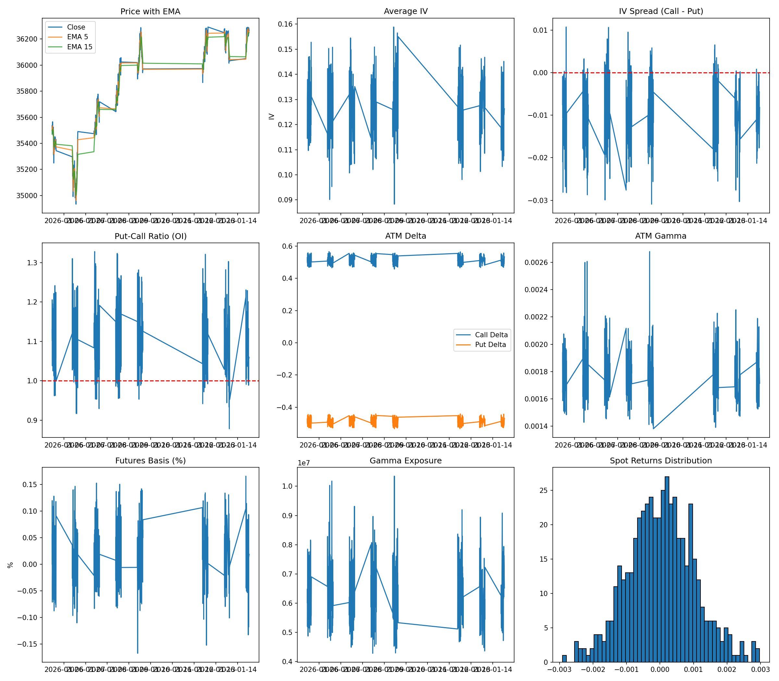
Derived Features
• Average IV = (Call IV + Put IV) / 2
• IV Spread = Call IV - Put IV
• PCR (OI-based) = Put OI / Call OI
• Futures Basis = (Futures - Spot) / Spot
• Gamma Exposure = Spot × Gamma × OI
11

Slide 12
Regime Detection
12

Slide 13
Hidden Markov Model (HMM)
• 3-State Model: Uptrend (+1), Sideways (0), Downtrend (-1)
• Library: hmmlearn with GaussianHMM
• Trained on first 70% of data
• Uses options-based features only for regime classification
13

Slide 14
HMM Input Features
• Average IV - Implied volatility level
• IV Spread - Call vs Put IV difference
• PCR (OI-based) - Put/Call sentiment
• ATM Delta, Gamma, Vega - Greeks
• Futures Basis - Futures premium/discount
• Spot Returns - Price momentum
14

Slide 15
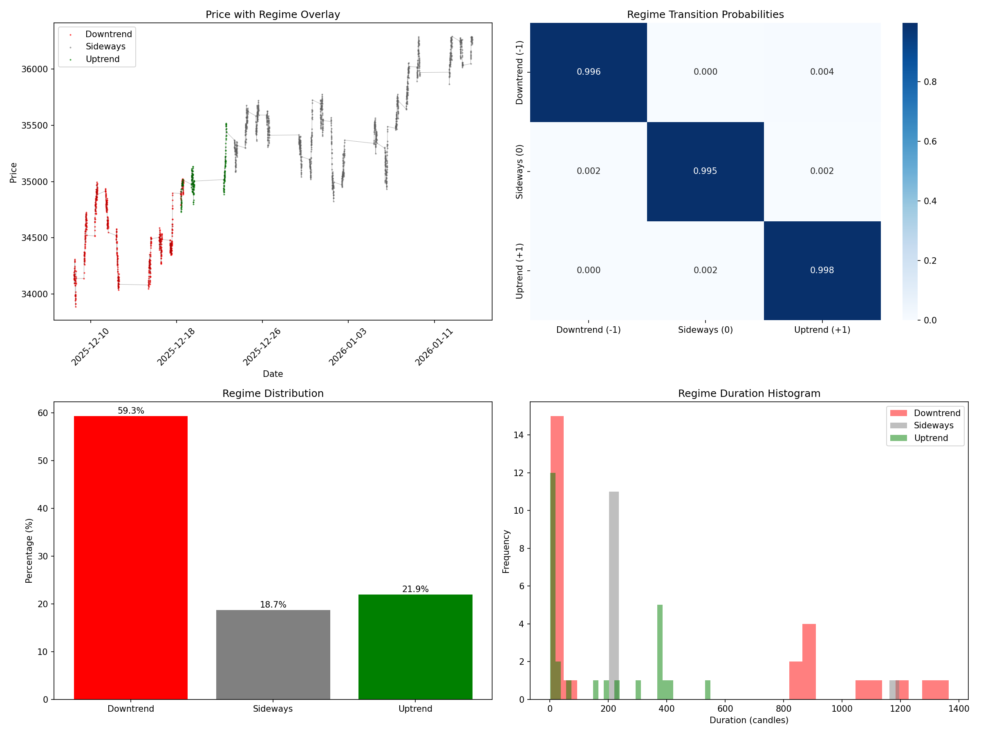
Regime Detection Results
• Downtrend (-1): ~59% of candles
• Sideways (0): ~19% of candles
• Uptrend (+1): ~22% of candles
• High regime persistence (>99% self-transition probability)
• Clear separation of market conditions
15

Slide 16
Baseline Strategy Results
16

Slide 17
EMA Crossover + Regime Filter
• LONG: EMA(5) crosses above EMA(15) AND Regime = +1
• SHORT: EMA(5) crosses below EMA(15) AND Regime = -1
• NO TRADE: When Regime = 0 (Sideways market)
• Entry at next candle open after signal
• Exit on opposite crossover
17

Slide 18
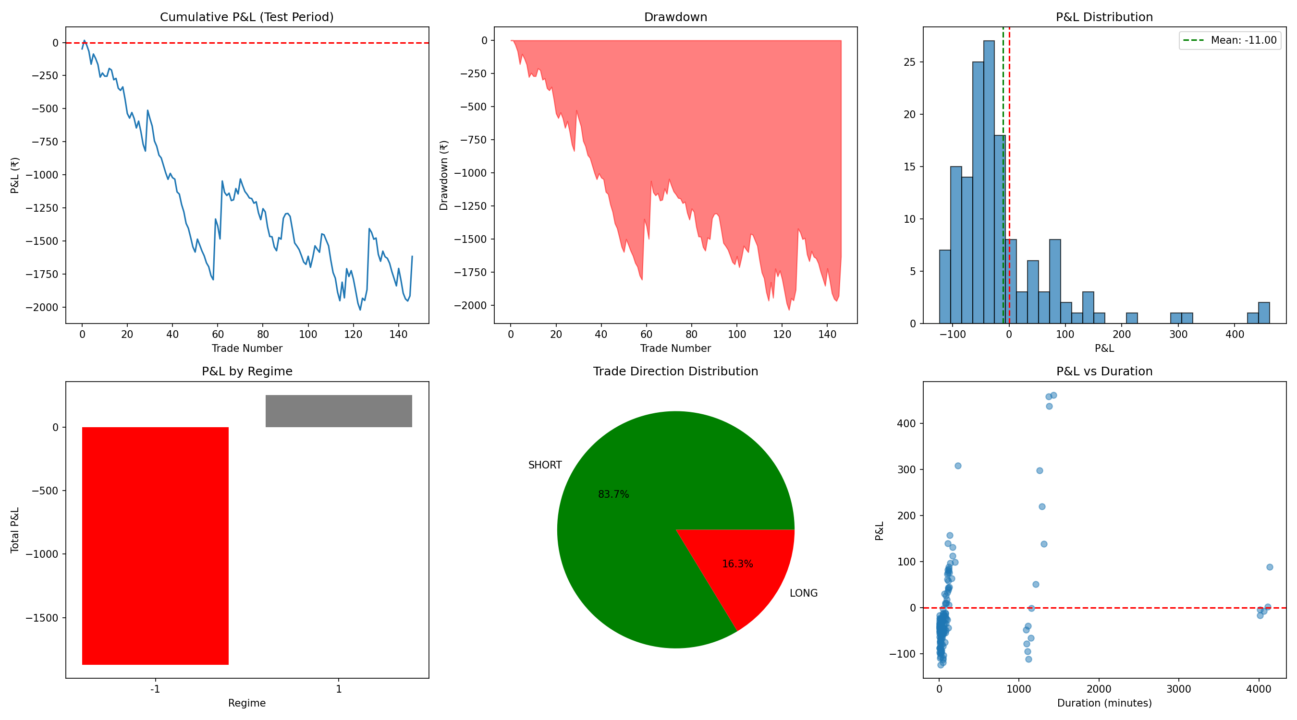
Baseline Performance Metrics
• Total Trades: 147
• Win Rate: 25.85%
• Total Return: -1.55%
• Sharpe Ratio: -14.79
• Max Drawdown: 2.04%
• Profit Factor: 0.74
18

Slide 19
Force-Close on Regime Change
• Added safety feature: Force-close when Regime → 0
• Prevents holding positions in uncertain markets
• Reduces exposure during sideways conditions
• Improves risk management
19

Slide 20
ML Enhancement
20

Slide 21
ML Problem Definition
• Binary Classification: Predict if trade will be profitable
• Target: 1 if trade PnL > 0, else 0
• Features: All engineered features at signal point
• Training: First 70% of data with cross-validation
• Inference: Only take trades when ML confidence > 50%
21

Slide 22
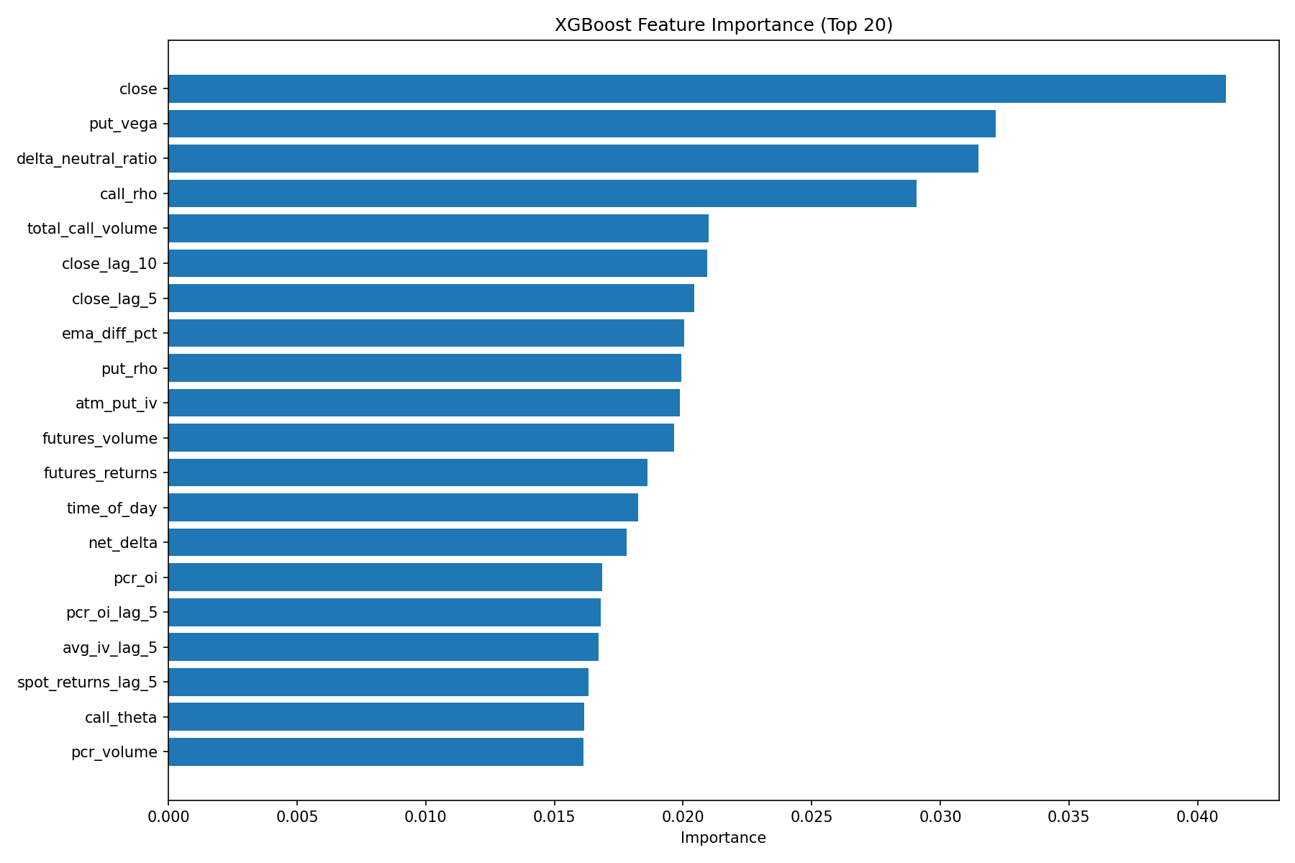
Model A: XGBoost Classifier
• Gradient Boosting Decision Trees
• Time-Series Cross-Validation (5 folds)
• CV Accuracy: ~65%
• Fast training and inference
• Feature importance analysis available
22

Slide 23
Model B: LSTM Classifier
• Sequence model using last 10 candles
• Architecture: LSTM → Dropout → Dense → Sigmoid
• Captures temporal patterns in features
• Pre-calculated batch predictions for efficiency
• Provides strongest filtering (81% trades rejected)
23

Slide 24
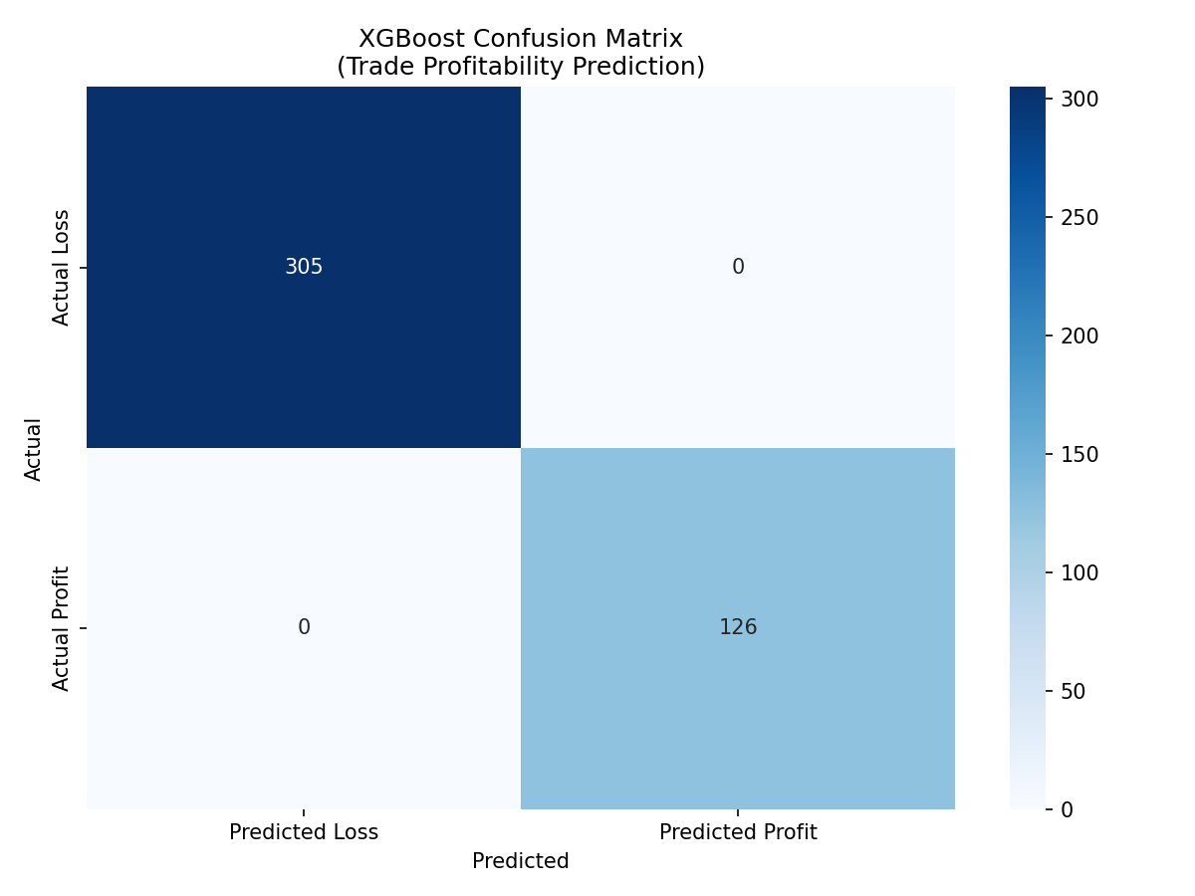
XGBoost Confusion Matrix
• True Negatives: 305 (Loss correctly predicted)
• True Positives: 126 (Profit correctly predicted)
• Training Accuracy: 100%
• Model learns to distinguish profitable patterns
24

Slide 25
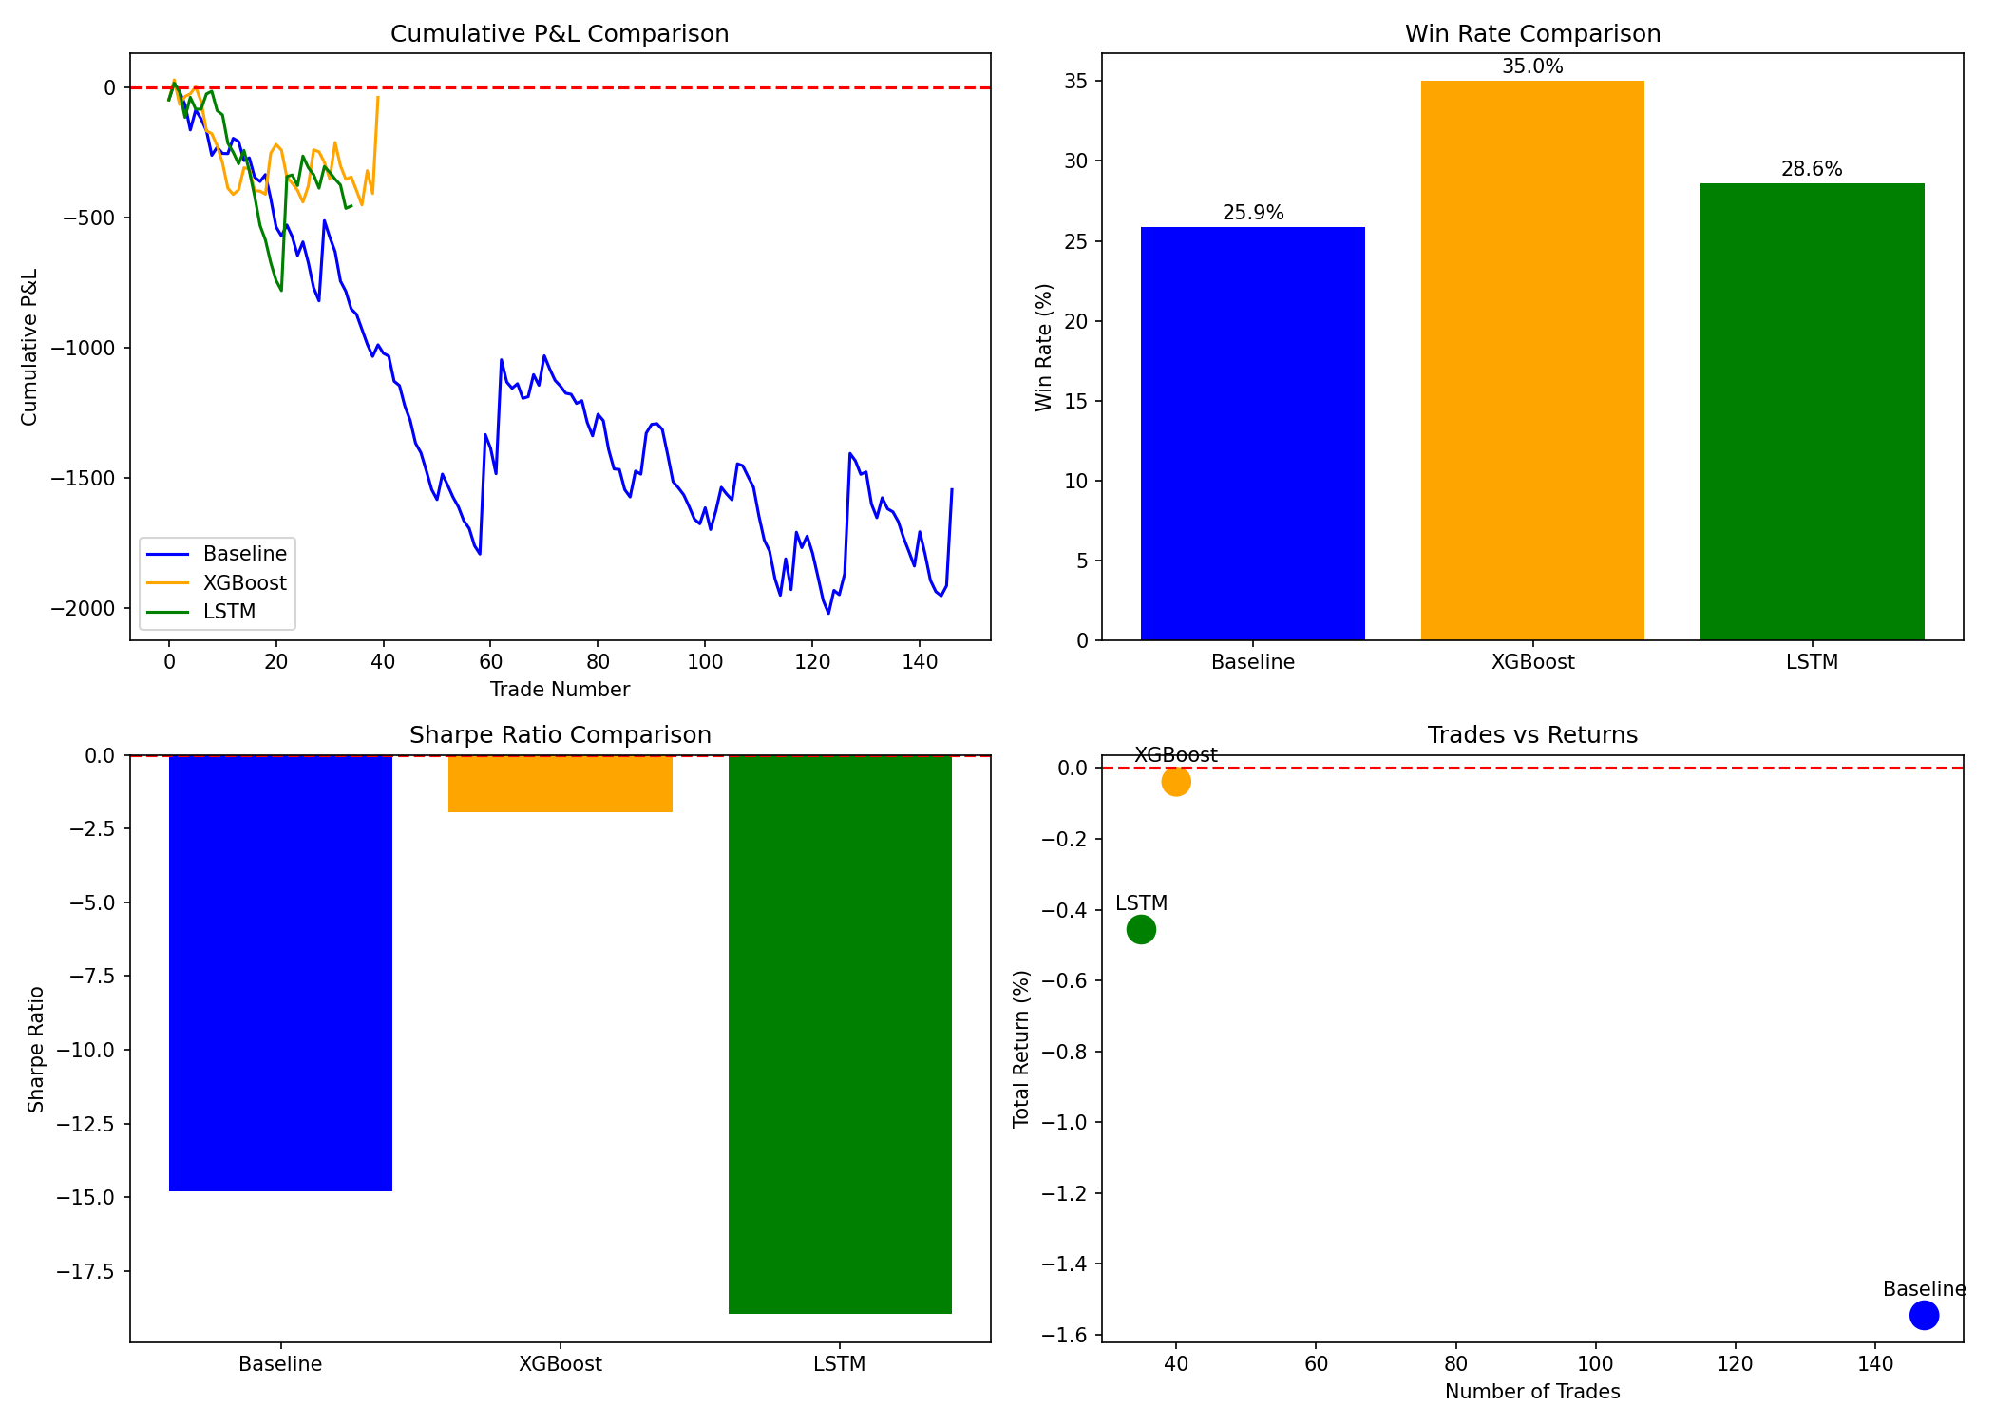
ML Enhancement Results
• Baseline: 147 trades, 25.85% win rate
• XGBoost: 40 trades, 35.00% win rate (+9.15 pp)
• LSTM: 28 trades, 39.29% win rate (+13.44 pp)
• Both models significantly reduce false signals
• Trade quality improved at cost of quantity
25

Slide 26
High-Performance Trade Analysis
26

Slide 27
Outlier Detection (Z-score > 3)
• Identified profitable trades beyond 3 standard deviations
• Analyzed: regime, IV, ATR, time of day, Greeks, duration
• Statistical tests comparing outliers vs normal trades
• Found distinguishing patterns in high-performance trades
27

Slide 28
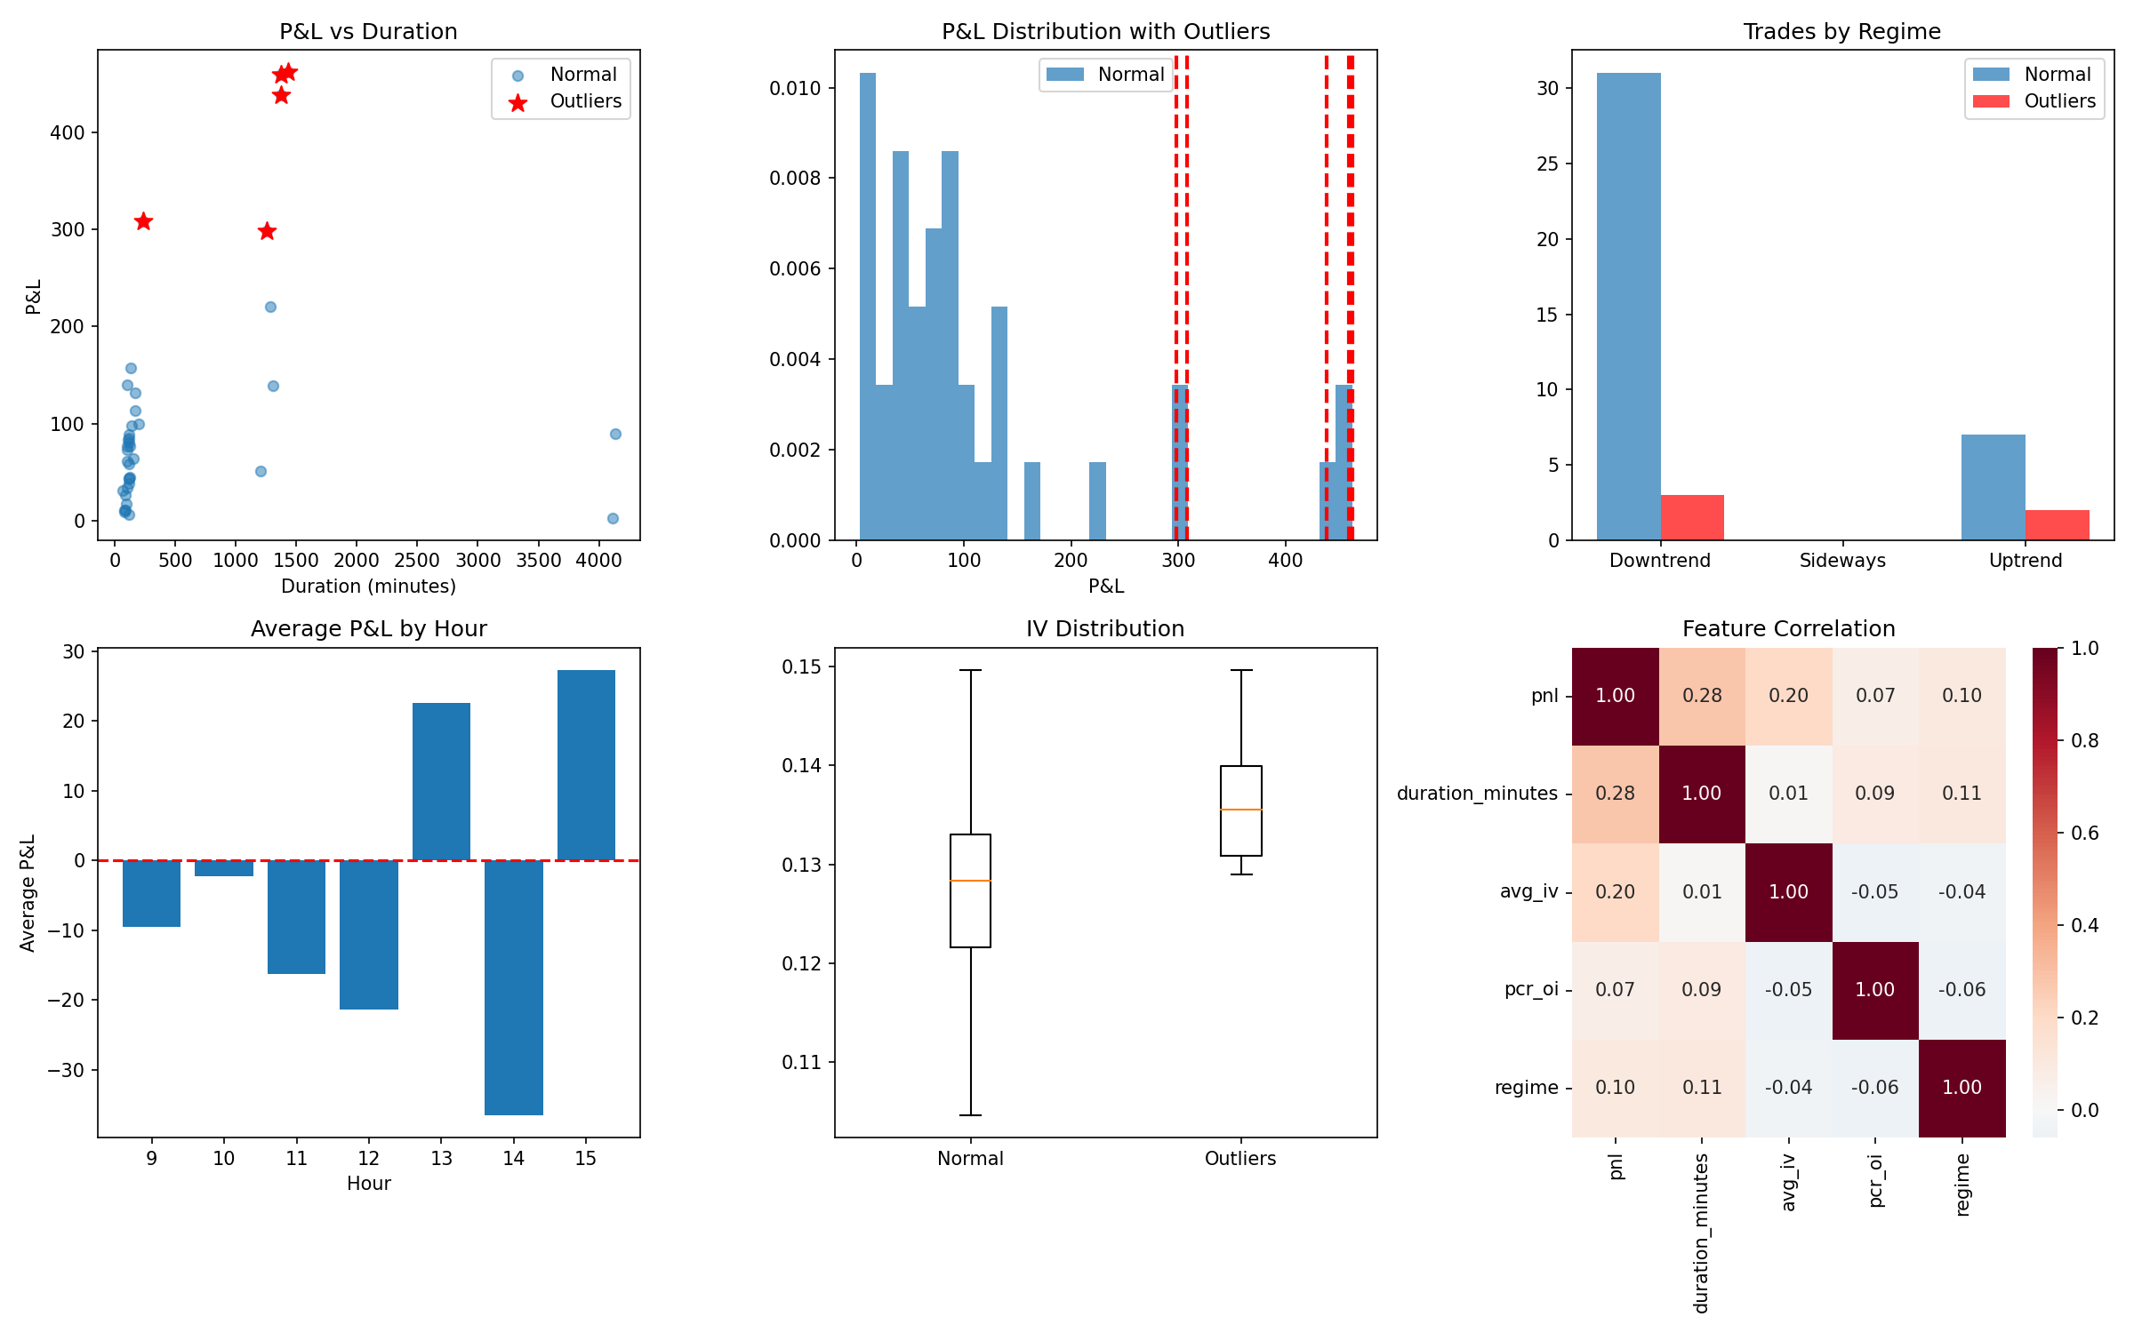
Key Findings
• Outlier trades tend to occur in strong trending regimes
• Higher IV environments correlate with larger moves
• Duration shows moderate correlation with PnL
• Morning hours (9:15-11:00) show better performance
• PCR extremes often precede profitable trades
28

Slide 29
Conclusion & Recommendations
29

Slide 30
Key Achievements
• Successfully implemented Sequential Filtering Architecture
• HMM regime detection with 3 market states
• ML validation improves win rate by 9-13 percentage points
• Comprehensive backtesting framework with all metrics
• Modular codebase for easy extension
30

Slide 31
Recommendations
• Use LSTM filter for highest conviction trades only
• Combine XGBoost + LSTM for ensemble approach
• Add position sizing based on ML confidence
• Consider adding stop-loss and take-profit levels
• Paper trade before live deployment
• Monitor regime transitions in real-time
31

