Slide 1


Project Review
Semester 6
Vivekanand Education Society's Institute of Technology
An Autonomous Institute Affiliated to University of Mumbai
Enhanced Automobile Event Data Recorder
Kartik Nagare | 24 / D19A
Jyotiraditya Bhosale | 8 / D19A
Prince Eppakayal | 13 / D19A
Mentor - Dr. Nandini Ammanagi
Assistant Professor, EXTC
1

Slide 2
Contents to be covered
Introduction
Problem Statement
System Overview
Work Done - Software
Work Done - Hardware
Design Challenges & Decisions
Remaining Work
Conclusion
1

Slide 3
Introduction
An Event Data Recorder (EDR) is a vehicle “black box” that continuously records how a vehicle is behaving.
  It monitors motion, GPS, and vehicle signals in real time.
  On a crash, it preserves the moments around the impact for later analysis.
Our project - the Enhanced EDR - extends this idea with:
  Multi-sensor capture at 100 Hz across 40 parameters.
  Redundant crash detection and forensic, tamper-evident storage.
  A power-survivability stage so recording completes even if the vehicle loses power.
Aim: a reliable, forensic-grade record of what happened in a crash.
2

Slide 4
Problem Statement
After a crash, objective evidence is often missing or incomplete:
  Speed, braking and impact direction are unknown or disputed.
  Vehicle power is frequently cut on impact, so data is lost mid-write.
A recorder for this must therefore:
  Detect a crash reliably, without a single point of failure.
  Preserve the data in tamper-evident, locked storage.
  Keep running through the power loss long enough to finish saving.
Objective: “Design a forensic-grade EDR that captures, secures and survives a crash event.”
3

Slide 5
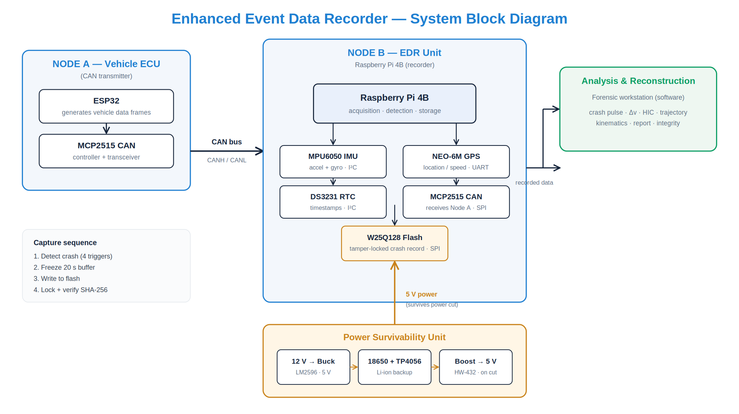
System Overview
Node A transmits vehicle data over CAN to Node B, which records it with its own sensors; the Power Survivability Unit keeps the recorder alive through a power cut.
4

Slide 6
Work Done - Overview
Component | Status | What we did
Simulation engine (Python) | Complete | Built & tested the full recorder core - 14/14 tests, 6 scenarios
Analysis workstation | Complete | Built a 10-module forensic analysis & reconstruction app
Power Survivability Unit | Designed | Designed, wired and routed the backup-power PCB
EDR HAT (sensor board) | Designed | Wiring, netlist and routed HAT PCB for the Pi
5

Slide 7
Work Done - Software: EDR Engine
Built a pure-Python recorder that runs identically on PC and Pi.
  40-parameter sensor model at 100 Hz.
  Four-trigger crash detection (IMU, speed drop, ECU flag, power-fail).
  Analytics: Delta-V, CSI, direction of force, rollover.
  Tamper-evident storage with SHA-256 verification.
Validated by unit tests and 6 crash scenarios (frontal, side, rollover, and correct non-events).
6

Slide 8
Work Done - Software: Analysis Workstation
A self-contained web app we built to reconstruct and analyse each captured event (runs offline).
Module | Function | Module | Function
Reconstruction | Top-down replay with force vectors | Spectrum | FFT of the crash pulse
Crash Pulse | Δv as integrated area under |a| | Trajectory | GPS path with impact point
Biomechanics | Head Injury Criterion & risk | Data Frame | All 40 parameters, live
Kinematics | Schematic, deformation, PDOF | Forensic / Report | SHA-256, lock, tamper, report
7

Slide 9
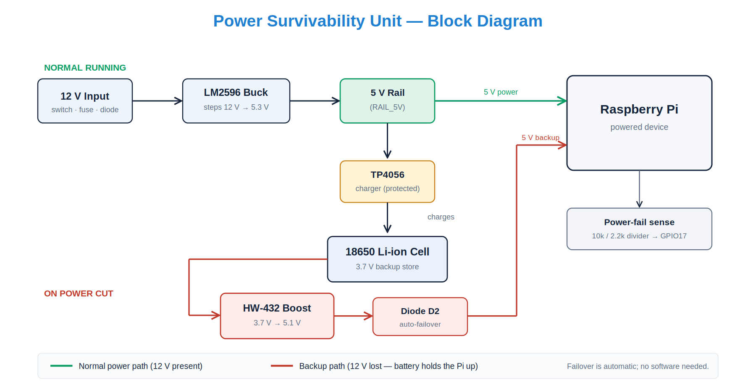
Power Survivability Unit - Block Diagram
Normally the 12 V line powers the Pi and charges the 18650; on a power cut the boost feeds the Pi automatically via a diode - no software action needed.
8

Slide 10
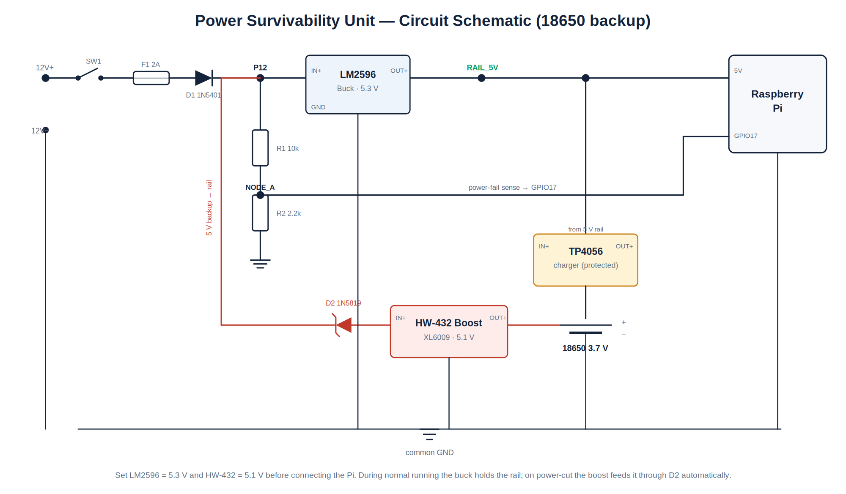
Power Survivability Unit - Circuit Schematic
Set the buck to 5.3 V and the boost to 5.1 V before connecting the Pi; the boost only ever steps up, so the Pi can never be over-volted.
9

Slide 11
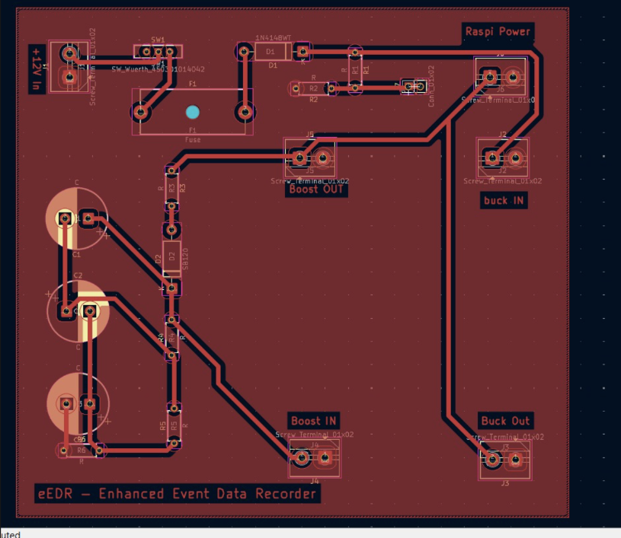
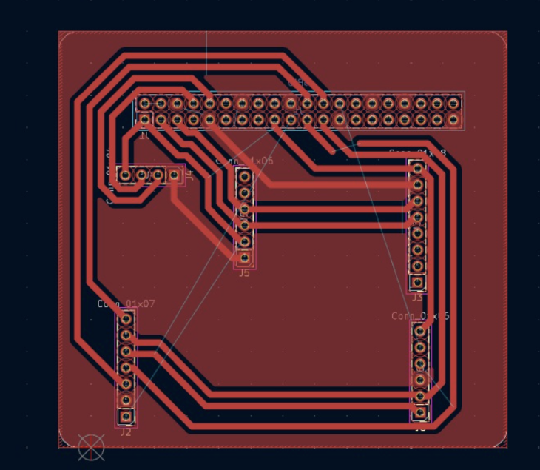
Work Done - Hardware: Custom PCBs
Power Survivability Unit PCB
Main EDR Unit HAT PCB
Routed 2-layer board · screw terminals for every I/O
Stacks on the Pi's 40-pin header · carries all sensors + CAN
10

Slide 12
Design Challenges & Decisions
Challenge | Our resolution
Supercapacitors unavailable & costly | Switched to 18650 + TP4056 - cheaper, available, longer hold-up
MT3608 boost out of stock | Verified HW-432 (XL6009) as a drop-in; recalculated backup time
5 V CAN module vs Pi's 3.3 V pins | Run the CAN module at 3.3 V - no level shifter, no risk to the Pi
Two SPI devices on one bus | Separate chip-selects (CE0 for CAN, CE1 for flash) avoid collision
11

Slide 13
Remaining Work
1
Fabricate and populate both PCBs (backup unit and EDR HAT).
2
Integrate sensors on the Pi; enable SPI/I²C and verify each module.
3
Bench-test power failover; confirm hold-up during a live write.
4
Demonstrate end-to-end crash capture: Node A → Node B → locked record.
5
Validate results and complete documentation.
12

Slide 14
Conclusion
Built and validated the complete recording & analysis software.
  40-parameter engine, tested across 6 scenarios.
  10-module forensic analysis workstation.
Designed and routed both custom PCBs.
  Power Survivability Unit and the EDR HAT.
Remaining work is fabrication, integration and on-bench validation.
13

Slide 15
Thank You
15

