Slide 1
P403 - AAPL Stock Forecast
Group 4

Slide 2
Introduction
Overview
Objectives
We analyzed AAPL stock prices from January 2012 to December 2019.
Identified key components such as trends, seasonality, cyclic variations and noise.
Understand the stock price movements over the period.
Predict the AAPL Stock Price for Next 30 days.

Slide 3
Data Preparation
Time Period
January 2012 to December 2019
Initial Steps
Loaded Dataset.
Converted the “Date” column to Date-Time Format.
Set “Date” column as Index.

Slide 4
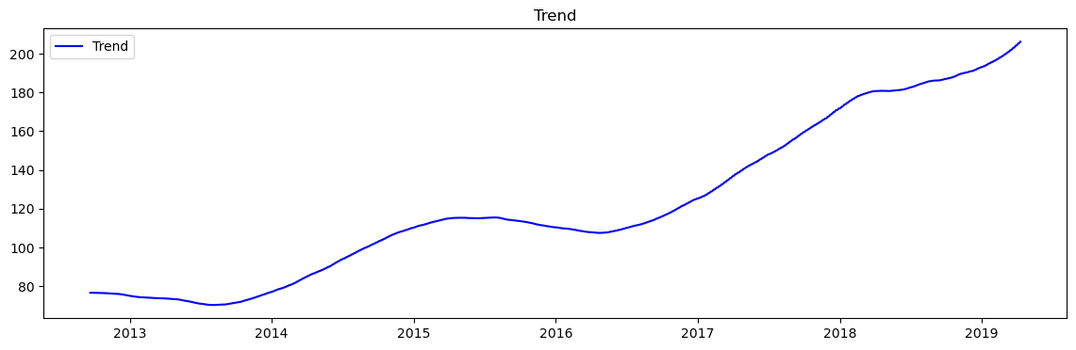
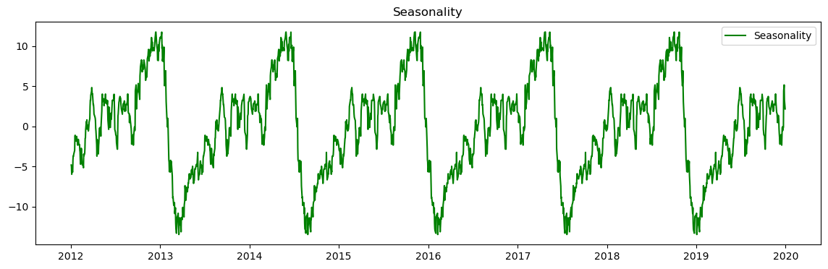
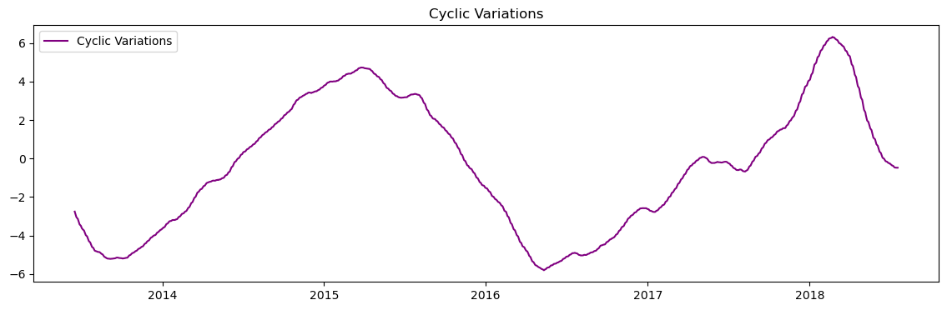
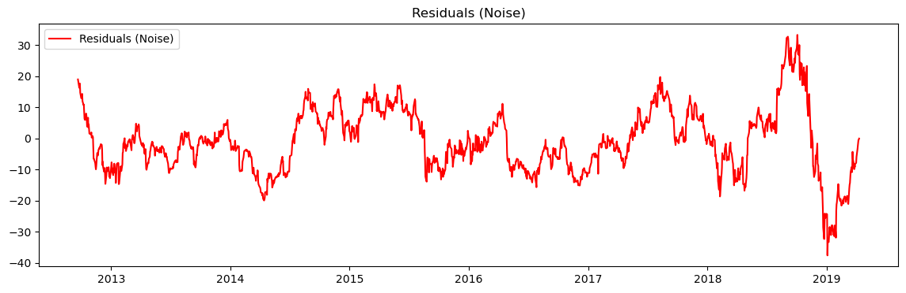
Key Findings from EDA
Trend Analysis:
Stock Prices Showed overall uptrend.
Significant peaks observed in 2015 and 2019.
Seasonality:
Clear seasonal patterns observed with recurring price increase towards the end of each year.
Higher volatility in certain months, particularly around product launch events.
Cyclic Variations:
Stock prices reflect broader economic cycles and market sentiment.
Notable price changes around key events like product launches and earnings report.
Noise:
Daily price movements contain significant noise, indicating market volatility.
Techniques like moving averages help to smooth out noise for better trend visualization.

Slide 5
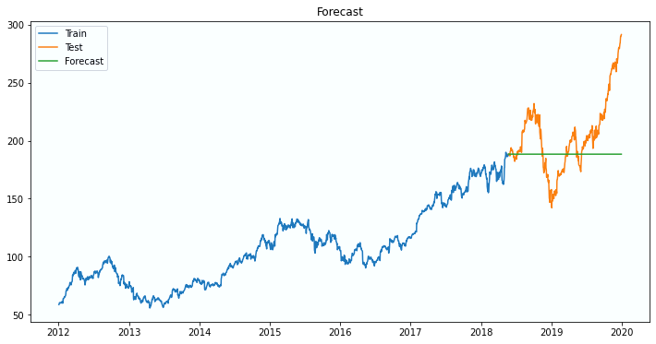
ARIMA
Autoregressive Integrated Moving Average
This model is used for forecasting time series data by capturing various aspects such as trend and seasonality.
Model Results
Model showed reasonable accuracy in capturing the trend and cyclic patterns in stock prices.
Residuals were analyzed to check for any patterns or autocorrelation, ensuring the model’s assumptions were valid.

Slide 6
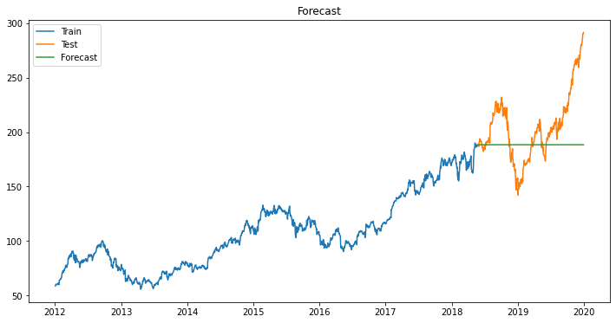
SARIMA
Seasonal Autoregressive Integrated Moving Average
This model extends ARIMA to support seasonality in the data, by capturing both non-seasonal (trend) and seasonal patterns.
Model Results
Model showed improved accuracy by capturing seasonal variations in addition to trend and cyclic patterns.
Residuals were analyzed to confirm the model’s validity and lack of autocorrelation.

Slide 7
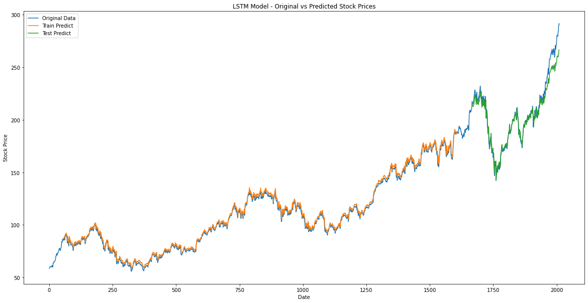
LSTM
Long Short-Term Memory
LSTM networks are a type of recurrent neural network (RNN) capable of learning long-term dependencies and trends in time series data.
Model Results
Model captured complex patterns in the data, providing accurate forecasts.
Monitored and addressed overfitting through techniques like dropout and regularization.

Slide 8
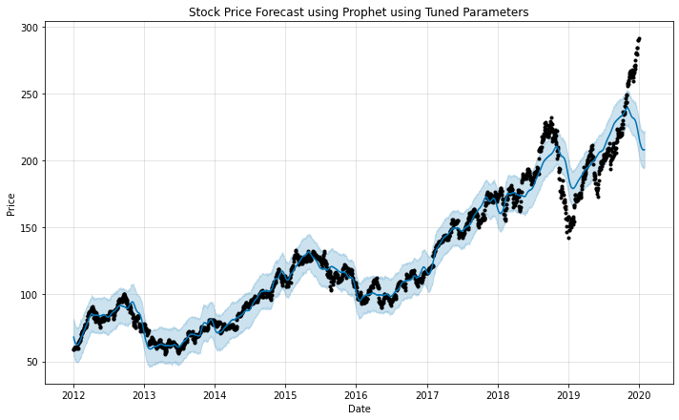
Prophet
Prophet is a robust forecasting tool developed by Facebook, designed to handle missing data, outliers, and seasonality.
Model Results
Model showed good accuracy in capturing overall trend and seasonal patterns.
Analyzed trend, weekly seasonality, and yearly seasonality components.

Slide 9
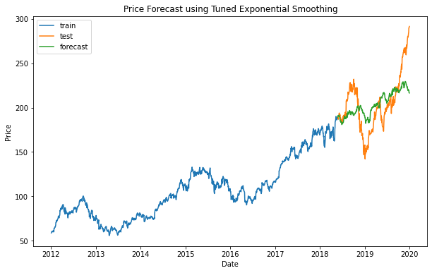
Exponential Smoothing
Holt-Winters Seasonal Model
It is a time series forecasting method for univariate data that considers level, trend, and seasonality components.
Model Results
Model effectively captured level, trend, and seasonal patterns in the data.
Residuals were analyzed to ensure no patterns were left unmodelled, indicating a good fit.

Slide 10
Best Parameters
ARIMA
SARIMA
LSTM
Exponential Smoothing
Prophet
P = 0
D = 1
Q = 1
P = 1
D = 0
Q = 1
M = 12
Optimizer = rmsprop
Activation = tanh
Epochs = 30
Batch Size = 32
Trend = mul
Seasonal = mul
Seasonal Periods = 252
Seasonality Prior Scale = 0.1
Holidays Prior Scale = 0.01
Seasonality Mode = additive
Hyperparameter Tuning Improves model performance by finding the optimal set of parameters for each forecasting model.

Slide 11
Deployment
Model Selection
Selected the model with best performance.
Model Export
Saved the trained model using Pickle Format.
Interface Development
Used Streamlit Framework to build a user-friendly Interface.
Integration
Based on evaluation metrics and forecast accuracy.
Integrated the model to generate forecasts based on new data.
Ensured the forecasts displayed historical data.

Slide 12
Challenges Faced and Potential Solutions
Challenges
Potential Solutions
Model Selection and Tuning:
Selecting and tuning the best model.
Poor performance with forecasts.
Computational Resources:
Long training times.
Resource exhaustion.
Model Drift and Maintenance:
Ensuring long-term accuracy is a big challenge.
Degrading performance over time.
Model Selection and Tuning:
Automated model selection and hyperparameter tuning.
Using Grid Search, Random Search.
Computational Resources:
Cloud-based scalable computing.
Dynamic resource allocation for cost efficiency.
Model Drift and Maintenance:
Regular monitoring of model performance.
Automated retraining for optimal performance over time.

Slide 13
Next Steps and Action Items
Next Steps
Explore additional features like economic indicators, sentiment analysis from news articles and social media trends.
Experimenting with hybrid models like combining different forecasting techniques. (e.g., ARIMA with LSTM)
Integrating additional data sources such as macroeconomic data and alternative data.
Action Items
Research and implementation of features that could improve model performance.
Scheduling regular reviews and updates of current models to ensure optimal performance.
Maintaining through documentation of all models, processes and updates.

Slide 14
Conclusion
Project Summary
The primary aim was to analyze and forecast AAPL stock prices from 2012 to 2019 using various time series forecasting models.
Key Steps Undertaken
Data Preparation: Prepared data for model building.
Data Preprocessing: Standardized and Normalized data for model compatibility.
Model Building: Developed and compared multiple models (ARIMA, SARIMA, LSTM, Prophet and Exponential Smoothing).
Hyperparameter Tuning: Used Grid Search and Cross-validation techniques to find the best model parameters.
Model Deployment: Used Streamlit framework for creating and user-friendly interface for price forecasting.

Slide 15
Thank You
Mohammad Faraz Ahmed
M A Rahman
Jaydeep Patel
Kartik Santosh Nanekar
Atharva Pravin Jadhav
Nikhitha Dasari
Priyanshu Suresh Rao

