Slide 1
TY AIDS · G DIV · PROJECT 1
VelocityLLM
SLA-aware dynamic batching for LLM serving
Dynamic Batching Engine for LLM Inference Serving
Notes:
Introduce the project and the team. One line: the batch size follows the latency target.

Slide 2
THE PROBLEM
A fixed batch is a guess.
71.3 s
p99 latency with a static
batch of 8 at 24 requests
per second
The SLA is 8 s. Only 12% of requests made it.
VELOCITYLLM
02 / 10
Notes:
Static batch of 8, 24 requests per second. 71 seconds p99 against an 8 second target. Only 12% on time.

Slide 3
THE IDEA
Let the latency target set the batch.
Measure
01
p99 latency and GPU memory, continuously.
Grow
02
Open more slots while requests wait and p99 has room.
Cut
03
Pull back the moment either limit is hit.
VELOCITYLLM
03 / 10
Notes:
Three verbs: measure, grow, cut. Reveal one at a time.

Slide 4
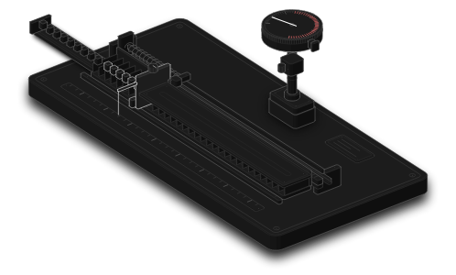
ANATOMY · THE BATCH GOVERNOR
Shutter
sets how many of the 32
slots are open
Dial
p99 latency against the
red SLA zone
Spring
pulls the shutter back
when p99 crosses
VELOCITYLLM
04 / 10
Notes:
The governor rig: shutter is the limit, dial is p99, spring is the cut. This is a model of the controller rule, not a measurement.

Slide 5
THE CONTROLLER
Additive up, multiplicative down.
GROW
CUT
+1, +2, +4
×0.75
while requests wait and memory has room
when p99 passes the SLA or memory hits 94%
RANGE
SOFT LIMIT
2 – 32
−1
in flight, start at 8, step every 0.25 s
when memory passes 88%, ahead of a cut
VELOCITYLLM
05 / 10
Notes:
Grow 1, 2, 4. Cut to 0.75 on an SLA breach or memory over 94%. Bounded 2 to 32.

Slide 6
UNDER THE HOOD
Drop-in in front of vLLM.
Client
Control
service
SLA
scheduler
AIMD
controller
vLLM
HTTP / SSE
→
→
→
→
AsyncLLMEngine
FastAPI :9000
priority queue
limit 2 – 32
p99 and KV-cache memory flow back into the controller.
A mock backend and an HF runner cover CPU testing.
VELOCITYLLM
06 / 10
Notes:
Request path from client to vLLM. Feedback from p99 and KV-cache memory returns to the controller.

Slide 7
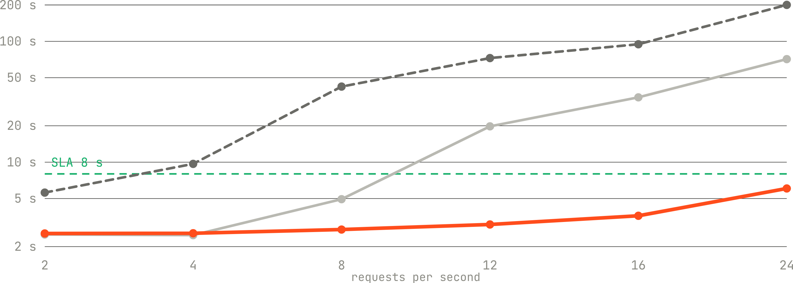
MEASURED · RTX 5050 8 GB · LLAMA-3.2-1B · 30 S PER LEVEL
p99 latency against load
Static, batch of 8
Static, wait to fill
VelocityLLM
VELOCITYLLM
07 / 10
Notes:
Measured sweep on the laptop RTX 5050. The orange line stays under the SLA at every rate.

Slide 8
AT 24 REQUESTS PER SECOND
Same GPU. Different outcome.
ON TIME
GOODPUT, TOKENS/S
12%
100%
80
2,109
→
→
static → VelocityLLM
static → VelocityLLM
VELOCITYLLM
08 / 10
Notes:
At 24 requests per second: on time 12% to 100%, goodput 80 to 2,109 tokens per second.

Slide 9
WHAT WE BUILT
More than a scheduler.
Engine
Control service
Load tools
vLLM, HF Transformers and
mock backends behind one
interface
FastAPI endpoints, live metrics
and controller state
Async load generator and rate
sweeps with SLA reports
Web app
Package
Deploy
A site that races static against
dynamic, live
pip install velocityllm on PyPI
Docker image on vllm-openai
and Triton scripts
VELOCITYLLM
09 / 10
Notes:
Everything around the scheduler: backends, service, load tools, web app, package, deploy scripts.

Slide 10
12% on time became 100%.
pip install velocityllm
github.com/kartikpagariya25/VelocityLLM
KARTIK · VIKRANT · ADITYA · PRANALI
Notes:
Close with the numbers and the install command.

