Slide 1
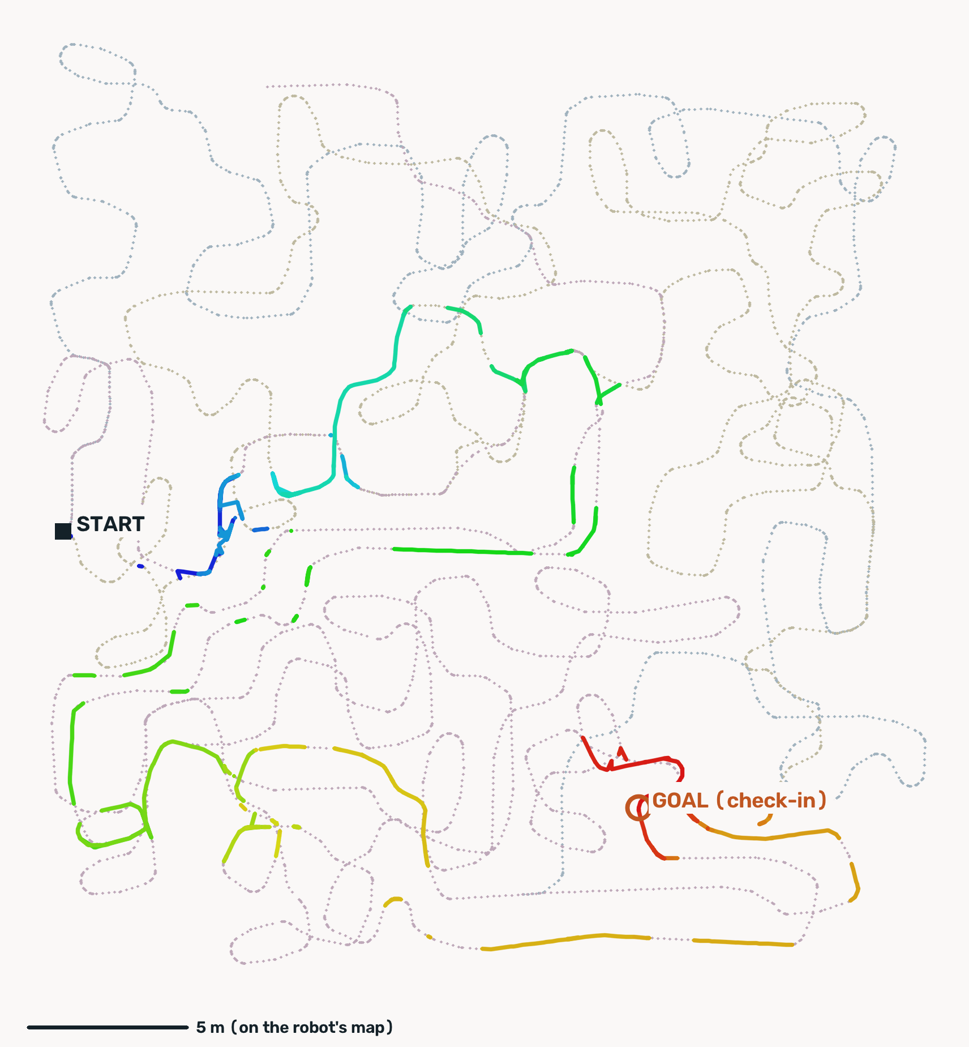
Robot Perception
Course Project
VISUAL NAVIGATION CHALLENGE · MID-TERM REPORT · FALL 2026
[Team Name]
Kartik Parameshwaran ([NetID1])
[Arya’s full name] ([NetID2])
The mid-term maze as the robot mapped it: its route from start to check-in (own map, not to scale)
Notes:
Robot Perception course project, Visual Navigation Challenge: mid-term report. The picture is the mid-term maze as the robot mapped it, with the route it believed it drove from the start to the check-in.

Slide 2
Description of the problem and references
PROBLEM
1
The goal
A robot starts in an unknown maze and must reach a goal it knows only from four photos taken there (front, left, back, right).
References
Savinov et al., SPTM: Semi-Parametric Topological Memory for Navigation, ICLR 2018
Keetha et al., AnyLoc: Towards Universal Visual Place Recognition, IEEE RA-L 2023
Oquab et al., DINOv2: Learning Robust Visual Features without Supervision, TMLR 2024
Arandjelović et al., NetVLAD: CNN Architecture for Weakly Supervised Place Recognition, CVPR 2016
DeTone et al., SuperPoint: Self-Supervised Interest Point Detection and Description, CVPR Workshops 2018
Sarlin et al., SuperGlue: Learning Feature Matching with Graph Neural Networks, CVPR 2020
Nistér, An Efficient Solution to the Five-Point Relative Pose Problem, IEEE TPAMI 2004
Tools: PyTorch, OpenCV (RANSAC, LSD lines), NetworkX (Dijkstra), the course’s vis-nav SDK and simulator
2
What it sees
Only its own 320 × 240 camera frame: no position, no map, no collision signal.
3
What it may study
Before the run, the frames of three earlier exploration drives through the same maze, each labelled with the move made after it.
4
How it scores
Only by checking in within 0.2 m and 20° of the goal pose; points come from distance, heading and path efficiency (SPL).
So: work out where you are and where the goal is from pixels alone, then get there in as few steps as possible.
Notes:
The task: camera-only navigation to a goal given by four photos, using a prior set of exploration photos, scored on distance, heading and SPL. Our solution builds on SPTM’s topological memory of photos, with AnyLoc (DINOv2 + VLAD) for place recognition and SuperPoint + SuperGlue for geometric checks and measured angles.

Slide 3
Method (1/2): the pipeline
METHOD · 1 OF 2
Before the first move: no steps spent
1
Photo graph
2
Metric map
3
Goal photo
One node per exploration photo; edges join consecutive photos, plus shortcuts AnyLoc proposes and SuperGlue confirms.
A vanishing-point compass, SuperGlue rotations and loop closures place every photo; edges cost steps.
The 4 goal photos against AnyLoc’s top 64 candidates each; the strongest SuperGlue match is the goal node.
Every decision: one camera frame in, one move out
1
Localise
2
Plan
3
Move
4
Last metre
AnyLoc match near the last node; a far jump needs 3 frames and SuperGlue.
Dijkstra to the goal node; a stalled stretch is re-planned.
Turn by the essential-matrix yaw to the next waypoint photo, else the L network; undo moves to back up.
Match the goal photos, line up and creep; check in only on 35+ inliers, 3 readings in a row.
Notes:
Before the first move (none of this costs steps): a topological graph of the exploration photos (SPTM style), shortcuts between drives verified geometrically, a metric map from a vanishing-point compass, SuperGlue rotations and loop closures, and the goal node chosen by matching the four goal photos. Online, each decision: localise with AnyLoc, plan with Dijkstra, move by the measured angle to the next waypoint photo (or the learned L network), and finish with a last-metre controller that matches the goal photos directly.

Slide 4
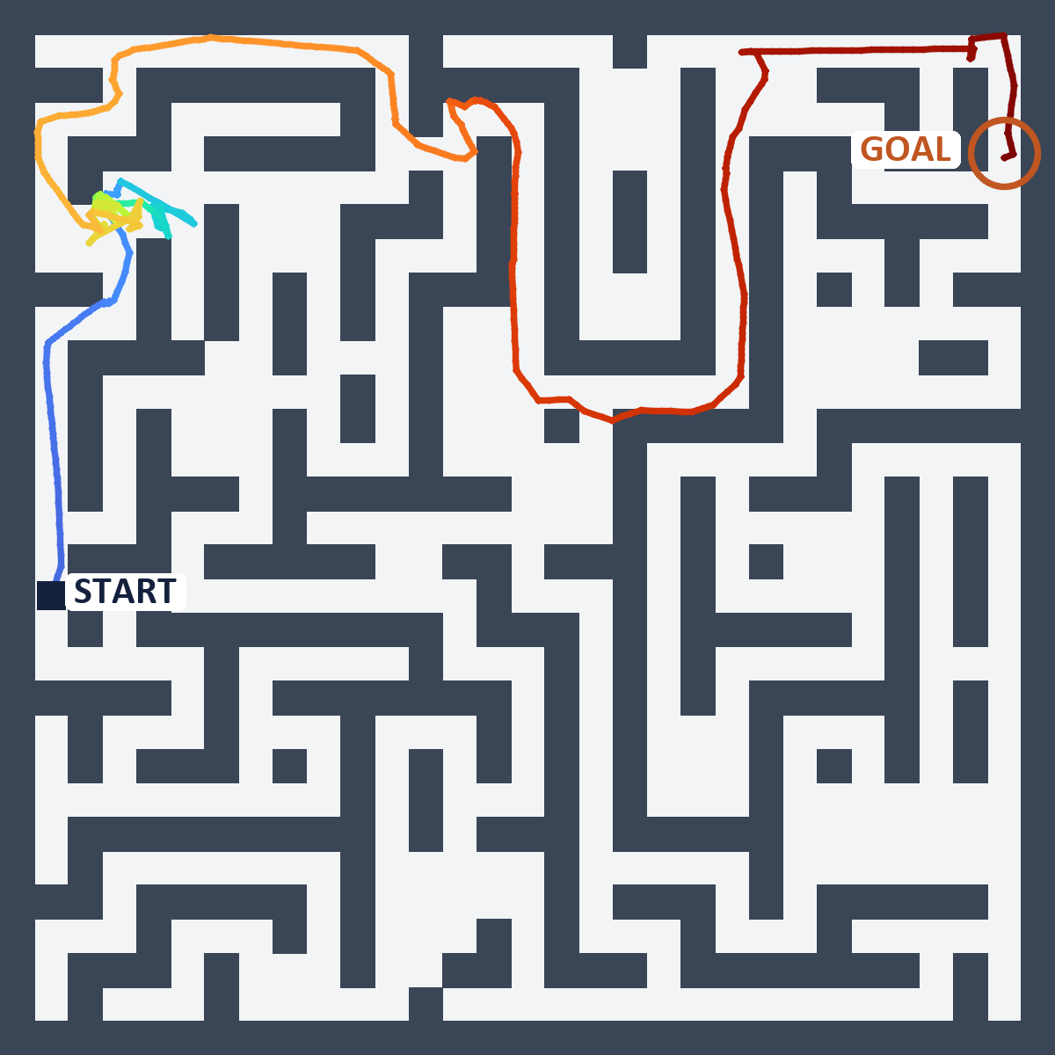
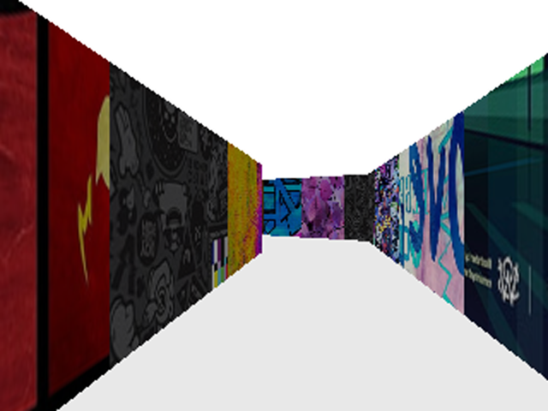
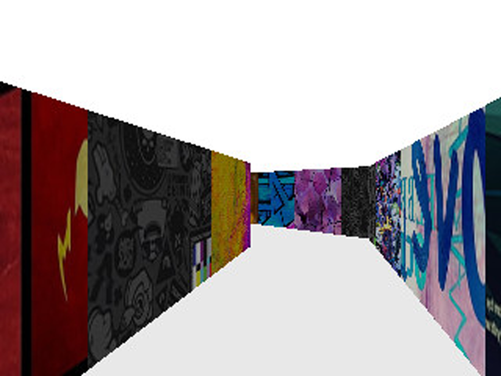
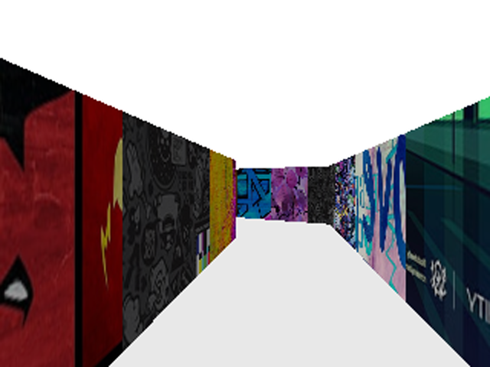
Method (2/2): what keeps it on track
METHOD · 2 OF 2
1
Think when confused. Three decisions on the same photo: SuperGlue checks the next 5 route photos. It costs time, not steps.
2
Measured steering. Yaw from the essential matrix between the live view and the waypoint photo; it keeps control down to 30 inliers.
1. Goal photo (given)
3
No repeated detours. A stretch that stalls gets costlier once, then the route is re-planned.
4
Robust goal choice. Each goal photo is checked against AnyLoc’s top 64 map photos; the strongest SuperGlue match is the goal node (photo 2). Wrong goal in 1 of 13 test mazes, down from 4 of 13.
2. Map photo picked as the goal
5
Safe check-in. Only on 35+ inliers with the goal photo, 3 readings in a row (photo 3). Correct check-ins had 43–122 inliers, wrong ones 21–25.
Local maze 25, the exact mid-term code, replayed on the simulator’s true poses. Colour = time, blue at the start to red at the check-in: 6/10, 2,965 steps, 0.02 m from the goal. The knot at top left is about 1,700 steps that got no closer to the goal (following, undoing and searching), the same kind of loss as in the mid-term.
3. Camera at check-in (0.02 m)
Notes:
Five ideas on top of the pipeline, each added after a measured failure. The picture is a local test maze run with the exact mid-term code; only locally can the true path be drawn, since the server never reveals the robot’s position. The three photos show the idea end to end: the goal photo the robot is given, the exploration photo it picked as the goal node before moving, and its own camera when it checked in 2 cm from the goal. The knot at the top left is about 1,700 steps that got no closer to the goal: following the L network, undoing recorded moves and searching for a waypoint, the same kind of waste that cost the mid-term its SPL points.

