Slide 1

SMART INDIA HACKATHON 2026
TITLE PAGE
Problem Statement ID – SIH26031
Problem Statement Title- Quality assessment and grading of onions are often subjective and vary across procurement centers, resulting in disputes and inconsistencies.
Theme- Smart Automation
PS Category- Software
Team ID- [Team ID]
Team Name- StrataCadastre_KP

Slide 2

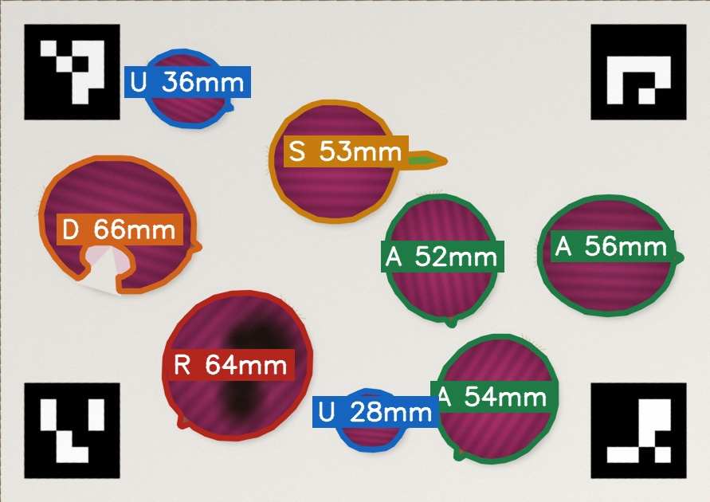























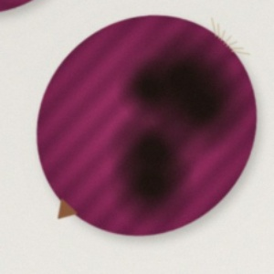

PROPOSED SOLUTION
StrataCadastre_KP
EkMaap (“one measure”): one photo of the sample → every onion measured and labelled → a verifiable quality report.
The gap
ONE PHOTO, EVERY ONION MEASURED AND LABELLED
WHAT CHANGES
Today (manual)
With EkMaap
An onion lot’s grade decides whether it is bought and at which rate, yet it is judged by eye at each procurement centre. Two officers can grade the same lot differently — the source of disputes.
Grade judged by eye
Grade computed from the photo
Size judged visually
Size in mm, tilt-corrected
No record of why
Every onion’s result stored
Why it matters
New norms applied unevenly
One versioned rule set
Norms change mid-season: in 2026 NAFED’s minimum size moved to 45 mm in June and URS purchases stopped on 30 July. Manual grading keeps no record of WHY a lot got its grade.
Dispute is word vs word
Photo + fingerprint as evidence
Unsure cases decided silently
Unsure onions go to the officer
Prototype output — A Grade A · U undersized · S sprouted · D damaged · R rotten
Our solution
OUTPUT PER LOT
Grade A %
URS %
Reject %
Officer review
SIX LABELS PER ONION
A phone app + server. The officer photographs the sample on a printed ArUco mat. AI outlines every onion, measures it in mm, flags damaged, rotten, sprouted and undersized bulbs, applies the current rule set and issues a fingerprinted report in seconds.
Grade A
Undersized
Sprouted
+ digital report
A
sound, above size limit
U
below size limit
S
shoot visible
Damaged
Rotten
Needs review
annotated
photo
size & condition
of every onion
rule-set
version
time &
GPS
SHA-256
fingerprint
QR to
verify
D
cut, split, peeled
R
mould, soft rot
?
model unsure

Slide 3
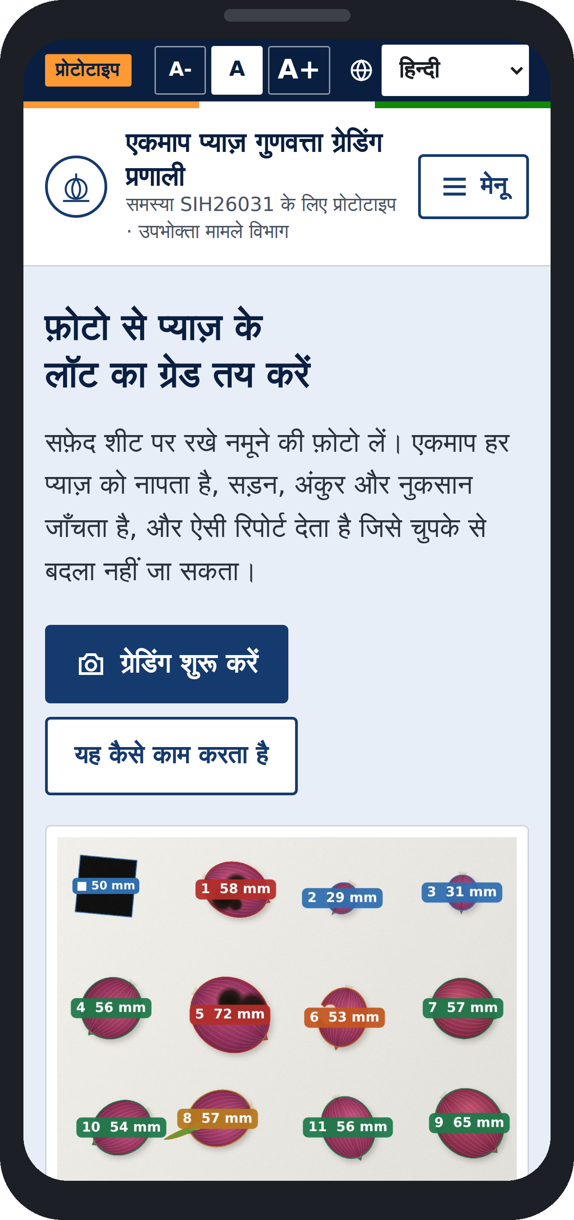















TECHNICAL APPROACH
StrataCadastre_KP
PROCESSING PIPELINE
CAPTURE
Phone photo of the
sample on the mat
CALIBRATE
4 ArUco markers →
mm grid, tilt removed
SEGMENT
ML outlines each onion;
touching ones split
MEASURE
Widest diameter in mm,
ruler-calibrated
CLASSIFY
ML condition + confidence;
unsure → officer
GRADE & REPORT
Rule set → Grade A / URS %
· fingerprinted PDF
SYSTEM ARCHITECTURE — LAYERED STACK
SEE IT RUNNING
FRONTEND
Officer web app (PWA) · phone camera · review screen · no install
WORKING PROTOTYPE
BACKEND
FastAPI · REST API with role-based access (officer / supervisor / labeller)
Click here to see the working prototype.
DATABASE
PostgreSQL · append-only analyses, reviews, reports, audit log
GITHUB REPO
Click here to see the GitHub repository.
VISION
OpenCV ArUco homography · scikit-image watershed · moment-based sizing
DEMO VIDEO
AI / ML
Trainable pixel segmenter + condition classifier (scikit-learn) · YOLO-seg on GPU
Click here to see the demo video.
RULES
Versioned rule sets: size limits, condition → grade; editable per circular
Built: calibration, segmentation, sizing, classifier, rule engine, fingerprinted PDF reports, dispute flow, dataset + model registry — REST API over PostgreSQL.
Prototype in Hindi
REPORTS
ReportLab PDF · SHA-256 fingerprint · QR · public verify endpoint
KEY INNOVATIONS
USER JOURNEY
ArUco grading mat
mm sizing, tilt-proof, ₹0 hardware
Officer in the loop
unsure onions never auto-graded
Self-improving
officer corrections = new training data
New lot
Photograph
Review flags
Grade
Share report

Slide 4



















FEASIBILITY AND VIABILITY
StrataCadastre_KP
ECONOMIC FEASIBILITY
TECHNICAL FEASIBILITY
OPERATIONAL FEASIBILITY
SOCIAL FEASIBILITY
Uses phones already in hand
Working prototype
Fits today’s process
Farmer sees the evidence
Web app in the officer’s phone browser. The only extra item is a printed A4 mat.
Full chain runs end to end: photo → mm sizing → condition → grade → verified PDF.
Officer still draws the sample; the app replaces judging by eye, not the officer.
Same annotated photo and per-onion result for farmer and officer.
No licence cost
Trains on a laptop
Norms change without code
Same lot, same grade
Open-source stack (OpenCV, scikit-learn, FastAPI, PostgreSQL), self-hosted in Docker.
Segmenter and classifier train on CPU in minutes; GPU model optional at scale.
New limits = new rule-set version, applied to every centre at once.
Any centre, same rule version → same answer from the same photo.
Fewer re-grades
Proven building blocks
Runs in NIC / state data centres
Local languages
Stored photo + report settle a dispute without re-grading the whole lot.
Marker-based metrology and image classification are mature computer-vision methods.
Self-hosted Docker stack; photos never leave government servers.
Interface in Hindi, Marathi, Gujarati, Tamil, Telugu, Kannada and English.
KEY RISKS AND HOW WE OVERCOME THEM
Varied light and backgrounds
Onions touching or clustered
Internal rot is invisible
Grade norms keep changing
Matte printed mat + capture guide; models retrained on photos from each new centre.
Learned boundary class + watershed splitting; officer confirms any flagged onion.
Report lists surface grade; the officer’s cut test stays part of the procedure.
Limits live in versioned rule sets, updated by a supervisor per official circular.
IMPLEMENTATION ROADMAP
DETAILED FINAL REPORT
Phase 1 · Data
Phase 2 · Train
Phase 3 · Pilot
Phase 4 · Scale
Click here to see the detailed report.
Architecture, database, API and training plan in full.
Label mandi onion photos; ruler-measure a subset
Train segmenter + classifier; test on held-out photos
One procurement centre, officers in the loop
Multi-centre rollout; retrain from officer corrections

Slide 5



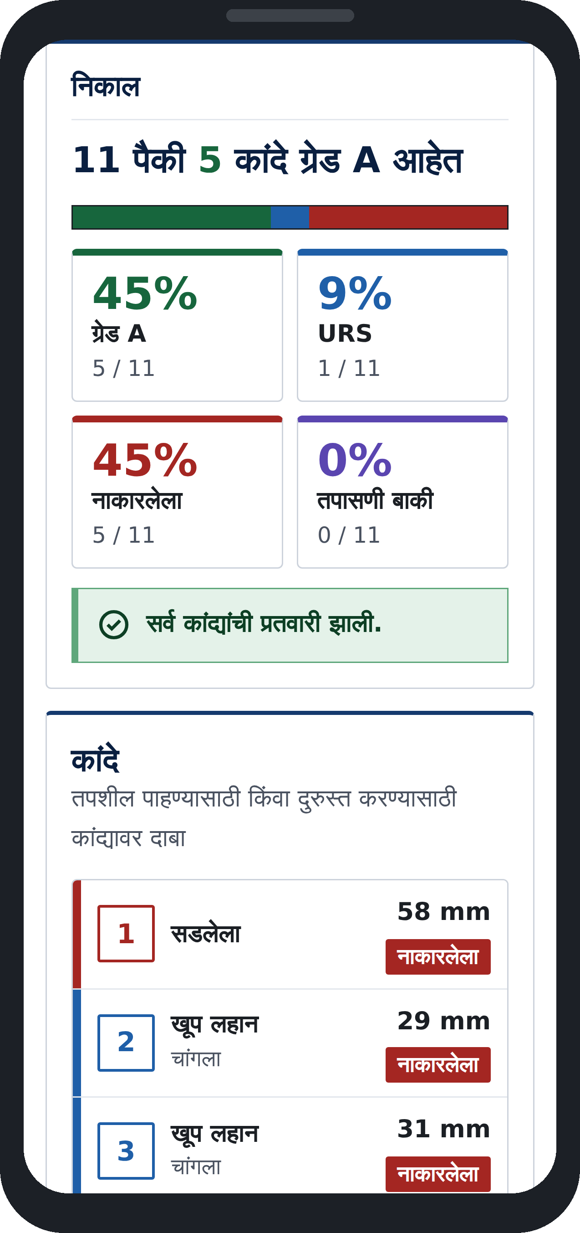
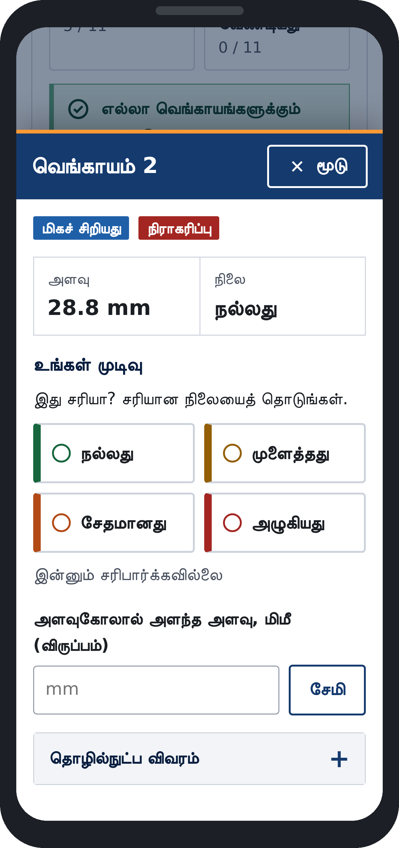
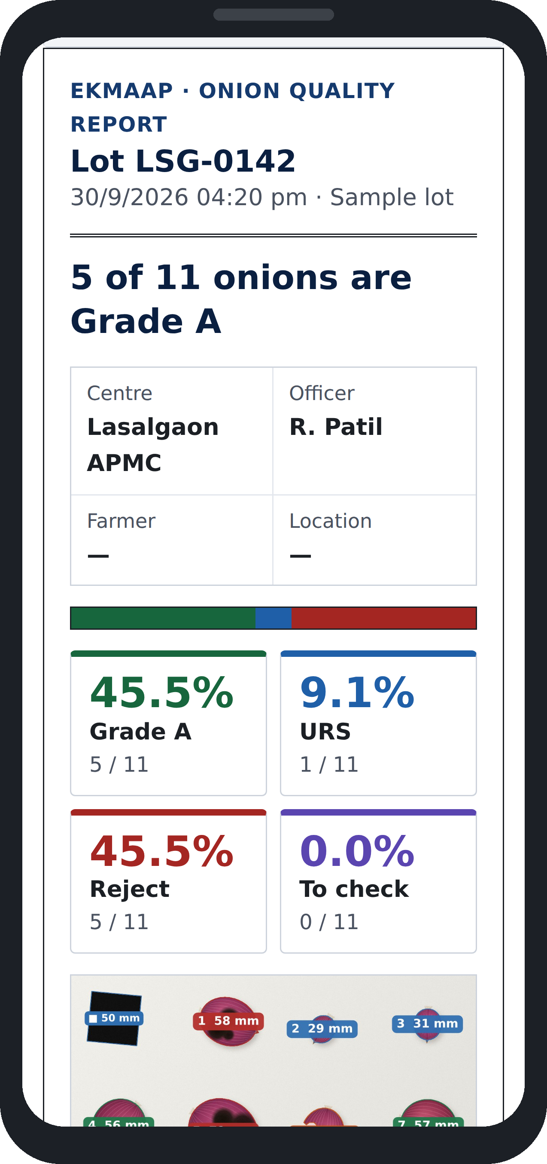







IMPACT AND BENEFITS
StrataCadastre_KP
2 lakh t
₹2,335/qtl
45 mm
7th
onion procurement target for 2026 (NAFED + NCCF, 1 lakh t each)³
Grade A procurement price from 30 July 2026²
minimum size NAFED accepted after the June 2026 relaxation (was ~55 mm)¹
procurement price hike of the season, by 30 July 2026²
GRADE A PROCUREMENT PRICE, 2026 (₹/QUINTAL)
GRADING RULES CHANGED MID-SEASON (2026)
PROTOTYPE — OFFICER SCREENS
June 2026 Norms relaxed¹
Min. size ~55 → 45 mm; one peeled layer, up to 30% blackening, 40% spots, 10% sunburn accepted.
30 July 2026 URS stopped²
Only Grade A bought from this date; Grade A price raised to ₹2,335/qtl.
Next change One click
In EkMaap: a new rule-set version, live at every centre the same day.
Source: Free Press Journal, 31 Jul 2026²
Result · Marathi
Check onion · Tamil
Report · English
IMPACT ON THE TARGET AUDIENCE
Officer confirms flagged onions, then issues the report.
Farmers
Procurement officers
NAFED / NCCF / DoCA
Consumers
See exactly why their lot got its grade; contest with evidence, not argument.
Grade backed by photo + rule version; less personal blame in disputes.
Comparable quality data across centres; new norms rolled out as one update.
Cleaner intake into the buffer stock released to stabilise onion prices.
SOCIAL
Fewer disputes at the centre; trust built on shared evidence
ECONOMIC
Right price for the right grade; fewer costly re-grades
GOVERNANCE
Auditable, versioned, tamper-evident grading at every centre

Slide 6












RESEARCH AND REFERENCES
StrataCadastre_KP
GRADING STANDARDS & POLICY
2026 PROCUREMENT FACTS (NEWS)
TECHNOLOGY STACK
SIH26031 problem statement
¹ NAFED relaxes onion procurement norms
OpenCV ArUco
DoCA, Ministry of Consumer Affairs — expected solution
Free Press Journal · 4 Jun 2026
Marker detection, homography, rectification
sih.gov.in
freepressjournal.in/pune
docs.opencv.org
Fruits & Vegetables Grading and Marking Rules, 2004
² Grade A rate ₹2,335/qtl; URS stopped 30 July
scikit-learn · scikit-image
AGMARK onion standard (Schedule XIX)
Free Press Journal · 31 Jul 2026
Pixel segmenter, classifier, watershed
agritech.tnau.ac.in/amis/pdf/ONION_AGMARK.pdf
freepressjournal.in/pune
scikit-learn.org · scikit-image.org
Price Stabilisation Fund
³ Early procurement, 2 lakh t target
FastAPI · PostgreSQL
Scheme under which the onion buffer is procured
Free Press Journal · 8 Apr 2026
REST API and audit-ready database
consumeraffairs.nic.in
freepressjournal.in/pune
fastapi.tiangolo.com · postgresql.org
NAFED · NCCF
Size range eased to 35–70 mm
ReportLab · CVAT
Central procurement agencies for the onion buffer
ETV Bharat · 7 Jun 2026
PDF reports with QR · labelling tool
nafed-india.com · nccf-india.com
etvbharat.com
reportlab.com · cvat.ai
FIELD VALIDATION PLAN
1. Mandi sample study
2. Procurement-centre observation
3. Grader-agreement study
good and defective onions photographed on the mat and measured by ruler — the labelled training and test set.
how officers draw and grade samples today, and which written norms they apply.
six graders vs the app on the same onions — measures the subjectivity the PS describes. Click here to see the research report.

