Slide 1
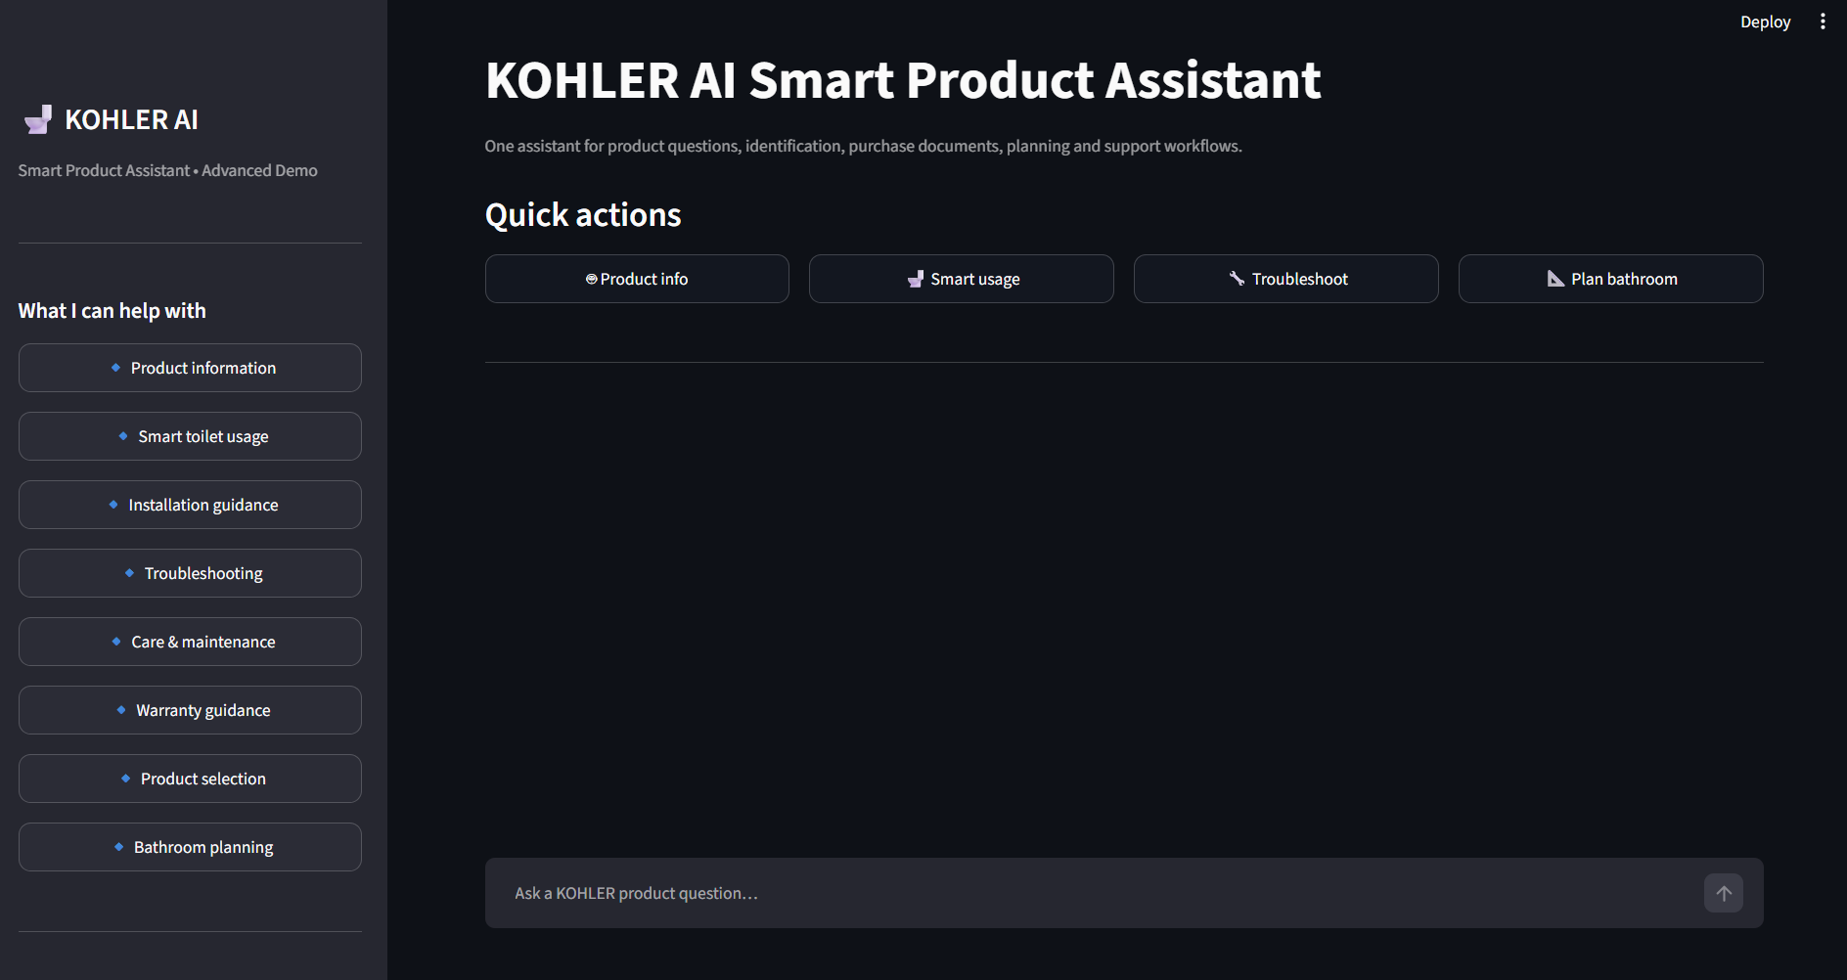








01 | CORE APPROACH
KOHLER AI Smart Product Assistant
One local, grounded AI assistant brings product Q&A, recognition, support and planning into a single experience
OUR APPROACH
THE PRODUCT · LIVE UI FROM THE REPO
Local-first and private
Questions, images and audio are processed on the user's machine by open models. No cloud AI service and no API key.
Grounded, not guessed
Answers come from retrieved KOHLER support documents and show which sources were used.
Multimodal by design
One vision-language model handles text questions, product photos and invoice images.
Assistive and safe
Rule-based first checks for faults, and every result prompts verification against the label or official KOHLER support.
ONE ASSISTANT · NINE CAPABILITIES · FOUR JOBS TO BE DONE
ASK
SEE
FIX
CHOOSE
AI chat with intent detection
Voice assistant
Product scanner (photo to model)
Bill scanner (invoice to JSON)
Guided troubleshooting + ticket
Manual and support finder
Product finder by style, budget
Bathroom planner
Source: github.com/kartiksaxena-max/kohler-ai-smart-product-assistant
Kartik Saxena · MIT World Peace University | 1
Notes:
Core approach: a single privacy-first assistant for KOHLER smart toilets and bidet seats. Four principles: local-first, grounded, multimodal, assistive. Nine capabilities grouped into Ask, See, Fix and Choose. Screenshot is the app home screen from the repo.

Slide 2
02 | SYSTEM ARCHITECTURE
KOHLER AI Smart Product Assistant
A layered architecture keeps retrieval, reasoning and data entirely on the user's own machine
INTERFACE
User → Streamlit app (app/main.py)
page routing · quick actions · chat · file uploads · JSON downloads
FEATURE
MODULES
AI chat
ai.py
Voice assistant
voice.py
Product + bill scanners
vision.py
Guided troubleshooting
troubleshooting.py
Finder + planner
catalog.py · planner.py
INTELLIGENCE
Intent + retrieval
keyword intent rules, then top-4 document search
faster-whisper
base model · CPU · int8, transcript goes to chat
Structured extraction
returns JSON, temperature 0.1
Rule engine
safe first checks for no power, not flushing, leaking
Catalog search
category, style, budget and room-area shortlist
LOCAL AI
ENGINE
Ollama · Qwen2.5-VL 3B · 127.0.0.1:11434
one local model for chat (temp 0.2) and vision (temp 0.1)
Deterministic logic
no model call needed
ON-DEVICE
DATA
Knowledge base: data/ (.txt, .md)
auto-indexed, each file starts with a SOURCE: line
In-memory uploads
temp audio deleted
tickets.json
local, never sent
catalog.json
demo product catalog
CHAT PIPELINE IN FOUR STEPS
1
Detect intent
usage, troubleshooting, warranty, installation, care or purchase
2
Retrieve
TF-IDF cosine blended with keyword overlap, top 4 docs kept
3
Generate
local model gets docs, last 8 messages and a no-invention prompt
4
Answer
shown with the detected intent and the sources used
Source: github.com/kartiksaxena-max/kohler-ai-smart-product-assistant (README, app/ modules)
Kartik Saxena · MIT World Peace University | 2
Notes:
Architecture: Streamlit UI routes to five feature modules. Intelligence layer holds intent rules plus TF-IDF retrieval, faster-whisper for speech, and structured extraction. A single Ollama-served Qwen2.5-VL 3B model powers chat and vision. Troubleshooting and the finder are deterministic. All data (knowledge base, tickets, catalog) stays on the device.

Slide 3
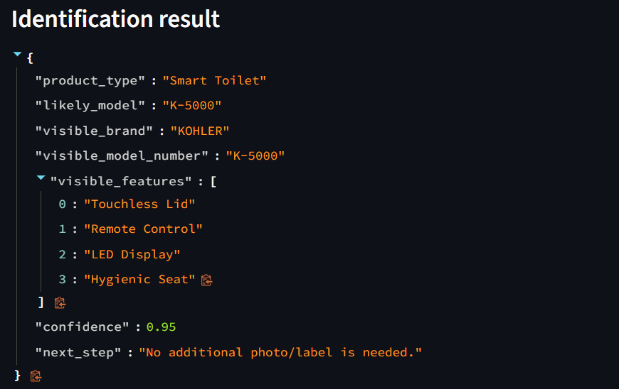
03 | TECH STACK
KOHLER AI Smart Product Assistant
A lean open-source stack delivers multimodal AI with no cloud service and no API key
LAYER | TECHNOLOGY | ROLE IN THE SYSTEM
Interface | Streamlit | Web UI, page routing, file uploads and JSON downloads
Language | Python 3.10+ | Single-language codebase with 12 focused modules under app/
Local AI runtime | Ollama | Serves the model over a local API on 127.0.0.1:11434
Vision-language model | Qwen2.5-VL 3B | One model for chat, product photos and invoice extraction
Speech to text | faster-whisper | Base model on CPU (int8) transcribes wav, mp3 and m4a locally
Retrieval | TF-IDF, scikit-learn | Unigram and bigram cosine similarity blended with keyword overlap
Configuration | python-dotenv | Model, URL and timeout set through .env (180 s default)
Quality | pytest | Tests for retrieval and intent detection
0
3.2 GB
API keys or cloud AI calls
one-time local model download
Top 4
8
documents retrieved per question
recent messages kept as context
LOCAL VISION OUTPUT · PRODUCT SCANNER
Source: github.com/kartiksaxena-max/kohler-ai-smart-product-assistant (README, requirements.txt, .env.example)
Kartik Saxena · MIT World Peace University | 3
Notes:
Tech stack: Streamlit + Python for the interface, Ollama serving Qwen2.5-VL 3B for both language and vision, faster-whisper for speech, scikit-learn TF-IDF for retrieval, python-dotenv for configuration and pytest for tests. Key numbers come from the README: about 3.2 GB model, top-4 retrieval, last 8 messages as context.

Slide 4
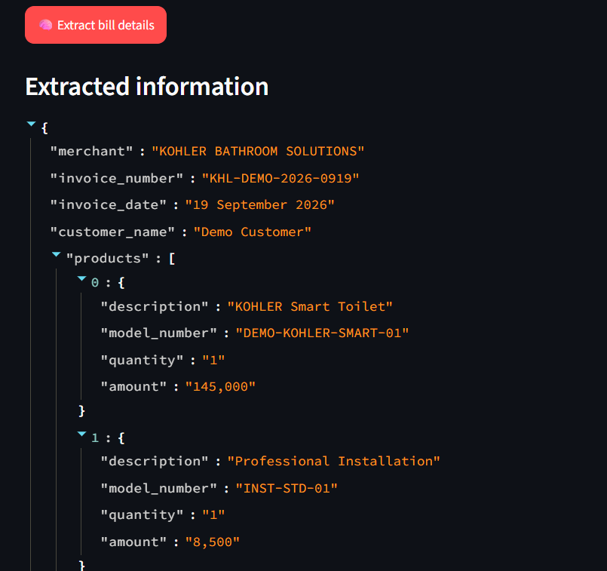




04 | INNOVATION PITCH
KOHLER AI Smart Product Assistant
Local-first multimodal support AI is the differentiator, with a clear path from prototype to production
Zero-cloud multimodal AI
Guardrails built into the prompt
Chat, vision and speech all run on-device with open models. No API key, no cloud AI service, no data leaving the machine.
The model may not invent models, prices, warranty eligibility or repair steps. Retrieved text is untrusted, and every answer cites its sources.
Photo-to-model and bill-to-JSON
Diagnose-to-ticket loop
One vision model identifies a product from a photo and turns an invoice into structured JSON, ready to download.
Guided troubleshooting runs safe first checks, then saves a support ticket locally as JSON for easy handoff.
Bill scanner: synthetic demo invoice turned into structured JSON
FROM PROTOTYPE TO PRODUCTION (ROADMAP FROM THE REPO)
TODAY · Prototype
NEXT · Data depth
LATER · Service integration
Local RAG chat, product and bill scanners, voice, troubleshooting, finder and planner, all working in the demo.
Real-time KOHLER catalog and pricing, stronger invoice OCR, and PDF manual ingestion into the knowledge base.
Clearance checks and visual layout, service-centre and CRM integration, and regional (India) product and warranty data.
Research prototype for the KOHLER-MITWPU AI Research Lab Program, not an official KOHLER product. Outputs are assistive and must be verified.
Kartik Saxena · MIT World Peace University | 4
Notes:
Innovation pitch: four differentiators (zero-cloud multimodal AI, prompt-level guardrails, photo-to-model and bill-to-JSON, diagnose-to-ticket loop) and the roadmap taken from the repo: real-time catalog and pricing, stronger OCR, PDF manual ingestion, clearance checks and visual layout, service-centre and CRM integration, and regional India data. Be upfront that this is a research prototype with a small model and small knowledge base.

