Slide 1
A PROJECT ON HANDWRITTEN DIGIT RECOGNITION USING PYTHON AND CNN

Slide 2
What is Handwritten Digit Recognition?
The handwritten digit recognition is the ability of computers to recognize human handwritten digits. It is a hard task for the machine because handwritten digits are not perfect and can be made with many different flavors. The handwritten digit recognition is the solution to this problem which uses the image of a digit and recognizes the digit present in the image.

Slide 3
Motivation:-
• Before computers existed all the information was stored in written form, this is very ineffiecient form of storage as the paper information cannot be stored for very long time and can get lost or be destroyed.
• On the contrary information on computer is stored safely for long time and multiple copies of same information can be made easily.
• Thus after inventing the computers lot of money was wasted in manual labor for converting this paper information into digital information.
• Instead machine learning can be used to identify and convert this paper information into digital information without human intervention or manual labor.
• Our project is just an introduction to this approach.

Slide 4
Objective:-
In this project, we developed a machine learning program which is able to recognize human’s handwritten digit from pictures. The learning algorithm we used is “convolutional neural network”, which is a computational model inspired by animals’ central nervous systems. The input pictures should be processed to only black-white color with a fixed number of pixels. The predict function will be able to output the prediction of any pictures of human’s handwritten digit based on weight vectors of the neural network. We will obtain the weight vectors by training the neural network with a set of pictures (training set) of human’s handwritten digit.

Slide 5
Abstract:-
Humans can see and visually sense the world around them by using their eyes and brains. Computer vision works on enabling computers to see and process images in the same way that human vision does. Several algorithms developed in the area of computer vision to recognize images. The goal of our work will be to create a model that will be able to identify and determine the handwritten digit from its image with better accuracy.

Slide 6
Related Problems:-
The handwritten digits are not always of the same size, width, orientation and justified to margins as they differ from writing of person to person, so the general problem would be while classifying the digits due to the similarity between digits such as 1 and 7, 5 and 6, 3 and 8, 2 and 5, 2 and 7, etc. This problem is faced more when many people write a single digit with a variety of different handwritings.

Slide 7
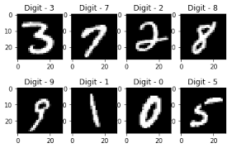
About the Python Deep Learning Project
In this article, we are going to implement a handwritten digit recognition program using the MNIST dataset. We will be using a special type of deep neural network that is Convolutional Neural Networks. In the end, we are going to use paint through which we can draw the digit and recognize it straight away.

Slide 8
Prerequisites
The interesting Python project requires you to have basic knowledge of Python programming, deep learning with Keras library.
The MNIST dataset
This is probably one of the most popular datasets among machine learning and deep learning enthusiasts. The MNIST dataset contains 60,000 training images of handwritten digits from zero to nine and 10,000 images for testing. So, the MNIST dataset has 10 different classes. The handwritten digits images are represented as a 28×28 matrix where each cell contains grayscale pixel value.

Slide 9
Steps to implement the handwritten digit recognition project-

Slide 10
1. Import the libraries and load the dataset:
First, we are going to import all the modules that we are going to need for training our model. The Keras library already contains some datasets and MNIST is one of them. So we can easily import the dataset and start working with it. The mnist.load_data() method returns us the training data, its labels and also the testing data and its labels.

Slide 11
2. Preprocess the data
The image data cannot be fed directly into the model so we need to perform some operations and process the data to make it ready for our neural network. The dimension of the training data is (60000,28,28). The CNN model will require one more dimension so we reshape the matrix to shape (60000,28,28,1).

Slide 12
3. Create the model
Now we will create our CNN model in Python data science project. A CNN model generally consists of convolutional and pooling layers. It works better for data that are represented as grid structures, this is the reason why CNN works well for image classification problems. The dropout layer is used to deactivate some of the neurons and while training, it reduces over fitting of the model. We will then compile the model with the Adadelta optimizer.

Slide 13
4. Train the model
The model.fit() function of Keras will start the training of the model. It takes the training data, validation data, epochs, and batch size.
It takes some time to train the model. After training, we save the weights and model definition in the ‘savedmodel.h5’ file.

Slide 14
5. Evaluate the model
We have 10,000 images in our dataset which will be used to evaluate how good our model works. The testing data was not involved in the training of the data therefore, it is new data for our model. The MNIST dataset is well balanced so we can get around 99% accuracy.

Slide 15
6. Use Paint As a Canvas to Predict Digit
We use paint as a black canvas to draw a random number and save it as an image of certain pixels to predict the digit.

Slide 16
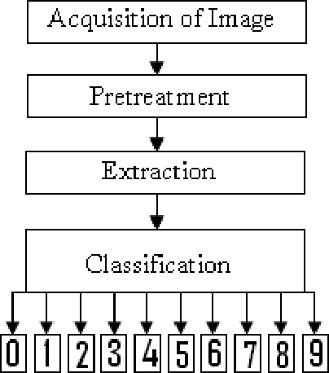
Flowchart:-

Slide 17
Conclusion:-
Machine learning can be used to identify and convert this paper information into digital information without human intervention or manual labor.

