Slide 1

CLUB MAHINDRA RESORTS
Guest Wayfinding Dashboard
An interactive resort navigation web app for a better guest experience.

Slide 2
THE CHALLENGE
Guests arrive, and struggle to find their way.
— Beyond Google Maps. Google Maps helps guests reach the resort but doesn't provide navigation inside the property. Our interactive internal map guides guests to rooms, restaurants, and amenities with real-time navigation.
— Real-Time Navigation. Printed maps show the resort layout but cannot display a guest's live location or provide navigation. Our digital internal map offers real-time location and easy navigation to any destination.
— Every resort is unique. Each resort has a different layout. Our customized internal map provides accurate navigation for every property.
— Repeated guest queries. Guests frequently ask for directions to rooms, restaurants, pools, and other amenities, increasing the workload on the front desk.
Frequently Asked Questions
“Where's my room block from here?”
“Is there a shortcut to the pool?”
“What's around the resort worth visiting?”
“How far is the restaurant, really?”
2

Slide 3
THE SOLUTION
One dashboard, every destination
A guest opens a link , picks their resort, and gets an illustrated, interactive map — with
turn-by-turn walking directions and nearby places to visit — all running locally, with zero app install.
01
02
03
04
Resort Finder
Interactive Map
Wayfinding
Nearby Places
Pick your state or country, then your resort, from a fast searchable dashboard.
A hand-mapped 2D layout of the resort — room blocks, dining, activities, facilities — with an optional 3D view.
Set where you are (landmark, tap the map, or GPS) and where you want to go — get the walking route, live.
Explore real attractions within ~100 km, one tap from opening driving directions in Google Maps.
3

Slide 4
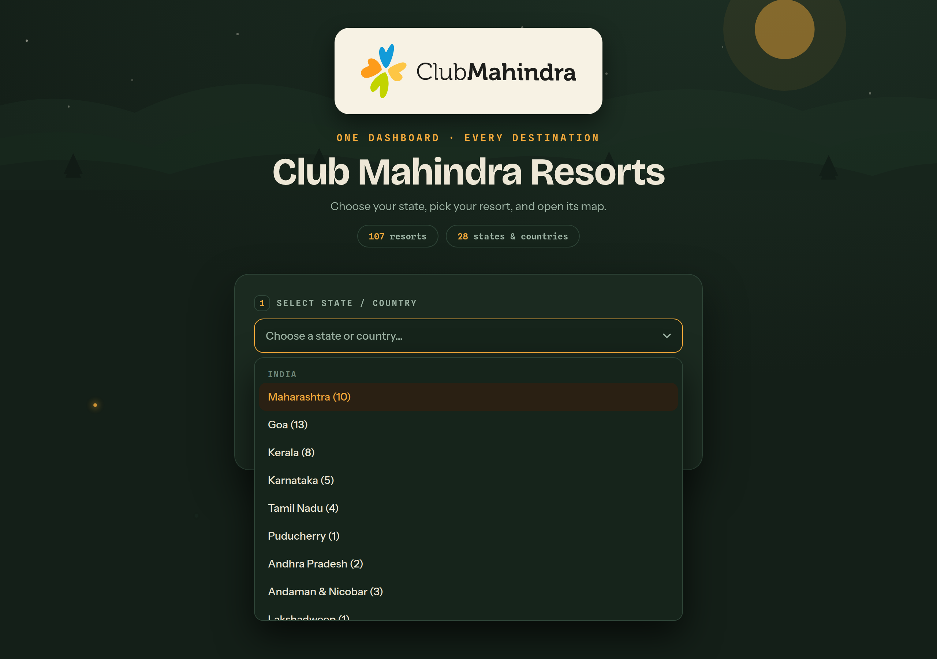
FEATURE 01 · RESORT FINDER
Find your resort in two taps
— Signed-in experience. A simple sign-in gate keeps the dashboard private to resort guests.
— Explore resorts across India. Browse Club Mahindra resorts across India with a dedicated page for each property.
— Custom-built dropdown. Guaranteed to fit any laptop or phone screen — never gets clipped, unlike a native browser dropdown.
— One tap to navigate. Choose a resort and open its interactive map with a single tap.
Dashboard — resort selection
Club Mahindra Resorts · Guest Wayfinding Dashboard
4

Slide 5
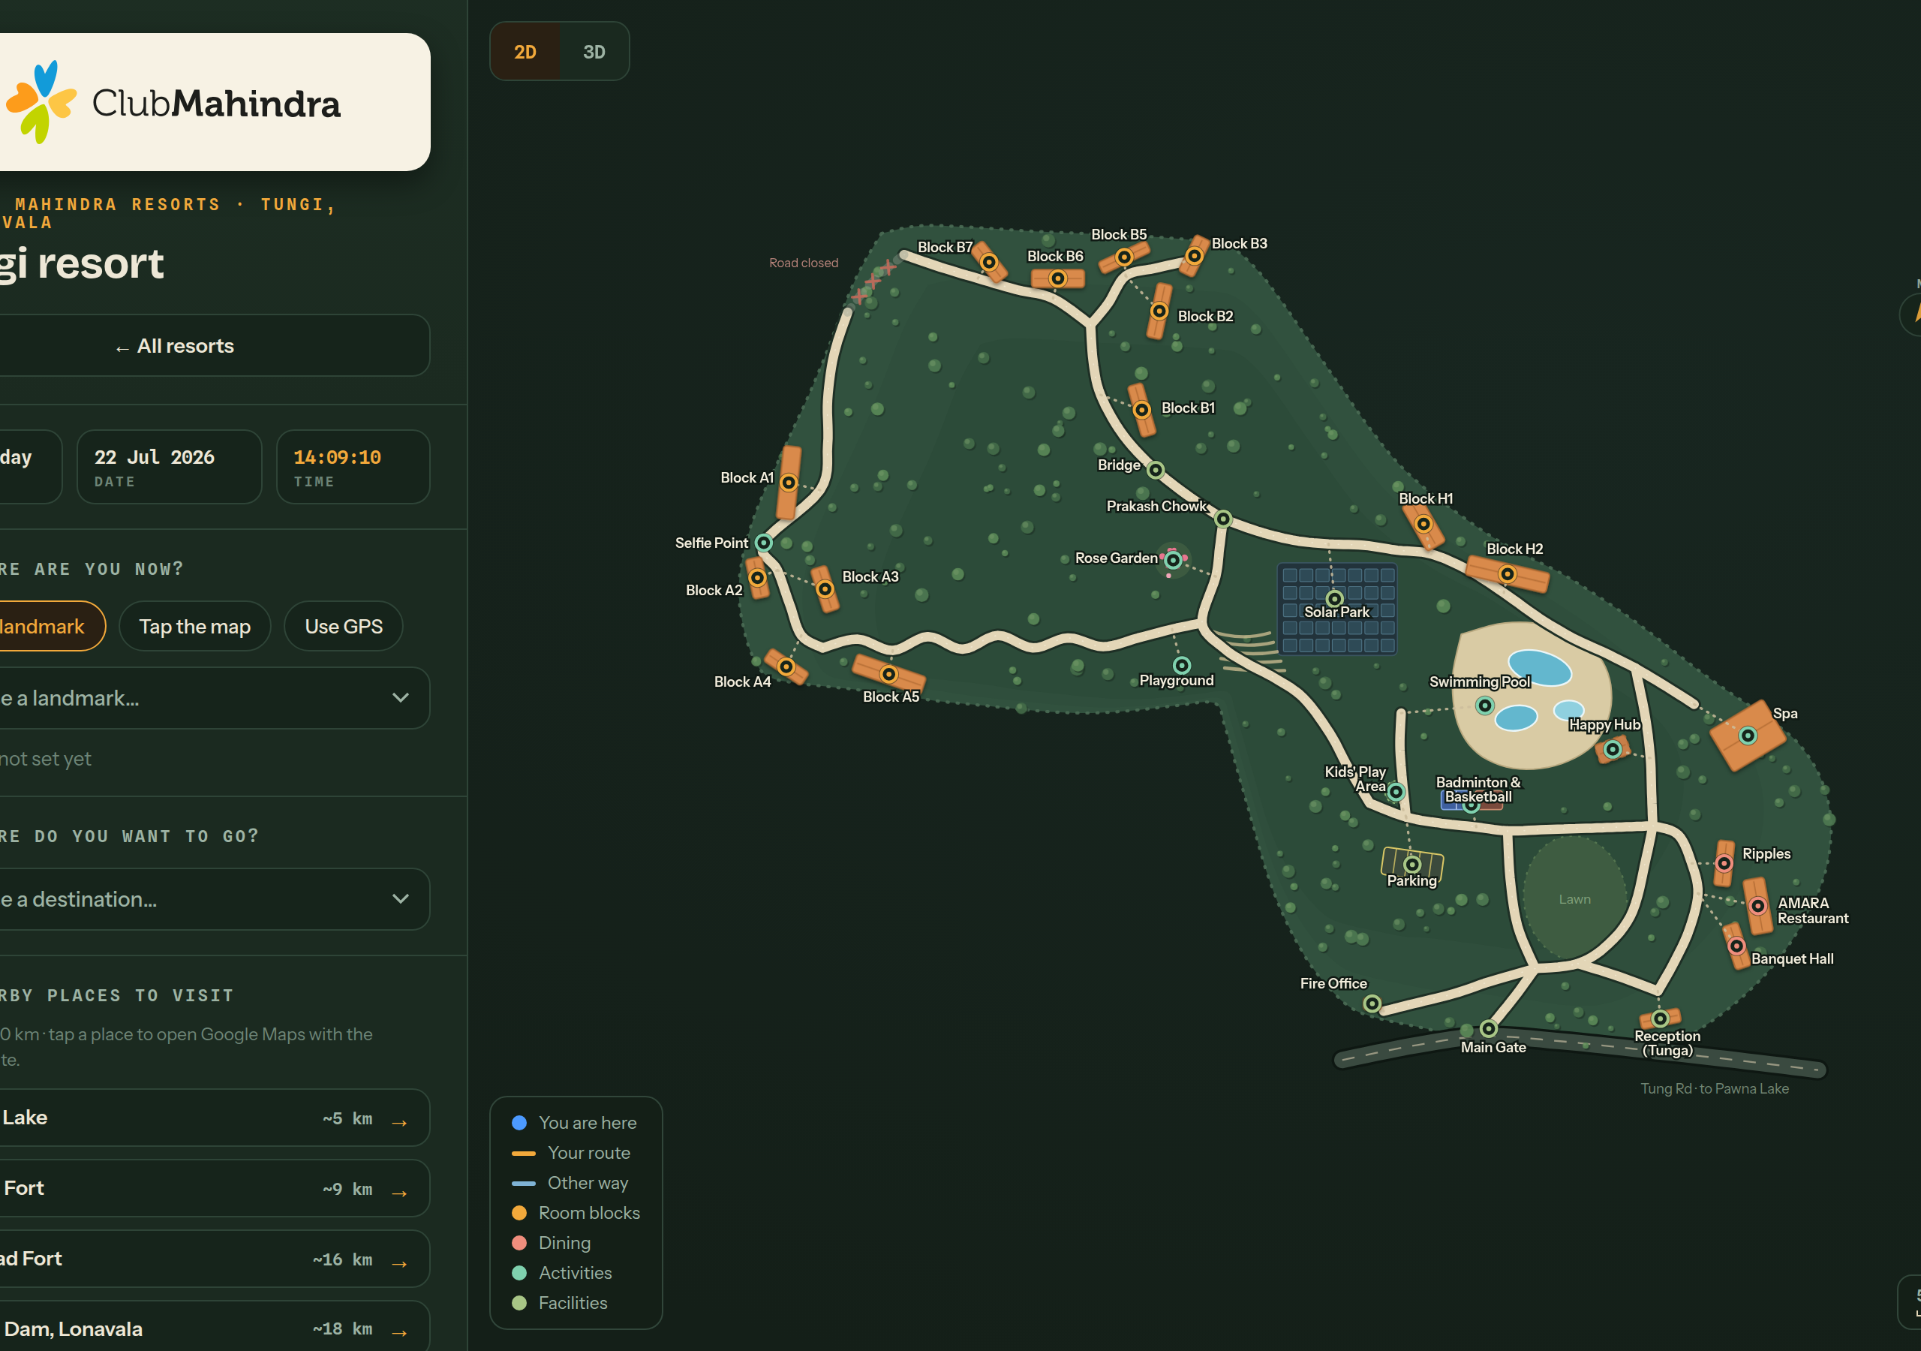
FEATURE 02 · INTERACTIVE MAP
A map that actually matches the resort
— Hand-mapped, not generic. Each layout is built from the resort's real footprint — room blocks, dining, activities, and facilities are placed accurately.
— 2D and 3D views. Guests can switch between a clean 2D top-down view and an explorable 3D view of the same resort.
— Zoom, pan, tap. Tap any place on the map to see it, set it as your starting point, or route to it instantly.
— Built to scale. Easily onboard new resorts using their layout files..
Club Mahindra Tungi — interactive resort map
5

Slide 6
FEATURE 03 · WAYFINDING
From "where am I" to "how do I get there"
1
2
3
Where are you now?
Where do you want to go?
Follow the route.
Pick a nearby landmark from a list, tap your position directly on the map, or use live GPS.
Choose any destination on the resort — room block, restaurant, pool, spa, activity area.
The app calculates the walking path (with an alternate route when available) and gives clear step-by-step directions.
6

Slide 7
FEATURE 04 · NEARBY PLACES TO VISIT
The resort is not the whole trip
— Explore nearby attractions. Discover popular attractions within 100 km of each resort, including waterfalls, forts, viewpoints, and local landmarks.
— One tap to directions. Every place opens Google Maps with driving directions already filled in from the resort.
— Always something to explore. If no attractions are listed, guests can instantly explore nearby places using Google Maps
— Encourages longer stays. Helps guests plan day trips without leaving the dashboard or needing prior research.
NEARBY PLACES TO VISIT
Pawna Lake
~5 km
Tikona Fort
~9 km
Lohagad Fort
~16 km
Bhushi Dam, Lonavala
~18 km
7

Slide 8
QUALITY & RELIABILITY
Compatible with All Devices.
— Optimized for every screen. Replaced the default dropdown with a responsive custom menu that fits perfectly on all devices
— Fully Tested. Every interaction was tested across different devices and screen sizes to ensure a smooth user experience.
— Responsive across the whole app. Logo sizing, map sidebar, and layout all adapt from a small phone up to a widescreen laptop.
— No app installation required. Simply sign in and access the dashboard through a web link.
8

Slide 9
Thank you
Questions & discussion

