Slide 1

Brain Tumor Detection Using ML Techniques
SRM INSTITUTE OF SCIENCE AND TECHNOLOGY
SCHOOL OF COMPUTING
DEPARTMENT OF COMPUTING TECHNOLOGIES
18CSP107L / 18CSP108L - MINOR PROJECT / INTERNSHIP
Guide name: Mrs. P .Renukadevi
Designation: Assistant Professor Department: Computing Technologies
Batch ID: B497
Student 1 Reg. No: RA2011003010810
Student 1 Name: Kartik Singh
Student 2 Reg. No: RA2011003010772
Student 2 Name: Utkarsh Gupta
14-10-2023

Slide 2
Abstract
Our project aims to develop an efficient and accurate method for detecting brain tumors in medical images using machine learning (ML) approaches.
Brain tumors pose a significant health risk and early detection is crucial for effective treatment.
The project involves multiple stages, including preprocessing of MRI images to enhance quality, extraction of relevant features from the images, and utilization of these features to train and test different ML models.
The proposed approach leverages the power of ML to learn intricate patterns and relationships within the images, thereby enabling accurate tumor classification.
The successful implementation of this project could significantly contribute to the medical field by providing a reliable tool for timely and accurate brain tumor diagnosis, facilitating better patient care and treatment planning.

Slide 3
Introduction
Brain tumors pose a significant medical challenge, impacting individuals' well-being and survival.
Timely and precise detection is vital for effective treatment planning.
This project leverages advanced techniques, including Support Vector Machines (SVM) and Histogram of Oriented Gradients (HOG).
We aim to enhance brain tumor diagnosis with SVM and HOG techniques. Our objective is to develop a robust and reliable brain tumor detection system.
By applying SVM and HOG to large datasets of brain MRI images, we seek to improve accuracy, speed, and consistency in brain tumor diagnosis.

Slide 4
Motivation
Early Detection: HOG and SVM aid in early brain tumor identification, enhancing treatment prospects and potentially saving lives.
Enhanced Accuracy: HOG's ability to capture texture and shape information combined with SVM's robust classification leads to highly accurate tumor detection.
Reduced False Positives: This approach minimizes incorrect tumor identifications, reducing patient stress and unnecessary procedures.
Robust and Adaptable: HOG and SVM can adapt to various image types and quality, making them suitable for diverse medical imaging scenarios.
Radiologist Support: These tools assist radiologists by offering automated or semi-automated solution

Slide 5
Literature Survey
S.No | Title | Problem Statement | Journal Date | Research Gap
1. | A Novel Method of Multimodal Medical Image Fusion Based on Hybrid Approach of NSCT and DTCWT | Enhancing medical image interpretation by various modalities (e.g., CT, MRI, PET) to extract features for diagnosis and treatment. | March, 2022 | The authors propose a novel method for multimodal medical image fusion using a hybrid approach(e.g., CT, MRI, PET)
2. | Enhancement Generative Adversarial Network in Medical Image Segmentation | The paper addresses challenges in medical image segmentation, such as limited data, data imbalance, and cross-device differences. | January, 2022 | The paper does not discuss the robustness of the EnGAN model in real-world clinical scenarios or its potential impact on medical diagnosis.

Slide 6
Literature Survey
S.No | Title | Problem Statement | Journal Date | Research Gap
3. | Detecting Brain Tumor by Using Machine Learning and Image Processing Techniques | To detect and classify brain tumor types from MRI images using image processing and machine learning methods. | February, 2022 | The accuracy achieved (min. 62%) falls short of expectations. Possible reasons for this include low-quality images in the dataset, varying perspectives due to MRI nature.
4. | Development of brain tumor segmentation of magnetic resonance imaging (MRI) using U-Net deep learning | Accurate and automated segmentation of brain tumors in medical imaging, particularly in MRI scans. | August, 2021 | Post-processing methods can enhance segmented regions, refining result precision.

Slide 7
Literature Survey
S.No | Title | Problem Statement | Journal Date | Research Gap
5. | Brain Tumor Detection and Classification Using Image Processing Techniques | Focuses on using image processing techniques to identify brain tumors through MRI images, aims to improve accuracy, early detection. | April, 2021 | Image processing techniques with machine learning algorithms could lead to more accurate tumor identification and classification in complex structures.
6. | Brain Tumor Detection Using Transfer Learning with Dimensionality Reduction Method | Detecting and classifying tumors from MRI images is challenging due to their varied nature and need for precise diagnosis | May, 2022 | Combining predictions, approaches to improve accuracy ,reduce bias. Hyperparameter Tuning to optimize model's performance.

Slide 8
Existing Methods & Techniques
Feature Extraction Techniques –
1.Pixel Intensity: This involves using the intensity values of individual pixels as features. This approach may not capture complex patterns in the image.
2.Region of Interest (ROI) Extraction: Identifying and extracting regions of interest within the image, such as tumors, can serve as features. Techniques like thresholding and segmentation are used for this purpose.
3.Texture Analysis: Texture features characterize the spatial distribution of pixel intensities. Methods like Gray Level Co-occurrence Matrix (GLCM), Gray Level Run-Length Matrix (GLRLM), and Local Binary Pattern (LBP) capture textural information.
4.Shape Analysis: Extracting features related to the shape of objects within the image, such as the dimensions, area, perimeter, and circularity of a tumor, can provide valuable information.
5.Statistical Features: Calculating statistical properties like mean, standard deviation, skewness, and kurtosis of pixel values within regions of interest can serve as features.
6.Frequency Domain Features: Transforming images into the frequency domain using techniques like the Fast Fourier Transform (FFT).

Slide 9
Existing Methods & Techniques
Feature Extraction Techniques –
7.Wavelet Transform: Applying wavelet transform decomposes images into multiple scales and orientations, allowing extraction of features at different levels of detail.
8.Principal Component Analysis (PCA): PCA is a dimensionality reduction technique that can be used to transform high-dimensional pixel data into a smaller set of principal components which represent the most important information in the image.
9.Convolutional Neural Networks (CNNs): CNNs automatically learn hierarchical features from raw images through multiple layers of convolution, pooling, and fully connected layers. Pre-trained CNN models can be used for feature extraction.
10.Transfer Learning: Utilizing pre-trained models from other tasks, such as natural image classification, and fine-tuning them on MRI images can capture relevant features.
11.Autoencoders: Autoencoders are neural network architectures designed to learn efficient codings of input data, which can then be used as features for classification.
12.Histogram-Based Features: Histograms of pixel intensity distributions or gradients can capture information about image content.

Slide 10
Existing Methods & Techniques
Machine Learning Techniques –
1.Support Vector Machines (SVM): SVMs are powerful classifiers that aim to find the best hyperplane that separates different classes in a high-dimensional feature space. They have been applied to MRI-based brain tumor classification by using extracted features.
2.Random Forest: Random Forest is an ensemble learning algorithm that consists of multiple decision trees. It's used for both feature selection and classification, making it suitable for complex datasets like medical images.
3.K-Nearest Neighbors (KNN): KNN classifies a data point based on the majority class among its k-nearest neighbors. It can be used with extracted features for brain tumor classification.
4.Artificial Neural Networks (ANN): ANNs are computational models inspired by the human brain's structure. They can learn complex relationships in data and are used for feature extraction and classification in brain tumor detection.
5.Convolutional Neural Networks (CNN): CNNs are deep learning architectures designed to handle images effectively. They can automatically learn hierarchical features from raw images, making them popular for medical image analysis, including brain tumor detection.

Slide 11
Existing Methods & Techniques
Machine Learning Techniques –
7.Naive Bayes: Naive Bayes is a probabilistic classifier based on Bayes' theorem. While it's relatively simple, it can work well with certain types of features and has been used in medical image analysis, including brain tumor detection.
8.Gradient Boosting: Gradient Boosting is an ensemble learning method that combines the outputs of multiple weak learners (usually decision trees) to create a strong classifier. It has been used for brain tumor detection tasks.
9.Logistic Regression: Despite its name, logistic regression is used for binary classification tasks. It models the probability of the input belonging to a certain class.
10.Ensemble Methods: Techniques like AdaBoost and XGBoost combine the outputs of multiple base models to create a more accurate and robust final classifier. These methods are suitable for brain tumor detection due to the complexity of the problem.
11.Gaussian Mixture Model (GMM): GMM is a probabilistic model used for clustering and classification tasks. It can be applied to segment MRI images and classify brain tumors.
12.Spectral Clustering: Spectral clustering is used for clustering data points based on their similarity. It has been applied to segment and classify brain tumors in MRI images.

Slide 12
Challenges to Address
Feature Relevance and Dimensionality: HOG captures local intensity gradients, providing more relevant and discriminative texture information compared to the complex and high-dimensional GLCM features.
Interpatient Variability and Generalization: HOG's focus on gradient patterns leads to better generalization across different patients and imaging modalities, addressing challenges related to interpatient variability.
Tumor Heterogeneity and Boundaries: HOG's ability to capture diverse gradient patterns enhances its capability to detect texture variations within tumors and define tumor boundaries more effectively than GLCM.
Algorithm Flexibility and Complexity: HOG's simplified features allow for a wider range of machine learning algorithms, enabling better adaptability to varying complexities while avoiding overfitting.
These points highlight how HOG can mitigate challenges associated with texture-based brain tumor detection, making it a promising alternative to GLCM in AI/ML techniques.

Slide 13
Challenges to Address
Our base paper used the GLCM feature extraction technique on MRI images and when further used with SVM could only produce minimum accuracy of 62%. The paper Performance evaluation of feature extraction techniques in MR-Brain image classification system compares three feature extraction techniques GLCM(Gray-Level Co-Occurrence Matrix), LBP(Local Binary Pattern), and HOG(Histogram of Oriented Gradients). It shows results of HOG having the best results for feature extraction in MRI images.
Therefore, we propose using HOG as the feature extraction technique and then further using SVM as the ML technique to perform brain tumor detection.
Furthermore, different ML techniques like CNN, Ensemble Learning, or Random Forest can also be used in collaboration with HOG and results can be compared to determine the favorable combination for brain tumor detection.

Slide 14
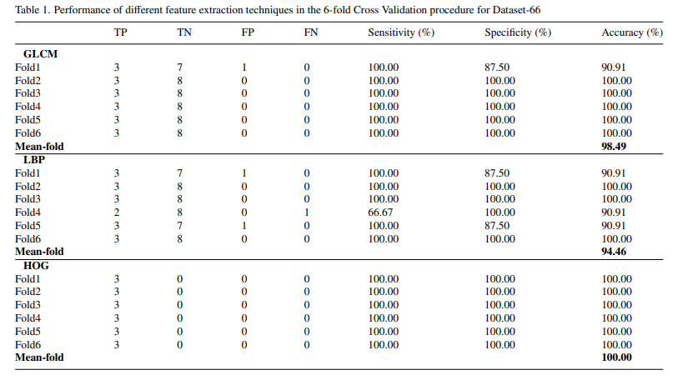

Slide 15
Problem Statement
Enhancing Brain Tumour Detection using HOG-Based AI/ML Techniques
Problem: Brain tumour detection is a critical task in medical imaging, involving challenges such as interpatient variability, tumour heterogeneity, and the need for accurate and relevant texture information

Slide 16
Objectives/Innovations:
1. Develop a brain tumour detection system using Histogram of Oriented Gradients (HOG) and AI/ML techniques to enhance texture-based analysis.
2. Leverage HOG's gradient-based features to create a robust system that overcomes challenges of interpatient variability and captures tumour heterogeneity.
3. Improve tumour localization accuracy and boundary delineation by utilizing HOG's capacity to capture fine-scale texture variations within heterogeneous regions.
4. Enhance algorithm flexibility by providing simplified yet informative HOG features, enabling the use of diverse AI/ML algorithms based on problem complexity.
Through these objectives, the project aims to establish an innovative brain tumour detection solution that leverages HOG-based AI/ML techniques, effectively addressing existing challenges and advancing the accuracy, reliability, and generalizability of brain tumour detection systems.

Slide 17
Scope:
Medical Imaging: Analyzing various medical imaging modalities, such as MRI, CT scans, and PET scans, for brain tumor detection.
Image Preprocessing: Developing techniques to enhance image quality, remove noise, and standardize data for consistent analysis.
Feature Extraction: Implementing the HOG feature extraction method to capture relevant texture and shape information in medical images.
Classification Algorithms: Employing SVM as a robust classification algorithm to differentiate between tumor and non-tumor regions.
Model Training: Training the SVM classifier on a labelled dataset of medical images to learn and generalize patterns.
Automation: Automating or semi-automating the tumor detection process to assist radiologists and medical professionals.

Slide 18
Application :
Medical Diagnostics: Early detection of brain tumors, which can be life-saving.
Improved accuracy in tumor identification and classification.
Reducing False Diagnoses: Minimizing false positives, ensuring patients receive appropriate care.
Radiologist Assistance: Supporting healthcare professionals by automating or aiding in the diagnostic process, enhancing their efficiency.
Treatment Planning: Providing valuable information for treatment planning, enabling timely interventions.
Research and Data Analysis: Contributing to research efforts by analyzing large datasets, uncovering trends, and refining diagnostic criteria.
Telemedicine: Enabling remote diagnosis and consultation, particularly valuable in underserved or remote areas.

Slide 19
Block Diagram
Database selection for brain tumour images
Feature extraction of brain tumour images using HOG
Labelling of the features extracted from the HOG
Feeding of the labelled features to the SVM
Classification of brain images into tumour (1) or no-tumour (0) using SVM
Performance test of SVM based on ROC characteristics
Accuracy, sensitivity and specificity values for each modality based on ROC curve

Slide 20
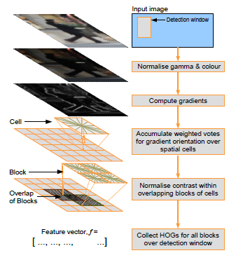
Module Description:
Dalal and Triggs first introduced Histogram of Oriented Gradients to recognize a person in an image. HOG is a feature descriptor used in image processing for object detection purpose.
The purpose of the feature descriptor is to generalise the object in an image such that this object produces the same feature descriptors in the images, containing that object, acquired under different conditions like different angle, illumination, distance etc.
The Histogram of Oriented Gradients (HOG) module is a critical component within the brain tumor detection system. It focuses on extracting relevant texture information from medical images, particularly magnetic resonance imaging (MRI) scans, to enhance the accuracy and effectiveness of tumor detection using AI/ML techniques.

Slide 21
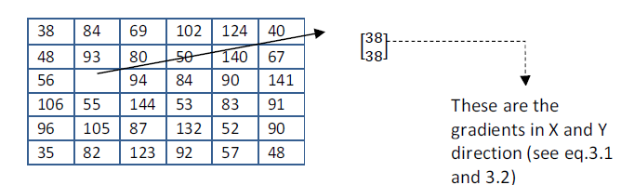
Cells
Module Description:
HOG initially divides the images into cells. Cells can be either rectangular or radial.
For every pixel in the cell, gradient vector is calculated.
Pixel Values In Zoomed Version Of A Cell

Slide 22
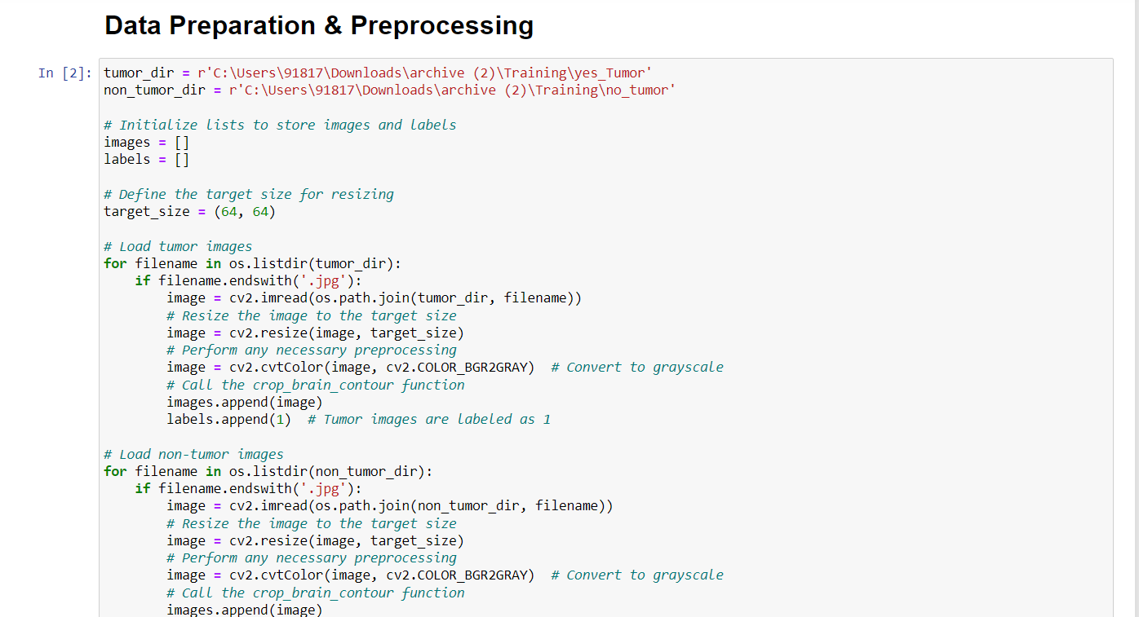
Implementation:

Slide 23
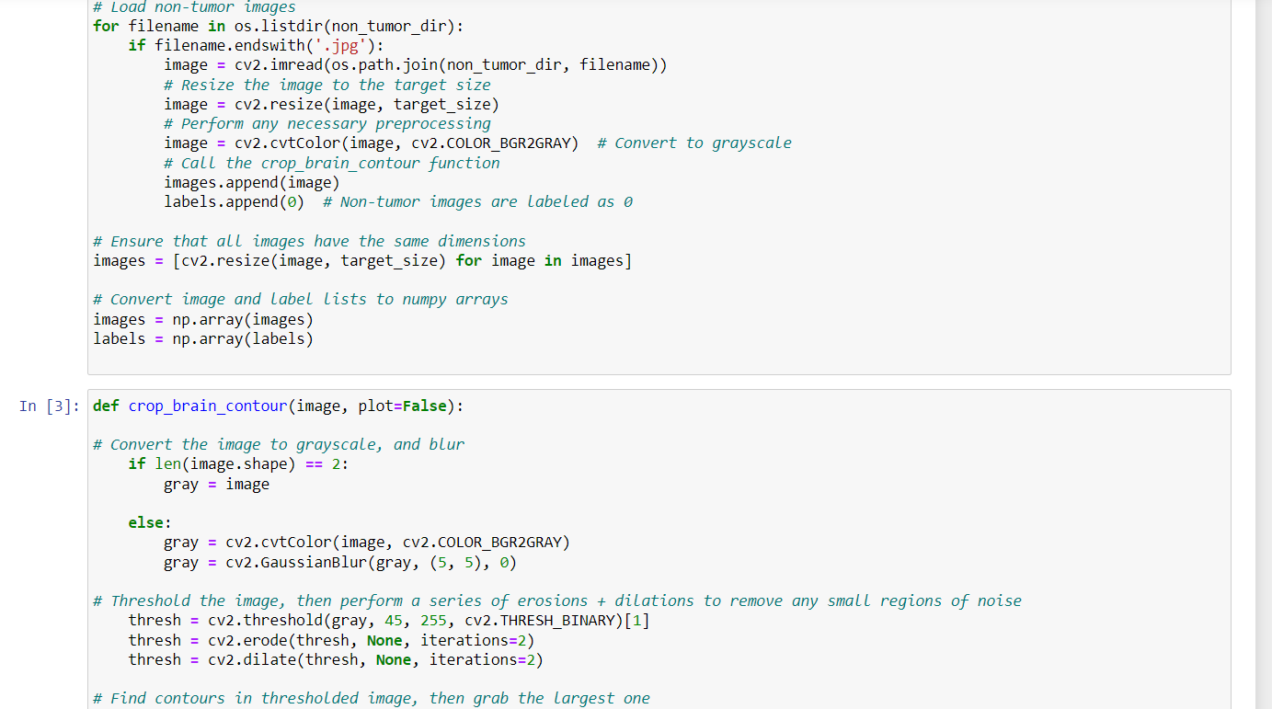
Implementation:

Slide 24
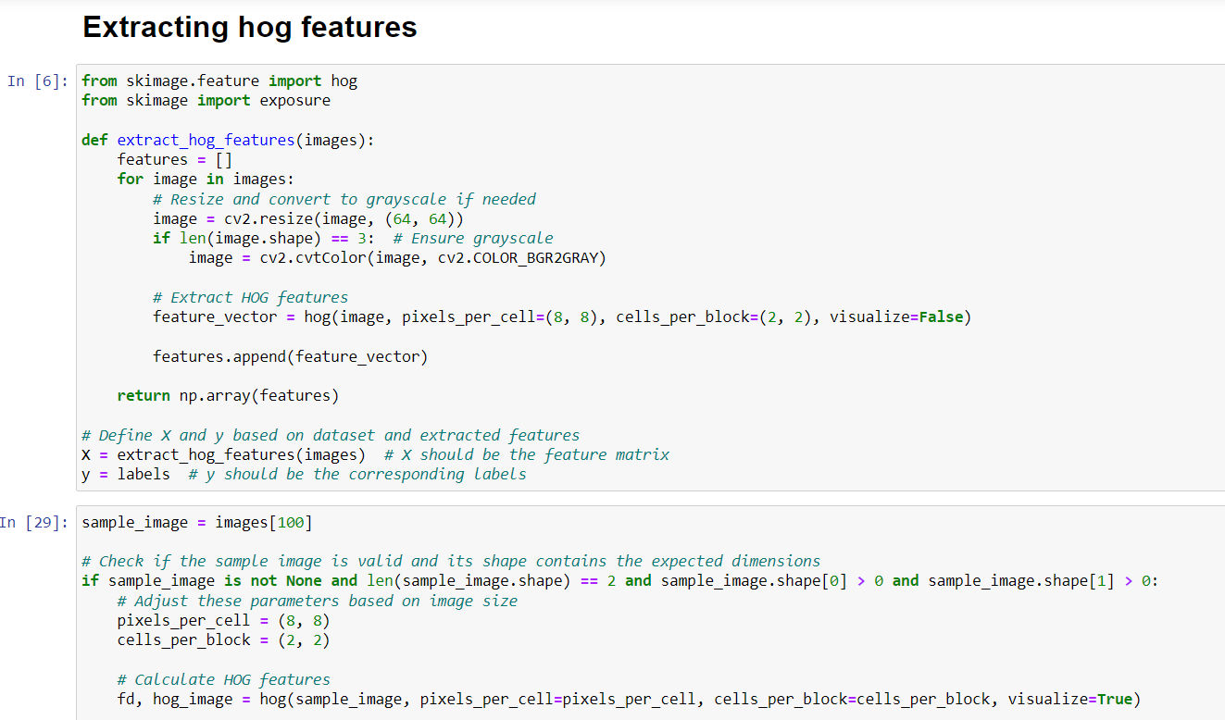
Implementation:

Slide 25
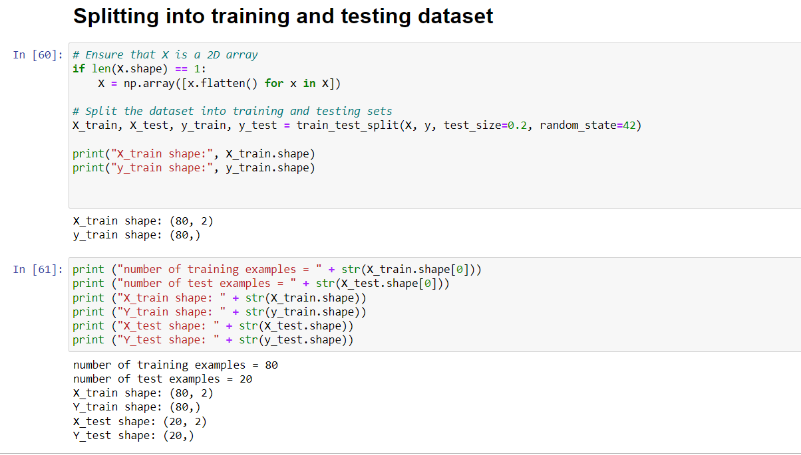
Implementation:

Slide 26
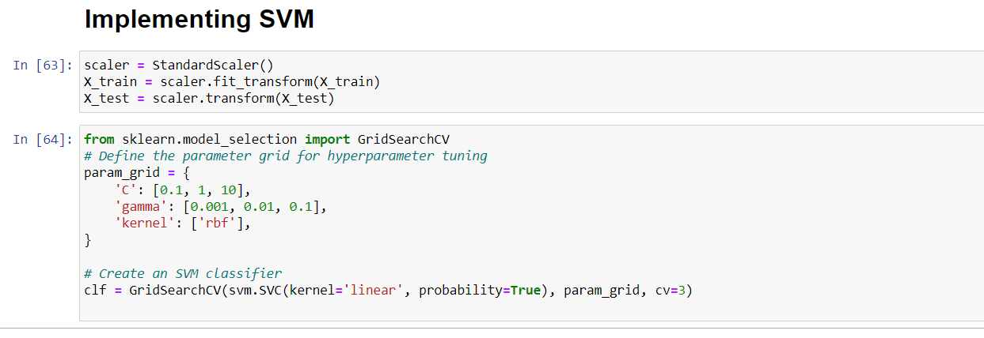
Implementation:

Slide 27
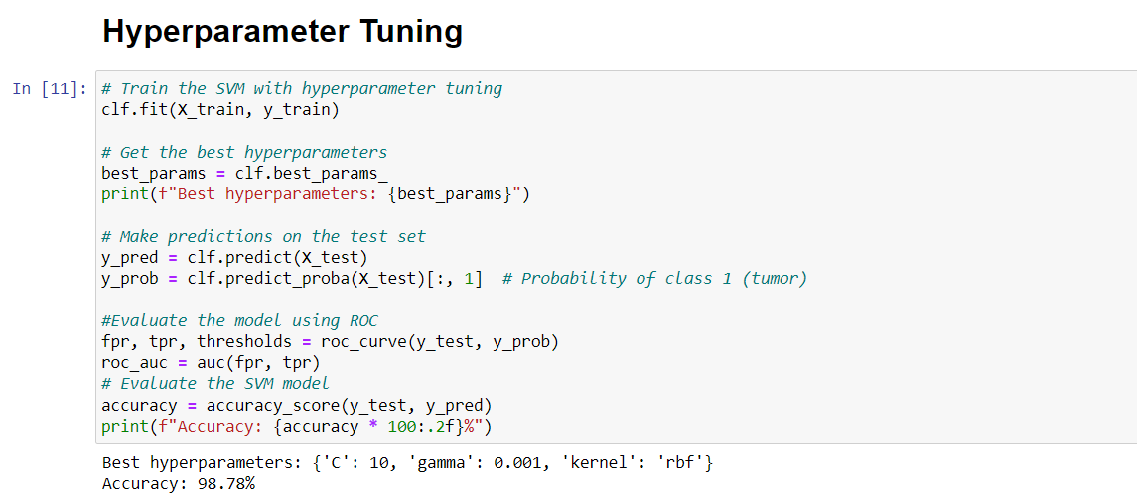
Implementation:

Slide 28
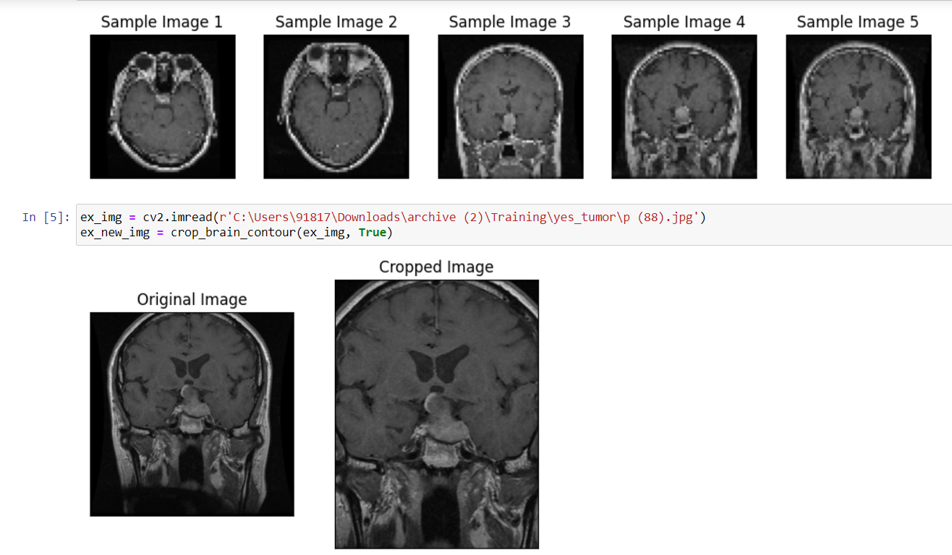
Results:

Slide 29
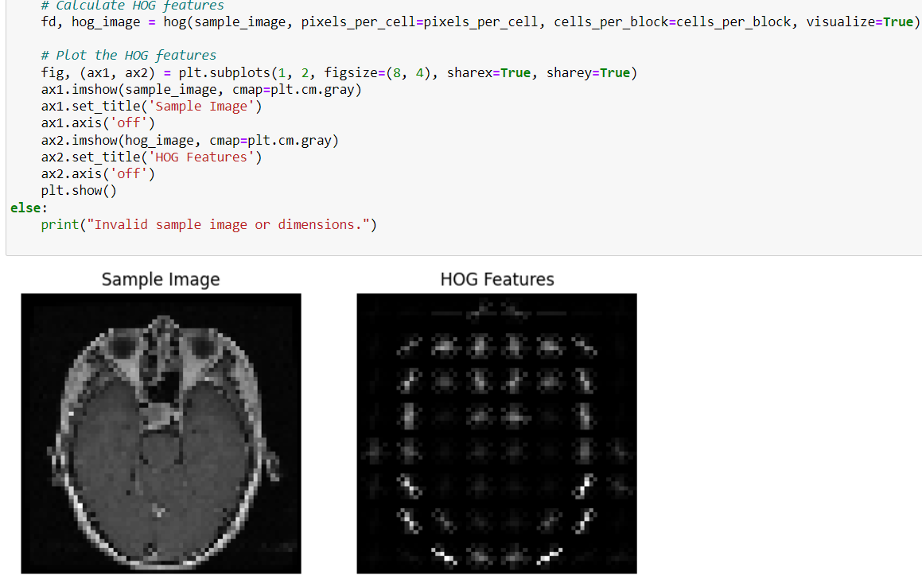
Results:

Slide 30
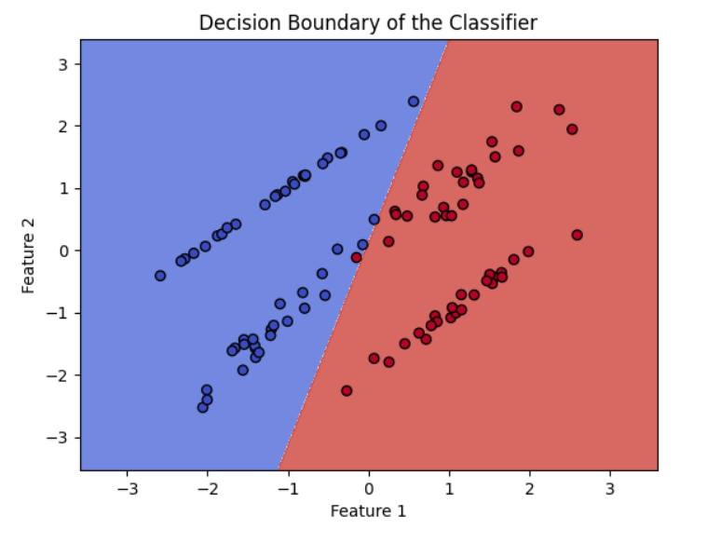
Results:

Slide 31
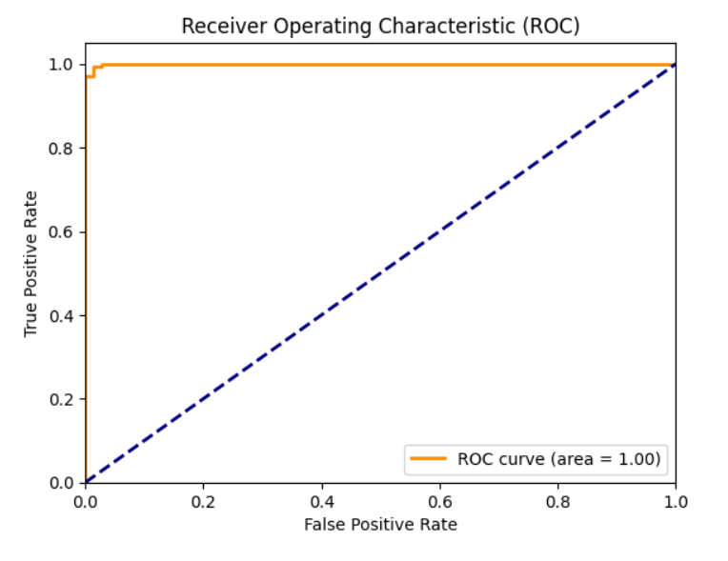
Results:

Slide 32
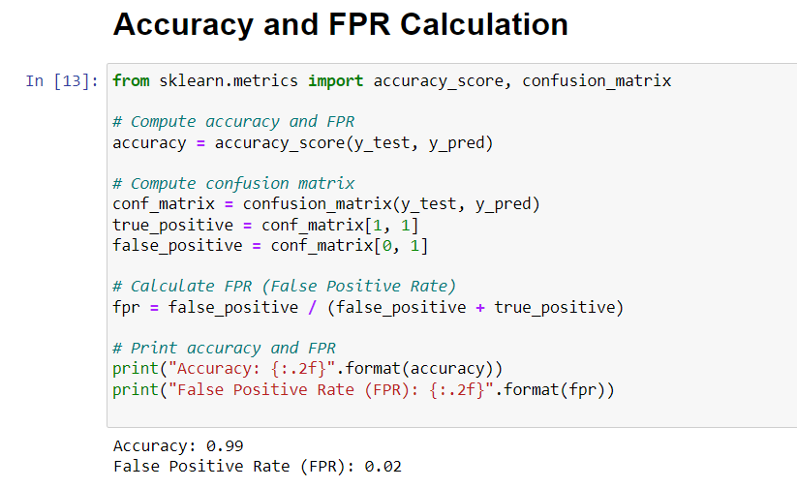
Results:

Slide 33
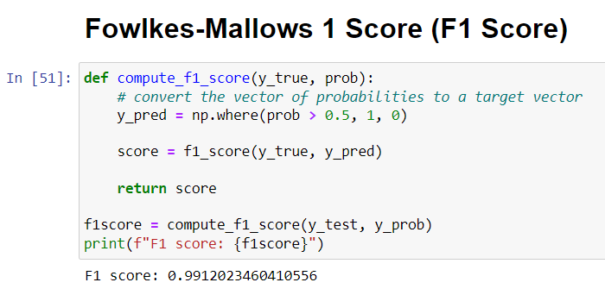
Results:

Slide 34
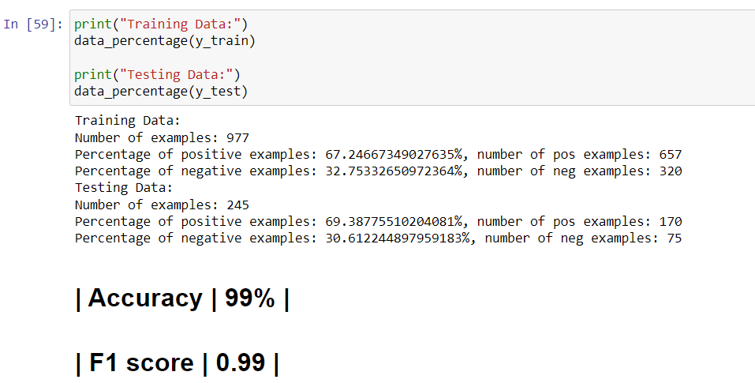
Results:

Slide 35
Discussion:
Feature Extraction with HOG: HOG (Histogram of Oriented Gradients) is a powerful technique used to extract meaningful features from medical images, especially brain tumor images.
SVM Classification: Support Vector Machine (SVM) is a popular choice for classifying brain tumor images its efficiency in handling high-dimensional feature vectors and its ability to find an optimal decision boundary are significant.
High Accuracy: The combination of HOG feature extraction and SVM classification demonstrates high accuracy in detecting brain tumors that often have distinct and well-defined patterns, making them suitable for accurate classification.
Challenges with Images: The accuracy of the classification drops, and sensitivity values tend to be lower for these images due to their less pronounced patterns and subtle variations.
Computational Efficiency and Practical Implications: The computational efficiency of this approach varies based on the dataset size and complexity. For practical applications, considering sensitivity and specificity in addition to accuracy is crucial when making decisions about diagnosis and treatment.

Slide 36
Future Enhancements
Research on brain tumour detection can also be extended in other ways:
The ROC characteristics accuracy, sensitivity and specificity of SVM in classifying tumours and non-tumours can be improved further for brain tumor detection.
To extract the features of images instead of the histogram of oriented gradients, one can use local binary pattern and other algorithms.
To test the performance of SVM on other databases for an improvement in accuracy, sensitivity and specificity values.
Classifiers like k- nearest neighbour, Bayes quadratic, Bayes linear and neural network can also be used in classifying the tumours and non-tumours

Slide 37
References:
[1] Khalil, M., Ayad, H., & Adib, A. (2021). Performance evaluation of feature extraction techniques in MR-Brain image classification system. Procedia Computer Science, 127, 218-225. doi: 10.1016/j.procs.2018.01.117
[2] (2023) Diva-portal.org. Available at : https://www.divaportal.org/smash/get/diva2:1184069/FULL TEXT.
[3] “Brain Tumors (Benign and Malignant): Symptoms, Causes, Treatment,” WebMD. [Online]. Available: https://www.webmd.com/cancer/brain-cancer/brain-tumors-in-adults.
[4] E. F. Badran, E. G. Mahmoud, and N. Hamdy, “An algorithm for detecting brain tumors in MRI images,” in The 2020 International Conference on Computer Engineering Systems, 2020, pp. 368–373.
[5] “Brain Tumor: Symptoms, Signs, Treatment, Surgery & Types.” [Online]. Available: https://www.medicinenet.com/brain_tumor/article.htm.
[6] D. S. Parameshwari and P. Aparna, “An efficient algorithm for textural feature extraction and detection of tumors for a class of brain MR imaging applications,” in 2022 19th International Conference on Digital Signal Processing, 2022, pp. 339–344.

