Slide 1
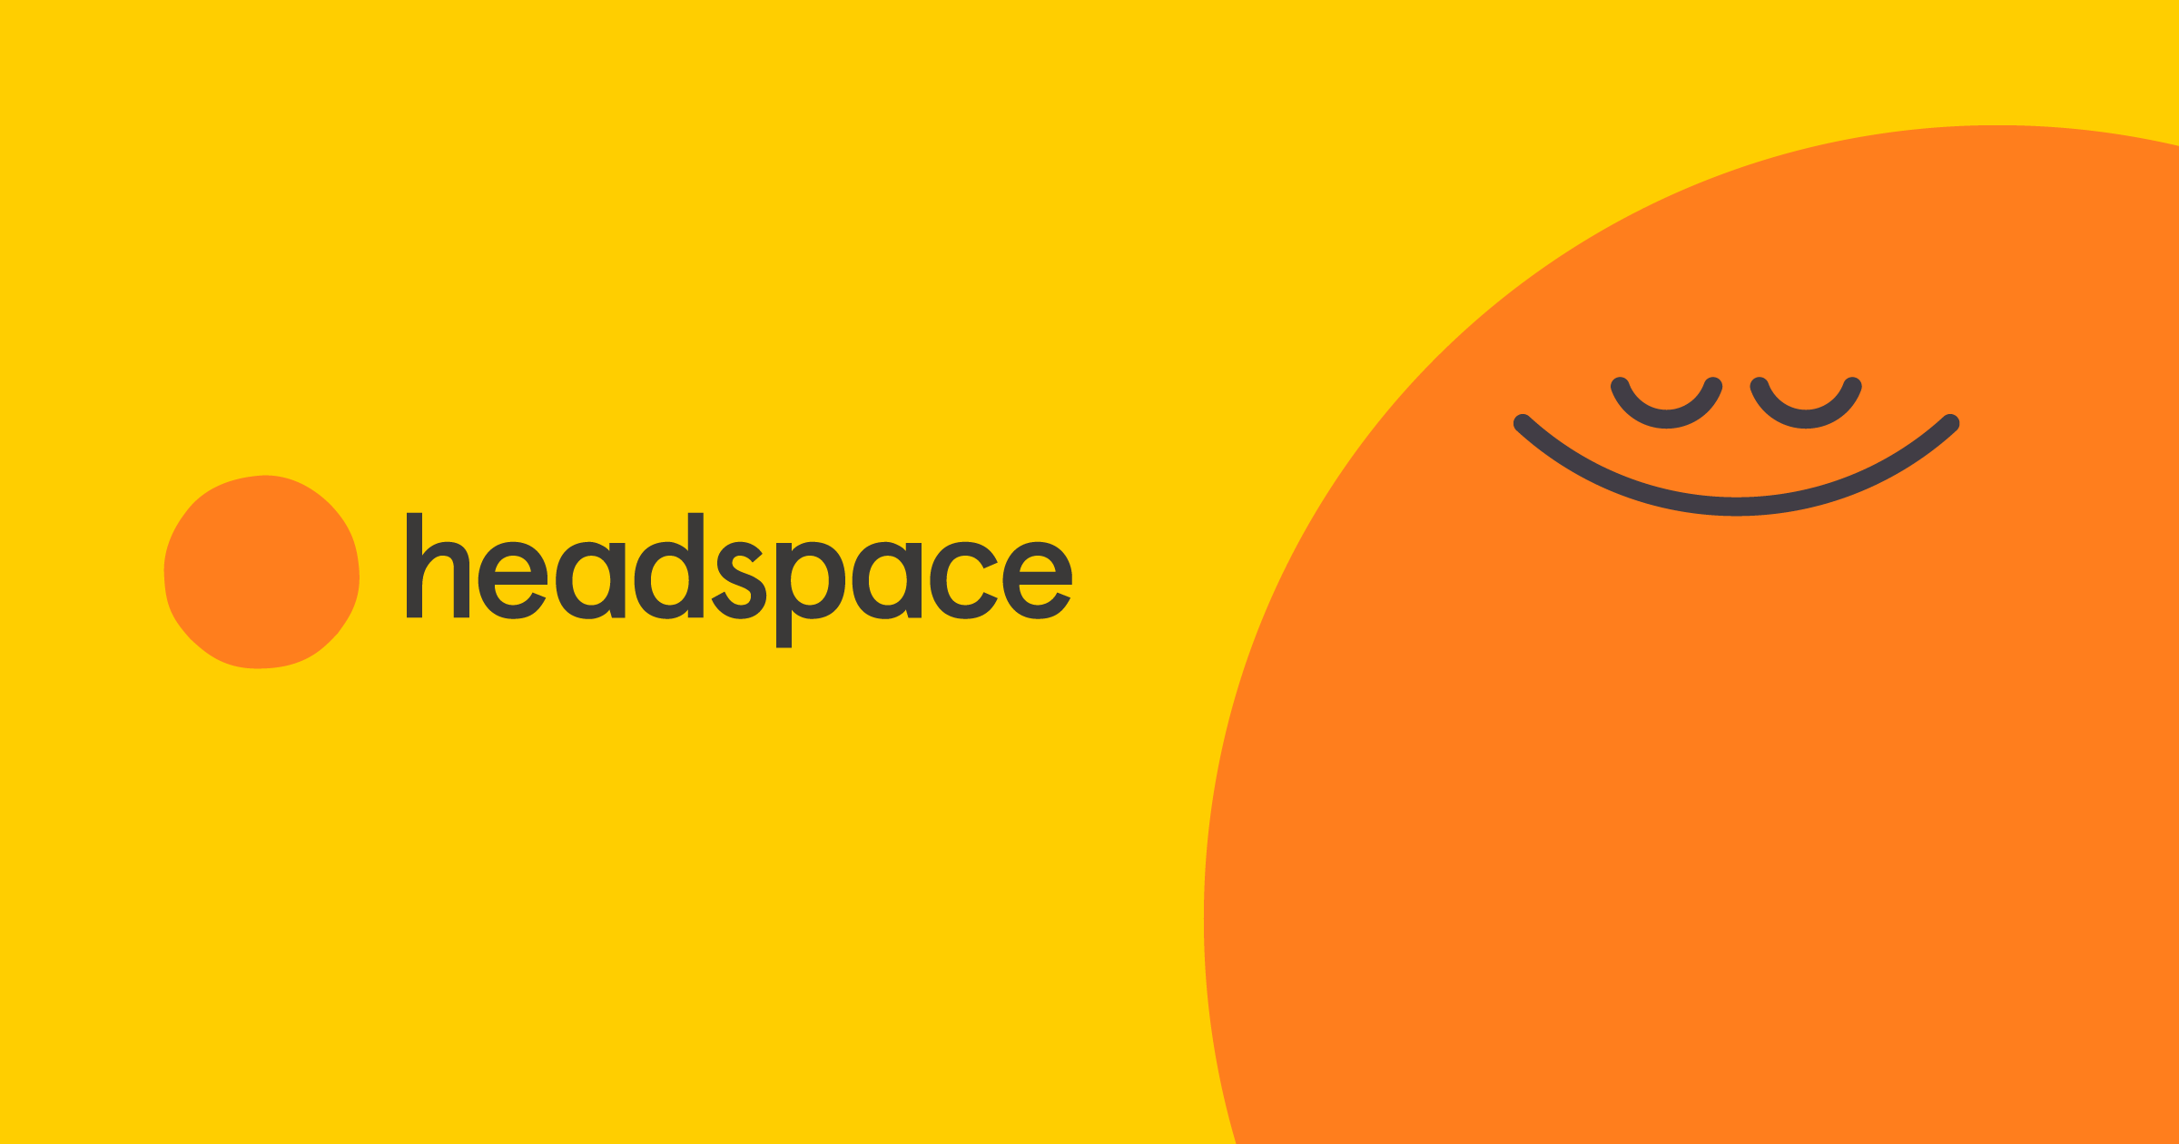

Slide 2

Let’s dive straight into it
Redesign the Onboarding Experience for Headspace application?" In your presentation, pls be sure to call out user problems and align business impact as per your understanding.

Slide 3
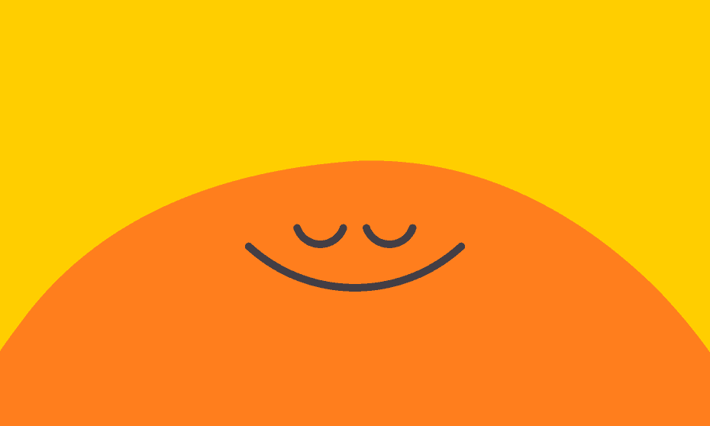
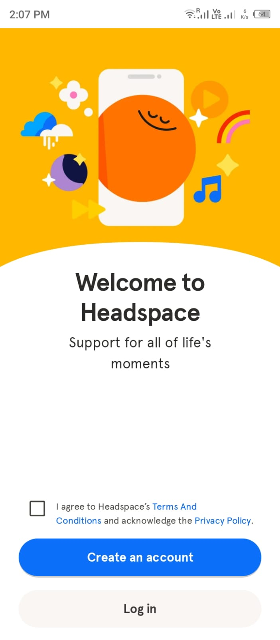
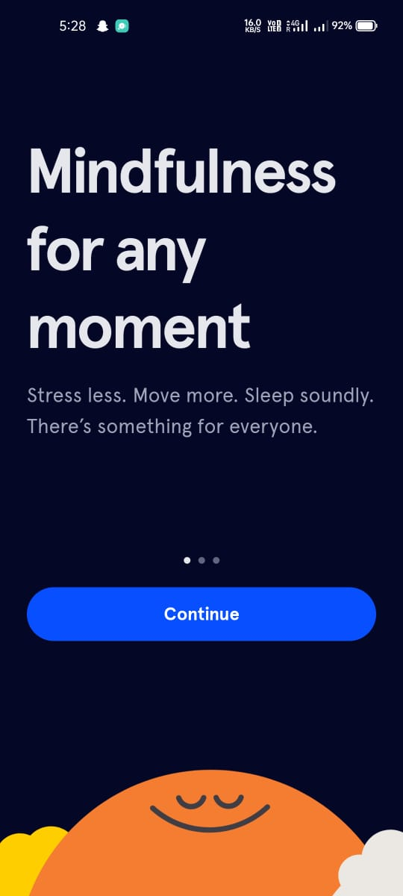
Throwing the "Sign Up" button at users right away is like handing them a marriage certificate before even buying them a drink!
Instead of introducing this carousel after several steps, it can be integrated into the welcome page to highlight the unique selling points (USPs) quickly , eliminating the need for a separate page and additional steps.

Slide 4
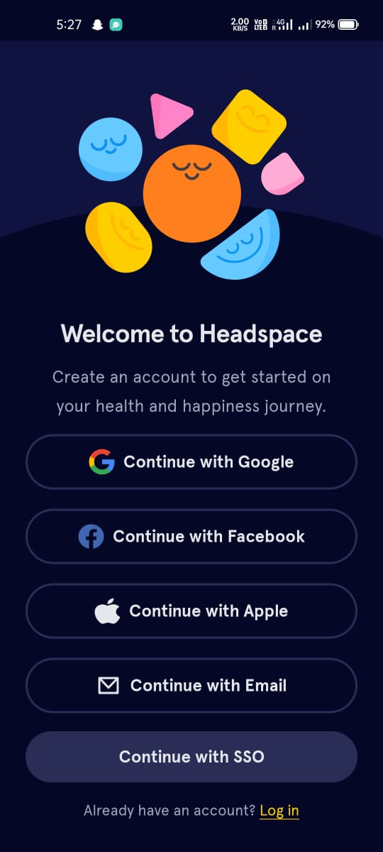
Rather than giving so many options and making it like this a simple option of login/sign up using email or phone no. and rest as logo can be used to represent the other options rather than fully occupying the whole white space.
Being a meditation and calming app as much as white space is there, the space will give a breathing and relaxed effect to mind. Too much content and so many options looks confusing and congested.

Slide 5
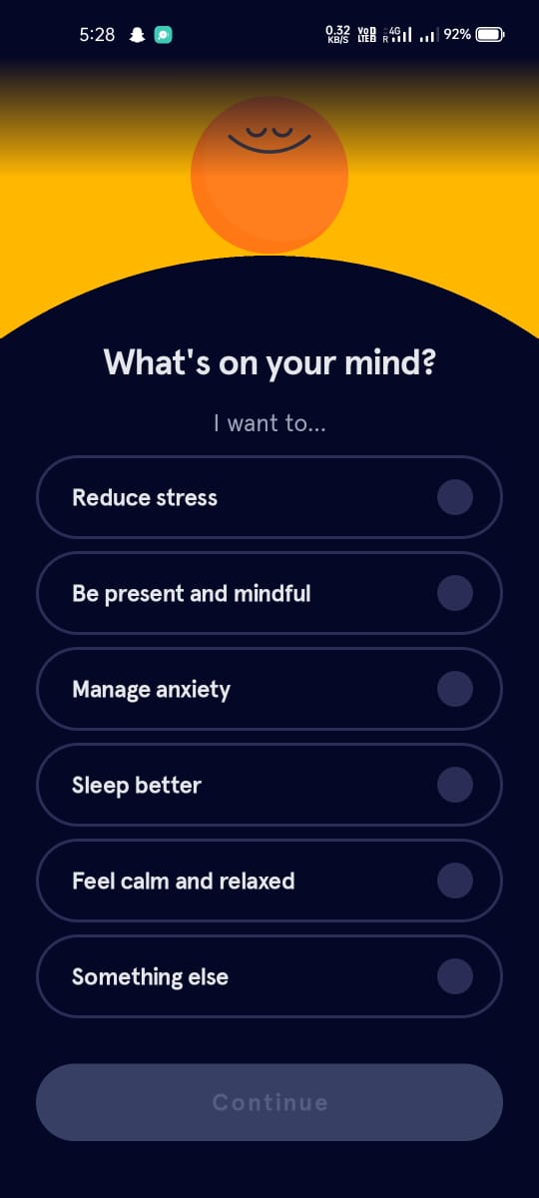
The top part of the image displays the available space, making it appear cluttered when scrolling to the bottom options. Users may feel overwhelmed by too many choices, leading them to select three or all options to quickly proceed. Simplifying questions can enhance the personalized experience.
Why don’t we ask them directly why are you here? Streamlining options by merging similar categories and providing a "Something else" label for items not covered above.

Slide 6
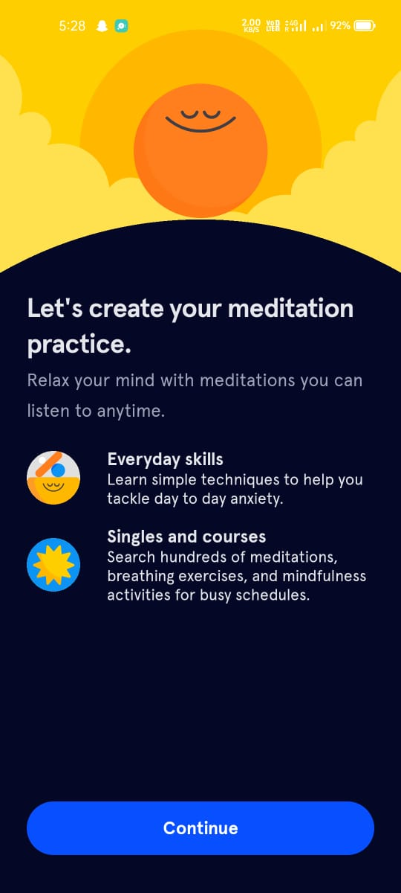
Keep on telling the USP doesn’t makes sense but rather increases the no. of steps that are there to have a smoother on boarding while it is already shown in the carousel and also can be a whole walk through after landing in the home screen rather than telling about the uses after every step.
Instead of an extra step, why not we add a animated transition and the time it’ll load meanwhile the user excitement for the application will increase. Increasing the no. of clicks reduces the excitement of the user.

Slide 7
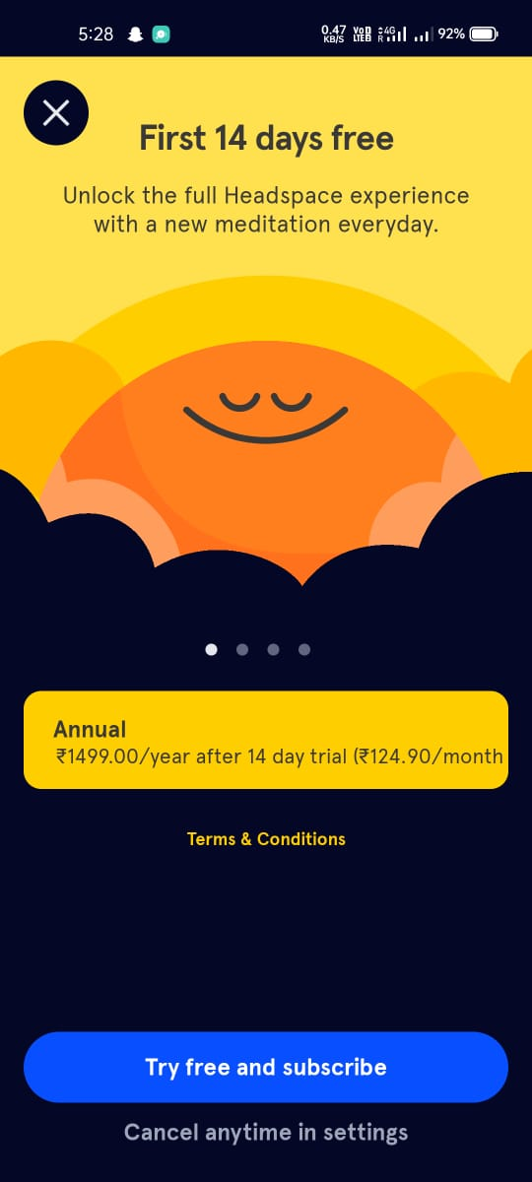
Endowment Effect: User value increases if they feel it’s theirs. Knowing what users want (job-to-be-done) can help you craft a personalized offer for anyone.
Paywall increases short-term values but can be hurtful to a long term customer value and the excitement that was built.
Freemium model, first let a user experience the minimum value in your product and then ask them to pay or refer. No one wants to pay without knowing if the app can do the job they are expecting from it.

Slide 8
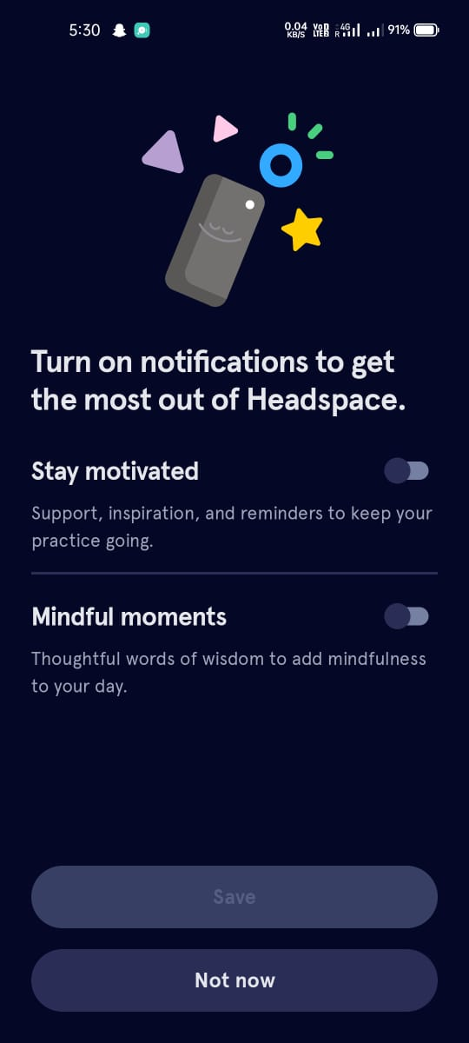
The timing of asking the notification is irritating as it is in the onboarding process, which should not be the case. Reciprocity: People reciprocate when they receive something. It’s okay to ask for a question but what if a stranger asks you 6 questions in a row, weird right? Same goes for the applications, if you want to ask for any permissions, make sure you’ve given the value before.
Skipping this step and slipping it into a pop-up when the user starts using the application makes sense. This way the user will not be affected and will not lose the excitement.

Slide 9
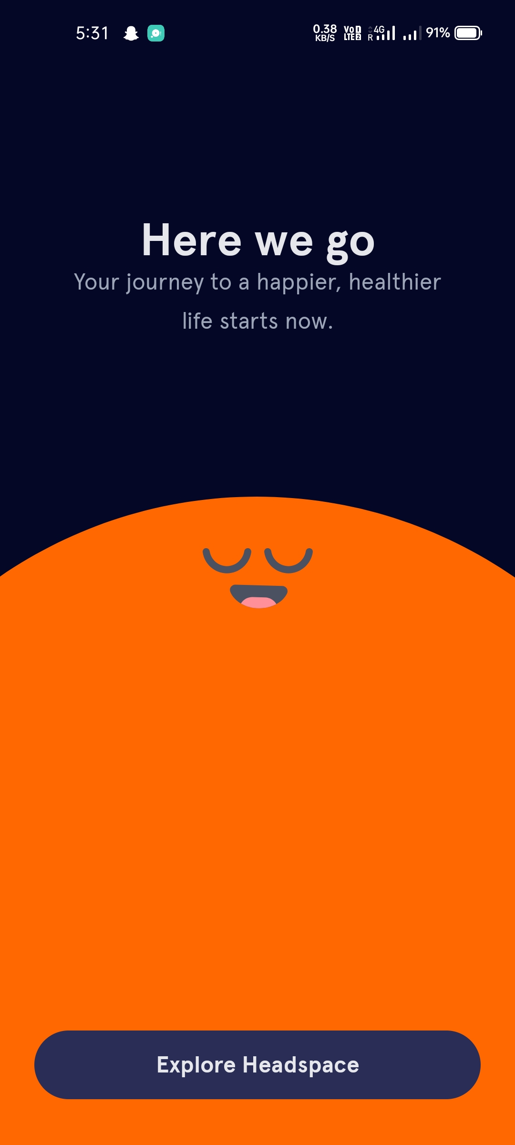
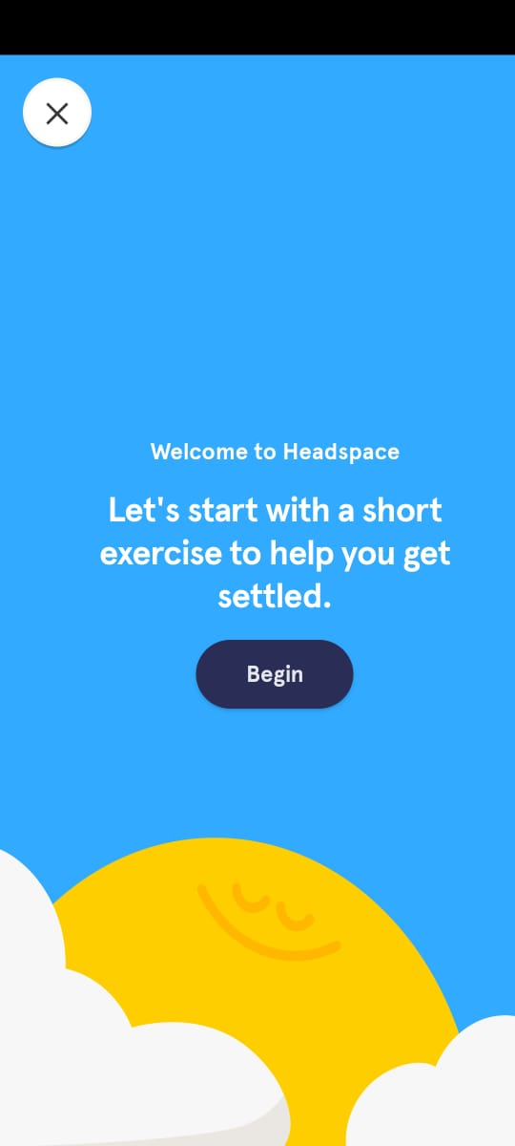
Having 2 screens back to back asking the same thing to begin or here we go, again addition to the interest drop of the user.
Demo video should be interactive or at least a white noise or guided meditation which can build the excitement of the user, simple texts will lead to getting bored. Directly Demo video should start rather than having 2 clicks to make it start.

Slide 10
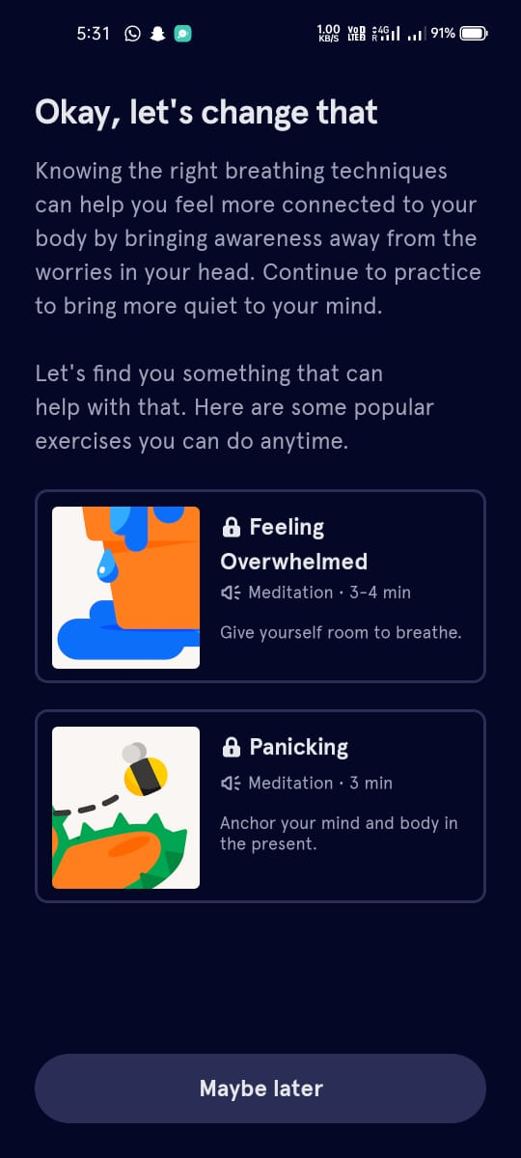
No need of asking and suggesting again as a whole page. We can have a suggested video section in the home screen to grab users attention. In Home Screen user will be looking for the personalized touch for which he answered the questions initially that time showing the suggestions will get users attention rather than before entering showing it directly to them as suggestions.

Slide 11
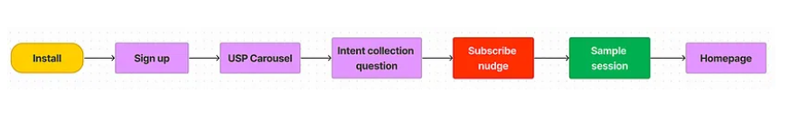
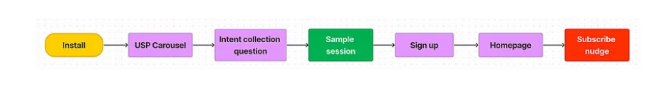
Before
This is the user flow of the application as of now which effects negatively in user retention and decrease in the user intent.
After
This is the suggested user flow for the improvement in the user retention and the user will not get exhausted after reaching the home page as the no. of clicks are reduced and onboarding is smoother.

Slide 12
THANK YOU
Work by : Kartik Singh

