Slide 1
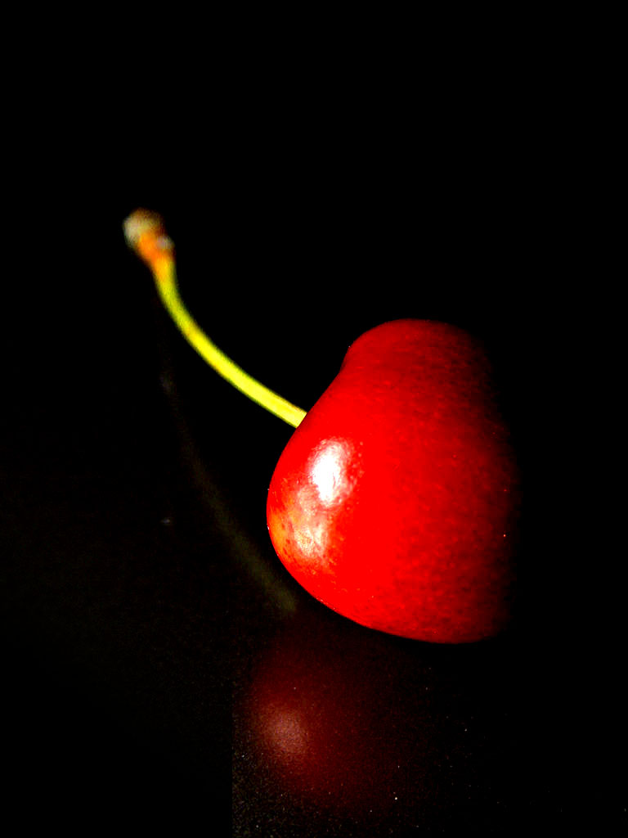
Cherry Title
Cherry SubTitle
Saturday 22 July 2017
father_name
mother_name
age
phone_no
city
class
year
1
fsf
rewrwe
ewrewr
34
45435435
rteret
retretret
2015
2
sd
sf
gf
1
121212
asa
as
2014
3
c
c
c
1
12
sds
ds
2015
6
sdf
dsfsd
fsdfs
3
343434
dfg
dg
2018
7
kartik
sood
abv
66
0999
fzr
7
2016
8
dsfkhkjdf
sdjflkjsdl
fdjflkjlksfg
34
35345353
gdfgdfg
mca
2014
9
Saturday 22 July 2017
Page 1 of
2

Slide 2
father_name
mother_name
age
phone_no
city
class
year
jgjgjgjg
hgjgjhgjgjh
ghffjf
45
575757757
ghjgjhgjh
hjgjhgjhgjh
2016
10
dshkj
fdgdfgdfg
gfdgfdg
34
453535
fd,.gmdfmg
gfdgdfg
2016
11
desfsf
fdgfdg
fdgfd
34
34535345
dfhdghgddgh
rsgdfgfdg
2015
12
adadf
adsfadsf
adfadf
33
343434
adfad
fadfa
2016
13
sadfas
asdfasdf
asdfsf
33
34343434
asdfad
fasdf
2018
14
dghs
sfdgsdfg
sdfg
44
454545
fgsfgs
fgsfg
2020
15
asdfa
adsfa
dfadf
33
34343434343
dfadfa
dsfa
2015
16
asdasd
ada
dadasd
2
22323
adada
daa
2019
Saturday 22 July 2017
Page 2 of
2

