Slide 1
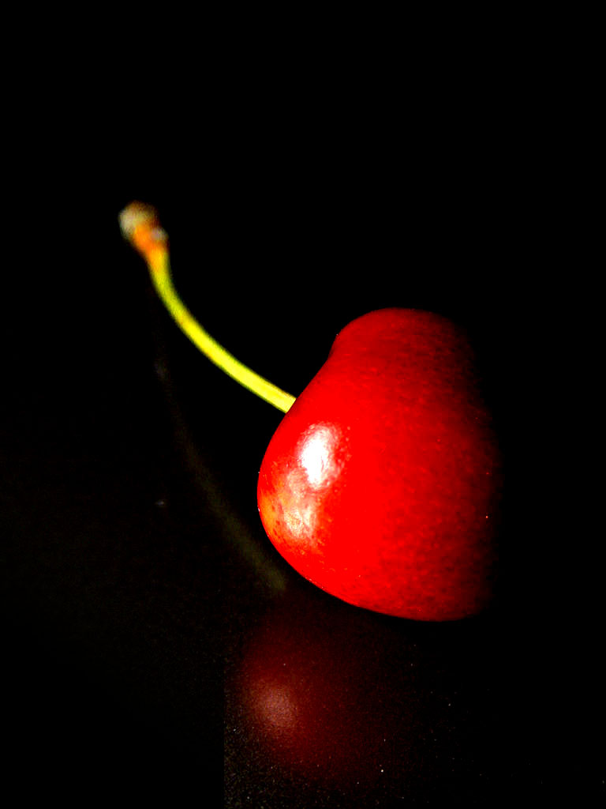
Cherry Title
Cherry SubTitle
Saturday 22 July 2017
Label
GroupField
GroupField
Field
Field
Field
Field
GroupField
Field
Field
Field
Field
Field
GroupField
Field
Field
Field
Field
Field
Saturday 22 July 2017
Page 1 of
1

