Slide 1
Hello Everyone
Today we will learn about
Stack Data Structure

Slide 2
Todays agenda
What is Data Structure in python
What is Stack
What are the application
What are the operation
Theoretical Implementation
Programming Implementation

Slide 3
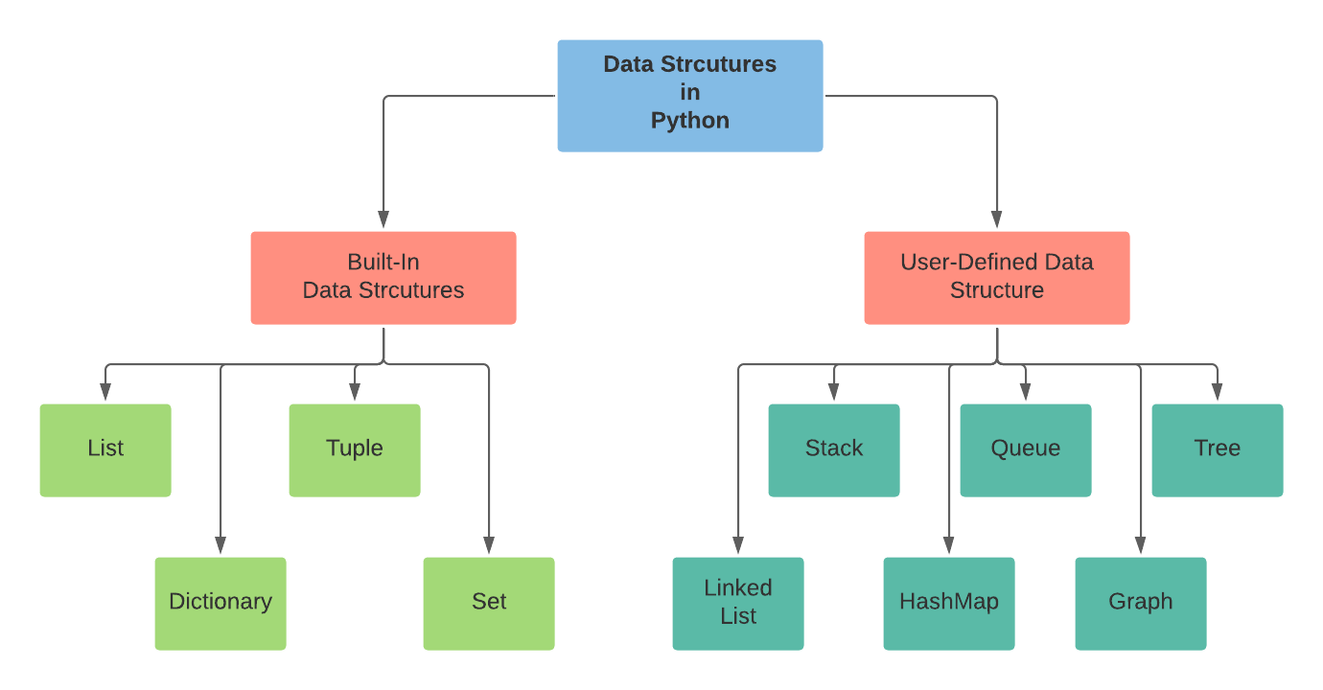

Slide 4
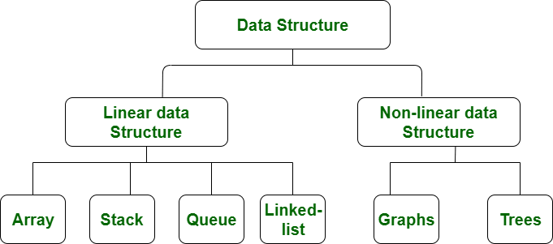

Slide 5
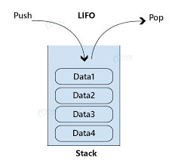
What is Stack
Stack is a linear data structure which follows a particular order in which the operations are performed. The order may be LIFO(Last In First Out) or FILO(First In Last Out).
In stack, a new element is added at one end and an element is removed from that end only

Slide 6
The functions associated with stack are:
empty() – Returns whether the stack is empty – Time Complexity: O(1)
size() – Returns the size of the stack – Time Complexity: O(1)
top() – Returns a reference to the topmost element of the stack – Time Complexity: O(1)
push(a) – Inserts the element ‘a’ at the top of the stack – Time Complexity: O(1)
pop() – Deletes the topmost element of the stack – Time Complexity: O(1)

Slide 7
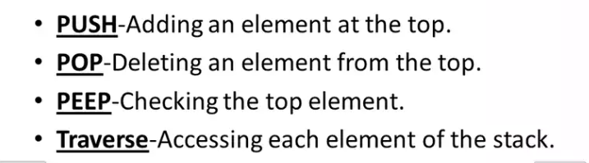

What are the operation of stack

Slide 8
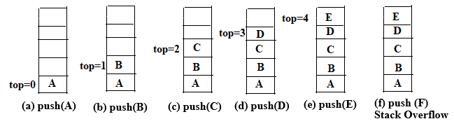
Push operation

Slide 9
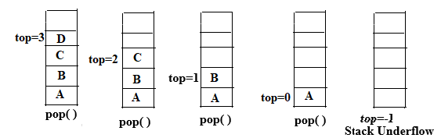
Pop operation

Slide 10
Implementation
There are various ways from which a stack can be implemented in Python. Stack in Python can be implemented using the following ways:
list
Collections.deque
queue.LifoQueue

