Slide 1
Bridge.
One workspace for your whole team's day
Attendance · Checklists · Leave · Payroll · Reviews · Compliance
— without the spreadsheet chaos
Daily work · Time · People · Pay & compliance · Insights · Control
Product overview · 2026
Notes:
Open on the name and the promise: one workspace for the whole team's day. The six colored areas preview the system.

Slide 2





THE PROBLEM
The problem every growing team knows
Five everyday failures that quietly cost you money, time, and trust.
Attendance on faith
Work lost in chat
Leave is a guess
Payroll by spreadsheet
No accountability
People clock in on paper — or not at all.
Photos and promises scroll away forever.
A phone call, a hunch, an argument in December.
Three late nights. One wrong cell, one wrong salary.
“Who approved this?” — silence.
None of these need more people. They need one system that carries a task from the moment it happens to the moment it is paid, approved, and filed — with proof at every step. Bridge is that system.
Bridge · One workspace for your whole team's day
2 / 14
Notes:
Name the five everyday pains. Land the takeaway: none of this needs more people — it needs one system with proof at every step.

Slide 3



WHAT IT IS
One app your whole company opens in the morning
On a phone or a laptop, nothing to install. Everyone sees only what their role allows.
Employees
Managers
HR & Owners
Their own day: clock in, today's checklists, and their live leave balance.
Their team, plus one inbox with everything waiting for a decision.
Payroll, compliance, and live analytics across the whole company.
Six areas, one shared live database — no copy-paste between tools, no version confusion.
Bridge · One workspace for your whole team's day
3 / 14
Notes:
Bridge is one web app, role-aware. Three audiences, one shared live database — nothing to install.

Slide 4
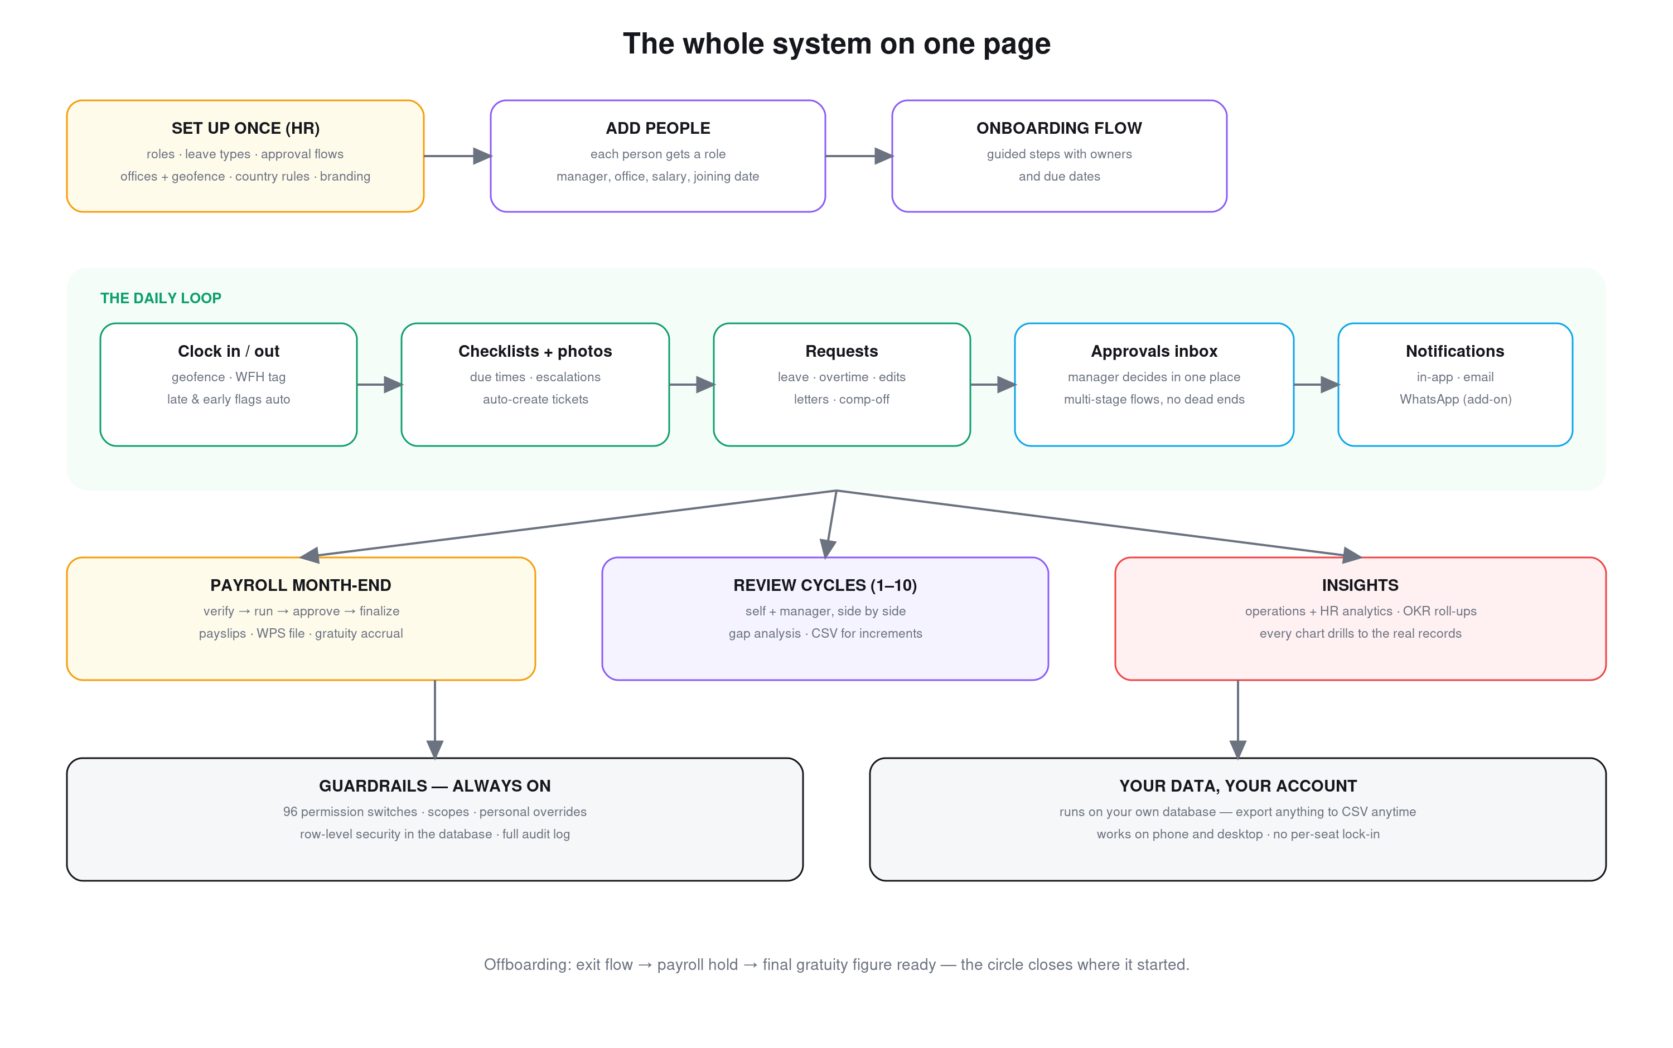
THE PLATFORM
Bridge · One workspace for your whole team's day
4 / 14
Notes:
The six areas at a glance. Stress that every module reads and writes the SAME database.

Slide 5
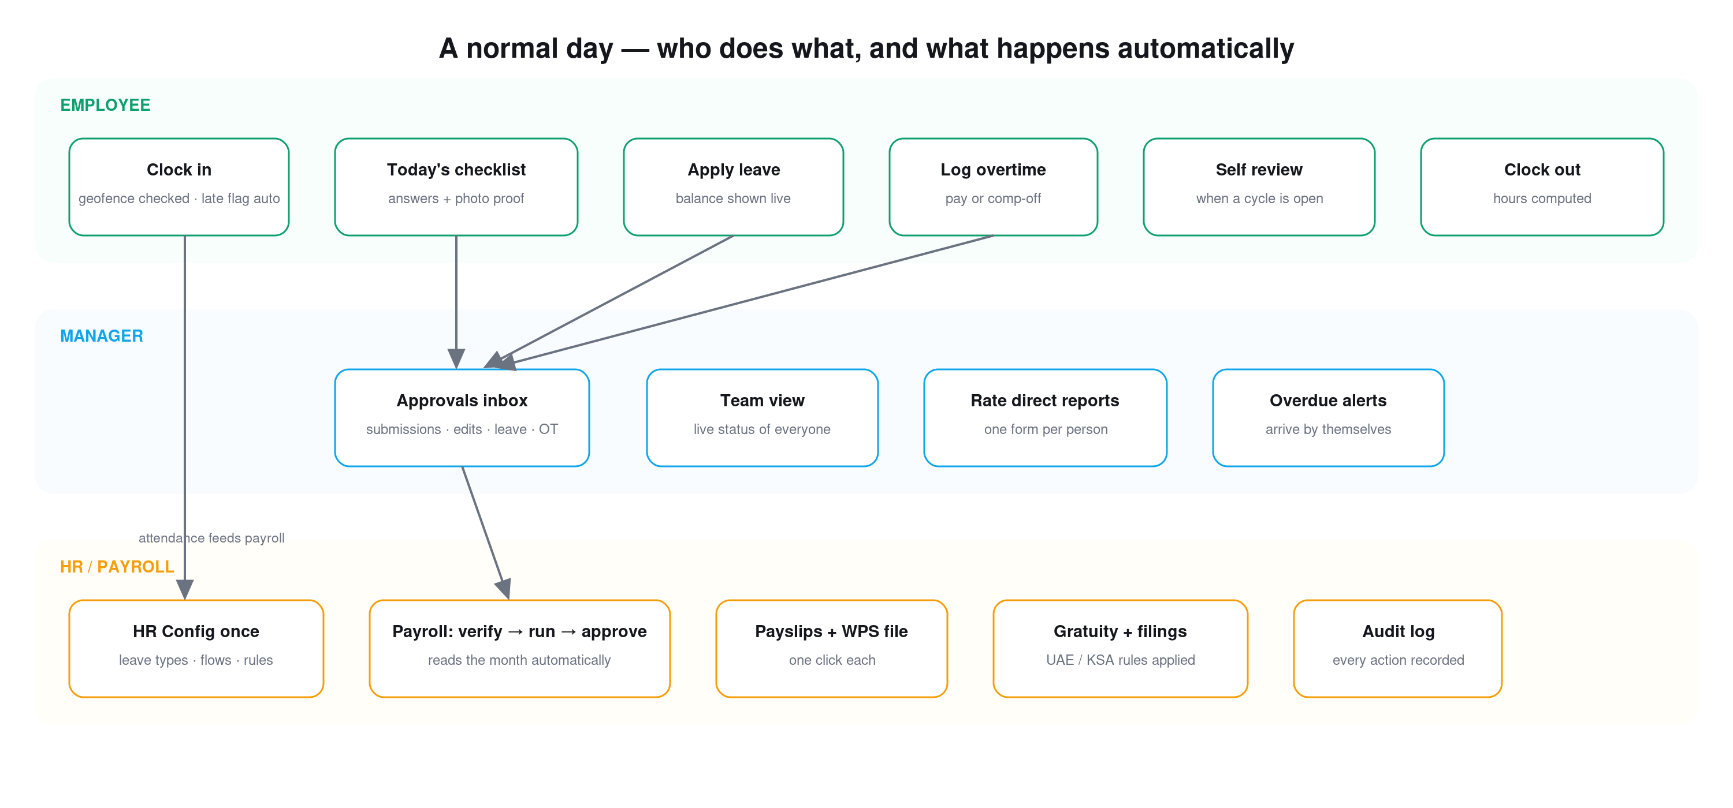
HOW IT WORKS
Everything an employee does flows to the manager's inbox; everything approved flows into payroll — automatically.
Bridge · One workspace for your whole team's day
5 / 14
Notes:
Walk one ordinary day: employee acts, it hits the manager's inbox, approvals flow into payroll automatically.

Slide 6






INSIDE BRIDGE
What's inside
Thirteen connected modules. Here are the ones teams feel from day one.
Checklists
Attendance
Leave
Daily task lists with due times, required photo proof, auto-LATE, and auto-escalation.
One-tap clock in/out with optional office geofence and automatic late / early flags.
Balances that calculate themselves; apply in 20 seconds; multi-stage approval.
Overtime & Shifts
Reviews & OKRs
Analytics
Overtime as pay or comp-off; weekly rosters planned as drafts, published in one click.
1–10 appraisal cycles and company goals that roll up the org tree automatically.
Ops & HR dashboards where every chart drills down to the underlying record.
Bridge · One workspace for your whole team's day
6 / 14
Notes:
The modules teams feel first. Photo-proof checklists and geofenced attendance are the day-one wins.

Slide 7
PAYROLL & COMPLIANCE
Payroll month — four gates, zero spreadsheets
THE MONTH ASSEMBLES ITSELF FROM
Attendance
paid days
Approved leave
paid / unpaid split
Approved overtime
× your multiplier
Unexplained absence
auto deduction
1 · VERIFY
tick every line
2 · RUN
draft for the month
3 · APPROVE
Head of People
4 · FINALIZE
locks + notifies everyone
Roll back available until finalized — mistakes are cheap.
Payslips
branded · gratuity shown
WPS bank file
employer IDs · upload-ready
Gratuity liability CSV
end-of-service · UAE / KSA
Variance vs last month
spot anomalies instantly
Operate in the Gulf? The WPS bank file and gratuity / end-of-service are built in — UAE & KSA presets, or any custom country.
Bridge · One workspace for your whole team's day
7 / 14
Notes:
Payroll assembles itself from the month's own records — four gates, rollback until the last. Gulf compliance is built in as a bonus.

Slide 8
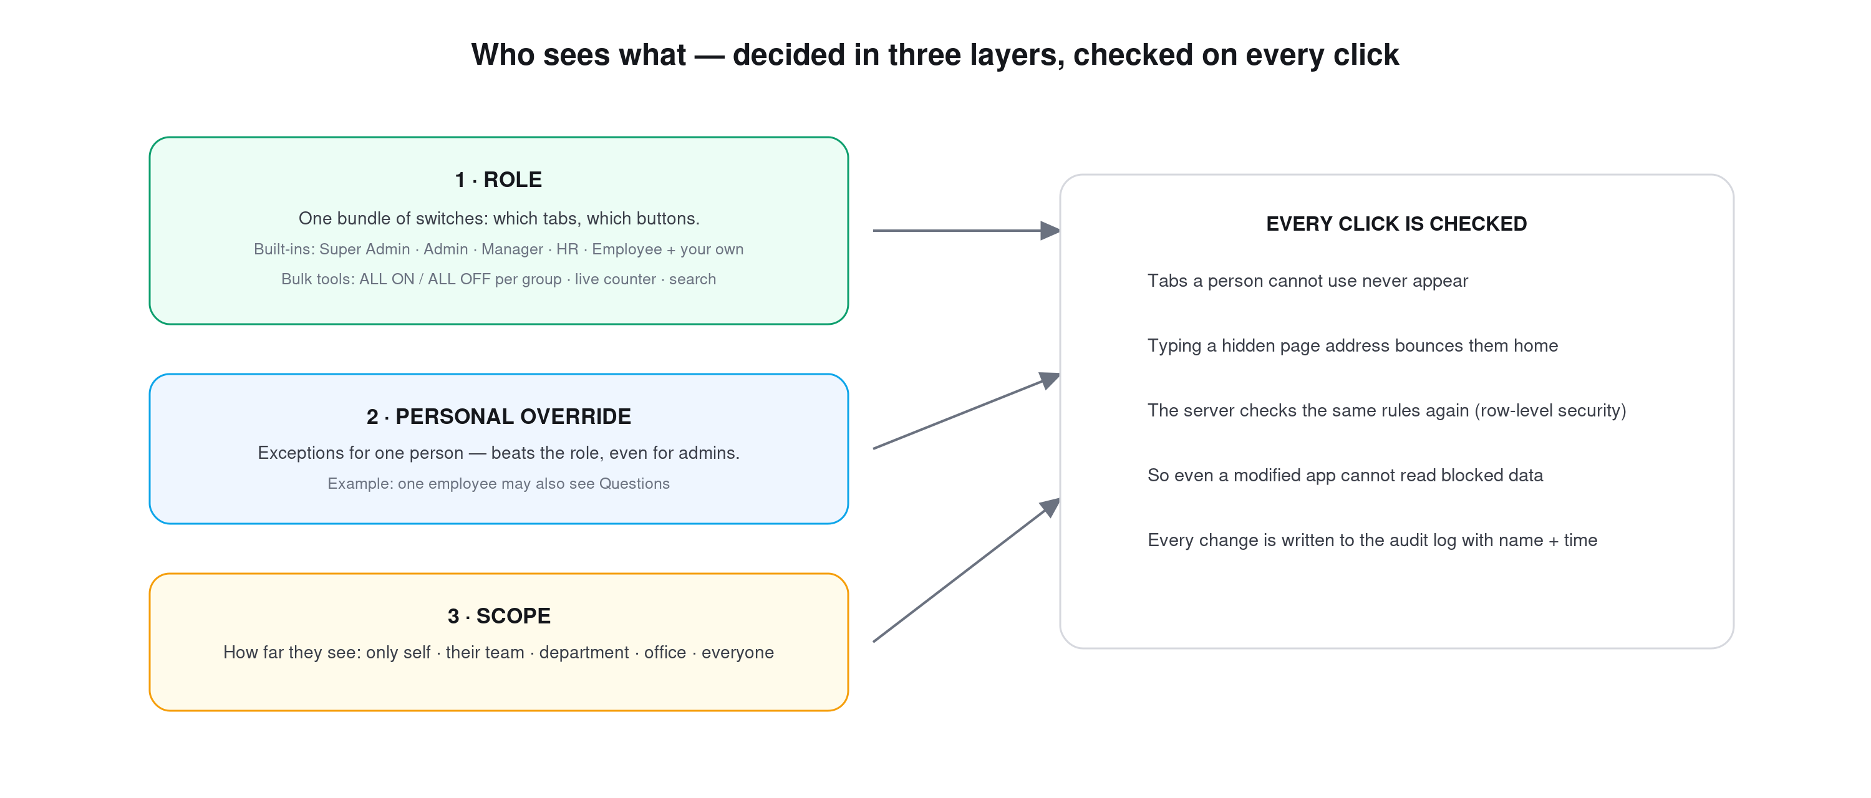
ACCESS CONTROL
About a hundred switches across 30+ areas — checked in the app AND again in the database.
Bridge · One workspace for your whole team's day
8 / 14
Notes:
Security isn't 'admin or not'. ~100 switches, per-person overrides, and it's re-checked in the database.

Slide 9
NOTIFICATIONS
One event → the right people → only the channels they chose
COMPANY SWITCHES
Per event: on / off
Master email switch
Templates you can edit
(subject, wording, button)
IN-APP
bell inbox · tap opens
the exact page · always on
SOMETHING HAPPENS
leave approved · checklist overdue · payslip ready · review opened…
EMAIL
branded template + button
respects every toggle
PERSONAL CHOICES
Each person: email on / off
In-app alerts per event
Micro-level: one toggle
per event, per person
WHATSAPP
optional add-on · enabled
on request · Business API
WhatsApp add-on — customised at micro level, per person:
Per-user opt-in with number
Per-event choice (payslip yes, chatter no)
Quiet hours (e.g. 20:00–08:00)
Language per person (EN / AR / HI…)
Critical-only mode
Falls back to email if undelivered
Same audit trail
No group chaos — 1-to-1, relevant only
Bridge · One workspace for your whole team's day
9 / 14
Notes:
One event reaches the right people on only the channels they chose. WhatsApp is an optional, opt-in add-on.

Slide 10
WHY BRIDGE
Why Bridge, instead of the usual options
Most teams run on spreadsheets plus chat, or a big HR suite priced per head. The honest comparison:
 | Spreadsheets + chat | Typical HR software | Bridge
Daily operations | Photos scroll away in chat | Rarely — HR only | Ops + HR in one flow
Proof & audit | Almost none | Partial, often hidden | Every action logged, visible
Payroll accuracy | Manual re-typing | Attendance lives elsewhere | Reads the month's own records
Customization | Total freedom, total chaos | Vendor tickets for changes | ~100 switches, per-person
Cost shape | “Free” until the first mistake | Per employee × month, forever | Flat and predictable
Your data | Scattered across files & phones | Locked-in in practice | Your own database · CSV export
Bridge · One workspace for your whole team's day
10 / 14
Notes:
The honest three-way comparison. Bridge = operations + HR in one flow, flat pricing, your own data.

Slide 11






TRUST
Your data, your security
Enterprise-grade foundations — without the enterprise price tag.
Your own database
Row-level security
Runs on your own Supabase / PostgreSQL — the data is yours, not rented back to you.
Permissions enforced inside the database, not just hidden in the app.
Encrypted everywhere
Permanent audit log
Encrypted connections; passwords handled by an industry-standard auth service.
Every meaningful action recorded with a name and timestamp — exportable anytime.
Built for trust. Proof at every step — from clock-in to payslip.
Nothing to install
Works on any modern phone or computer browser. Nothing to update.
Bridge · One workspace for your whole team's day
11 / 14
Notes:
Enterprise-grade foundations: your own DB, row-level security, encryption, permanent audit log.

Slide 12





GETTING STARTED
From first call to first payroll
A guided path, not an implementation project.
1
2
3
4
30-minute setup call
Your people are added
Week one → two
First month-end
Offices & geofence, departments, leave policy, roles.
Each gets a login and a guided “how this tab works” note on every page.
Attendance + checklists live in week one; leave & approvals in week two.
Payroll joins at the next month-end. Templates branded with your logo.
A dedicated support channel with the Bridge team. Small adjustments are configuration, not development projects.
Bridge · One workspace for your whole team's day
12 / 14
Notes:
Onboarding is a guided checklist, not a project. First team working the same week.

Slide 13
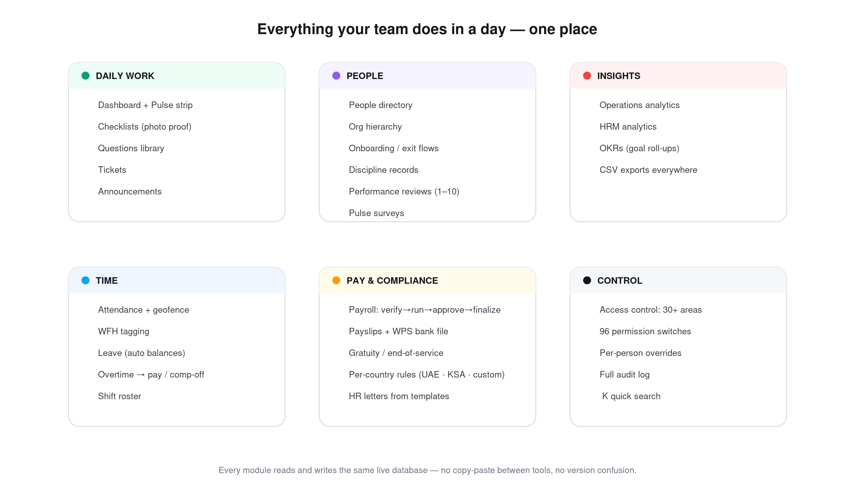
THE WHOLE SYSTEM
From setup, through every working day, to payroll, filings, reviews and insights — one connected loop.
Bridge · One workspace for your whole team's day
13 / 14
Notes:
The whole loop on one page — setup, daily work, payroll, reviews, insights.

Slide 14

Built where the work happens.
Bridge — one workspace for your whole team's day.
See Bridge running on your own data
A 30-minute setup call — your first team working the same week.
Product overview · 2026
Notes:
Close with the CTA: a 30-minute call and a live look on their own data.

