Slide 1
TECHNICAL PRESENTATION
CarePulse:
Hospital Management System
Group No. 3
Subject: Java Programming
CarePulse: Hospital Management System | Group No. 3 | Subject: Java Programming

Slide 2
1. Problem & Solution
Why we built CarePulse
■ The Challenge
Traditional hospitals rely heavily on paper records. This results in slow data retrieval, increased error rates, and difficulty in auditing medical histories.
■ Our Solution
CarePulse is a comprehensive, digital desktop application built to unify patient registration, doctor schedules, and billing into one seamless UI.
■ Technical Scope
Developed in pure Java SE 11+ using Java Swing. No external databases are used. Data is managed purely in-memory via optimized Data Structures.
CarePulse: Hospital Management System | Group No. 3 | Subject: Java Programming

Slide 3
2. System Architecture
MVC (Model-View-Controller) Pattern Implementation
UI Layer
(Swing Panels)
Service Layer
(HospitalService)
Model Layer
(POJOs)
View:
Captures user inputs via JTextFields & buttons.
Controller:
Validates data and mutates underlying HashMaps.
Model:
Encapsulates Patient and Doctor data safely.
CarePulse: Hospital Management System | Group No. 3 | Subject: Java Programming

Slide 4
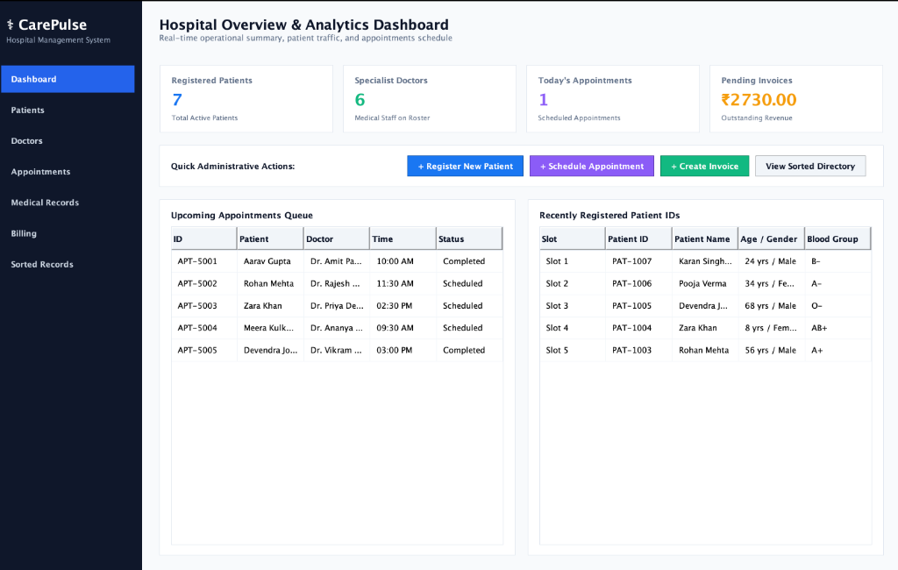
3. Dashboard & Arrays
Real-time analytics and circular buffers
Data Structure: Array (O(1))
The Dashboard retrieves live sizes of the HashMaps and LinkedLists to calculate Key Performance Indicators.
The 'Recently Registered Patients' table utilizes a fixed-size Java Array (String[5]) operating as a circular buffer, ensuring instant O(1) index access without memory overhead.
CarePulse: Hospital Management System | Group No. 3 | Subject: Java Programming

Slide 5
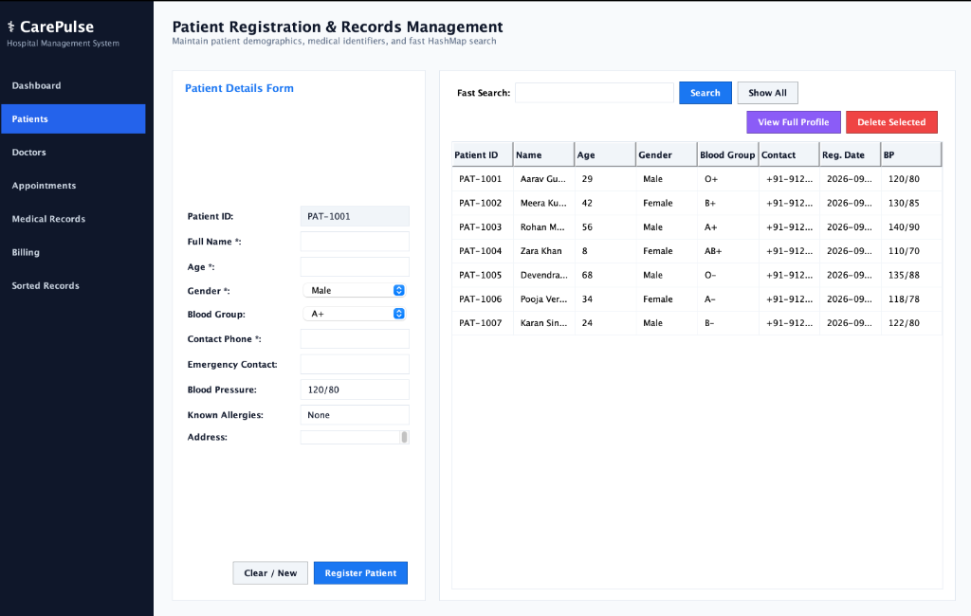
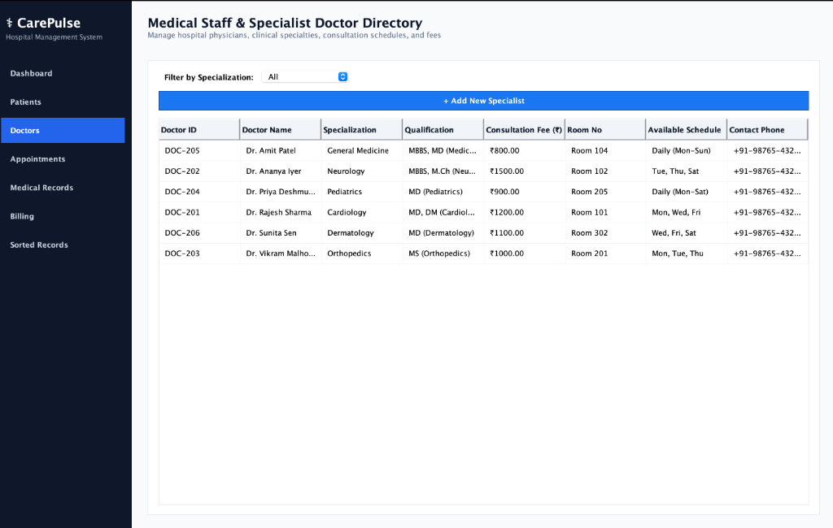
4. Registration & Directories
O(1) lookups via HashMaps
Data Structure: HashMap<String, Patient> (O(1))
When a patient is registered, they are stored in a HashMap using their ID as the key. This allows the receptionist to search for 'PAT-1004' and retrieve the full demographic profile instantly in O(1) constant time, entirely bypassing the need to iterate through lists.
CarePulse: Hospital Management System | Group No. 3 | Subject: Java Programming

Slide 6
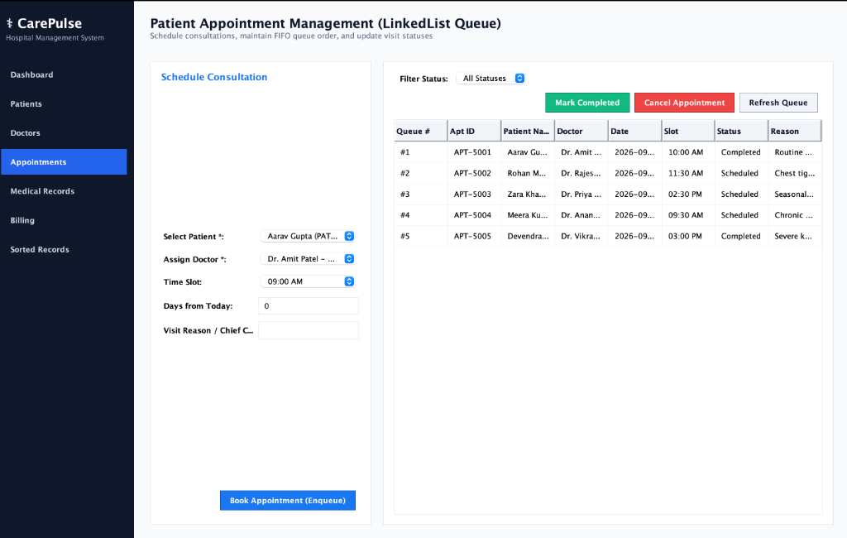
5. Appointments & Queues
Strict FIFO ordering via LinkedLists
Data Structure: LinkedList (O(1) Insertion)
Clinical appointments are inherently First-In-First-Out (FIFO). We utilized a Java LinkedList rather than an ArrayList.
Inserting a new appointment at the tail (booking) or removing it from the head (completion) takes exact O(1) time. An ArrayList would require shifting all elements, causing O(n) latency.
CarePulse: Hospital Management System | Group No. 3 | Subject: Java Programming

Slide 7
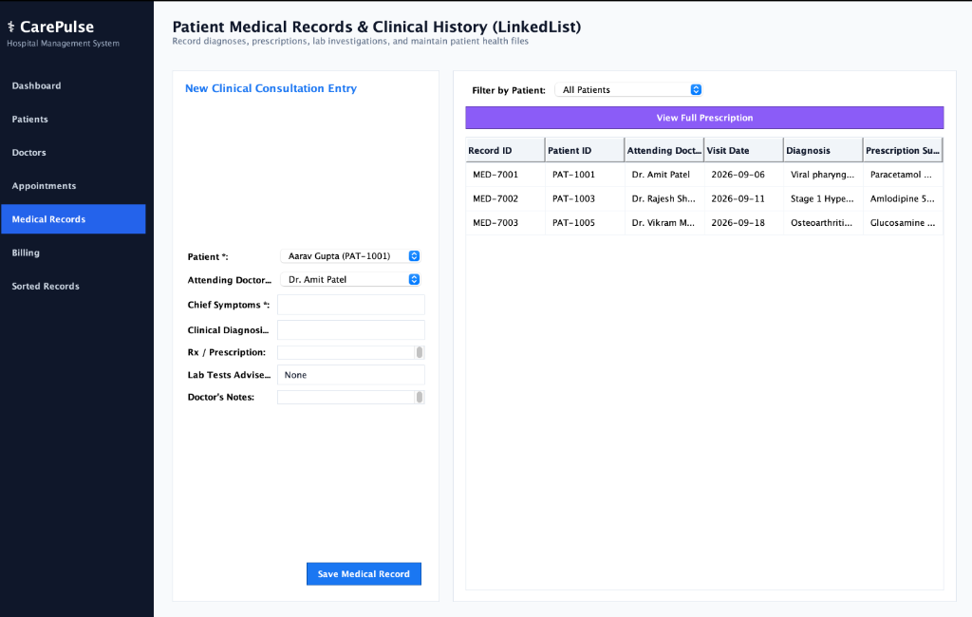
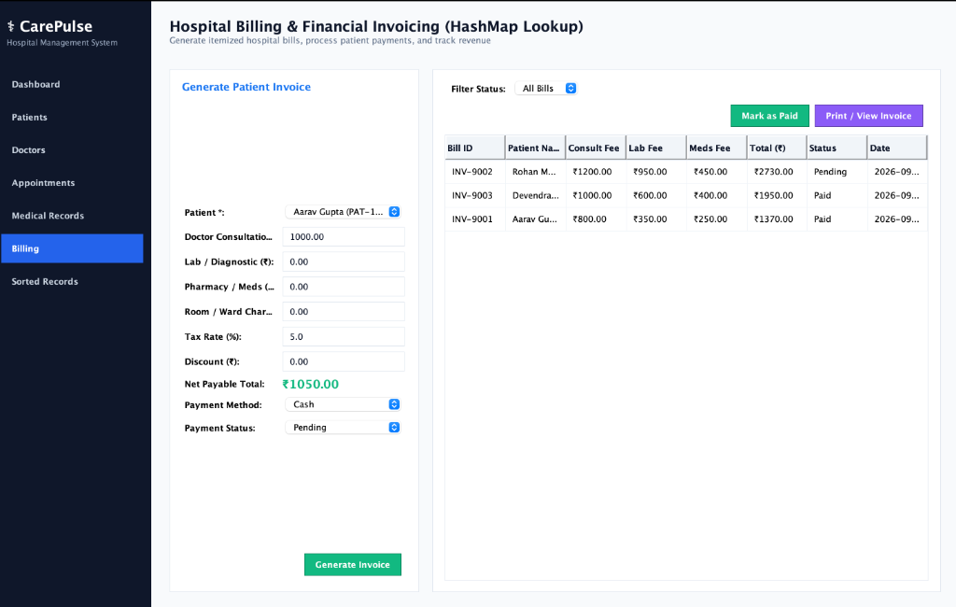
6. Clinical Records & Billing
Data association and financial computation
Clinical & Financial Association
Post-consultation, doctors append diagnoses to the patient's ID. Simultaneously, the Billing module aggregates consultation fees, lab costs, and taxes to generate a final invoice. These records are securely associated with the Patient object in memory.
CarePulse: Hospital Management System | Group No. 3 | Subject: Java Programming

Slide 8
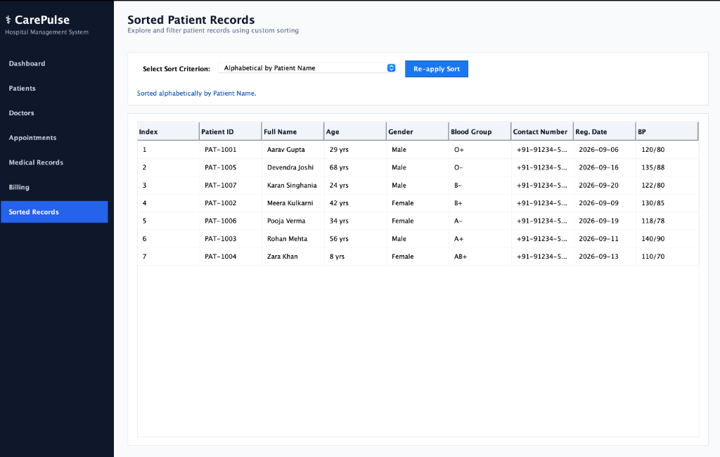
7. Sorted Patient Directory
O(log n) automatic sorting via TreeMaps
Data Structure: TreeMap (O(log n))
Administrators frequently need to view patients alphabetically. Instead of running a sorting algorithm (like Bubble Sort at O(n^2)) every time the view is opened, we dual-insert patients into a TreeMap.
The TreeMap self-balances in O(log n) time upon insertion, meaning the sorted view renders instantly with zero calculation latency.
CarePulse: Hospital Management System | Group No. 3 | Subject: Java Programming

Slide 9
8. Object-Oriented Principles
Core Java concepts implemented
■ Singleton Pattern
The HospitalService class implements Singleton. A private constructor and static getInstance() method ensures only one centralized data store exists across all UI panels.
■ Encapsulation
All variables in Patient and Doctor classes are private. Mutations can only occur through validated public setter methods, protecting the system from invalid data states.
■ Comparable Interface (Polymorphism)
To enable the TreeMap to sort automatically, the Patient class implements Comparable<Patient> and overrides the compareTo() method, allowing polymorphism in sorting mechanisms.
■ Thread Safety
Key data mutation methods in the Singleton service are marked 'synchronized', preventing data corruption if multiple threads attempt to modify queues simultaneously.
CarePulse: Hospital Management System | Group No. 3 | Subject: Java Programming

Slide 10
9. Conclusion & Future Scope
Final Takeaways
■ Goal Achieved
Successfully digitized paper records with zero-latency lookups using optimal Data Structures (HashMap, TreeMap, LinkedList, Array).
■ UI/UX Success
Delivered 7 distinct UI panels using Java Swing CardLayout for seamless navigation.
■ Future Scope: Database
Integrating MySQL/PostgreSQL to persist the HashMap and LinkedList data permanently to disk.
■ Future Scope: Authentication
Adding role-based login (Admin vs Doctor) to securely restrict access to medical records.
CarePulse: Hospital Management System | Group No. 3 | Subject: Java Programming

