Slide 1
Guidelines
KindlQ usg thg givgn tgmplatg fior submitting Qour prototQpg(Makg a copQ ofi thg tgmplatg)
Ong tgam is onlQ rgquirgd to submit ong projgct.
Thg idgal sizg ofi thg prgsgntation should not bg morg than 10 slidgs.
You arg wglcomg to add as manQ POCs and dgsign concgpts to support Qour projgct.
Thg projgct should bg figasiblg and thg tgam mgmbgrs should bg capablg gnough, to comg up with thg fiullQ fiunctioning prototQpg ofi thg samg idga, ifi rgquirgd.
In casg ofi qugrigs, kindlQ rgach out to us at solutionchallgnggsupport@hack2skill.com
Note: PrototQpg must includg cloud dgploQmgnt and usg at lgast ong Googlg AI modgl or sgrvicg (g.g., Ggmini) as part ofi thg solution.

Slide 2

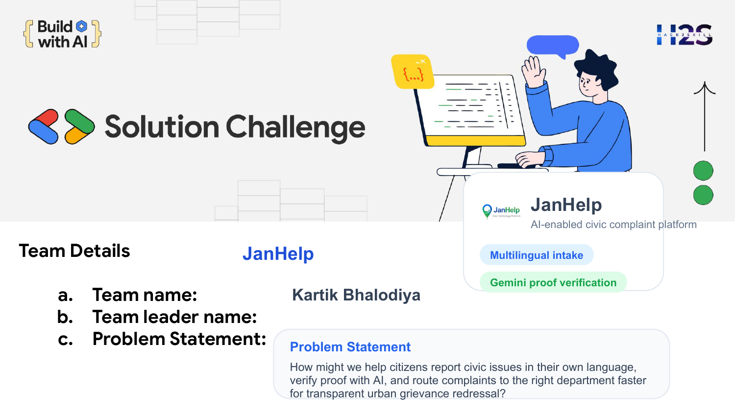
Team Details
Team name:
Team leader name:
Problem Statement:

Slide 3
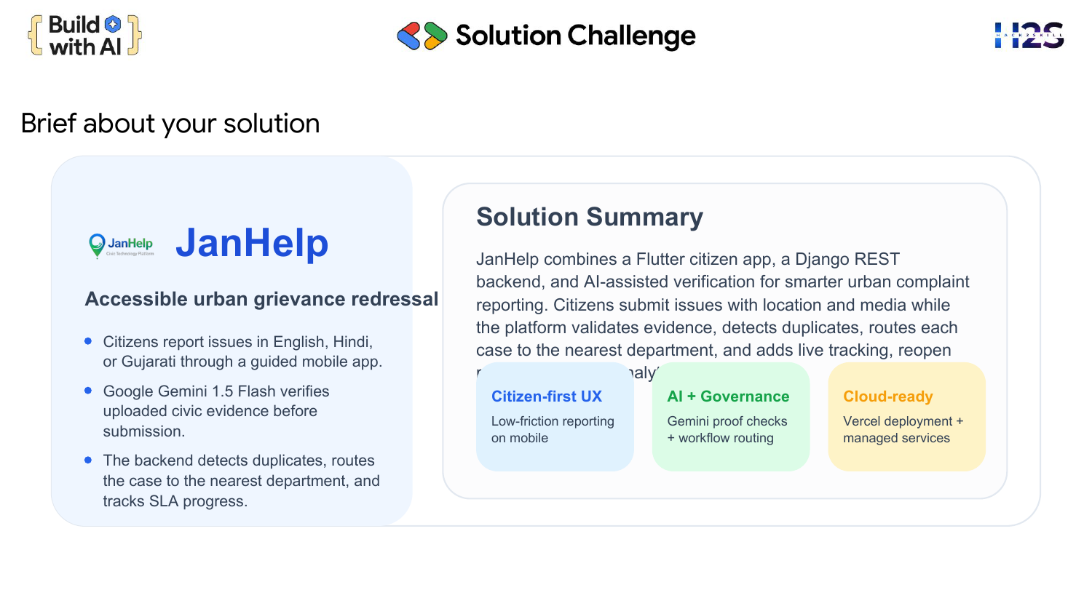
Brigfi about Qour solution

Slide 4
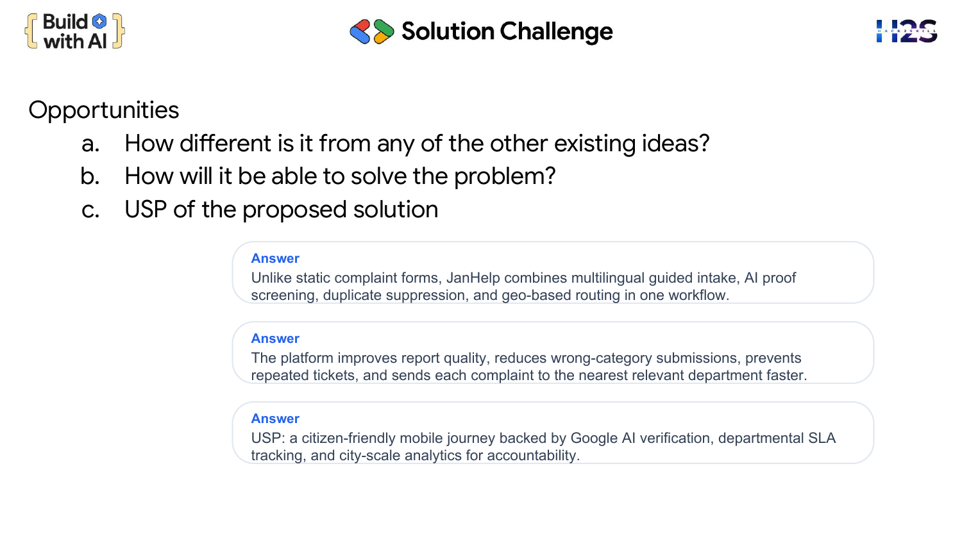
Opportunitigs
How diffgrgnt is it firom anQ ofi thg othgr gxisting idgas?
How will it bg ablg to solvg thg problgm?
USP ofi thg proposgd solution

Slide 5
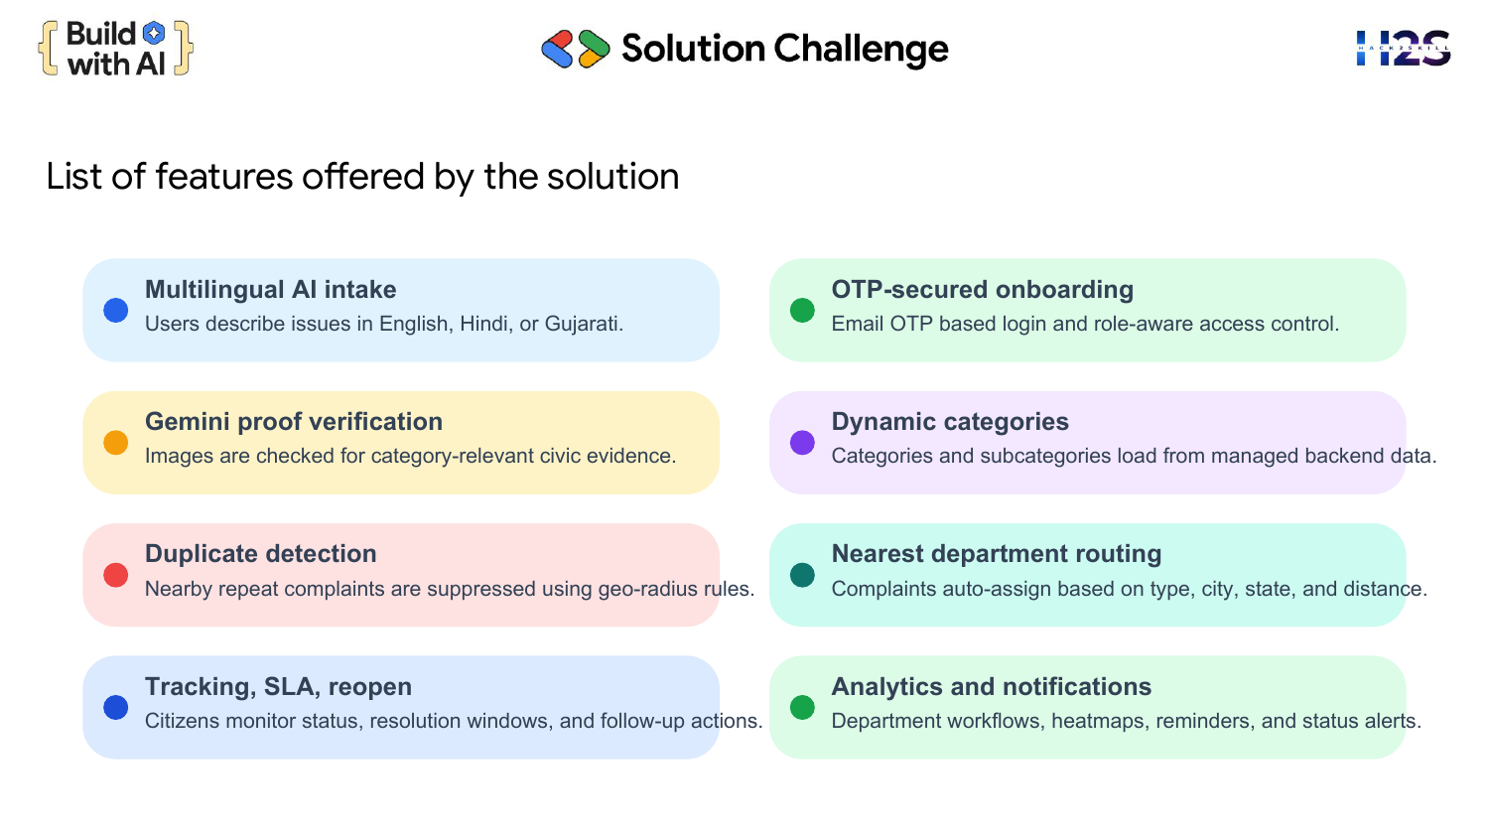
List ofi figaturgs offgrgd bQ thg solution

Slide 6
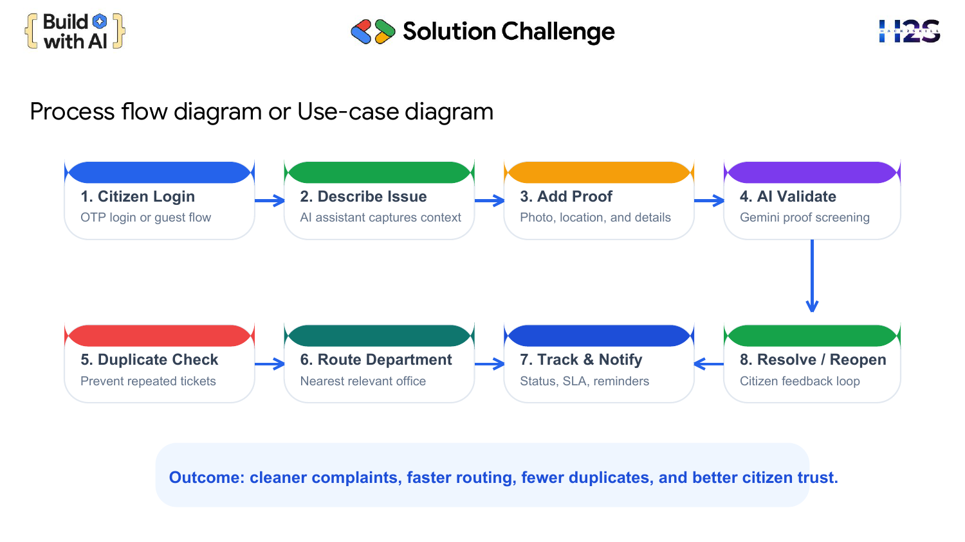
Procgss flow diagram or Usg-casg diagram

Slide 7
Wirgfiramgs/Mock diagrams ofi thg proposgd solution (optional)
Low-fidelity mobile wireframes
Home
AI Assistant
Track Status
JanHelp
JanHelp
JanHelp
Live Stats
SC482913
Departments
Assigned to Road Dept
Quick Report
In progress
Describe issue in any language
Resolved + reopen
These mock screens represent the implemented citizen dashboard, AI assistant, complaint intake, and tracking flow.

Slide 8
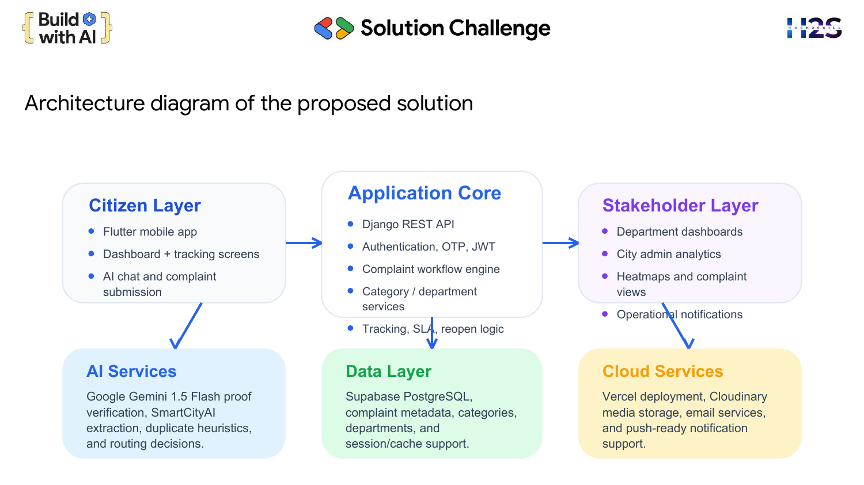
Architgcturg diagram ofi thg proposgd solution

Slide 9
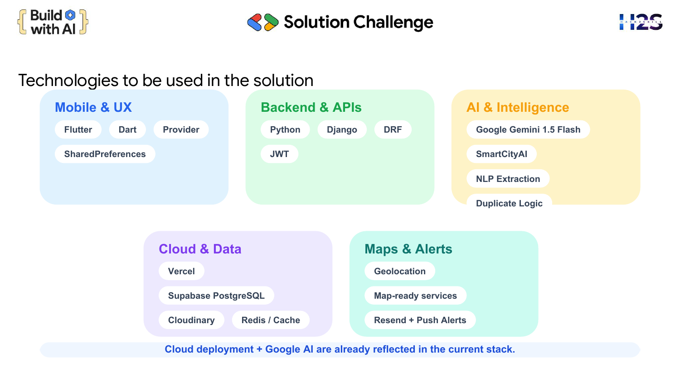
Tgchnologigs to bg usgd in thg solution

Slide 10
Estimatgd implgmgntation cost (optional)
Illustrative pilot estimate for a small-city rollout
Cost Head
Estimated Cost
Cloud hosting and deployment
Rs 0 - 2,000 / month
Database and storage
Rs 0 - 3,500 / month
Cloudinary media handling
Rs 0 - 2,500 / month
Gemini and AI usage
Rs 1,000 - 4,000 / month
Email, alerts, and maintenance buffer
Rs 1,500 - 3,000 / month
Estimated pilot total
Approx Rs 4,500 - 15,000 / month
The MVP can begin on free or low-cost tiers and scale costs only when complaint volume grows.

Slide 11
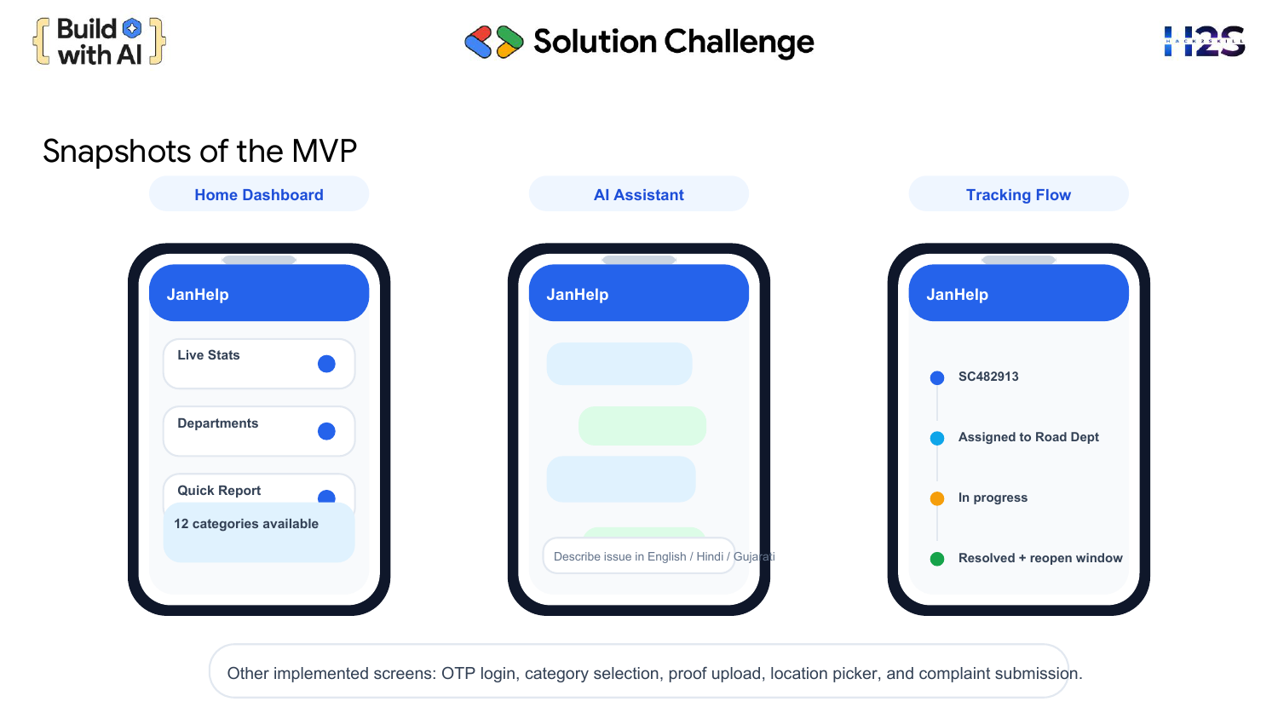
Snapshots ofi thg MVP

Slide 12
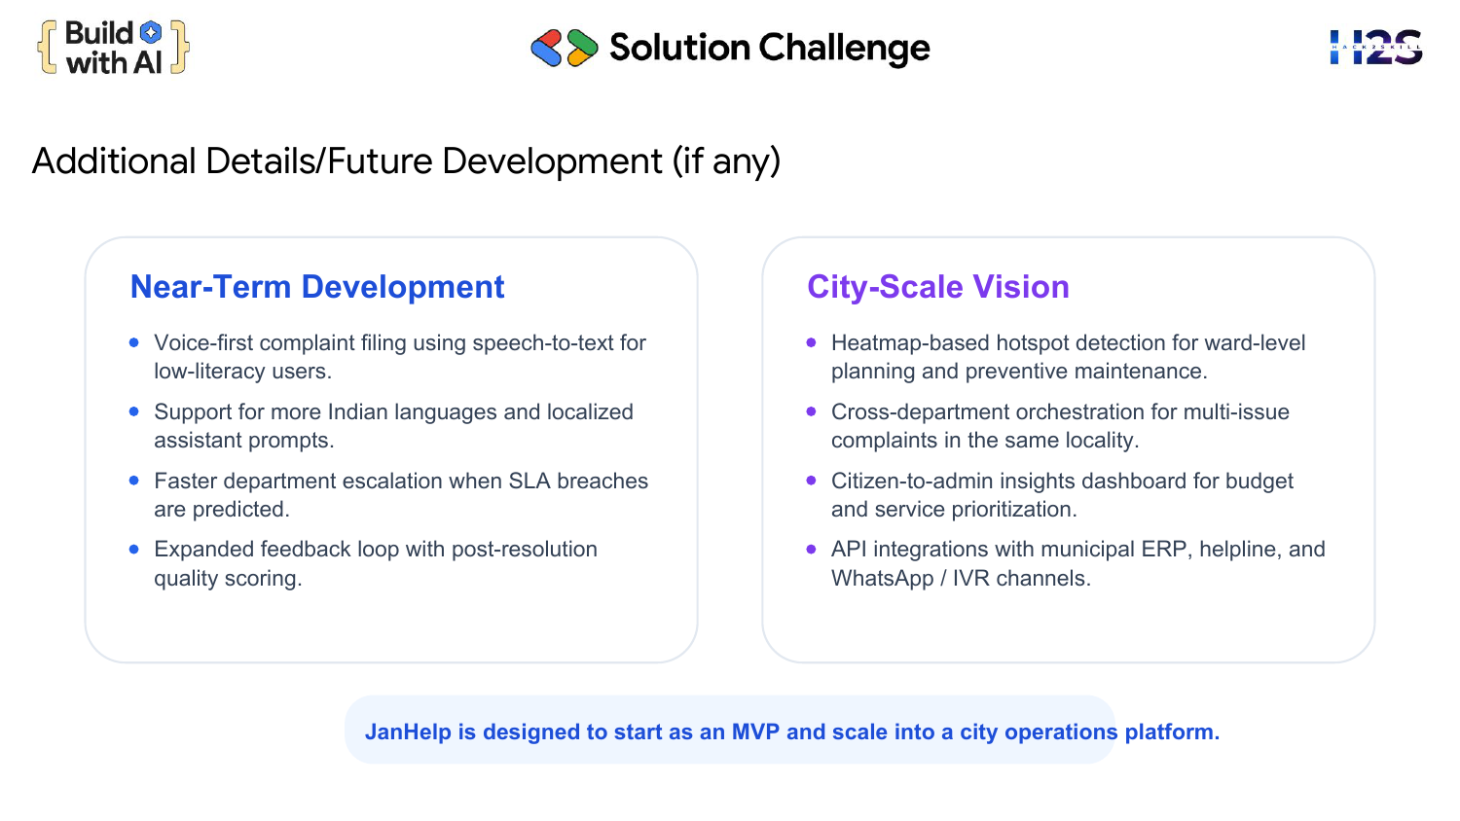
Additional Dgtails/Futurg Dgvglopmgnt (ifi anQ)

Slide 13
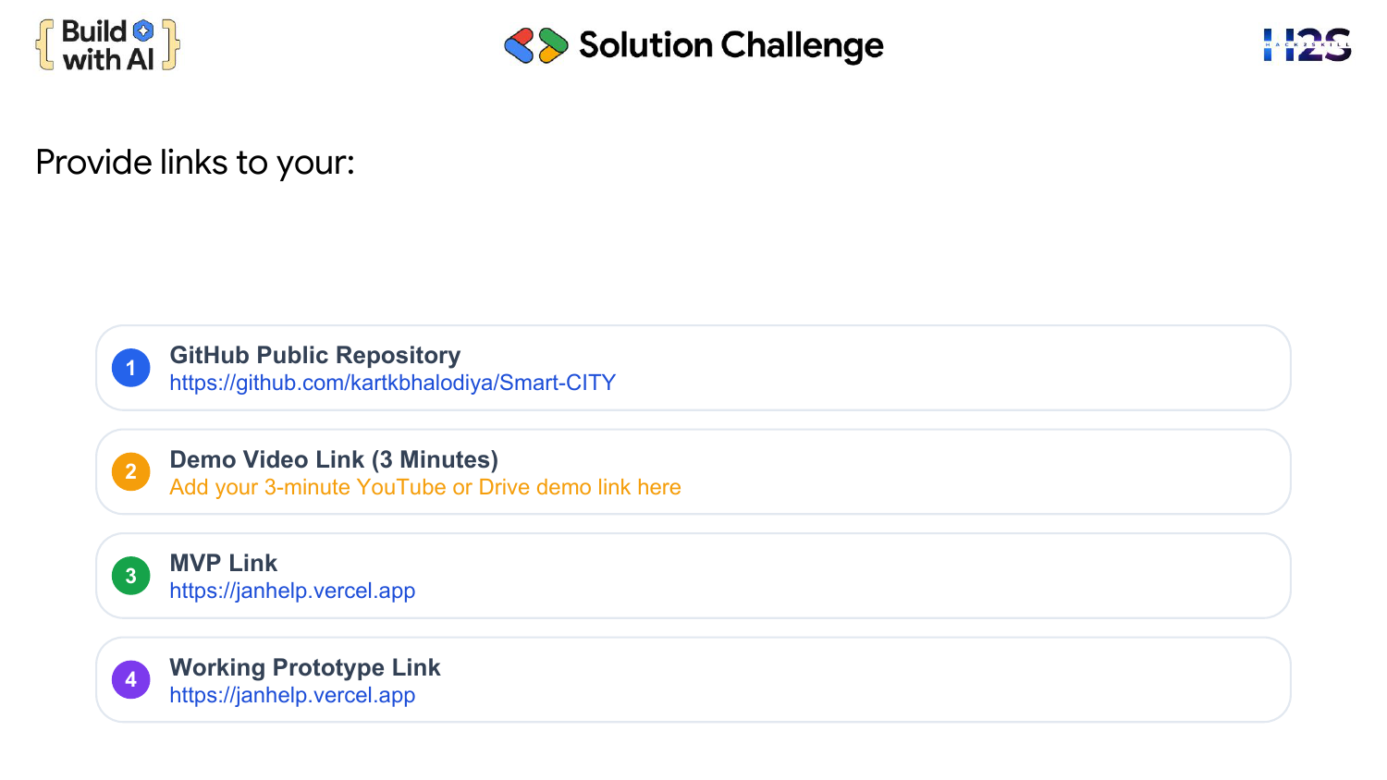
Providg links to Qour:
GitHub Public RgpositorQ
Dgmo Vidgo Link (3 Minutgs)
MVP Link
Working PrototQpg Link

Slide 14
Pilot Readiness and Expected Impact
24/7 access
Cleaner data
Faster routing
Citizens can report issues anytime through multilingual guided intake.
AI proof checks and duplicate suppression improve complaint quality.
Nearest-department assignment reduces manual triage and delay.
Why JanHelp is deployment-ready now
Suggested pilot KPIs
Cloud deployment already defined in the backend stack
Complaint submission time reduced
Google Gemini usage already built into proof verification
Duplicate complaints reduced
Citizen, department, and admin workflows already modeled
Routing accuracy improved
Citizen satisfaction improved

Slide 15

Solution Challenge
$ Builds $
& with Al #
JanHelp
AI-enabled civic complaint platform
Team: JanHelp | Lead: Kartik Bhalodiya

