Slide 1


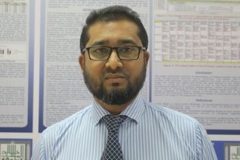
Facilitator: sayed salahuddin ahmed department of English college of Science & arts, king khalid university.
6 february, 2019 9 am Lab 7
A talk on
The
Basics
of
IELTS

Slide 2
Disclaimer
This presentation discusses only the basic concepts of IELTS and is prepared for them who have not taken the test yet but have a plan to sit for IELTS soon.
Fundamental information about IELTS may disappoint them who have taken the test for one or several times or are expert on the test.
For convenience, I will consider you all as prospective IELTS takers who are going to sit for the test.
This presentation focuses only on Academic module of IELTS, not General Training module.

Slide 3
Purpose
What is IELTS?
Why we need IELTS?
The International English Language Testing System (IELTS) examination which is designed to assess the readiness of candidates to study or train in further or higher education courses held in English at college or university. IELTS measures the language proficiency of people who want to study or work where English is used as a language of communication. It uses a nine-band scale to clearly identify levels of proficiency, from non-user (band score 1) through expert user (band score 9).
IELTS is accepted as evidence of English language proﬁciency for study, work and migration in Australia, Canada, New Zealand and the UK, the USA and many other countries.
Each country sets its own IELTS requirements. For up-to-date information, please visit the relevant government websites.

Slide 4
TYPES
ACADEMIC Module
The IELTS Academic test is for people applying for higher education or professional registration in an English speaking environment. It reflects some of the features of academic language and assesses whether you are ready to begin studying or training…
GENERAL TRAINING Module
The IELTS General Training test is for those people who are going to English speaking countries for secondary education, work experience or training programs. It is also a requirement for migration to Australia, Canada, New Zealand, the UK and other countries. The test focuses on basic survival skills in broad social and workplace contexts.

Slide 5
Test components
Listening and Speaking are the same for both Academic and General Training tests, but the subject matter of the Reading and Writing components differs depending on which test you take.
The Listening, Reading and Writing components of all IELTS tests are completed on the same day, with no breaks between them.
The Speaking component, however, can be completed up to a week before or after the other tests. Your test center will advise.
The total test time is 2 hours and 45 minutes.

Slide 6

FORMATS
Paper-based IELTS
This test requires test takers to sit at a desk with the question papers and answer sheets for the Reading, Listening and Writing tests in an official IELTS test center. Test takers will write their answers with either pen or HB-pencils. The Speaking test is carried out face-to-face with a trained IELTS examiner.
Computer-delivered IELTS
This test requires test takers to sit for the Reading, Listening and Writing tests in front of a computer with the questions presented on the screen in an official IELTS test center. The test takers then submit their answers through the use of a keyboard and a mouse. The Speaking test is not on computer and is carried out face-to-face with a trained IELTS examiner.

Slide 7
Listening sub-test
Approximately 30 minutes (plus 10 minutes transfer time).
Total number of questions: 40
Each question is worth 1 mark. No negative marking.
You will listen to four recordings of native English speakers and then write your answers to a series of questions.
Recording 1 – a conversation between two persons set in an everyday social context.
Recording 2 - a monologue set in an everyday social context, e.g. a speech about local facilities.
Recording 3 – a conversation between up to four persons set in an educational or training context, e.g. a university tutor and a student discussing an assignment.
Recording 4 - a monologue on an academic subject, e.g. a university lecture.

Slide 8
Listening sub-test (contd.)
Assessors will be looking for evidence of your ability to understand the main ideas and detailed factual information. The first two sections deal with situations set in everyday social contexts. In Section 1, there is a conversation between two speakers (for example, a conversation about travel arrangements), and in Section 2, there is a monologue (for example, a speech about local facilities). The final two sections deal with situations set in educational and training contexts. In Section 3, there is a conversation between two main speakers (for example, two university students in discussion, perhaps guided by a tutor), and in Section 4, there is a monologue on an academic subject.
The recordings are heard only once. They include a range of accents, including British, Australian, New Zealand, American and Canadian.

Slide 9
Listening sub-test (contd.)
A variety of question types are used, chosen from the following: multiple choice, matching, plan/map/diagram labeling, form/note/table/flow-chart/summary completion, sentence completion.
Test takers write their answers on the question paper as they listen and at the end of the test are given 10 minutes to transfer their answers to an answer sheet. Care should be taken when writing answers on the answer sheet as poor spelling and grammar are penalized.

Slide 10
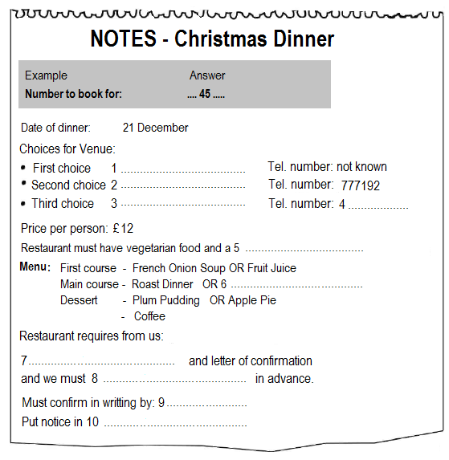
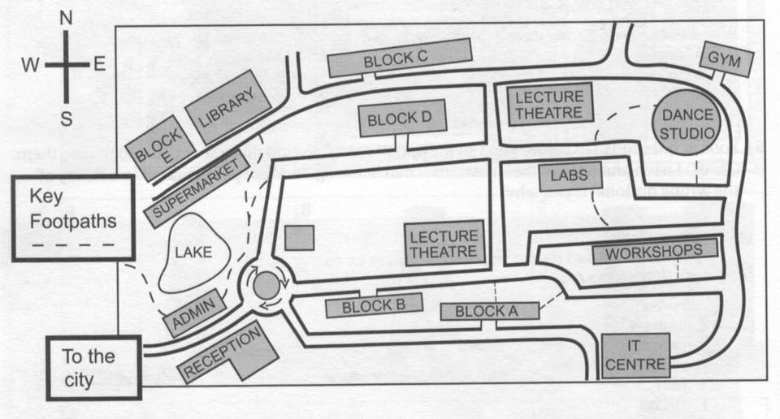
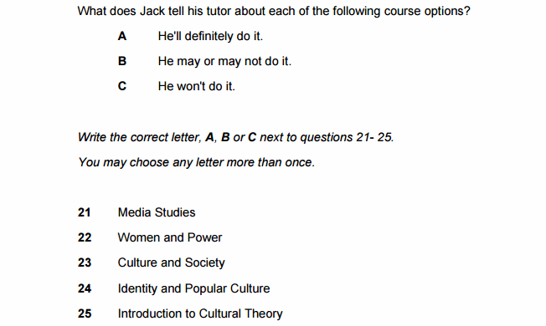
Sample listening questions

Slide 11
Reading (academic) sub-test
60 minutes: 40 questions : Each question is worth 1 mark.
No negative marking
The Reading component consists of 40 questions, designed to test a wide range of reading skills. These include reading for gist, reading for main ideas, reading for detail, skimming, understanding logical argument and recognizing writers' opinions, attitudes and purpose.
Academic reading test includes three long texts which range from the descriptive and factual to the discursive and analytical. These are taken from books, journals, magazines and newspapers. They have been selected for a non-specialist audience but are appropriate for people entering university courses or seeking professional registration.

Slide 12
Reading (academic) sub-test (contd.)
Answering:
Test takers are required to transfer their answers to an answer sheet during the time allowed for the test. No extra time is allowed for transfer. Care should be taken when writing answers on the answer sheet as poor spelling and grammar are penalized.

Slide 13
Reading (academic) sub-test (contd.)
Task types
Multiple choice
Identifying information
Identifying writer’s views/claims
Matching information
Matching headings
Matching features
Matching sentence endings
Sentence completion
Summary, note, table, flow-chart completion
Diagram label completion
Short-answer questions

Slide 14
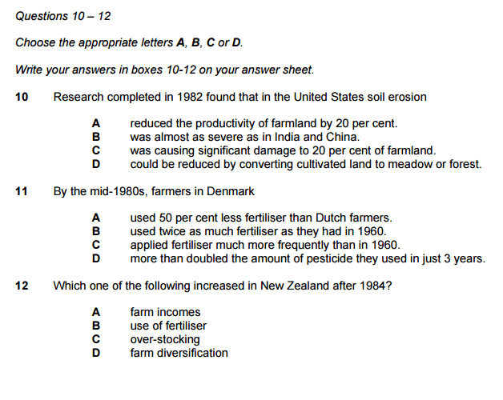
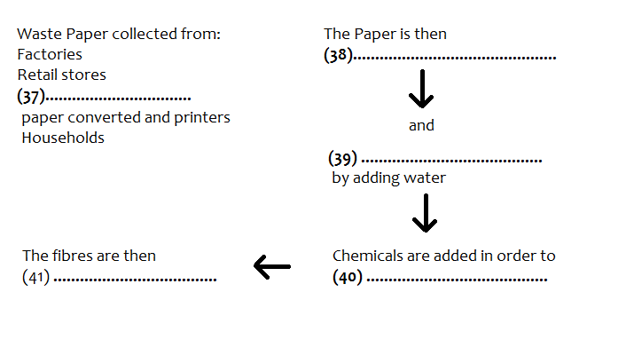
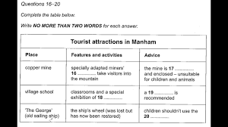
Reading (academic) sample questions

Slide 15
Writing (academic) sub-test
2 tasks: total 60 minutes
Topics are of general interest to, and suitable for, test takers entering undergraduate and postgraduate studies or seeking professional registration. There are two tasks:
Task 1 - You will be presented with a graph, table, chart or diagram and asked to describe, summarize or explain the information in your own words. You may be asked to describe and explain data, describe the stages of a process, how something works or describe an object or event. They need to write 150 words in about 20 minutes.

Slide 16
Writing (academic) sub-test (contd.)
Task 2 - You will be asked to write an essay in response to a point of view, argument or problem. Responses to both tasks must be in a formal style.
They need to write 250 words in about 40 minutes.
Answers must be given on the answer sheet and must be written in full. Notes or bullet points are not acceptable as answers. Test takers may write on the question paper but this cannot be taken from the examination room and will not be seen by the examiner.

Slide 17
Performance descriptors
Task 1 (150 words: 20 minutes)
1.Task achievement
fulfilling the requirement set out in the task.
2. Coherence and cohesion
logical sequencing.
use of cohesive devices
3. Lexical resource
overall clarity and fluency.
range of vocabulary used.
4. Grammatical range and accuracy
accurate use of grammar as manifested in their sentence writing.
Task 2 (250 words: 40 minutes)
1.Task response
to formulate and develop a position in relation to a given prompt in the form of a question or statement
2. Coherence and cohesion
overall clarity and fluency.
logical sequencing.
use of cohesive devices
3. Lexical resource
Range of vocabulary used
4. Grammatical range and accuracy
accurate use of grammar as manifested in their sentence writing.

Slide 18
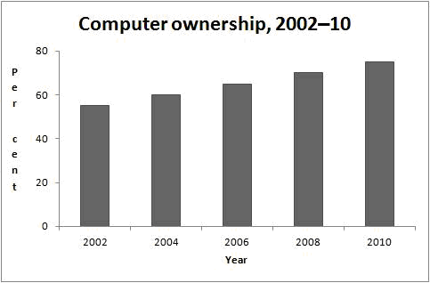
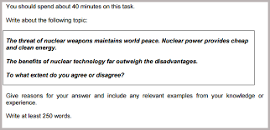
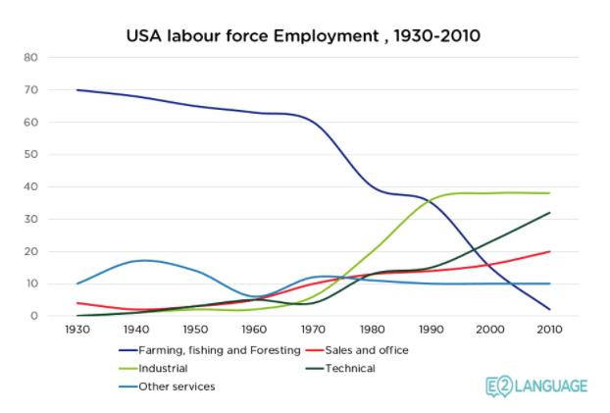
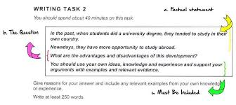
Writing (academic) sample questions

Slide 19
Speaking sub-test
11–14 minutes (approx.)
The speaking component assesses your use of spoken English.
Every test is recorded.
Part 1 - The examiner will ask you general questions about yourself and a range of familiar topics, such as home, family, work, studies and interests. This part lasts between four and five minutes.
Part 2 - You will be given a card which asks you to talk about a particular topic. You will have one minute to prepare before speaking for up to two minutes. The examiner will then ask one or two questions on the same topic.
Part 3 - You will be asked further questions about the topic in Part 2. These will give you the opportunity to discuss more abstract ideas and issues. This part of the test lasts between four and five minutes.

Slide 20
Speaking sub-test (contd.)
Part 1 – Introduction and interview (4-5 minutes)
In this part, the examiner introduces him/herself and checks the test takers' identity. They then ask the test takers general questions on some familiar topics such as home, family, work, studies and interests. To ensure consistency, questions are taken from a script.
Part 2 – Long turn (3–4 minutes, including the preparation time)
Part 2 is the individual long turn. The examiner gives the test takers a task card which asks the test takers to talk about a particular topic and instructs the test takers to explain one aspect of the topic. Test takers are given one minute to prepare their talk, and are given a pencil and paper to make notes. The examiner asks the test takers to talk for 1 to 2 minutes, stops the test takers after 2 minutes, and asks one or two questions on the same topic.
Using the points on the task card effectively, and making notes during the preparation time will help the test takers think of appropriate things to say, structure their talk, and keep talking for 2 minutes.

Slide 21
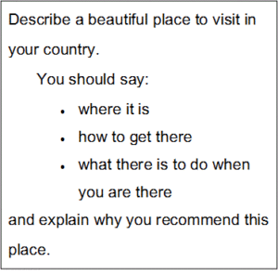
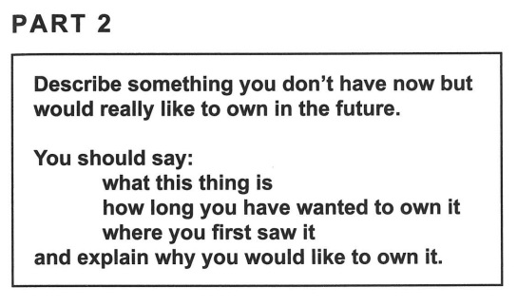
Speaking part 2 sample cue card s

Slide 22
Speaking sub-test (contd.)
Part 3 – Discussion (4-5 minutes)
In Part 3, the examiner and the test takers discuss issues related to the topic in Part 2 in a more general as well as abstract way and where appropriate, in greater depth.

Slide 23
Speaking sub-test (c0ntd.)
Marking and assessment
Fluency and coherence
the ability to talk with normal levels of
continuity and to link ideas.
logical sequencing of sentences
use of cohesive devices
2. Lexical resource
the range of vocabulary used
the adequacy and appropriacy of the words used

Slide 24
Speaking sub-test (contd.)
3. Grammatical range and accuracy
appropriate use of the test takers' grammatical resource
the length and complexity of the spoken sentences
grammatical errors in a given amount of speech and the communicative effect of error.
4. Pronunciation
the amount of strain caused to the listener
the amount of the speech which is unintelligible and the noticeability of L1 influence.

Slide 25
MARKING policy
You will be given a mark between 0 and 9 for each of the 4 Sub-tests (there are no half marks in the Writing and Speaking Sub-tests). Your Overall Band Score is an average of the 4 Subtest Band Scores, with fractional scores rounding up or down to the nearest x.0 or x.5 score (with x.25 and x.75 rounding up.)
Therefore, if you score 6.5 in the Listening Sub-test 5 in the Reading Sub-test, 7 in the Writing Sub-test and 6 in the Speaking Sub-test, your total score is 24.5
By averaging the scores (dividing the total score 24.5 by 4) in the example above, you would achieve an Overall Band Score of 6.0 (which is 6.125 rounded down).

Slide 26
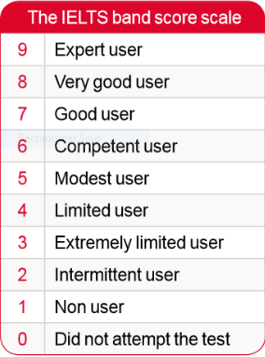
Band score definition

Slide 27
A few tips
Read all instructions VERY CAREFULLY. For example, in Reading section, you must be sure how many words you can use in the gaps, etc.
Underline the instructions.
Write with HB pencils.
Attempt all questions; no negative marking.
Write the answers in ALL CAPS.
Write clearly; take care of spelling and grammar.
Be careful about time management and word count in the Writing part.
Jot down some points in paper in the part 2 of the Speaking Test.
Reply in detail in the speaking test.

Slide 28
preparation
Books
Cambridge English IELTS.
The official Cambridge guide to IELTS.
Barron’s IELTS.
IELTS Advantage.
The complete guide to IELTS.
Improve your IELTS writing
IELTS success formula
YouTube videos
1.TakeIELTS official https://www.youtube.com/user/BCIELTS
2. IELTS Advantage
https://www.youtube.com/channel/UCXg7gy4XmPZEGr4kumPNGyQ
3. IELTS Liz
https://www.youtube.com/user/ieltsliz
4. Eng Vid
https://www.youtube.com/channel/UCVBErcpqaokOf4fI5j73K_w

Slide 29

Thanks !
LET’S FLY WITH IELTS!

