Slide 1

Presented by: Krishna Singh(22DCS011)
Presented to: Dr. Kamlesh Dutta
Clustering-Based Gene Expression Analysis for Disease Subtype Discovery
Department of Computer Science and Engineering
NATIONAL INSTITUTE OF TECHNOLOGY, HAMIRPUR
Distt. Hamirpur, Himachal Pradesh - 177005

Slide 2
Table of Contents
Introduction: The Problem of Disease Subtyping
Literature Review: Current State-of-the-Art
Methodology: Our Project Work Flow
Datasets Used: The Gene Expression Data
Data Preprocessing: Standardization
Dimensionality Reduction: Using PCA
Clustering Algorithms: The Four Methods
Evaluation Metrics: How We Measure Performance
Results & Analysis: Per-Dataset Breakdown
Conclusions & Future Directions
References

Slide 3
The Problem
Many complex diseases, like cancer, are not single, uniform entities.
They are highly heterogeneous, consisting of many distinct molecular subtypes.
A "one-size-fits-all" treatment approach often fails because it doesn't account for this biological diversity.
Discovering these subtypes is critical for developing targeted therapies and personalized medicine.

Slide 4
Objective
Goal: To use unsupervised machine learning to analyze high-dimensional gene expression data.
Method: We apply and compare four different clustering algorithms to partition patients into distinct groups based on their gene activity.
Validation: We then validate these data-driven clusters against the known clinical subtypes (ground truth) to measure algorithm performance.

Slide 5
Literature Review: Foundational papers
Aspect | Paper 1: Golub et al. (1999) [1] | Paper 2: Perou et al. (2000) [2]
Study Type | Unsupervised Class Discovery | Unsupervised Subtype Discovery
Data Source | 38 Leukemia samples (ALL vs. AML) | 65 Breast Tumor samples
Algorithm Used | Self-Organizing Maps (SOMs) | Hierarchical Clustering
Visualization | Cluster Heatmaps | Dendrogram & Heatmap ("Molecular Portrait")
Key Contribution | Proved that gene expression clustering could discover and classify cancer without prior knowledge. | Discovered the "intrinsic" breast cancer subtypes (Luminal, Basal, HER2-E) still used in clinics today.

Slide 6
Literature Review: Recent
Aspect | Paper 1: MOGONET (2021) | Paper 2: BayesSpace (2021)
Study Type | Multi-Omics Integration | Spatial Transcriptomics Clustering
Data Source | TCGA (RNA-seq, Methylation) | 10x Visium (Gene Expression + (x,y) Coords)
Algorithm Used | Graph Convolutional Network | Bayesian Markov Random Field
Key Contribution | Integrates multiple data types (multi-omics) for a more robust and accurate patient classification. | Creates "spatially-aware" clusters, identifying cellular neighborhoods that respect the tissue's anatomy.

Slide 7
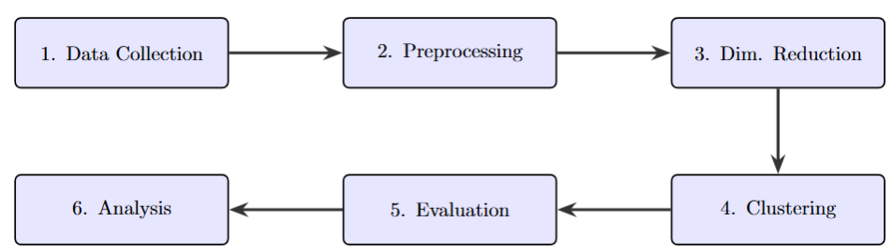
Project Work Flow
Data Collection (Load .csv files)
Data Preprocessing (Feature/Label split, StandardScaler)
Dimensionality Reduction (PCA for noise reduction, PCA for visualization)
Clustering Algorithms (K-Means, Hierarchical, Spectral, GMM)
Evaluation (Compute 7 External & Internal metrics)
Analysis (Compare metrics, visualize clusters)

Slide 8
Hardware & Software Requirements
Category | Tool / Specification | Purpose
Language | Python 3.9+ | Core language for modeling.
Data Handling | pandas, numpy | Data loading, wrangling, and numerical operations.
ML Library | scikit-learn | Implements all clustering, PCA, Scaling, and Metrics.
Plotting | matplotlib, seaborn | Generates 2D PCA plots and metric charts.
Helper | scipy | Used for linkage in the Hierarchical dendrogram.

Slide 9
Datasets Used
Dataset | GEO ID | Description | Ground Truth ('type') | Source (Link)
Leukemia | GSE9476 | Patient gene expression for leukemia. | Multiple leukemia subtypes (ALL, AML, etc.) | https://www.kaggle.com/datasets/brunogrisci/leukemia-gene-expression-cumida
Brain Cancer | GSE50161 | Gene expression from brain tumors. | Tumor subtypes and grades (Astrocytoma, etc.) | https://www.kaggle.com/datasets/brunogrisci/brain-cancer-gene-expression-cumida
Breast Cancer | GSE45827 | Gene expression from breast cancer. | Known clinical subtypes (Luminal A, Basal-like) | https://www.kaggle.com/datasets/brunogrisci/breast-cancer-gene-expression-cumida

Slide 10
Data Preprocessing: Step 1 - Feature-Label Split
The first step is to separate our raw data into two distinct parts:
  Features (X):
    The thousands of gene expression values.
    This is the high-dimensional data we will cluster.
  Labels (y):
    The single type column.
    This is our "ground truth" used only for evaluation at the end.

Slide 11
Data Preprocessing: Step 2 - Standardization
Problem: Different genes are expressed at vastly different levels (scales).
Solution: We apply StandardScaler from scikit-learn to all features (X).
Result: All gene features are transformed to have a mean of 0 and a standard deviation of 1.
This step is essential for PCA and K-Means to function correctly.

Slide 12
Dimensionality Reduction: For Clustering
Purpose: To reduce noise, prevent overfitting, and speed up computation.
Method: PCA(n_components=0.90)
Action: This keeps the minimum number of principal components (e.g., 50-80) that are required to explain 90% of the data's variance.
This clean, low-dimensional data is the final input for our clustering algorithms.

Slide 13
Dimensionality Reduction: For Visualization
Purpose: To "flatten" the data for 2D scatter plots.
Method: PCA(n_components=2)
Action: This aggressively reduces the thousands of gene dimensions down to just two principal components (PC1 and PC2).
This allows us to visually inspect how well the clusters are separated in a 2D space.

Slide 14
Clustering Algorithms Used
K-Means:
  Type: Partitioning
  Concept: Finds centroids and assumes clusters are spherical.
Hierarchical:
  Type: Agglomerative
  Concept: Builds a tree (dendrogram) to show relationships.
Spectral:
  Type: Graph-Based
  Concept: Models data as a network; finds complex, non-spherical shapes.
GMM (Gaussian Mixture Model):
  Type: Probabilistic
  Concept: Assumes data is a mix of flexible "ellipsoids"; an upgrade to K-Means.

Slide 15
Evaluation Metrics: External (Supervised)
These metrics compare our predicted clusters (y_pred) to the known ground truth labels (y_true).
Adjusted Rand Index (ARI): Measures similarity, correcting for chance. (Good: 1.0, Random: 0.0)
Homogeneity: Do clusters contain only members of a single class? (Good: 1.0)
Completeness: Are all members of a class in the same cluster? (Good: 1.0)
V-Measure: The harmonic mean of Homogeneity and Completeness. (Good: 1.0)
Fowlkes-Mallows Score (FMS): Measures similarity. (Good: 1.0)

Slide 16
Evaluation Metrics: Internal (Unsupervised)
These metrics measure cluster quality without using the ground truth labels. They assess cluster "tightness" and "separation".
Silhouette Score:
  Measures how similar a sample is to its own cluster vs. other clusters.
  (Good: +1.0, Bad: -1.0, Overlapping: 0.0)
Davies-Bouldin Score:
  Measures the average similarity between each cluster and its most similar one.
  (Good: 0.0, Bad: Higher values)

Slide 17
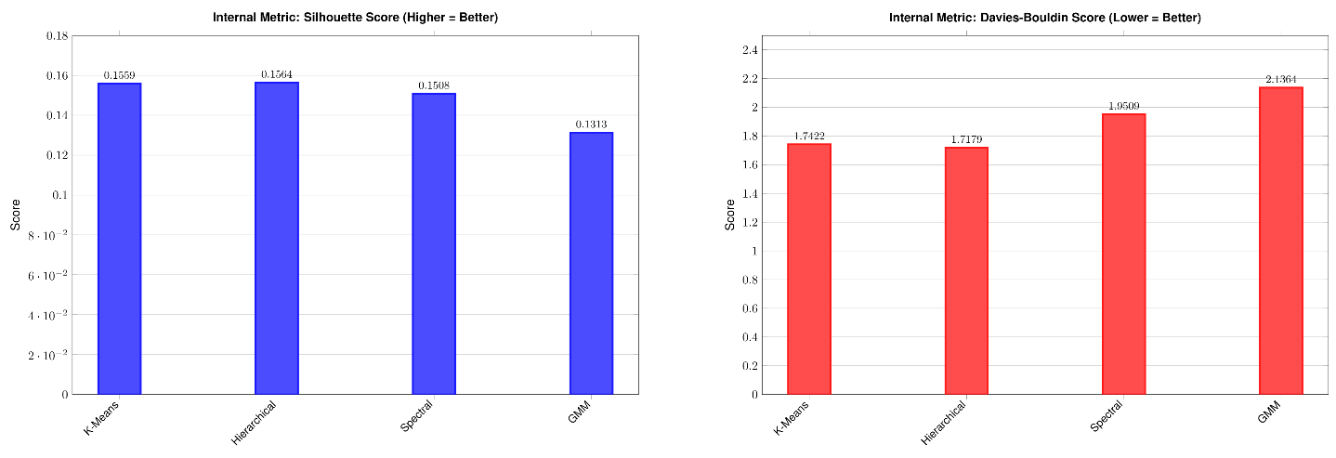
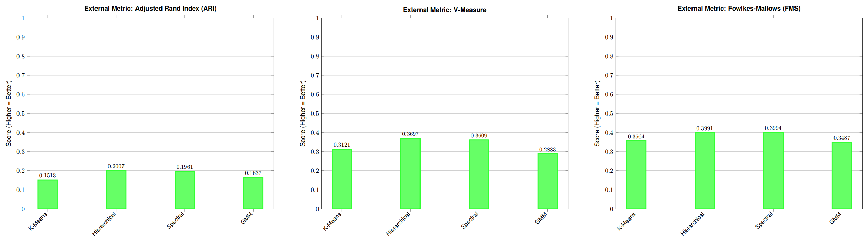
Results: Leukemia (GSE9476) — Metric Comparison

Slide 18
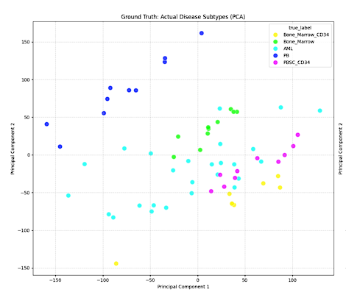
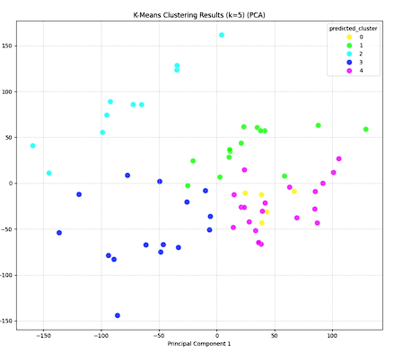
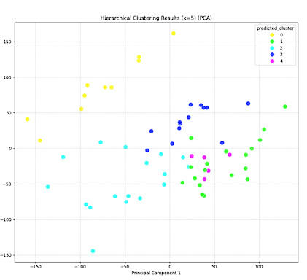
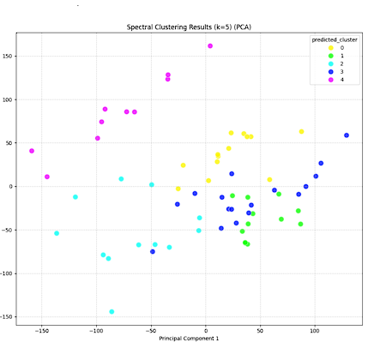
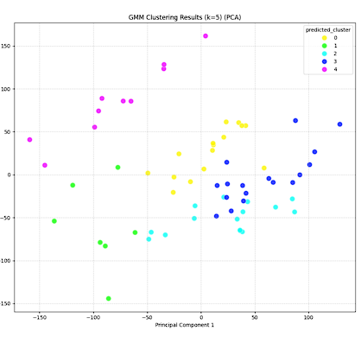
Analysis: Leukemia (GSE9476) — Visual PCA

Slide 19
Analysis:
Hierarchical Clustering was the clear top performer for this dataset. It achieved the highest external metrics (ARI: 0.5133, V-Measure: 0.6930) and the best internal metrics (Silhouette: 0.1564, DB: 1.7179).
K-Means was a strong second (ARI: 0.4451), while GMM (ARI: 0.3719) struggled the most to match the ground truth.
The visual PCA (right) confirms this strong performance, showing a high alignment between the clusters and the Ground Truth (left).

Slide 20
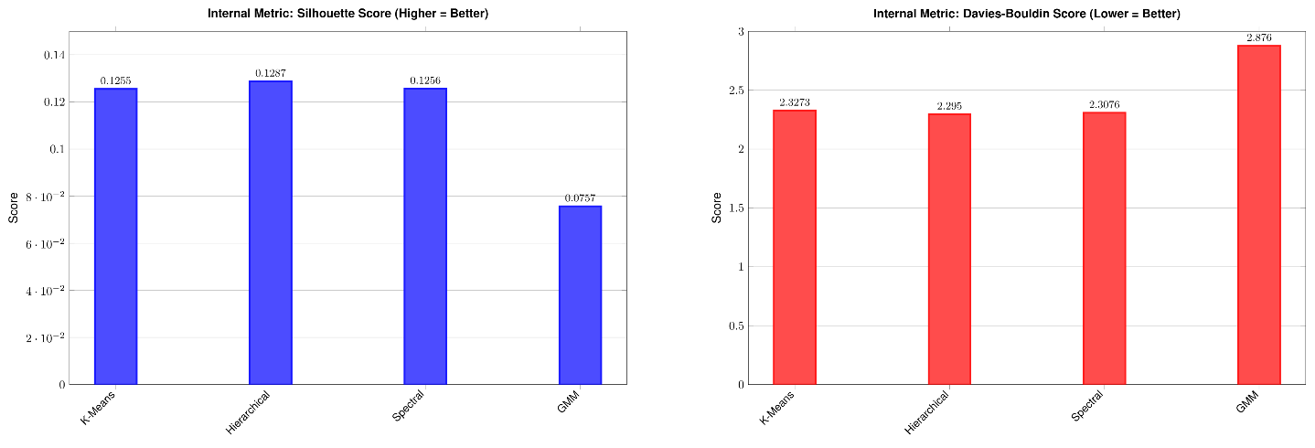
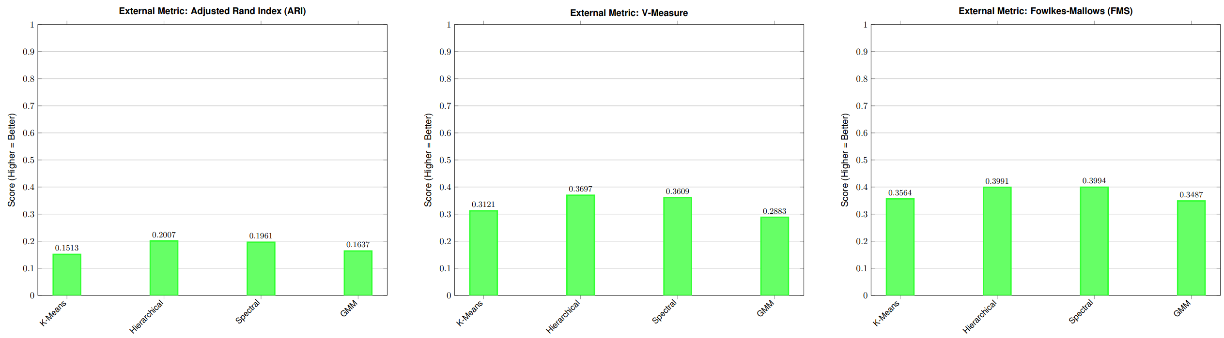
Results: Brain cancer (GSE50161) — Metric Comparison

Slide 21
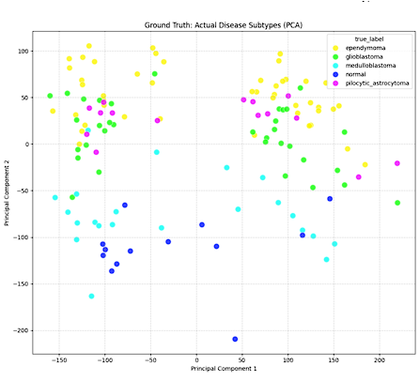
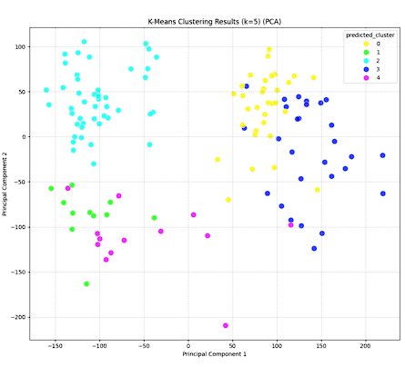
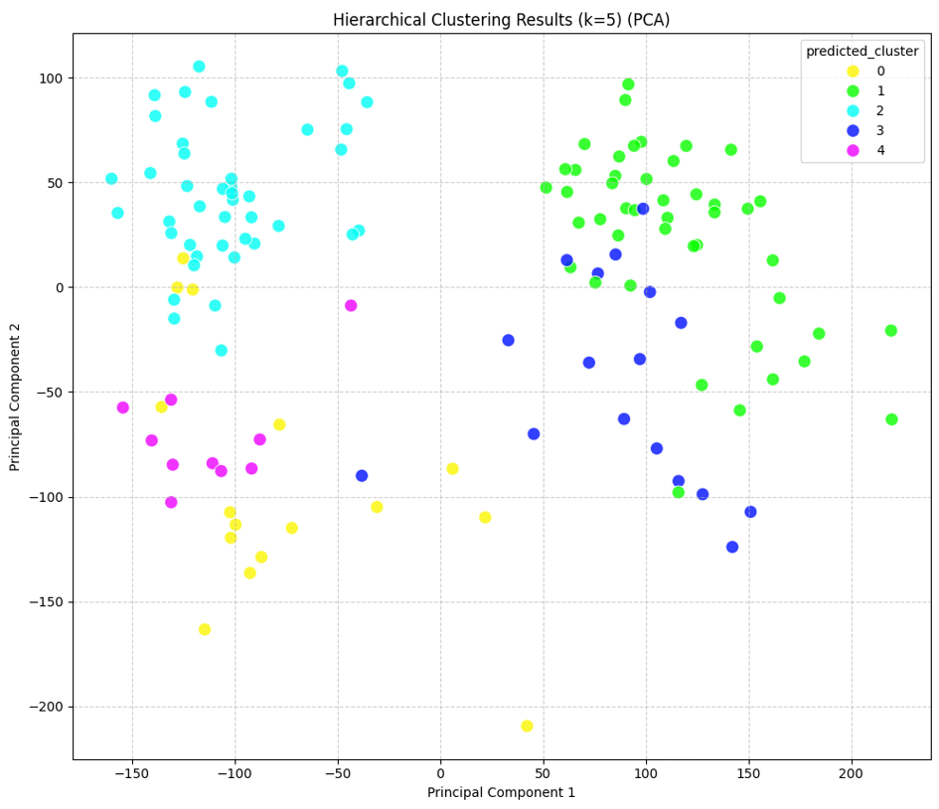
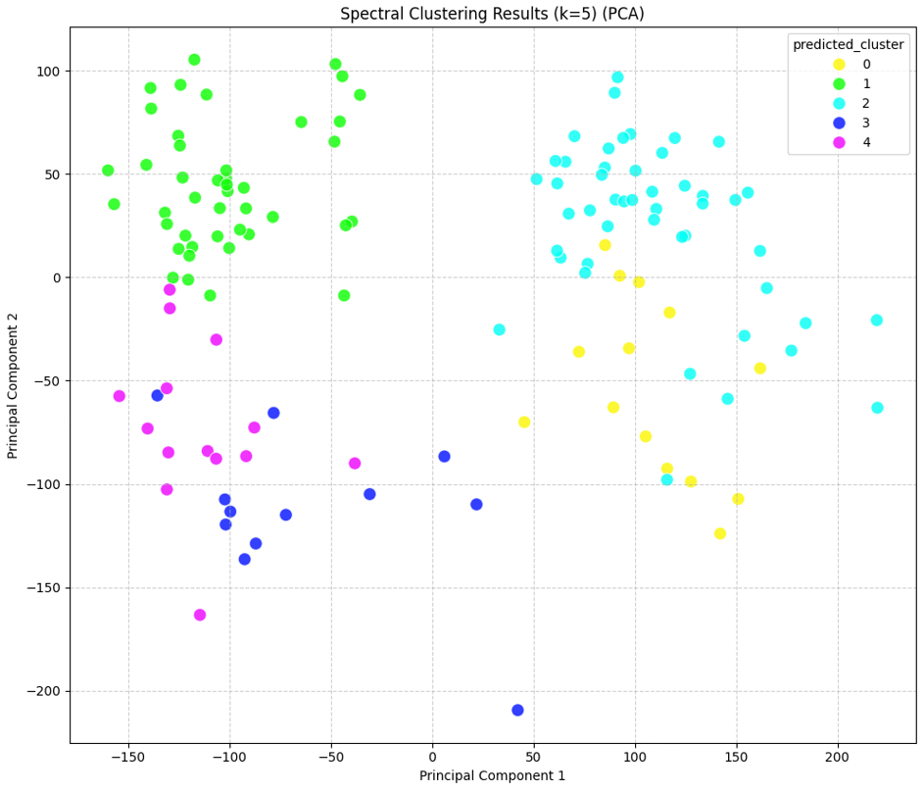
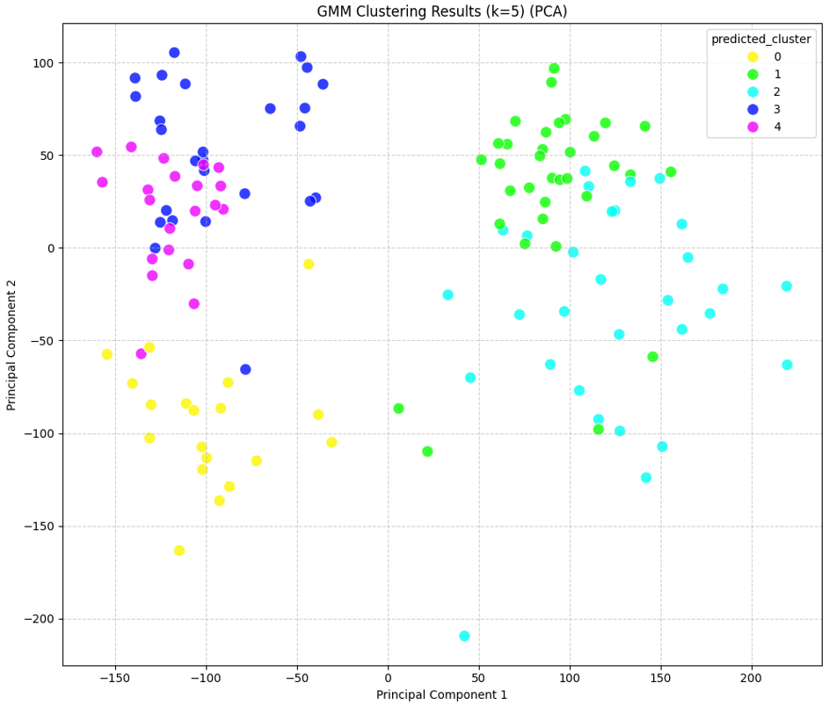
Brain cancer (GSE50161) — Visual PCA

Slide 22
Analysis:
This was the most challenging dataset. All models had low external scores (ARI < 0.21), indicating the ground truth subtypes are complex and highly overlapping.
Hierarchical Clustering provided the best fit, winning on all metrics (ARI: 0.2007, V-Measure: 0.3697, Sil: 0.1287).
Spectral (ARI: 0.1961) was a very close second. GMM (ARI: 0.1637, Sil: 0.0757) performed the worst, struggling with both cluster shape and separation.

Slide 23
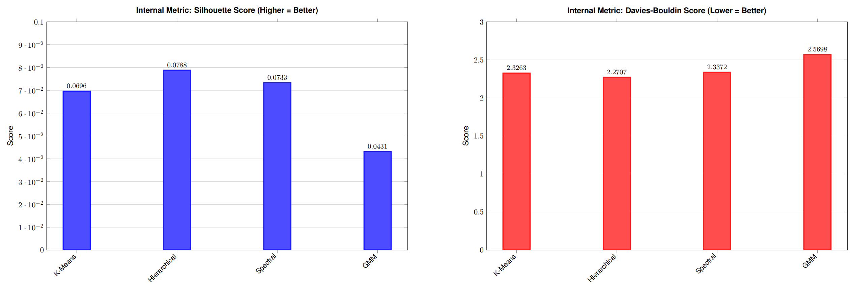
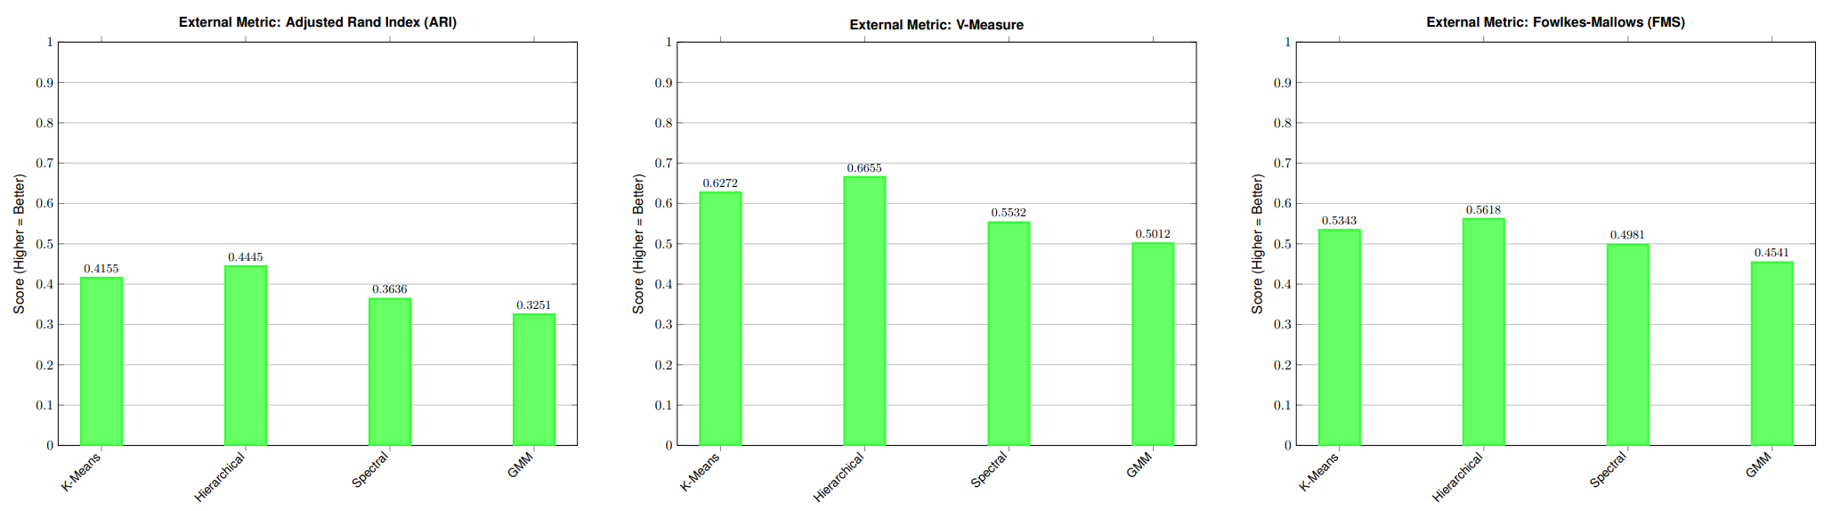
Breast cancer (GSE45827) — Metric Comparison

Slide 24
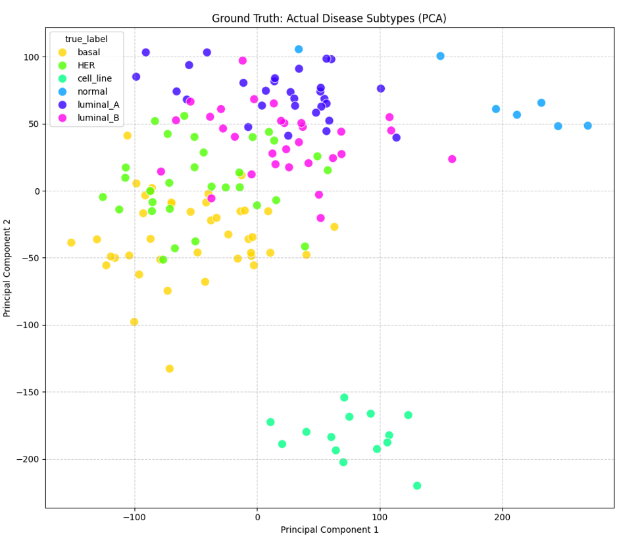
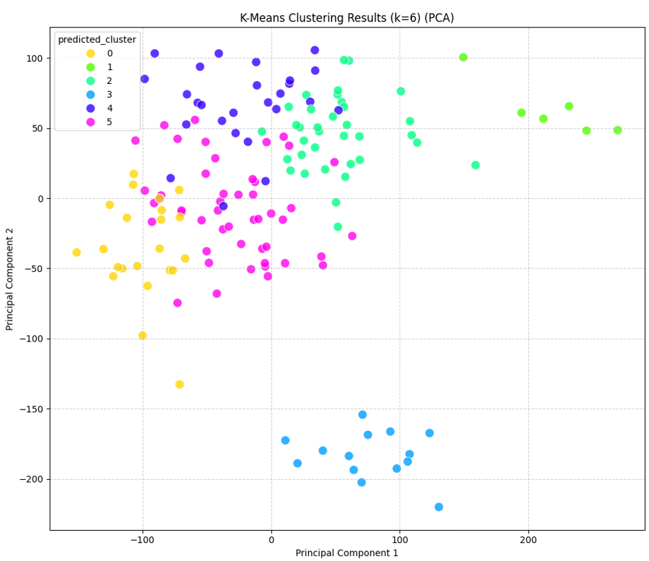
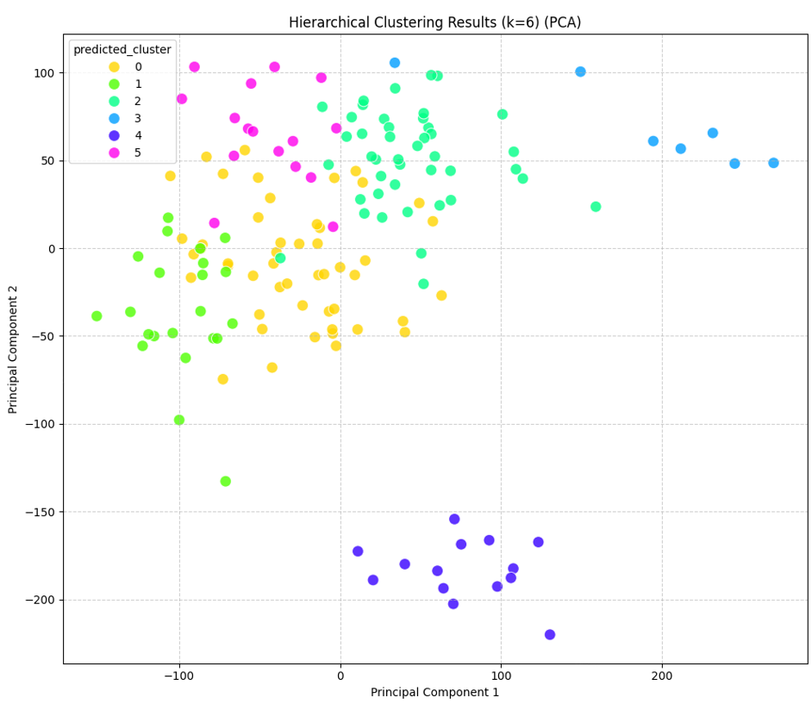
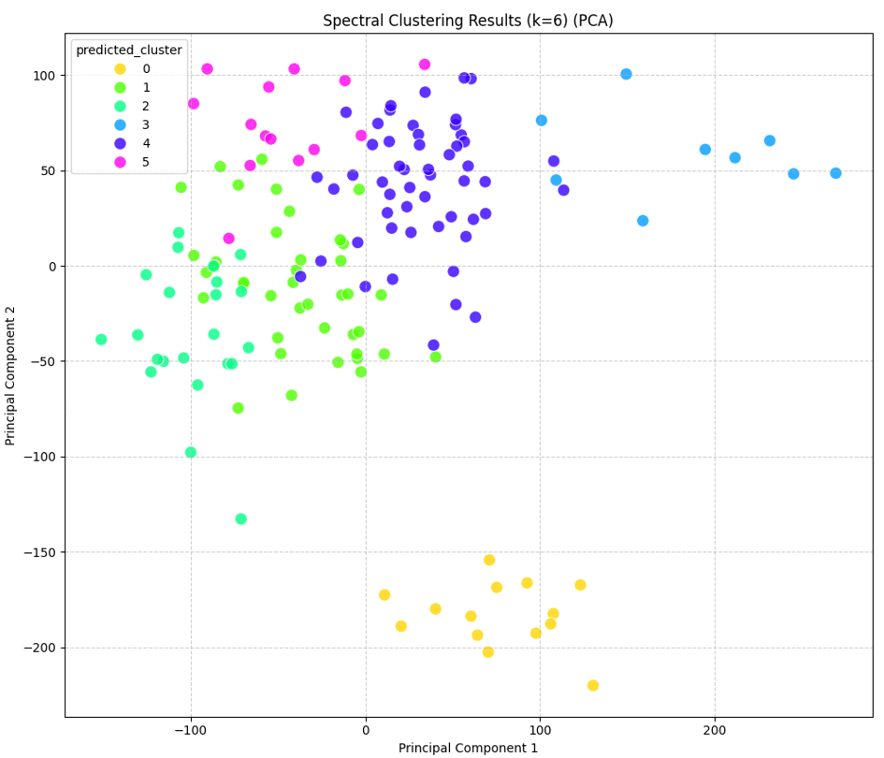
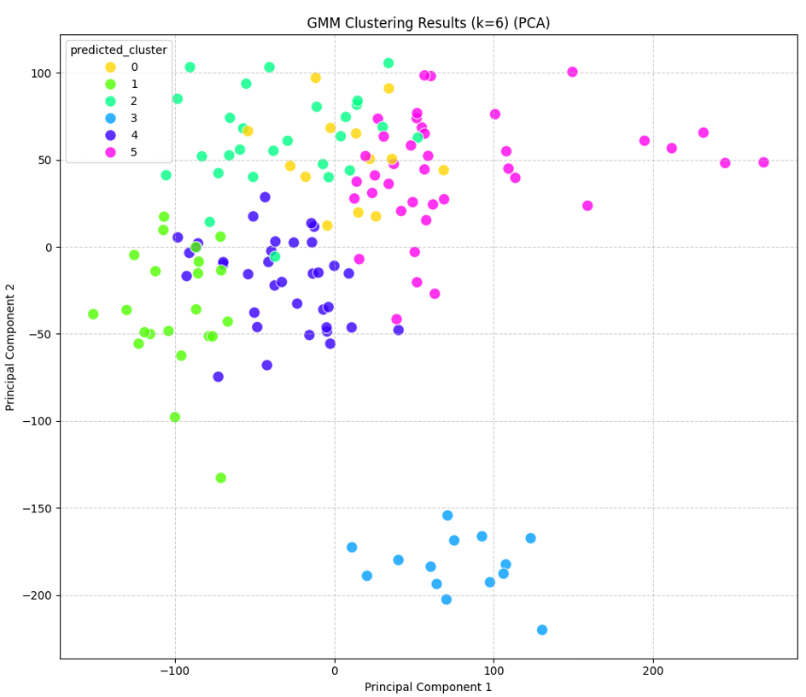
Analysis: Breast cancer (GSE45827) — Visual PCA

Slide 25
Analysis:
Similar to the other datasets, Hierarchical Clustering was the most effective model. It has achieved the highest external scores (ARI: 0.4445, V-Measure: 0.6655) and the best internal scores (Silhouette: 0.0788, DB: 2.2707).
K-Means (ARI: 0.4155) was a strong second, performing well on this data.
Spectral and GMM were less effective, with GMM showing the lowest performance across all 7 metrics (e.g., ARI: 0.3251).

Slide 26
Conclusions
Model Performance: Hierarchical Clustering was the clear and consistent top performer. It achieved the highest external validation scores (ARI, V-Measure) and the best internal scores (Silhouette, Davies-Bouldin) across all three datasets (Leukemia, Brain, and Breast).
Baseline Comparison: K-Means was a solid baseline, consistently performing as the second-best model. GMM, despite its flexibility, generally performed the worst, suggesting its probabilistic model was not a good fit for this PCA-transformed data.
Pipeline Success: The StandardScaler + PCA(0.90) pipeline proved to be an essential and effective strategy for normalizing the data and reducing high-dimensional noise before clustering.
Clinical Relevance: The strong external metric scores (e.g., ARI of 0.5133 for Leukemia, 0.4445 for Breast) confirm a significant correlation between our unsupervised clusters and the known clinical 'type' labels. This validates that the data-driven approach can successfully identify clinically meaningful biological subtypes.

Slide 27
Future Directions
Multi-Omics Integration:
  Apply this 4-model pipeline to larger TCGA datasets.
  Integrate gene expression (RNA-seq) with DNA methylation and copy number data using Similarity Network Fusion (SNF) to find more robust, biologically-driven subtypes.
Deep Learning Models:
  Implement and benchmark a Deep Embedding Clustering (DEC) model.
  Use a Variational Autoencoder (VAE) to capture complex, non-linear patterns missed by traditional PCA.
Single-Cell & Spatial Analysis:
  Adapt these methods for scRNA-seq and Spatial Transcriptomics data.
  Shift the goal from clustering patients to discovering cellular subtypes and their organization within the tissue.

Slide 28
References
[1] T. R. Golub et al., "Molecular classification of cancer: class discovery and class prediction by gene expression monitoring," Science, vol. 286, no. 5439, pp. 531–537, Oct. 1999. [Online]. Available: [https://www.science.org/doi/10.1126/science.286.5439.531]
[2] C. M. Perou et al., "Molecular portraits of human breast tumours," Nature, vol. 406, no. 6797, pp. 747–752, Aug. 2000. [Online]. Available: [https://www.nature.com/articles/35021093]
[3] J. A. Meira et al., "A clinical, pathological and molecular analysis of breast cancer in a case-series from Northeast Brazil," GEO Accession GSE45827, 2013. [Online]. Available: [https://www.ncbi.nlm.nih.gov/geo/query/acc.cgi?acc=GSE45827]
[4] J. G. G. J. M. Kros et al., "Gene expression profiling to identify distinct subclasses of oligodendroglioma," GEO Accession GSE50161, 2014. [Online]. Available: [https://www.ncbi.nlm.nih.gov/geo/query/acc.cgi?acc=GSE50161]
[5] G. Haferlach et al., "Gene expression profiling of acute myeloid leukemia," GEO Accession GSE9476, 2007. [Online]. Available: [https://www.ncbi.nlm.nih.gov/geo/query/acc.cgi?acc=GSE9476]
[6] F. Pedregosa et al., "Scikit-learn: Machine Learning in Python," Journal of Machine Learning Research, vol. 12, pp. 2825-2830, 2011. [Online]. Available: [http://jmlr.org/papers/v12/pedregosa11a.html]

Slide 29
Thank you

